Slide 1
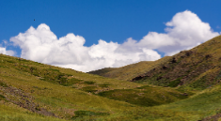

end
(after n iterations)
Generate image
Request similarity
PROMPT
A landscape of mountains under blue sky
VQGAN
(the Generator)
CLIP
(the Perceptor)
start
calculate the loss
Initial image
(white noise)
Back-propagation
Calculate image/text similarity

Slide 2



AI PROMPT
AR
The sentiment in the country in contemporary art style
AI PROMPT
A3
The sentiment in the country combining 3D and contemporary art styles
AI PROMPT
3D
The sentiment in the country in 3D digital art style

