Slide 1
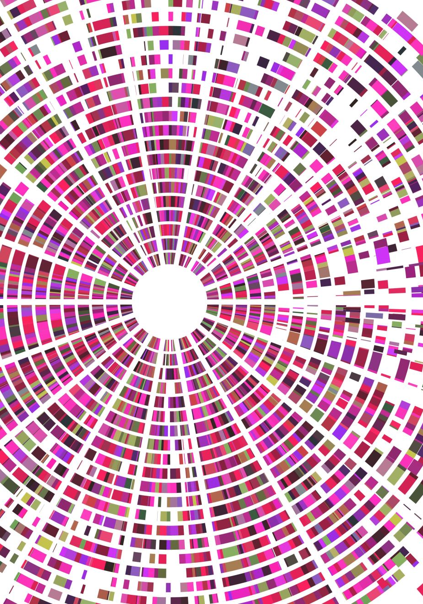
Origin of Global Music
Team 9
Chris Hauck, Colleen Banzhof, Ken Njema, Eric Lewiston

Slide 2

Data Origin
Hosted on UCI: Machine Learning Repository
Data set was created for ML (KNN and Random Forest)
Other Data:
United Nations M49 Region Codes
United Nations Geoscheme

Slide 3

Data Cleaning Tools
Jupyter Notebook
NewPythonData env
Pandas
read_html
Google Geocoding API

Slide 4

Cleaning
Song Data Required No cleaning
UN M49 Region Codes
Created a Region/Sub-Region scheme
South America is the only continent without any subregions
Obtained Country Name, Two Letter Code, and M49 Codes
Manually assigned Taiwan: Asia/Eastern Asia
Google Geocoding API
Input: Lat/Long
Output: Two letter country code

