Slide 1
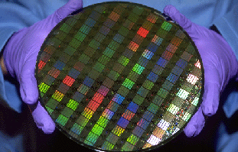
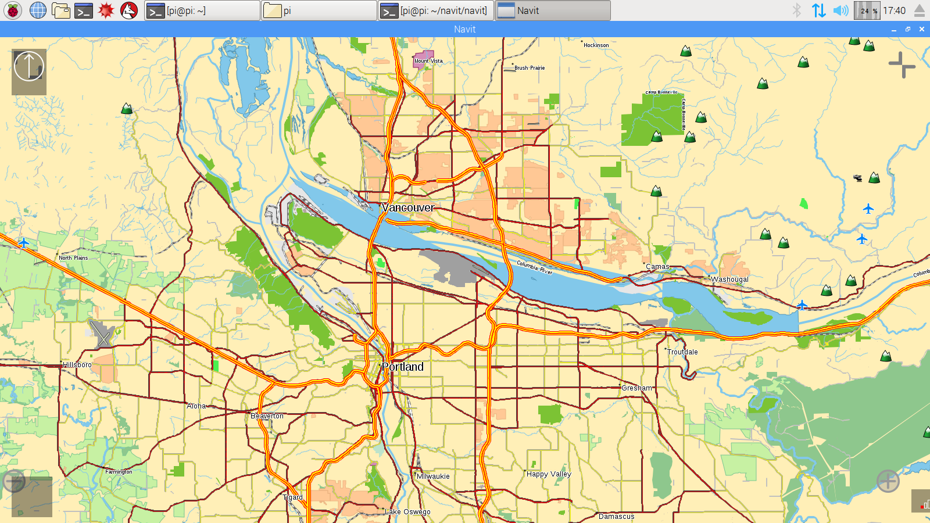
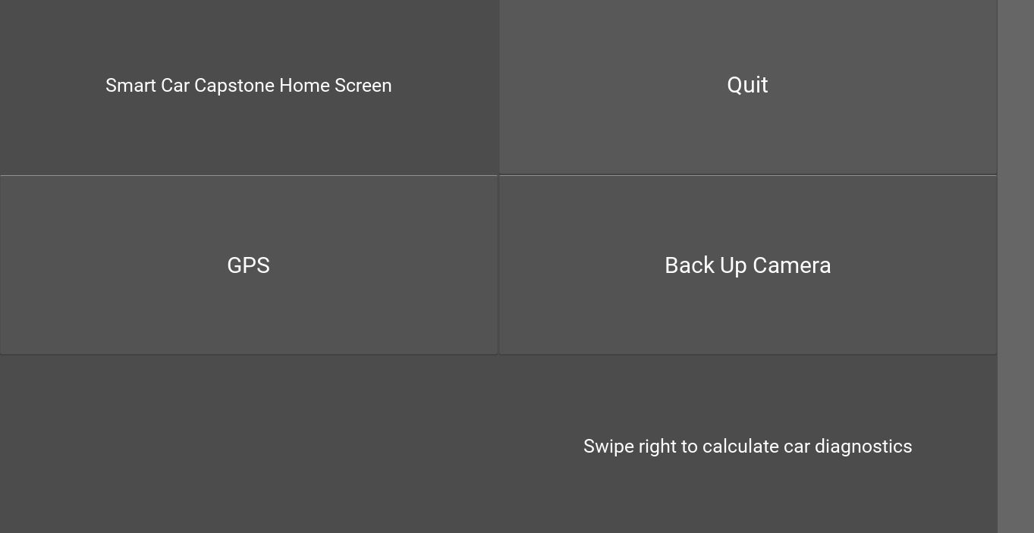
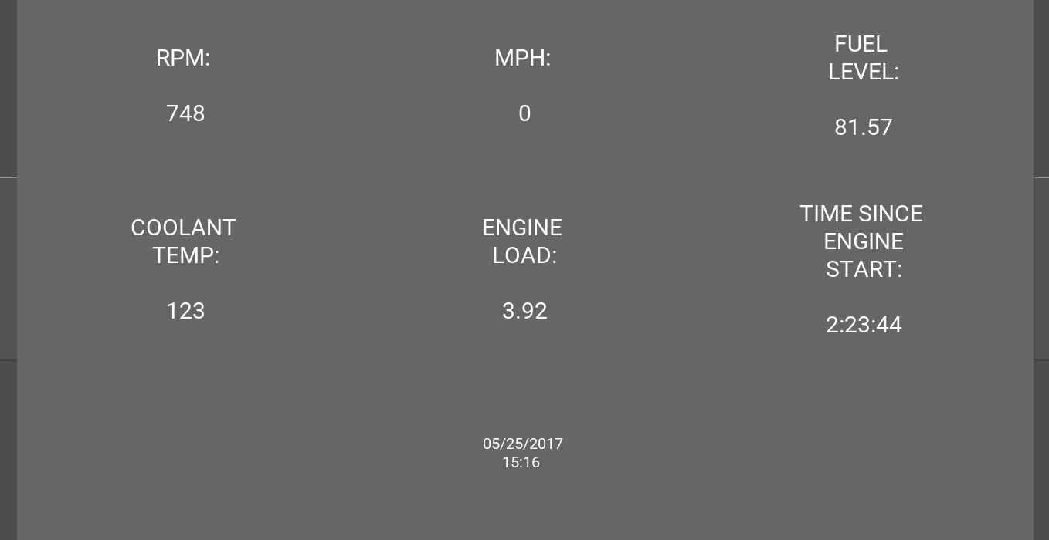
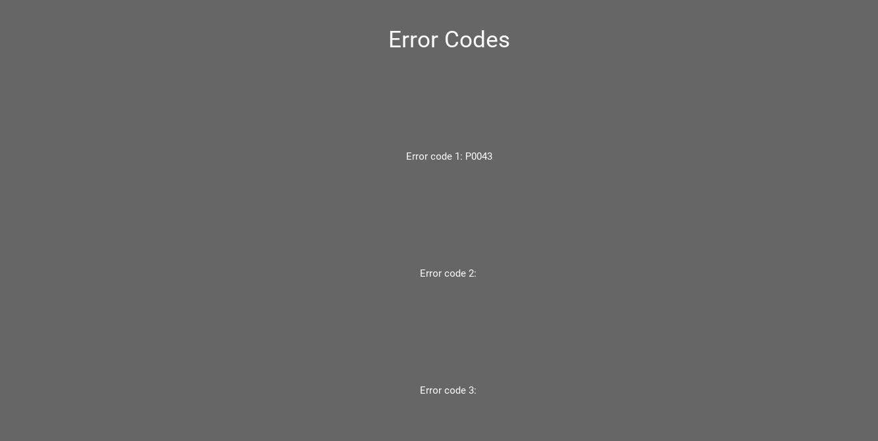
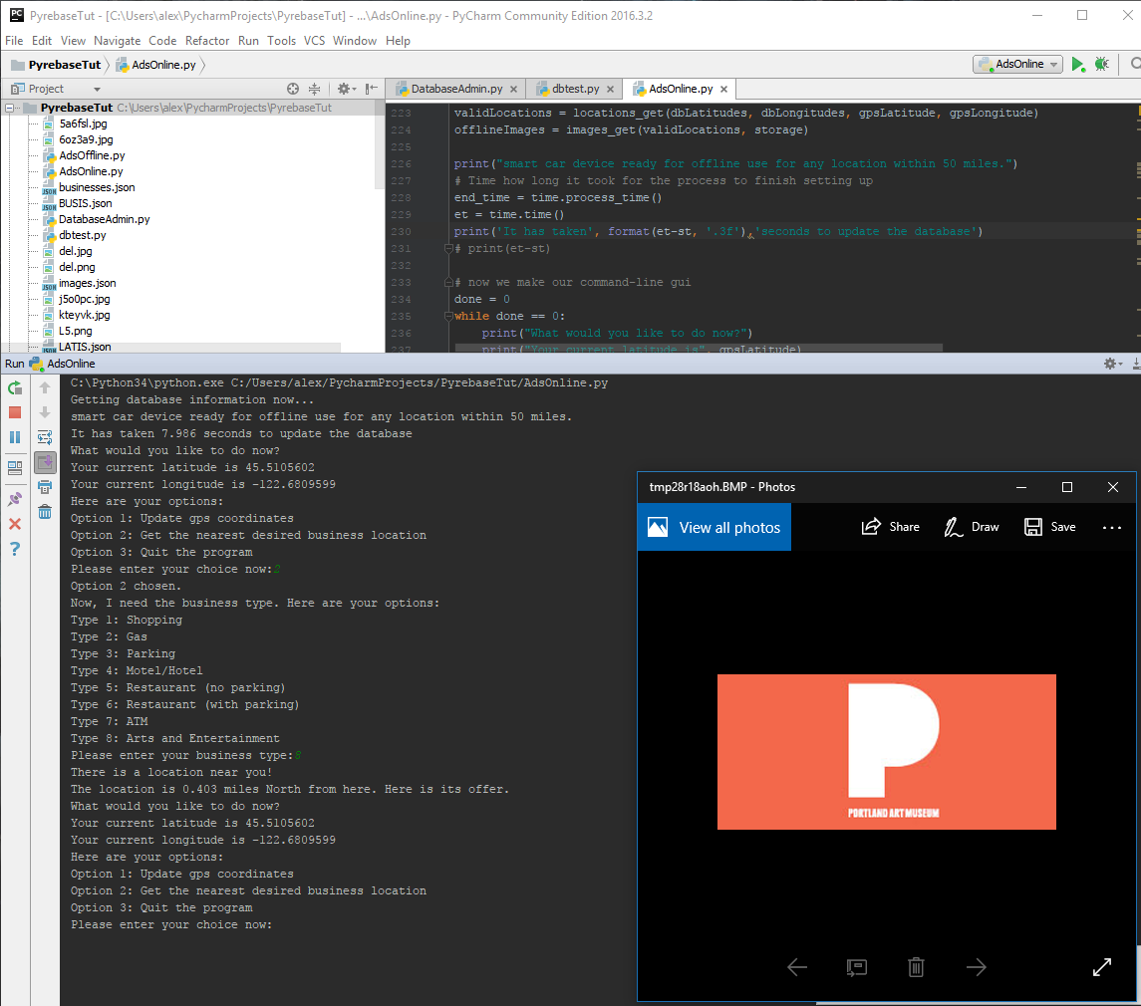
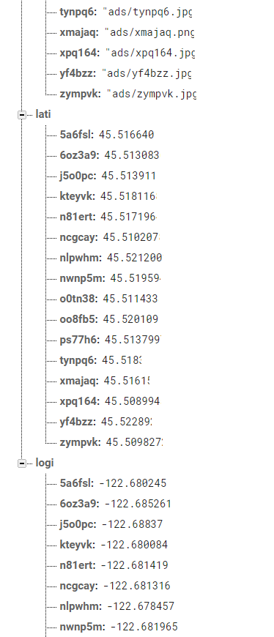
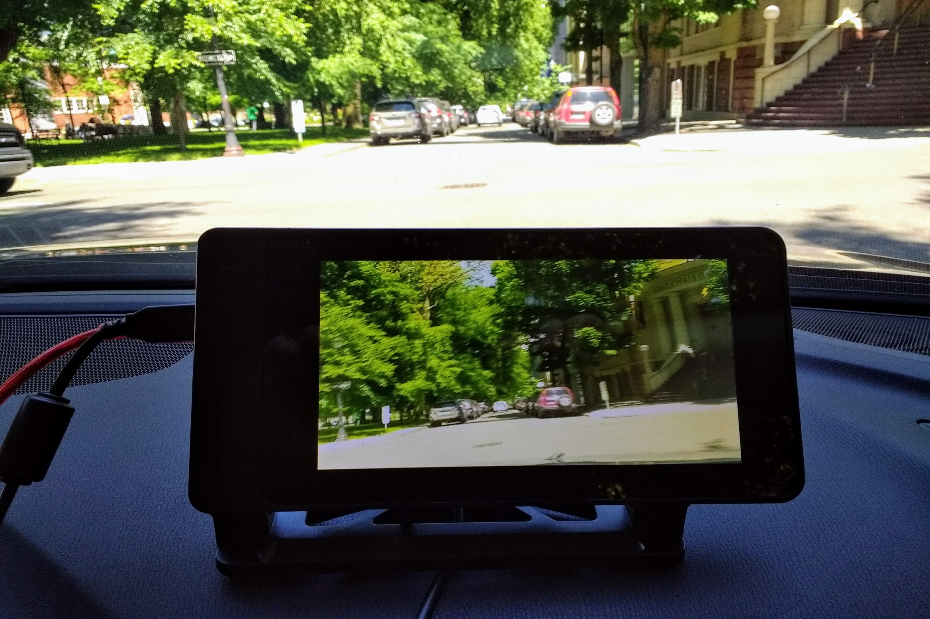

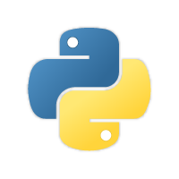

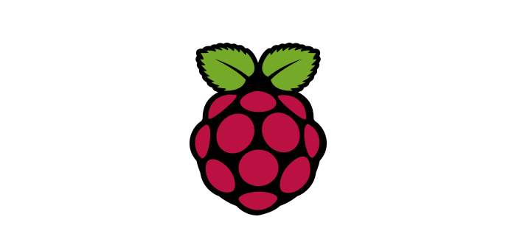


Device Design for Smart Car Alex Mendez, Colleen Nhim, Jasjit Singh, Matthew Konyndyk
Xiaoyu Song (ECE Faculty Advisor), Tanvir Alam (Company Sponsor)
Navigation module:
The GPS module allows typical navigation features. This is a screenshot from the RPi showing a map of Portland. The GPS module will be used with the database to show the driver of “pop-ups”
Graphical User Interface (GUI): These three images are screenshots from the GUI. The home page has 3 buttons. The user will swipe left to see the two following pages. The next page displays car diagnostic data from the OBD port. The last page displays the error codes from the OBD port.
PROBLEM STATEMENT
Smart devices are the focus for current technology. From smart phones to smart TVs, smart cars are now the next big thing. There are currently devices that connect to a car’s OBD (On-Board Diagnostic) port to access data but are missing other smart features. Many of these devices depend on a smart phone as the display. This capstone’s goal is to create a device that will be able to access and display important car data without the use of a smartphone.
PROJECT GOALS
Eliminate the dependence of a smart phone by using a large touchscreen display
Built-in GPS that notifies user of nearby surroundings via database
Device connects to OBD port to gather important diagnostics
OBD data displayed to user in meaningful way
Affordable device
Device works with a car model date of 1996 or later
Raspberry Pi is preferred “brain” of the device with a GUI (Graphical User Interface) running
IMPLEMENTATION
Hardware:
A raspberry pi 3 is used as the “brain” of the device. A camera module is attached for the backup camera addition and a GPS module is added for mapping capabilities. There is an OBD port cable that connects to the raspberry pi as well as a 7” touchscreen LCD display. The LCD will display the OBD data as well as the camera and GPS modules.
Software:
Written in Python, the main scripts allows to read and write from and to the OBD port. Firebase is used to control the database where companies can put their information up onto the GPS module. Kivy is used in pair with Python to script the GUI. The GUI will display the OBD data, GPS, and camera modules. The GUI also will have full touchscreen capabilities.
FUTURE WORK
The next steps for this project would be to write to the OBD port. A script would need to read when a button in the car is pushed so that it can be written to. This would allow further advance features such as rolling down the windows, automated windshield wipers, or turning on the headlights all through the Raspberry Pi/ GUI. Another step would be to actively have deals pop up on the GPS on the GUI.
Back up Camera:
Live video footage using a raspberry pi camera module. Through the GUI, the user can push the camera button to load up or turn off the camera. The idea is to be an affordable back-up camera.
Firebase Database: Firebase allows us to easily add and modify location information in a JSON-style database. The data we stored on each location consisted of its latitude, longitude, business type, and the location of its image in the Firebase database. As seen in the screenshots, each location has a unique 6-character ID so that gathering information on a single location is quick and convenient.
Department of Electrical and Computer Engineering

