Slide 1
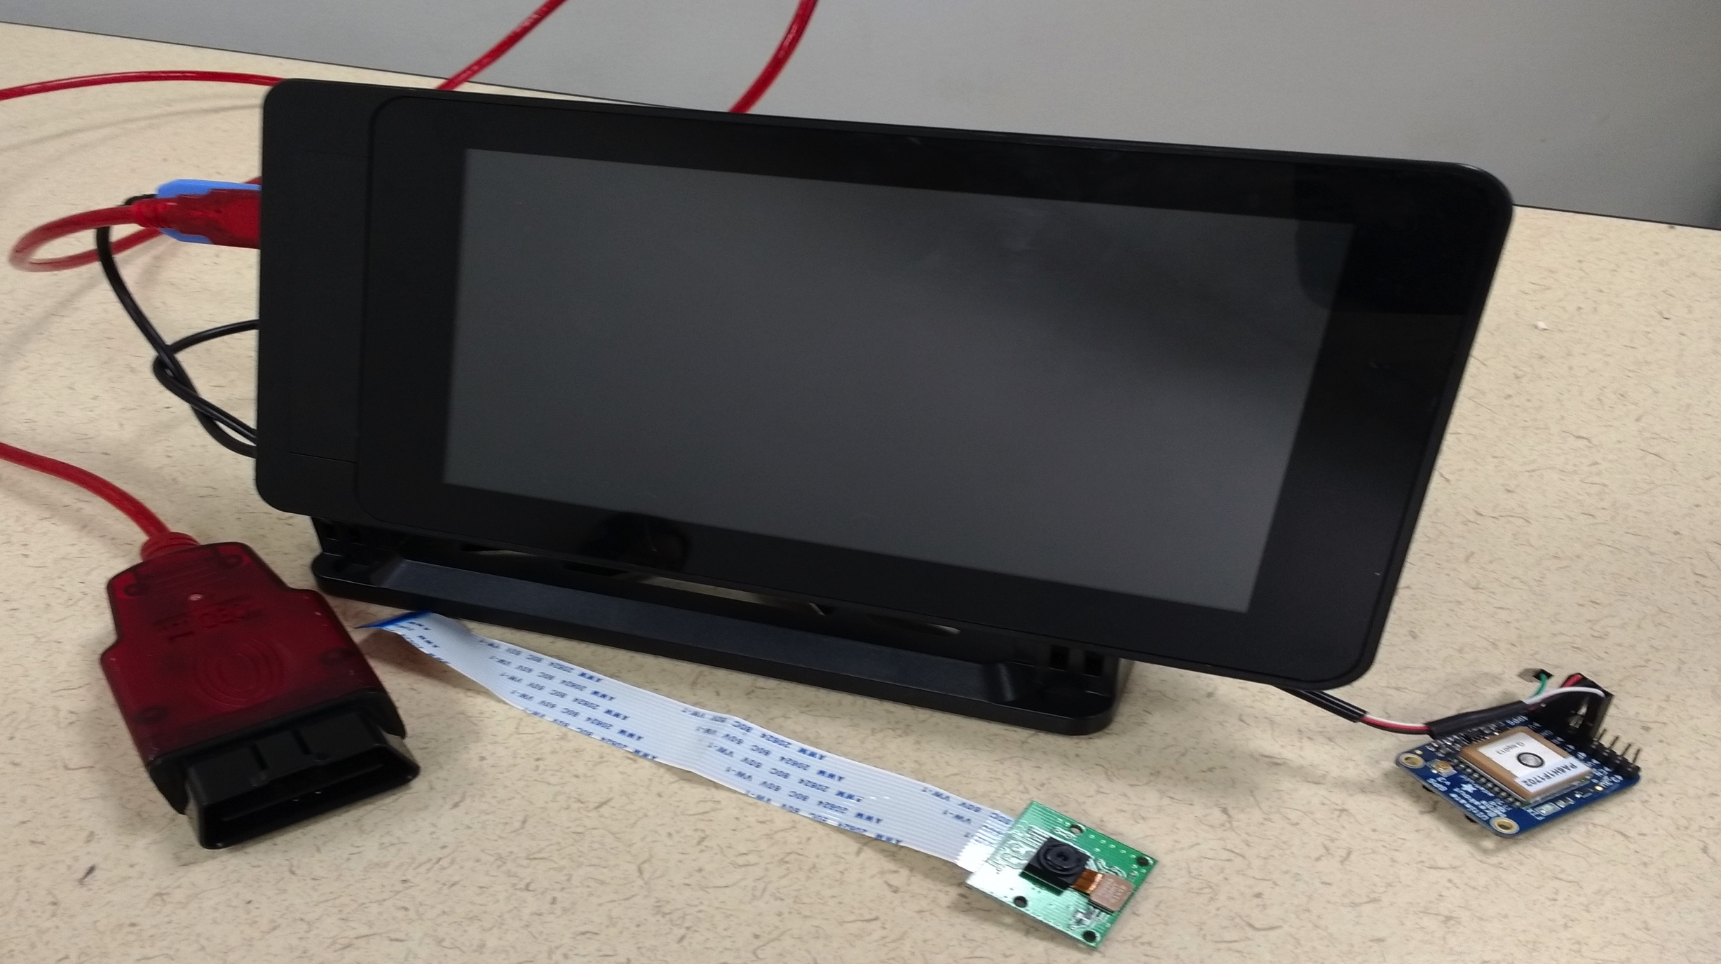
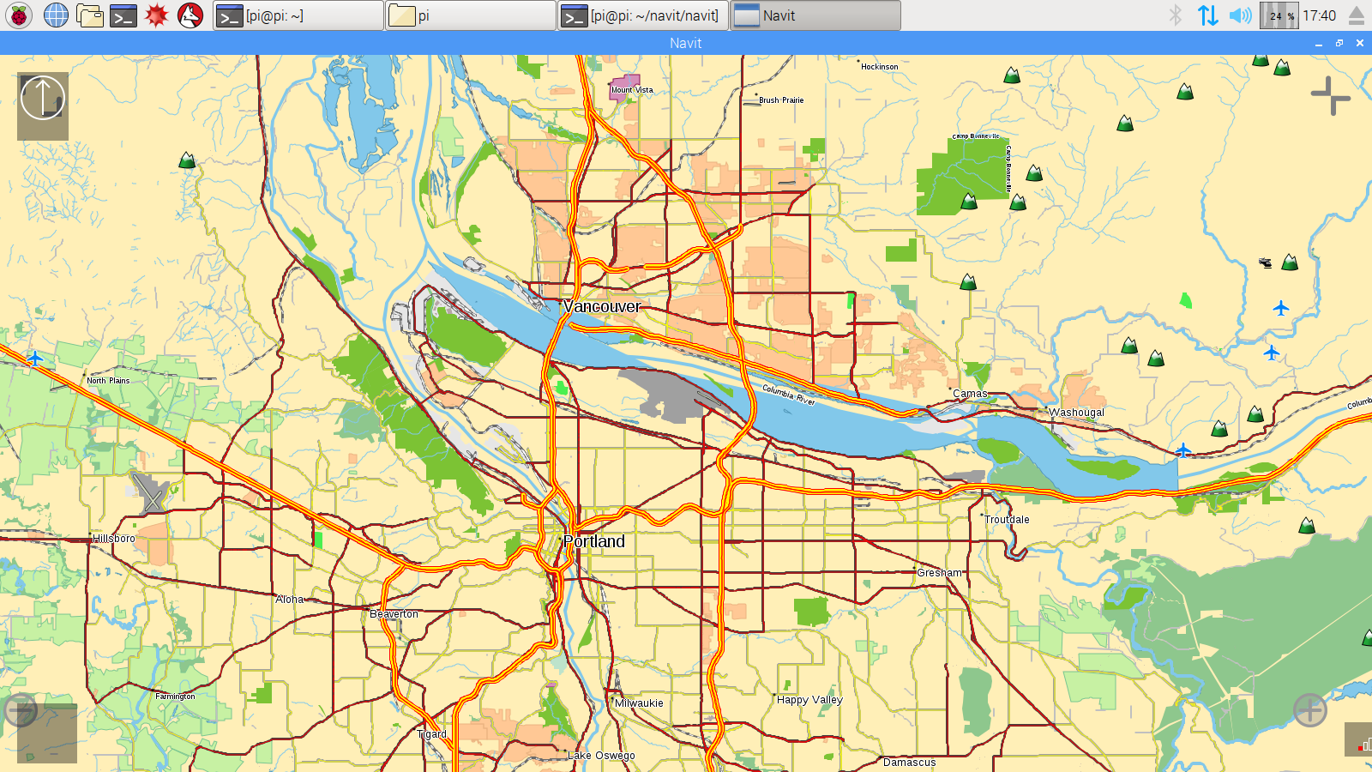
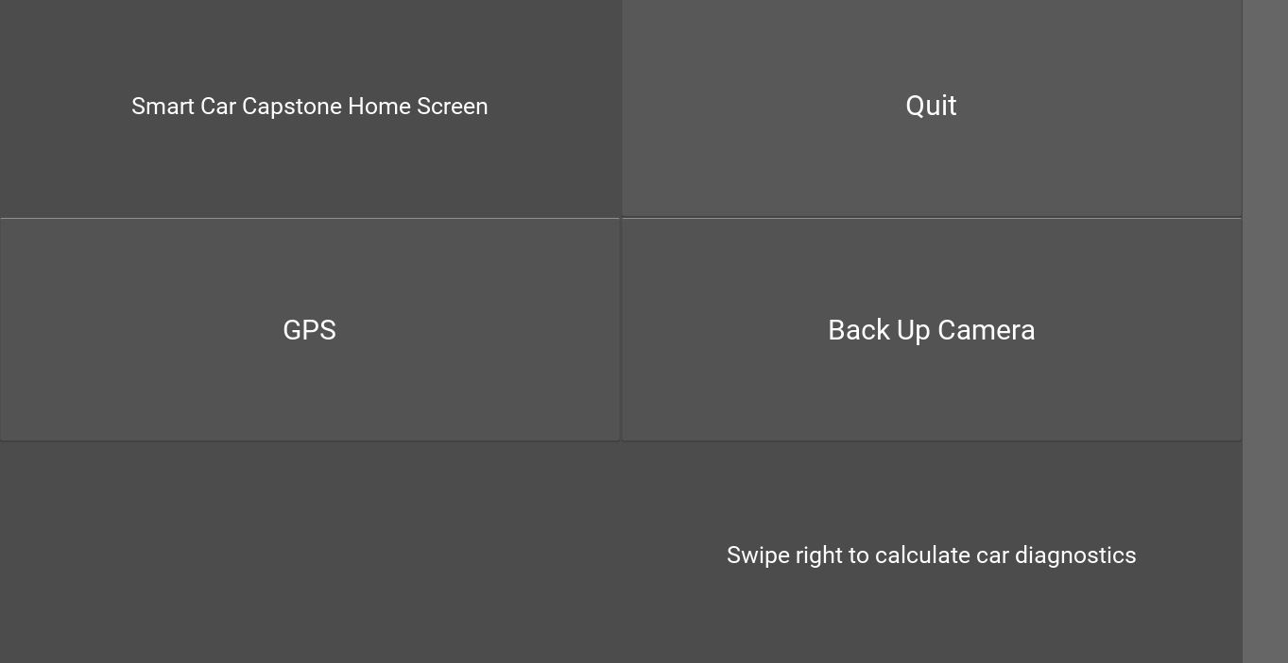
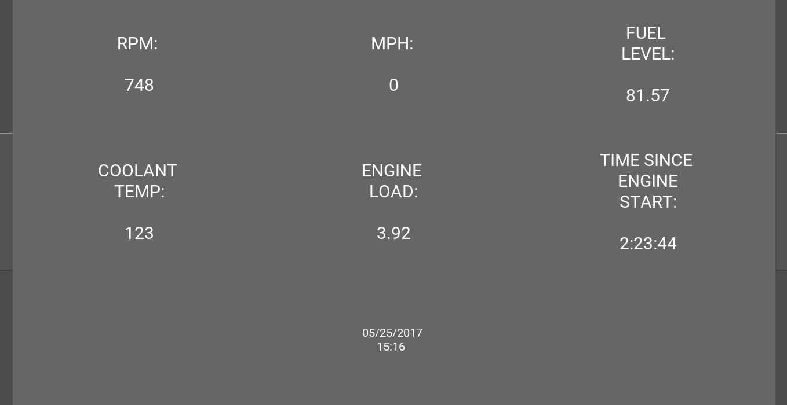
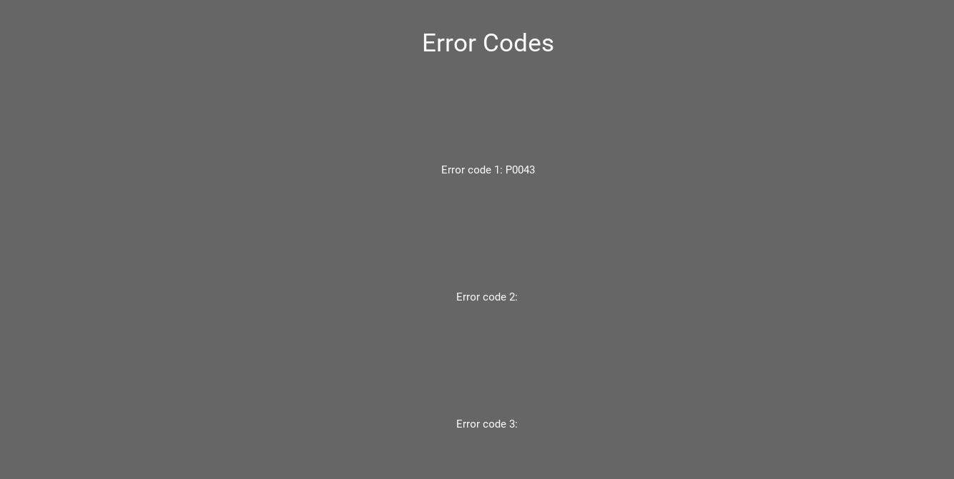
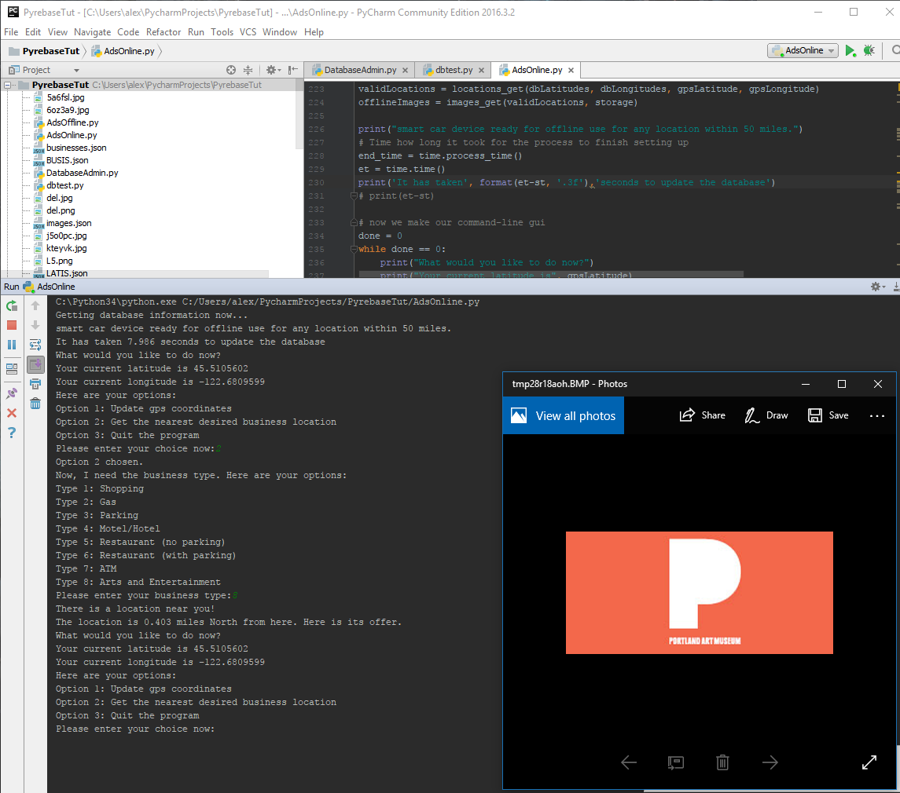
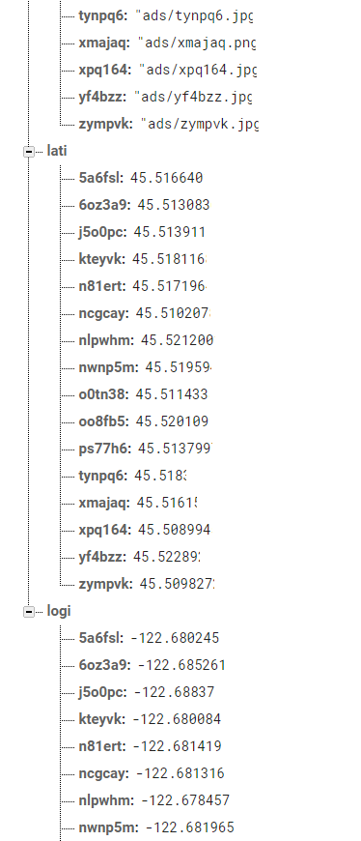
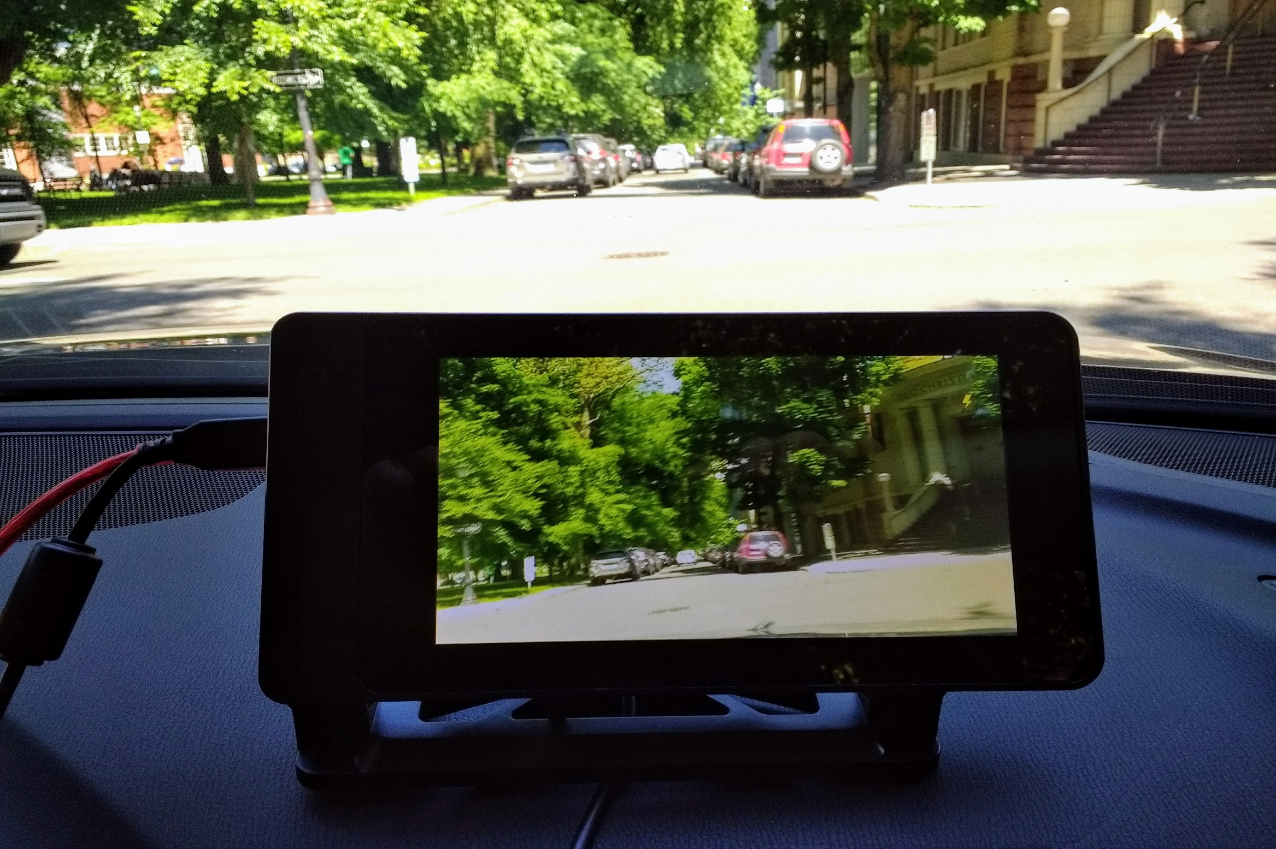






`
Device Design for Smart Car Alex Mendez, Colleen Nhim, Jasjit Singh, Matthew Konyndyk
Xiaoyu Song (ECE Faculty Advisor), Tanvir Alam (Company Sponsor)
Navigation module:
The GPS module allows typical navigation features. This is a screenshot from the RPi showing a map (using Navit) of Portland. The GPS module will be used with the database to show the driver “pop-ups”
Graphical User Interface (GUI): These three images are screenshots from the GUI. The home page has 3 buttons. The user can swipe left to see the two following pages. The next page displays car diagnostic data from the OBD port. The last page displays the error codes from the OBD port.
PROBLEM STATEMENT
Smart devices are a major focus of current technology. Our goal is to make a standalone device that turns an older model car into a ‘Smart Car.’ There are currently applications that use a OBD (On-Board Diagnostic) connection to access data from the car, but most are missing additional smart features. Many of these devices depend on a smart phone as the display. This capstone’s goal is to make a device that will be able to access and display important car data, have GPS and camera capabilities, a database of local businesses, and the potential for additional features.
PROJECT GOALS
Eliminate the dependence of a smart phone by using a large touchscreen display
Built-in GPS that notifies user of nearby surroundings via database
Device connects to OBD port to gather important diagnostics
OBD data displayed to user in meaningful way
Affordable device
Device works with a car model date of 1996 or later
Control interior accessories through the GUI
Raspberry Pi is preferred “brain” of the device with a GUI (Graphical User Interface) running
IMPLEMENTATION
Hardware:
A Raspberry Pi 3 is used as the “brain” of the device. A camera module is attached for the backup camera and a GPS module is used for navigation capabilities. An OBD port cable sends car data to the raspberry pi with 7” touchscreen LCD. The LCD will display the OBD data, camera and GPS Navigation map. We used an ELM327 based OBD to USB adaptor to establish a serial connection with the car’s CAN bus. We used the Raspberry Pi 3’s built in Wi-Fi capabilities to connect to a hotspot for an internet connection on the road.
Software:
The script to read data from the car’s OBD port is written in Python. We used an open source library (pySerial) to establish the serial connection. Firebase is used to control the database, where companies can advertise onto the GPS module. Kivy was used for the GUI, which will display the OBD data, GPS, and camera modules. The GUI also will have full touchscreen capabilities.
FUTURE WORK
The next steps for this project would be to write to the OBD port. This would allow further advanced features such as rolling down the windows, automatic windshield wipers, or turning on the headlights all through the Raspberry Pi/ GUI. Another step would be to actively have deals pop up on the GPS.
Back up Camera:
Live video footage using a raspberry pi camera module. Through the GUI, the user can push the camera button to load up or turn off the camera. The idea is to be an affordable back-up camera.
Firebase Database: Firebase allows us to easily add and modify location information in a JSON-style database. The data we stored on each location consists of its latitude, longitude, business type, and the location of its image in the Firebase database. As seen in the screenshots, each location has a unique 6-character ID so that gathering information on a single location is quick and convenient.
Department of Electrical and Computer Engineering

