Slide 1


Guiders Hub
A communication web application
Colleen McConnell – B00637513
Computer Science
Group 13
Dr Fiona Browne
Tuesday 13th December 2016
Notes:
CGI (no date) Association Logo Available at: http://www.girlguidesireland.ie/go/about_us/association_logo_badge (Accessed: 01 December 2016).
CGI (no date) Association Badge Available at: http://www.girlguidesireland.ie/go/about_us/association_logo_badge (Accessed: 01 December 2016).

Slide 2
Overview
Project background
Structure of the organisation
Current situation
Literature review
Proposed solution
Technologies
Software methodology
Requirements gathering
Risks
Design

Slide 3
Project background
Leader for 3 years, member for 10.
Girl guiding is a scouting organisation operating in 145 countries.
Local unit is situated in West Belfast.
18 leaders
50+ young people.
Take part in many activities such as
Day trips
Camping
Fundraising
Badge work
Cooking
Etc
Notes:
Girl guiding is an organisation that is operating within 145 countries around the world. It is the largest voluntary movement in the world.
I belong to the Irish girl guides. Broken into districts then into local units.
My local unit is situated in West Belfast.

Slide 4
Structure of the organisation
National
Region
Guiders hub will be a resource for my local unit
Areas
Districts
Units
Notes:
Began in 1928.
GuidersHub will be for a local unit.
Divided into 4 different sections depending on age groups. Then there are adult volunteers over the age of 18. Explain sections.

Slide 5
Current Situation
There is no central resource for communication.
Current communication is through:
Facebook
What’s app
Text message
Emails
Phone calls
Problems:
Not everyone is on Facebook
Older generation are not as familiar with new technology.
Not everyone owns a smart phone
Paper based
Notes:
The problem is there are too many forms of communication, creating one central resource will mean that communicating with leaders and parents will become more organised.
The problem with this is:
Not every leader or parent is a member of Facebook, so they miss out on event updates and they are not kept up to date with what the young people are doing.
Not everyone owns a smart phone, and in the interviews we can see that in the small sample we took only 60% owned a smart phone.
Still use a paper based system. E.g. permission slips. Disadvantage is lack of storage. Children are always forgetting to take flyers home with them.

Slide 6
Literature review
 | Features
Applications | Login | Communication | Gallery | Event page | News feed | Personal profiles
World association of girl guides and girl scouts |  |  | x
Girl guiding Canada | x |  | x |  |  | x
Online guide manager | X | X
SendHub | x | x
compass | x | x |  |  |  | x
Slack | x | x |  |  |  | x
Notes:
The reason for choosing to develop a web application is because web applications are mainly used for social media sites according to Good works lab, mobile app and software product development.
WAGGS – Is a travel application, providing information about places to visit in London. Targets members who are travelling to London to visit the WAGGS head quarters.
Girl guiding Canada – Mobile application that allows users to keep track of their badges, payment of registration and calendar feature. (Girl Guides of Canada, 2016)
Online guide manager and compass – Keeps track of units finances, registration, badge records and events. Admin style application. Although the problem with this web application is that, it is restricted to leaders, leaving out parents and other members.
Send hub – is a general communication app, used for businesses but can be applied to any group or organisation. (Moreau, 2016)
Slack – Another chat application, create private chat channels.
Moreau, E. (2016) Best social media management applications use these social media tools to promote content and manage engagement. Available at: http://webtrends.about.com/od/pr6/tp/The-Top-10-Social-Media-Management-Applications.htm (Accessed: 14 October 2016).
Girl Guides of Canada (2016) Girl guides of Canada – Android Apps on Google play. Available at: https://play.google.com/store/apps/details?id=com.ggc.moble.app&hl=en_GB (Accessed: 13 October 2016).
GuestU (2016) World Assoc.Girl Guides/Scouts. Available at: https://play.google.com/store/apps/details?id=com.xtourmaker.WAGGGS&hl=en_GB (Accessed: 13 October 2016).

Slide 7
Proposed solution
Aim
To develop an online resource that will incorporate all forms of communication together for a local girl-guiding unit.
In addition, to create a social hub filled with information and photos for registered members of the organisation.
Objectives
Develop questionnaires and interviews to establish requirements.
To develop a login feature that will allow authorised users to enter.
Create a chat feature to allow users to communicate efficiently.
Create a gallery to allow users to view images posted on the site.
Develop an event pages displaying the current events coming up. Also allow users to confirm attendance.
Develop a personal page for users to view their own details.
Create a secure database that will store users login details.
Create a user friendly application where users can navigate easily through the site.

Slide 8
Technologies
Software
MySQL database
Visual Studio
Other technology
GitHub
Bootstrap
HTML, CSS,
JavaScript, JQuery
Ajax
C#
Web sockets
Web apis

Slide 9
Methodology – Waterfall
The deliverables that come with each phase match up with the project deadlines set by the university.
Requirements
Design
Implementation
Testing
Maintenance
Notes:
Works well with smaller projects.
My requirements are well understood.
Overlapping stages are possible only if necessary.
Requirements
Requirement spec
Design
Software architecture
Wireframes
Implementation
Building software
Testing
Test features
Maintenance
Fix bugs

Slide 10
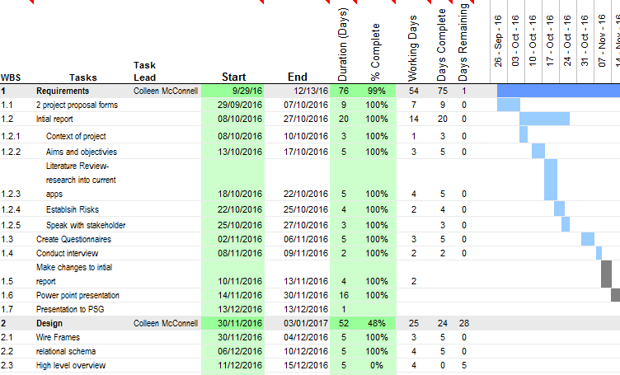

Slide 11
Requirement gathering
Interview
Informal interview with stakeholder, able to ask follow up questions.
Discussed the current problem and potential benefits of using a web application.
Questionnaire
.Survey monkey.
7 responses from potential users. Sent via whats app group.
Own experience
I have been a leader for 3 years, I understand the issues.
Notes:
Questionnaire
Survey monkey is a web based survey solution. It allows users to create, publish and analyse surveys. It is used by many businesses and organisations. Answers are collected and analysed and displayed in the form of graphs and tables.
Only 60% of leaders had a smart phone.
They were asked to rate the current communication. Average was 3 stars.
100% said they wanted a guide web application.
Potential users were able to say what they would like to see in the web application.
Interview
Questions such as:
Access to internet..
Features they would like to see in order of preference
What benefits is there to creating this web application
Rational
Unique insight into the issues.
Can ask follow up questions.

Slide 12
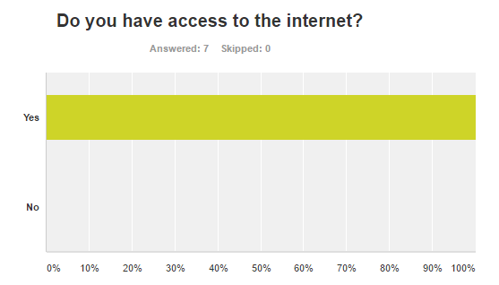

Some sample answers

Slide 13
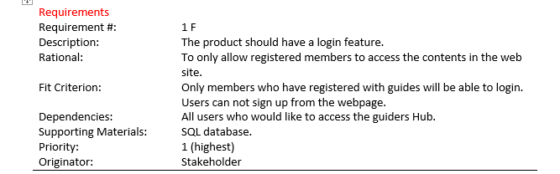
Customer Requirements – volere shell template
Functional requirements: 9
Non functional requirements: 5
Notes:
Requirements are prioritised, in order to help establish which features should be developed first.

Slide 14
Security requirements
Users must be authorised to access the site
Data protection, Database will be encrypted
Child protection – parents permission
Only authorised users may post events, images, or information.
Limited number of password attempts.
Notes:
Child protection- parents must sign consent forms before any images are uploaded to the website.
There will be an authorised user who will be given permissions to upload content to the web application.
Encrypt database with a built in mysql function. Using AES encryption algorithm. Test with Netsparker that uses SQL injection to gain access.

Slide 15
Risks
 | Risk | Impact | How to avoid risk
1 | Loosing work | Very High | Keep multiple copies of work. Example external hard drive, pen drive, cloud applications, repositories and local disk drive.
2 | Computer breaks | High | Keep copies of work.
3 | Working with new languages and software | Medium | Read up about the software and practice small projects before its time to implement project.
4 | Internet problems | Medium | Find other suitable places to work on project. Example local library, coffee shop, university library Jordanstown and Belfast campus.
5 | Other module work | Low | Establish a timetable and give certain days to a subject.
6 | Breaking child protection policies by posting guiding pictures. | High | Make sure the parents have given permission for their daughters photographs to be shared by the guides.
7 | Working with sensitive information regarding children | High | Encrypt data in database using AES algorithms and test fully.
8 | Continuous changing requirements | Medium | Use waterfall so requirements are established at the start. Explain to stakeholder before agreeing on requirements that no changes can be made.
9 | Unrealistic time estimations | Medium | Look at history of assignments and try to overestimate.
10 | Failure to manage end user expectations | low | Always keep stakeholder up to date with how the application is going. Ask their opinions on layouts and colours.

Slide 16
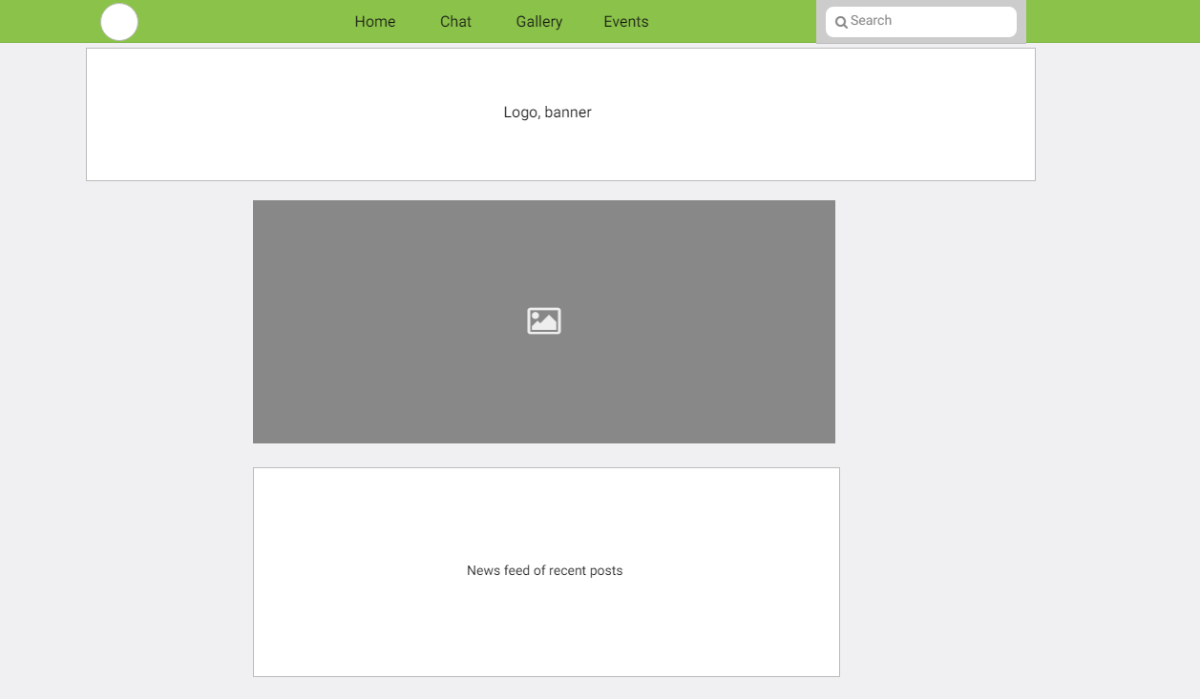
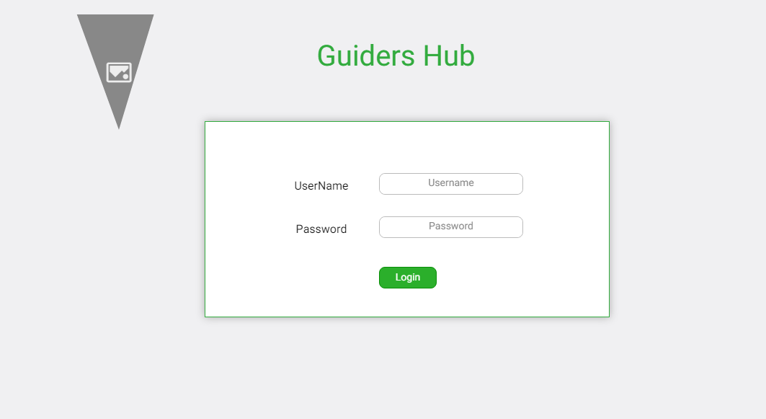
master page and Login
Notes:
Architecture

Slide 17
Relational schema
Parent (ParentID, FirstName, Surname, Address1, Address2, Town, City, Postcode, Telephone, Email, Password, NumOfChildrenReg, NameOfChild1, NameOfChild2, NameOfChild3)
Admin (AdminID*, FirstName, Surname, Email, Passowrd)
Leader (LeaderID, FirstName, Surname, Email, Address1, Address2, Town, City, Postcode, Telephone, Password)
Events (EventID, AdminID*, DateOfEvent, Time, Place, Address1, Addess2, Town, NumAttending)

Slide 18
Next stage
Requirements stage is completed.
Requirement spec
Environment set up
Currently onto design stage.
High level design
System Architecture
Create git hub repository.
After exam revision I will be into coding stage.
Build database
Begin developing features

