Slide 1
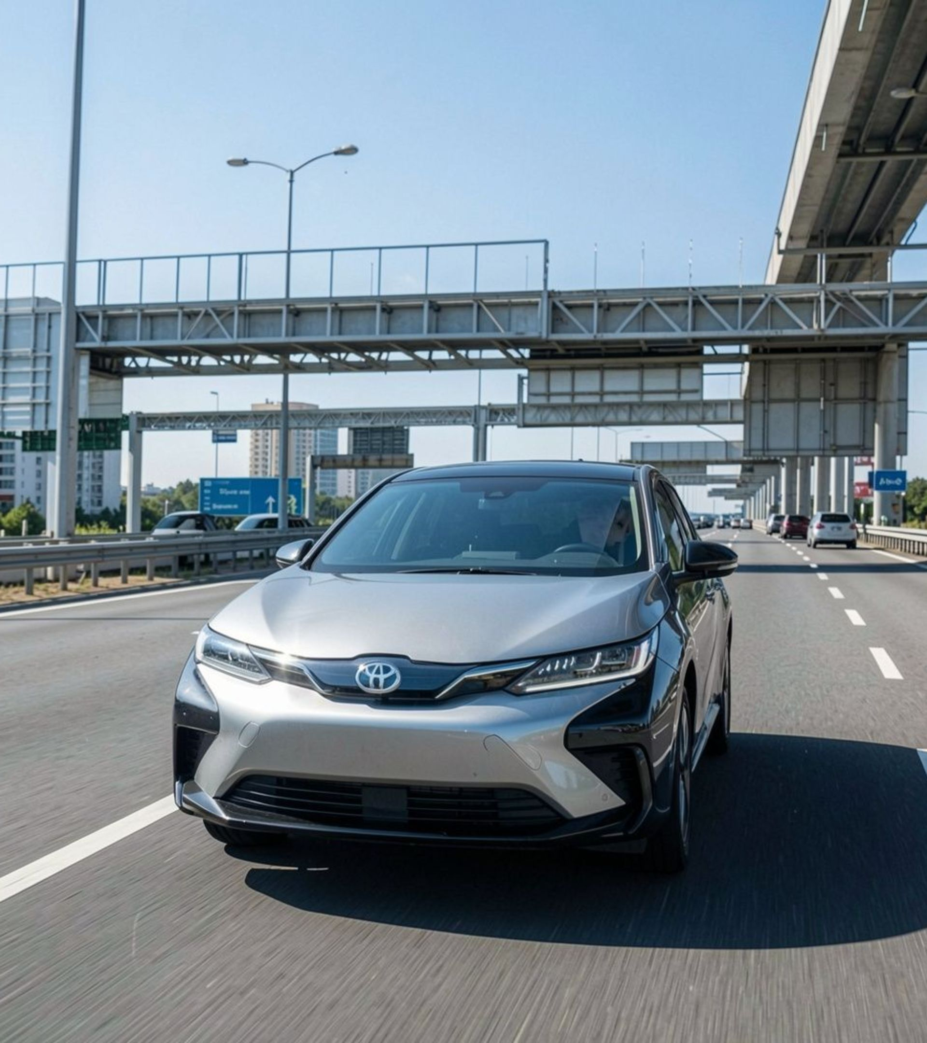
TEAM ZX · INTELLIGENT TRANSPORTATION SYSTEMS
SMART ADAPTIVE
SPEED CONTROL
& EMERGENCY SYSTEM
Route-aware speed monitoring, driver warnings, closed-loop PID throttle governance, and automated post-crash telemetry response.
Presented by Team ZX

Slide 2
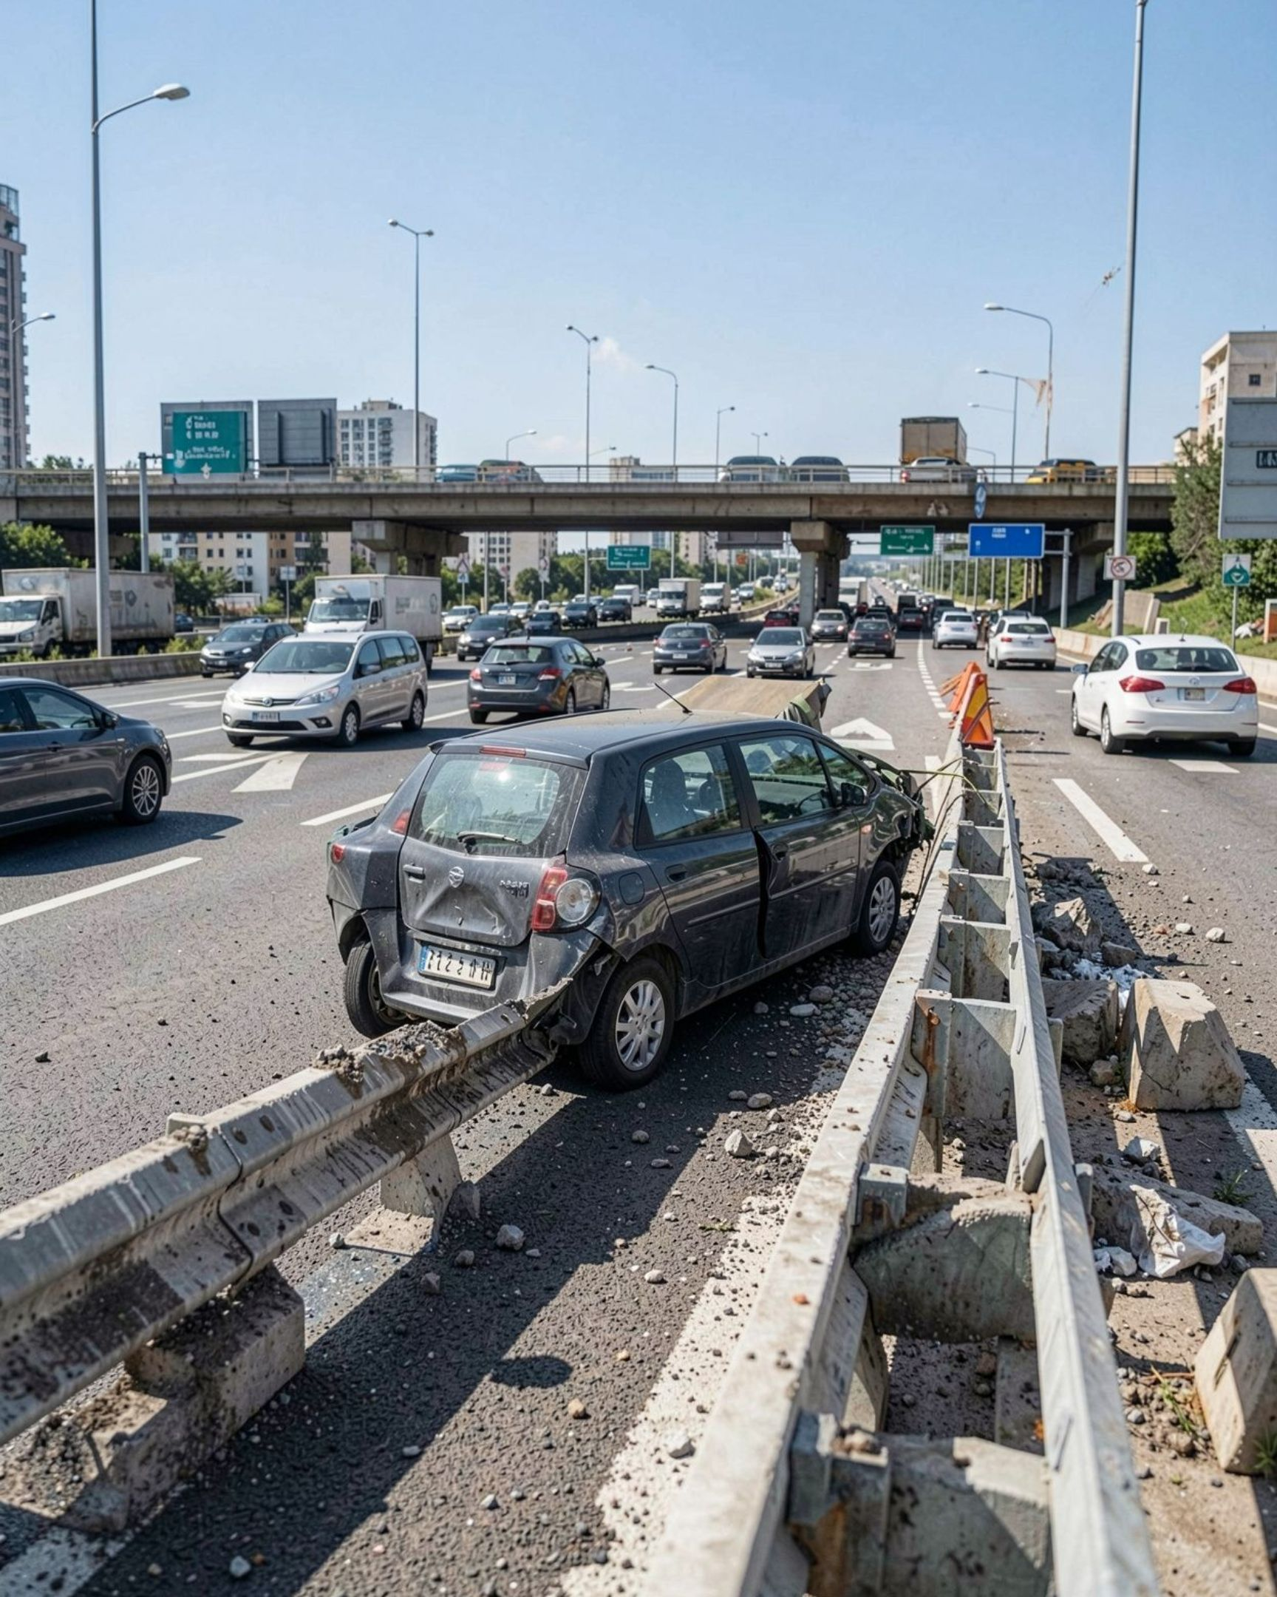
THE SAFETY GAP
OVER-SPEEDING REMAINS AN ACTIVE SAFETY PROBLEM
3,28,727
road accidents attributed to over-speeding in India in 2023
68.4% of all reported road accidents. Source: MoRTH, 2023.
Passive navigation alerts depend on driver attention at the exact moment attention is most fragile. Static limits and warnings need an active intervention layer that is contextual, staged, and fail-safe.

Slide 3




FROM INFORMATION TO CONTROL
SAFETY MUST MOVE FROM AWARENESS TO INTERVENTION
Static signs
Navigation chimes
Standard cruise control
ISA framework
Visible, but not adaptive to route context or vehicle state.
Informative, but easy to ignore.
Connects digital road intelligence to vehicle powertrain control with explicit uncertainty handling.
Holds a set speed, but does not govern against legal limits.

Slide 4
CENTRAL WORKFLOW
FOUR STEPS TO INTELLIGENT SPEED GOVERNANCE
Every intervention earns its way from location confidence to controlled action.
01
02
03
04
IDENTIFY
VALIDATE
RESPOND
FAIL SAFELY
Detect the road segment and fetch the applicable legal limit.
Evaluate GPS confidence and vehicle-class rules.
Warn the driver, then stage throttle reduction if speeding persists.
Missing or uncertain data triggers advisory mode instead of unverified enforcement.

Slide 5



CONTROL SHOULD BE SMOOTH, CONTEXTUAL, AND REVERSIBLE
Every intervention is bounded, explainable, and reversible.
PID throttle dampening
Uncertainty rule
Emergency kick-down
Modulate fuel or power input progressively to avoid hazardous sudden braking.
GPS dropouts in tunnels or underpasses automatically fall back to advisory mode.
Preserve a driver accelerator override for urgent highway overtaking.

Slide 6
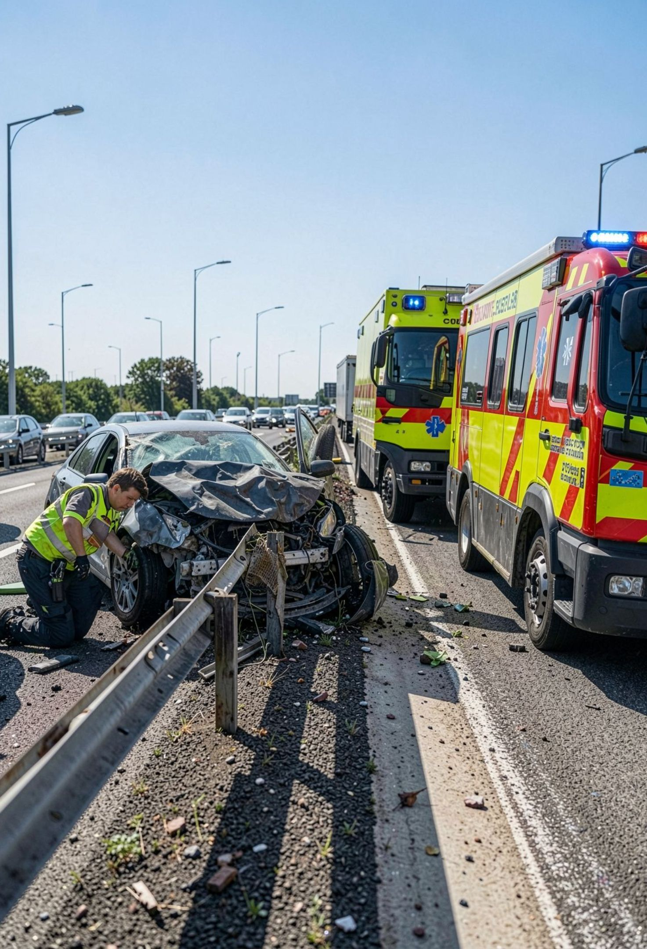
PROPOSED EMERGENCY RESPONSE
POST-CRASH RESPONSE CLOSES THE SAFETY LOOP
1
Impact detection
3.5G impact threshold uses high-frequency accelerometer motion data to identify severe deceleration.
2
Telemetry dispatch
Transmit live coordinates and crash severity to emergency services.
3
Fuel isolation
Electronically cut fuel after a qualifying impact to reduce post-impact fire risk.
3.5G is a proposed system parameter, not a universal regulatory threshold.

Slide 7
SYSTEM ARCHITECTURE
CLOSED-LOOP ARCHITECTURE CONNECTS SENSING TO ACTION
A safety gate separates trusted context from actuation.
1
→
2
→
3
INPUTS
CORE + SAFETY GATE
OUTPUTS
NEO-6M GPS
Processing microcontroller
HUD + audio
GPS telemetry: route position and speed context.
Fuses location, confidence, vehicle state, and crash signals.
Driver-facing warnings.
Actuation + beacon
MPU6050
Confidence check
Smooth actuator control and emergency GSM/LoRa beacon.
Accelerometer data: acceleration and crash signals.
Missing or uncertain data triggers advisory mode before actuation.

Slide 8
COMMERCIAL PATHWAYS
THREE PATHWAYS CREATE A VIABLE MARKET
Recurring telemetry revenue meets retrofit accessibility and public-sector scale.
1
2
3
B2B FLEET MANAGEMENT
AFTERMARKET CONSUMER KITS
GOVERNMENT INFRASTRUCTURE
SaaS telemetry and geofenced speed compliance for logistics trucks and public buses.
Affordable plug-and-play OBD-II modules for private vehicle owners.
Municipal partnerships for accident-blackspot speed governance.
Retrofit accessibility
Public-sector scale
Recurring telemetry revenue

Slide 9
DEPLOYMENT DISCIPLINE
DESIGN FOR COMPLIANCE, RETROFIT, AND SCALE
DESIGN PRIORITY | SYSTEM POSITION | SCALING VALUE
Compliance | Align with applicable MoRTH road-safety frameworks and vehicle safety requirements. | Avoid specific mandate claims unless verified.
Risk reduction | Measure speed compliance and incident telemetry. | Support lower fleet risk and insurance exposure.
Retrofit scale | Use software, geofencing, and retrofit modules. | Reach national highway networks without expensive OEM structural redesigns.

Slide 10



THE TAKEAWAY
BUILT INTO THE ARCHITECTURE
SMARTER ROADS.
SAFER JOURNEYS.
Uncertainty handling
Driver override
Post-crash response
Move transport safety from passive information to active, context-aware intervention.
Q&A

