Slide 1

B.Tech Project Evaluation-1 Developing Online Discussion Forums as Student Centered Peer E-learning Environment (CollegeQues)
Presented by :-
Abhay Bansal, 20180108169
Navneet Srivastava, 2018007307
Kumar Shivam,2018006994
Deepali Kumari, 2018014938
Under the Supervision of:-
( Mr. Sudhir Mohan)
Sharda University, Gr. Noida
DEPARTMENT OF COMPUTER SCIENCE & ENGINEERING
SCHOOL OF ENGINEERING AND TECHNOLOGY
May 2022
1

Slide 2
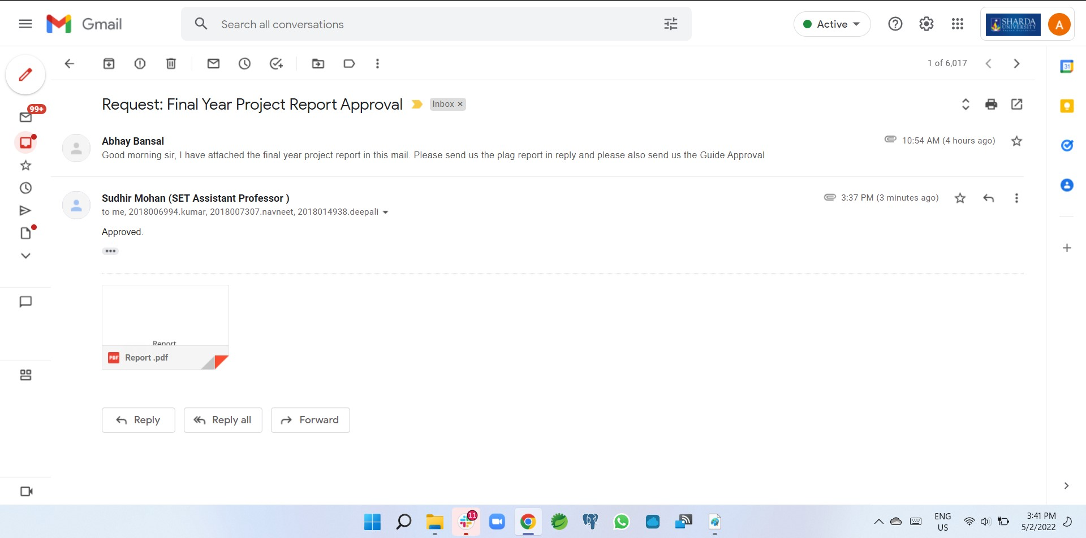
Guide’s Approval

Slide 3

INTRODUCTION
The purpose of the CollegeQues Project is to provide a platform for students, Where student can rise question and anyone from college (Faculty, Other students etc.) can give answer to the question, In CollegeQues the question is get classified into to their related topic, subject and the teacher related to that subject, topic get notify to give answer to that question, Student get notify by the their expertise topic chosen by himself.

Slide 4

PROJECT OBJECTIVES
Development of web application to provide a Discussion platform for college/university students.
Development of mobile application which provide easy accessibility from mobile devices.
Developing a functionality using NLP which help user to get the answers in summarized form.
The main objective of the Project is to provide an authentic platform where students get answer to there question from there college students and faculty .

Slide 5
PROBLEM STATEMENT
In recent time the quest for this knowledge has risen drastically, surfing or browsing the web without direction for information is becoming stressful especially using search engines.
New students in colleges totally disconnected from there seniors who have lots of information which can’t be further transfer to new one due to they got shifted to different collocations.
Due to busy schedules of lecturers, they find it difficult passing information to students, students in turn also find it difficult to interact with them, especially to ask question and get ideas.

Slide 6
Setting up a discussion forum is actually quite an interesting problem. We will need some way of storing the Question, answers, comment, like, dislike etc, and use these data to recommend the question to the relevant member of the discussion forum who can able to answer the question.

Slide 7
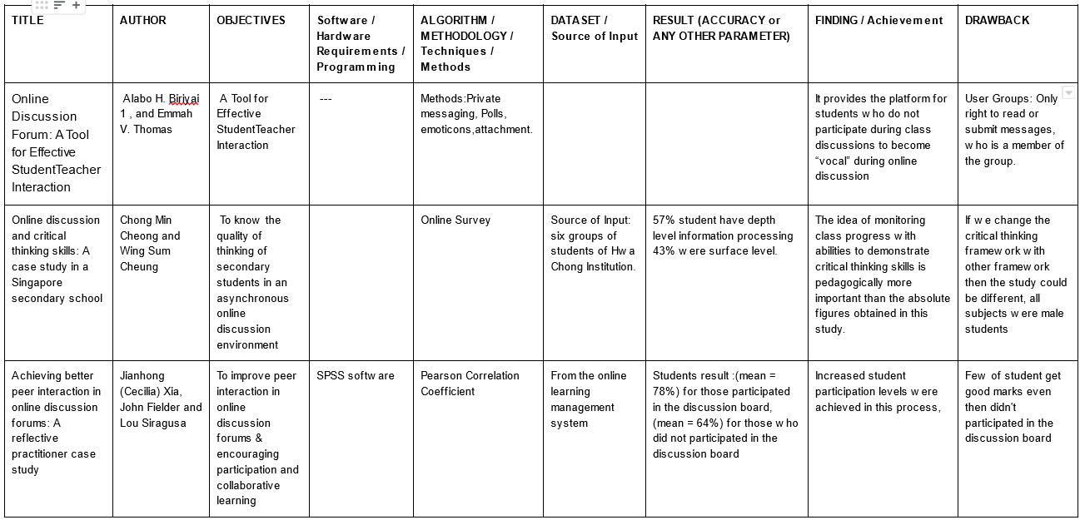
LITERATURE SURVEY

Slide 8
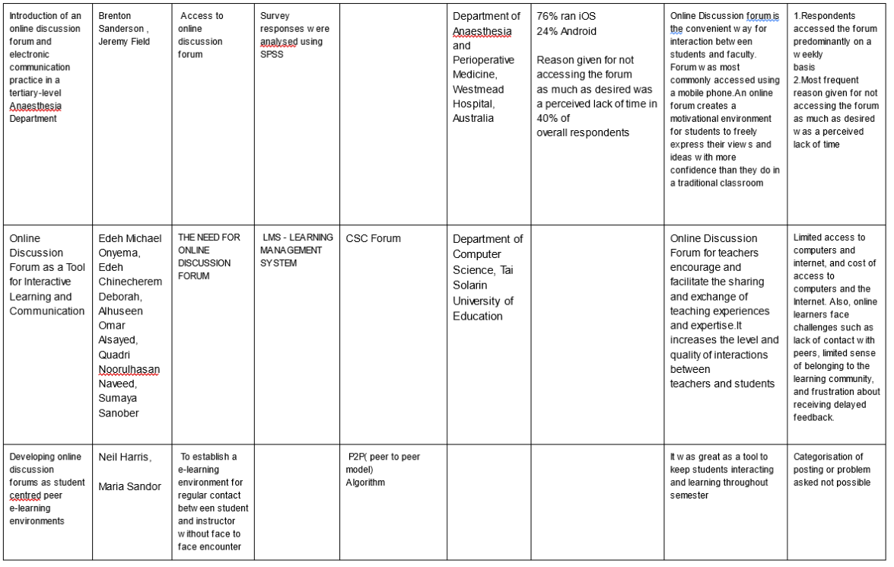

Slide 9
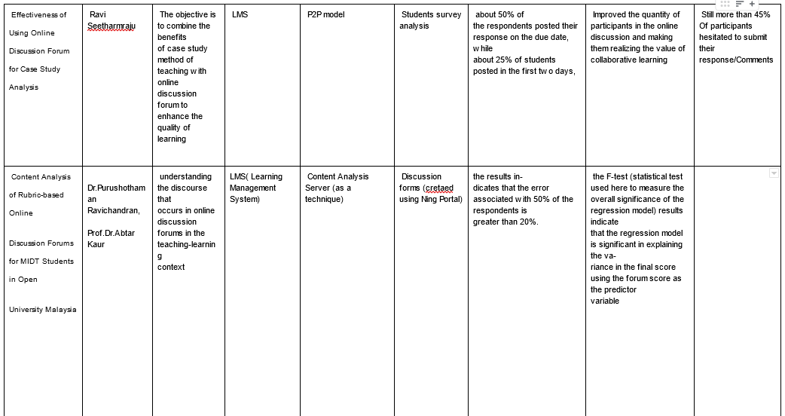

Slide 10
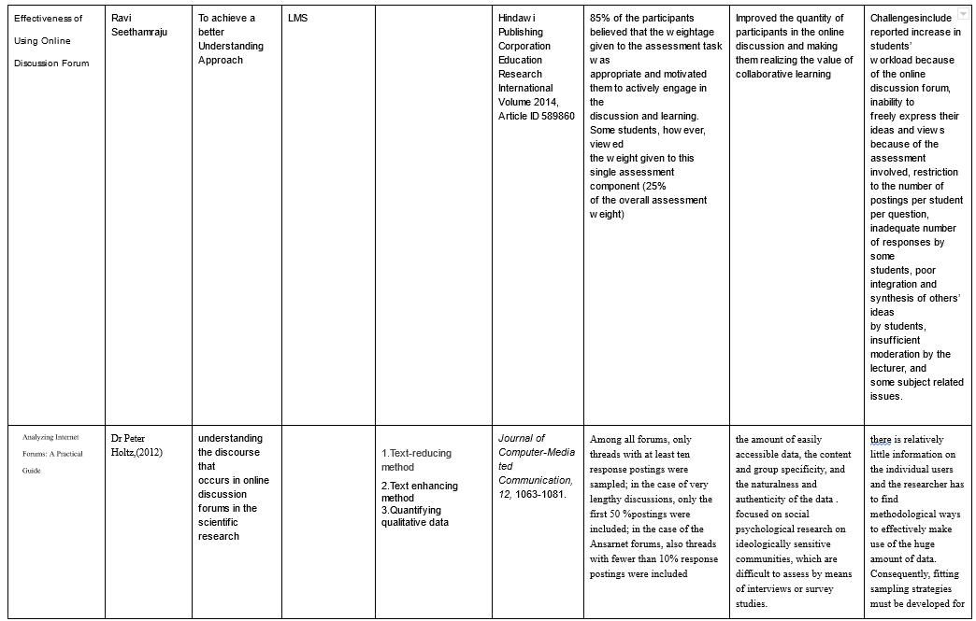

Slide 11
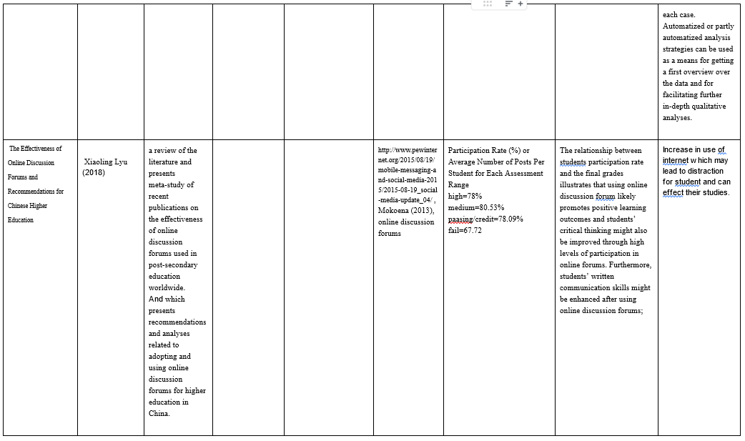

Slide 12
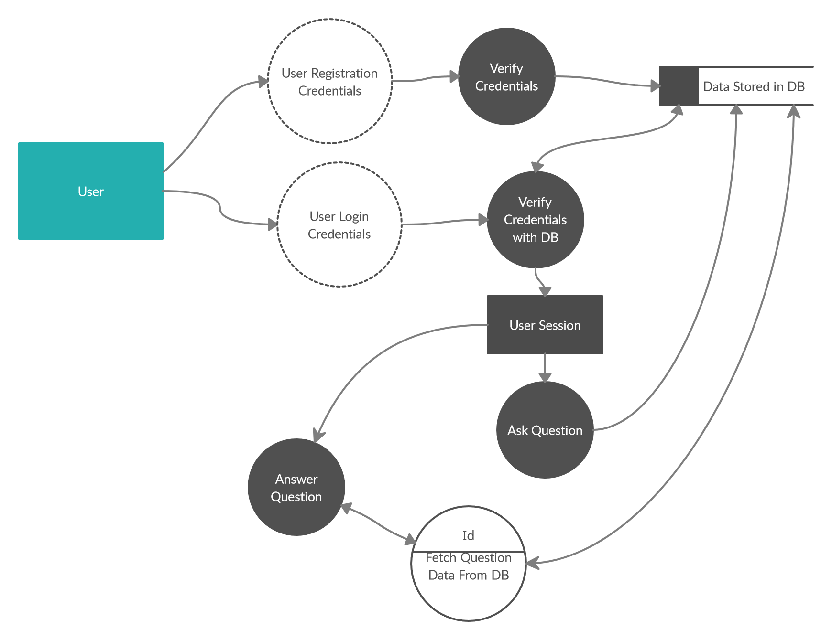
Basic Process Flow Diagram

Slide 13
AGILE SDLC PROCESS
PLAN
Gathering requirements
Planning
Exploring
Identifying software and tools
REVIEW
- Quality Assurance
Maintenance
Operate the system
6. REVIEW
1. PLAN
DEPLOY
- Automated Testing
Continuous Integration
Product and Technical Support
DESIGN
- Diagrams like Flowchart, process design,
Collaboration
5. DEPLOY
2.DESIGN
4. TEST
TEST
- Issue Resolution
User Interaction
- Debugging and reduce errors
Continuous Improvement
3. DEVELOP
DEVELOP
- Iteration
Build
Improve

Slide 14
AGILE SDLC PROCESS CONT…
We have decided to use Agile model because of the following:
Less resource requirements.
Changing the requirements can be done easily.
Provides the realistic approach for development of our software.
Documentation can easily be employed.
Little Planning is enough
Management of the project is easy.
Gives enough iterative development.
Adaptive Planning is possible.

Slide 15
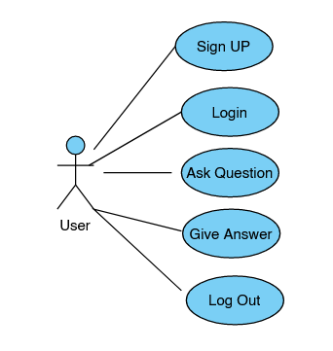
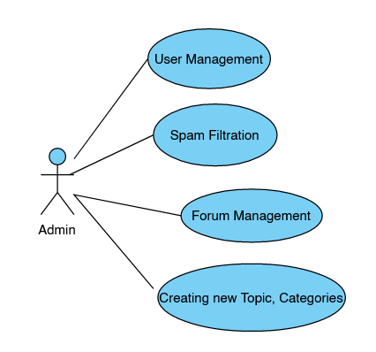
USE CASE DIAGRAMS
USER END
ADMIN END

Slide 16
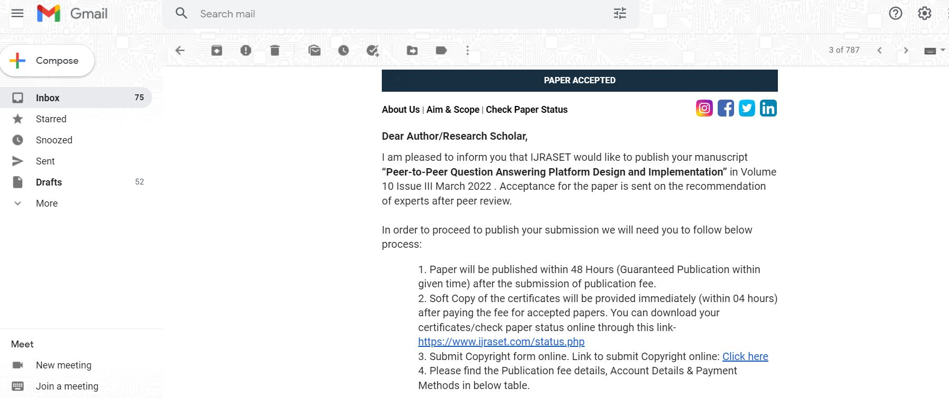
RESULT

Slide 17
CONCLUSION
Rather than using hundreds of website and unable to find relevant information related to college campus, subjects etc, students can able to ask question directly to there faculty, department staff, batch mates or their seniors, our proposed platform make student life easier and they feel more connected to college, department , faculty etc.

Slide 18
THANK YOU

