Slide 1
Linear Functions & Data
Determining Whether a Set of Data is Linear
All slides in this presentations are based on the book Functions, Data and Models, S.P. Gordon and F. S Gordon ISBN 978-0-88385-767-0

Slide 2
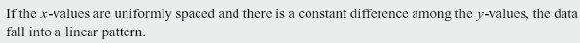
Determining Whether a Set of Data is Linear

Slide 3
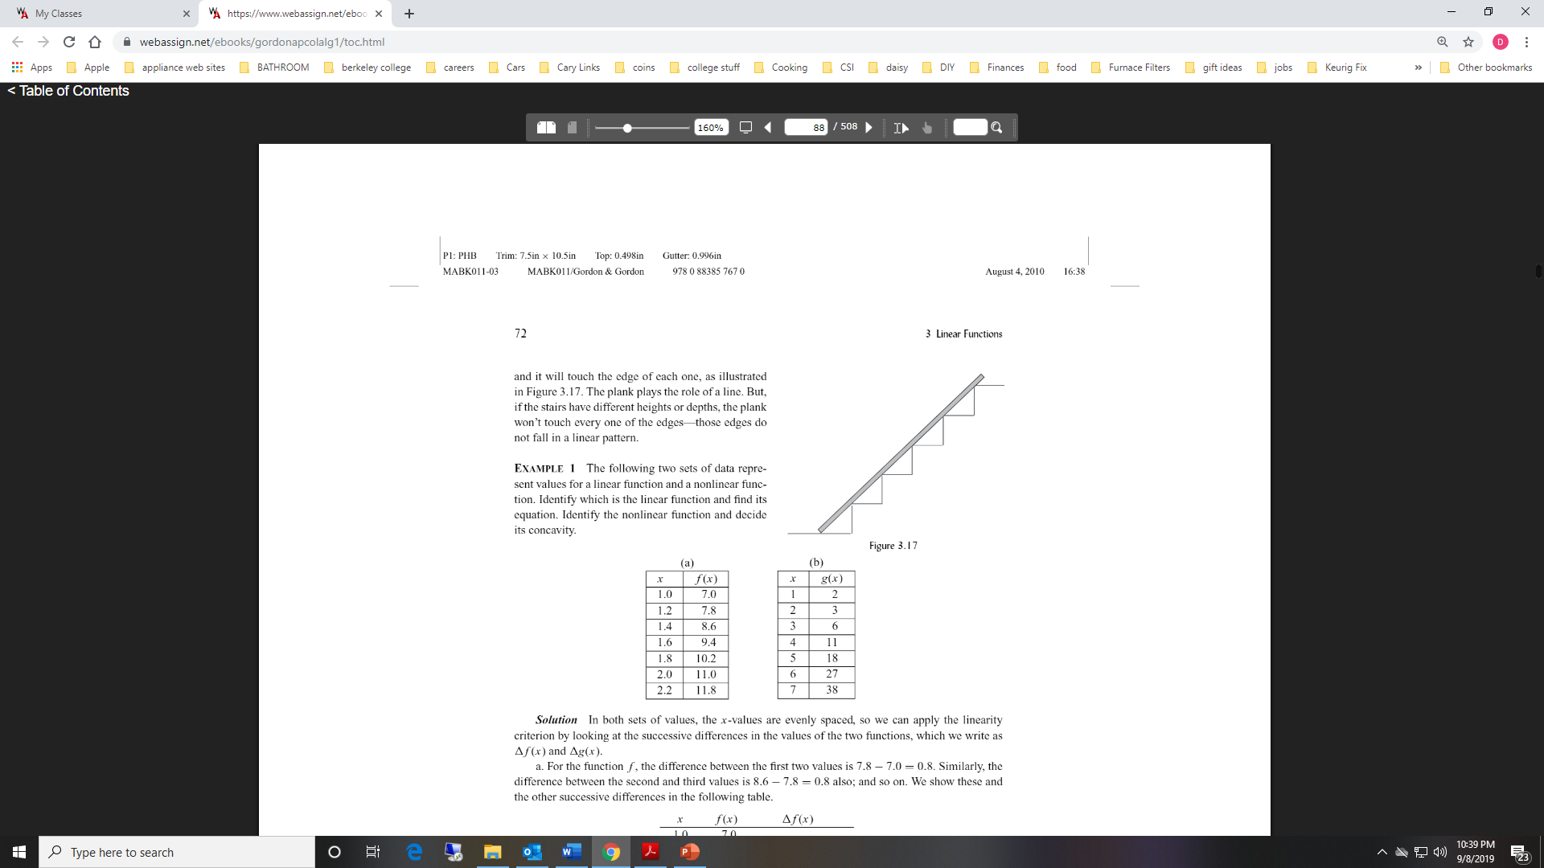
Example 1
Example 1 The following two sets of data represent values for a linear function and a nonlinear function. Identify which is the linear function and find its equation. Identify the nonlinear function and decide its concavity.

Slide 4
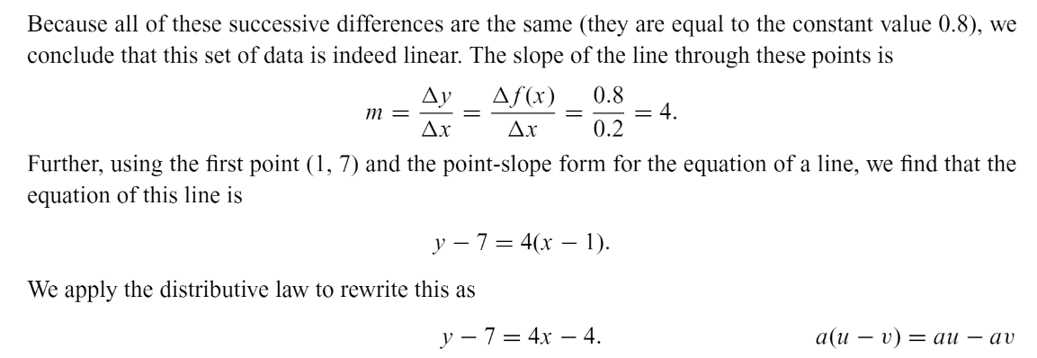
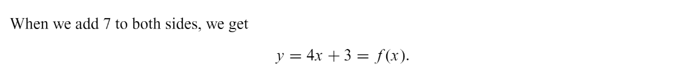

Example 1 Part (a) solution
Example 1 The following two sets of data represent values for a linear function and a nonlinear function. Identify which is the linear function and find its equation. Identify the nonlinear function and decide its concavity.
$$∆f(x)$$

Slide 5

Example 1-part (b) Solution
Example 1 The following two sets of data represent values for a linear function and a nonlinear function. Identify which is the linear function and find its equation. Identify the nonlinear function and decide its concavity.
Because g(x) is increasing at an increasing rate, the function must be concave up.
$$∆g(x)$$
3 – 2 = 1
6 – 3 = 3
11 – 6 = 5
18 – 11 = 7
27 – 18 = 9
38 – 27 = 11

Slide 6
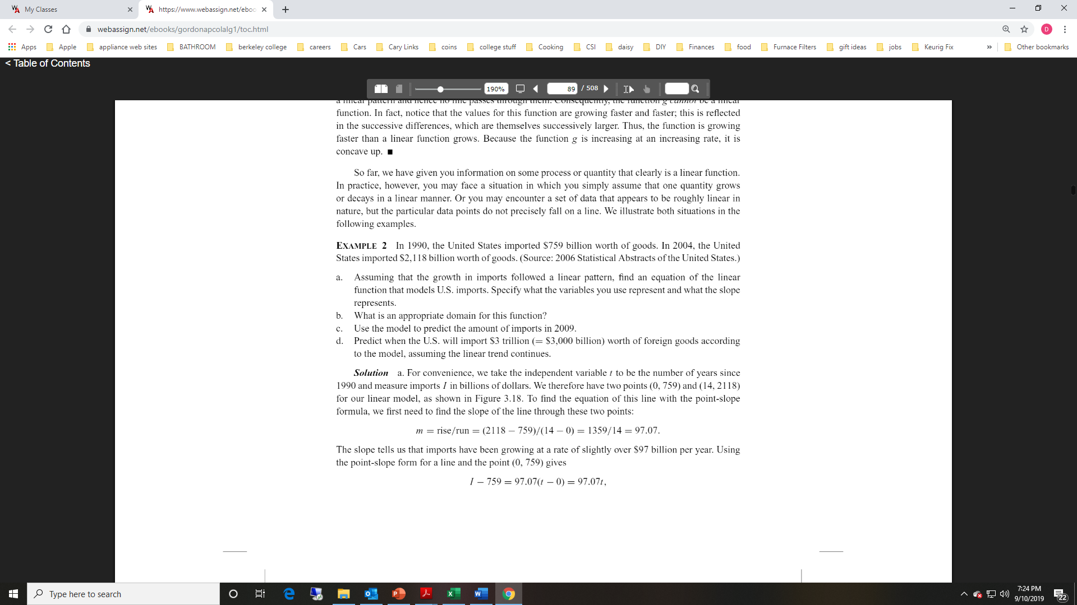
Example 2

Slide 7

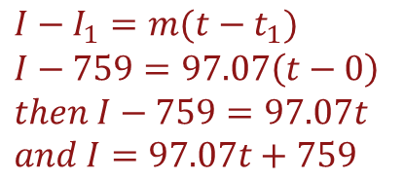
Example 2 Solution part (a)
Let t be the number of years since 1990 (independent variable) and let I be imports in billions of dollars (dependent variable).
Therefore we have two points (0, 759) and (14, 2,118)
$$m=\frac{rise}{run}=\frac{2118−759}{14−0}=\frac{1359}{14}≈97.07$$
The slope tells us, imports are growing at a rate slightly more than $97 billion dollars per year.
$I−I_{1}=m(t−t_{1})$
$$I−759=97.07\left(t−0\right)$$
$$then I−759=97.07t$$
$$and I=97.07t+759$$
(Used the point (0, 759) )
(Distribute the 97.07)
(Add 759 to both sides of the equation)

Slide 8
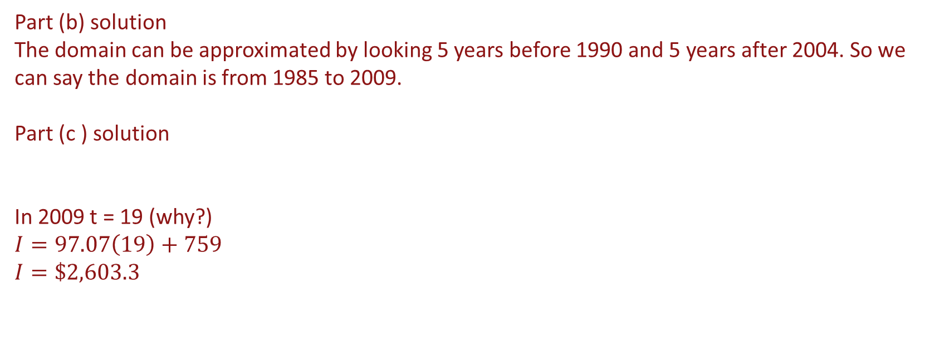

Example 2 Solution parts (b),(c )
Part (b) solution
The domain can be approximated by looking 5 years before 1990 and 5 years after 2004. So we can say the domain is from 1985 to 2009.
Part (c ) solution
In 2009 t = 19 (why?)
$$I=97.07\left(19\right)+759$$
$$I=\$2,603.3$$
$$I=97.07t+759$$

Slide 9
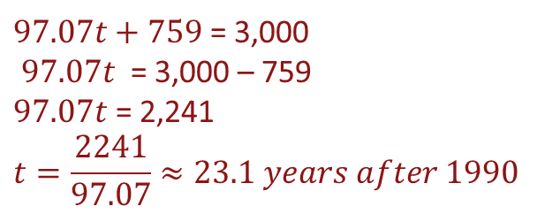
Example 2 Solution part (d)
$Remember I=97.07t+759$ we would like to know t when I = $3,000 Billion
$97.07t+759$ = 3,000
$97.07t$ = 3,000 – 759
$97.07t$ = 2,241
$$t=\frac{2241}{97.07}≈23.1 years after 1990$$

Slide 10
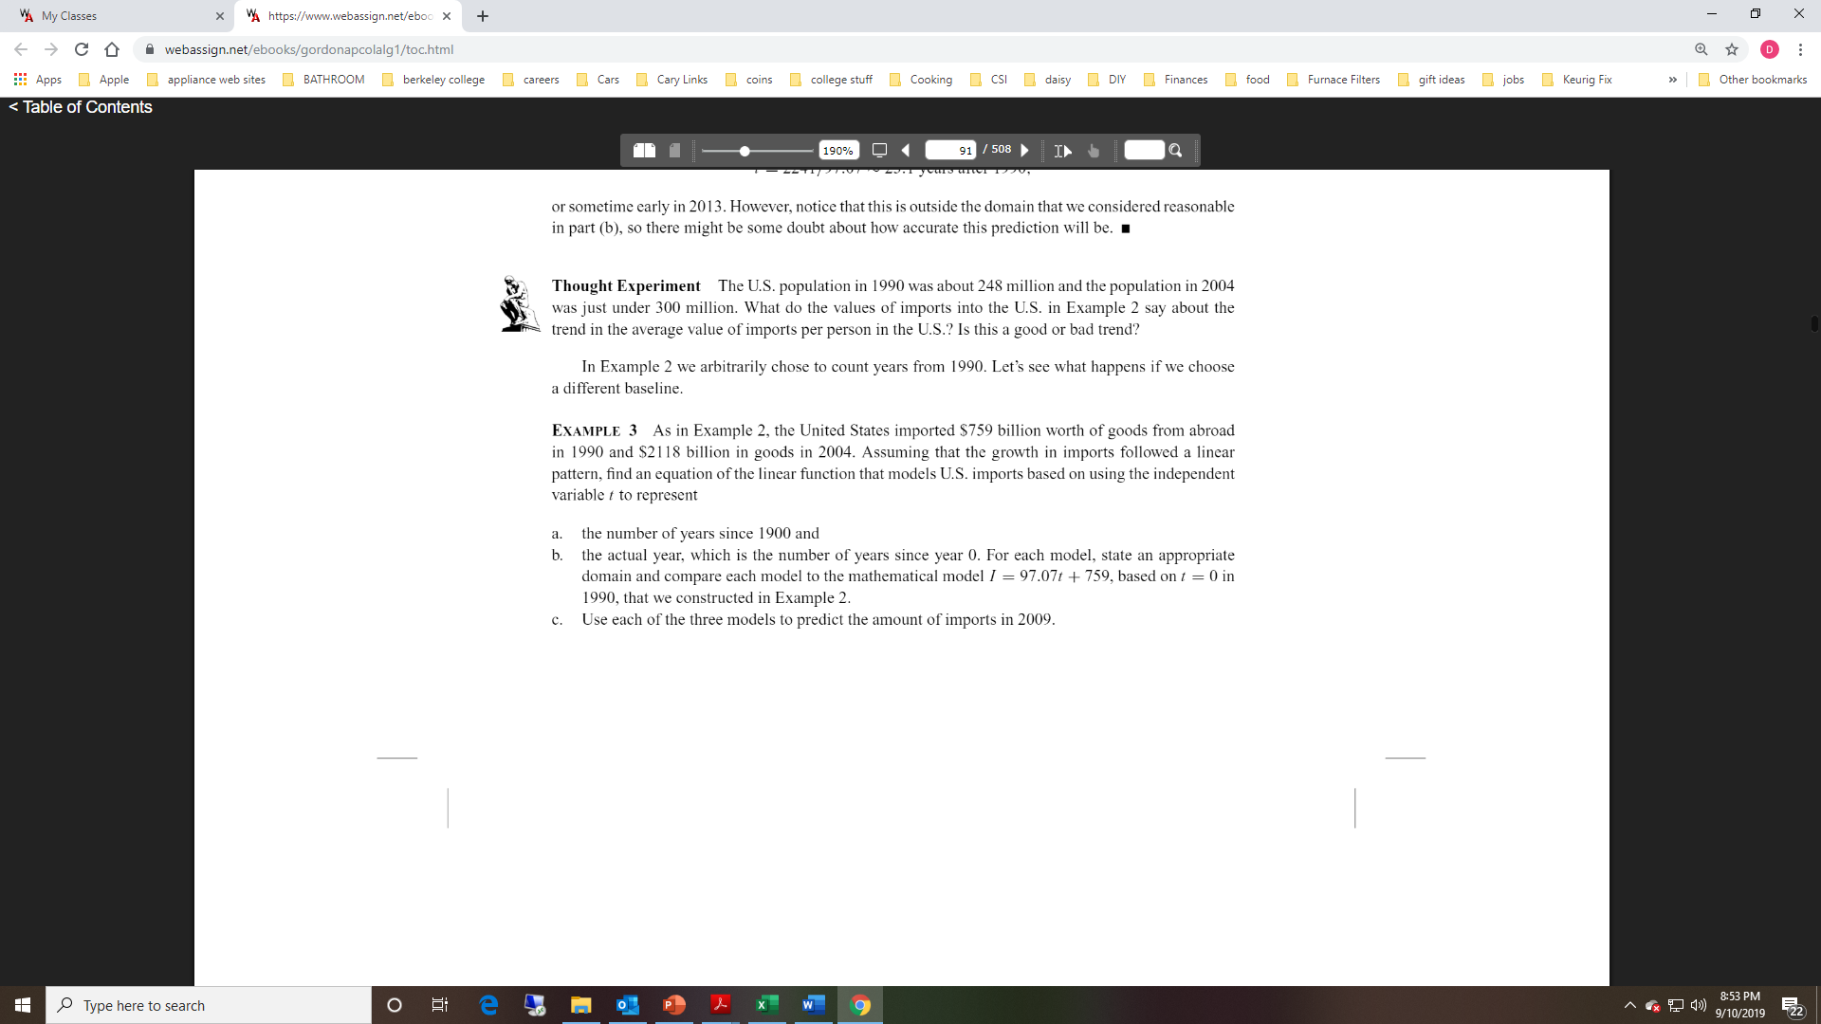
Example 3

Slide 11
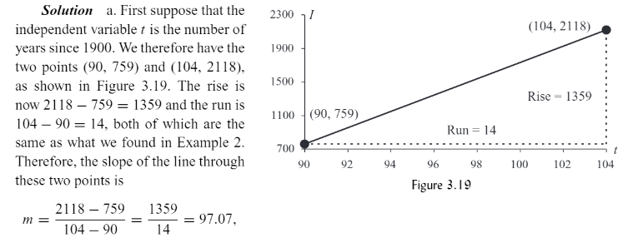
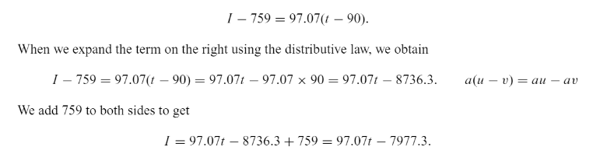
Example 3 Solution part (a)

Slide 12
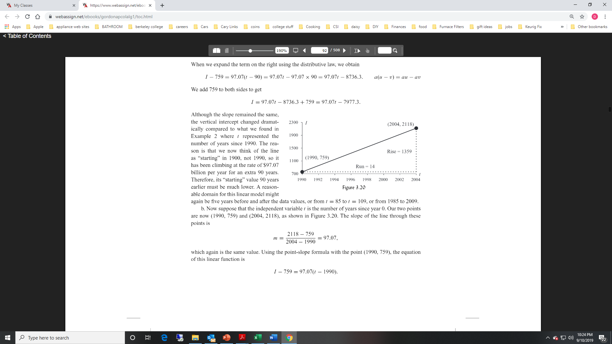
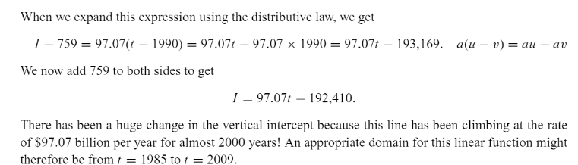
Example 3 Solution part (b)

Slide 13






Example 3 Solution Part (c)
Model 1
Model 2
Model 3
$$I=97.07t+759$$
$$I=97.07t−7977.3$$
$$I=97.07t−192,410$$
Year 2009 means t = 19
Year 2009 means t = 109
Year 2009 means t = 2009
$$I=97.07(19)+759$$
$$I=97.07(109)−7977.3$$
$$I=97.07(2009)−192,410$$
I = 2603.33
I = 2603.33
I = 2603.33

Slide 14
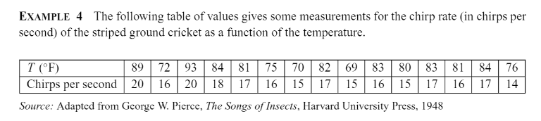
Example 4
Estimate the equation of the line that captures this linear pattern. (Will need to plot points)

Slide 15
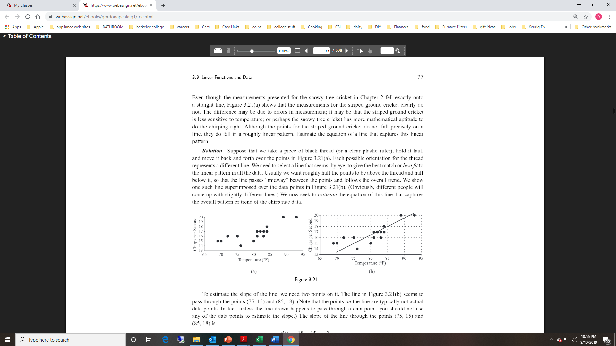
Example 4 solution

Slide 16

Example 4 Solution
To estimate the equation, we will need to estimate the slope.
Choose 2 points on the line, (75, 15) and (85,18)
$$m=\frac{18−15}{85−75}=\frac{3}{10}=0.3$$

Slide 17





Example 4 solution
To estimate the equation, we will need to estimate the slope.
Choose 2 points on the line, (75, 15) and (85,18)
$$m=\frac{18−15}{85−75}=\frac{3}{10}=0.3$$
Now use the point – slope formula:
$$C−C_{1}=m(T−T_{1})$$
$$C−15=0.3(T−75)$$
$$C−15=0.3T−22.5$$
$$C=0.3T−7.5$$

