Slide 1
Fitting Exponential Functions to Data
All slides in this presentations are based on the book Functions, Data and Models, S.P. Gordon and F. S Gordon ISBN 978-0-88385-767-0

Slide 2
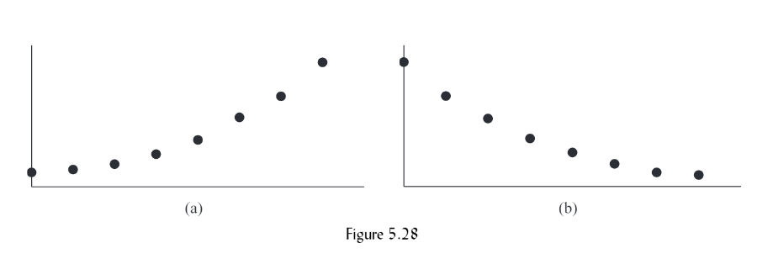
Fitting Data to An Exponential Function
Although Linear Regression is a powerful tool, not all relationships between two quantities are linear. (See scatterplots in figure 5.28)
Scatterplots suggest an exponential pattern, so we need to fit data to an exponential function (Using TI 83/84 Calculators)

Slide 3
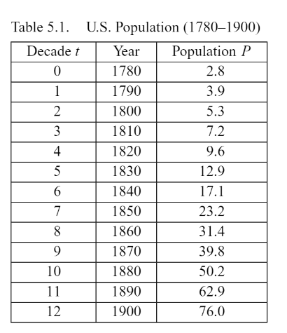
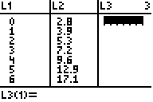
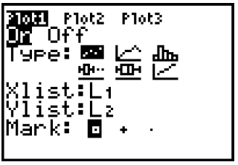
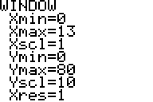
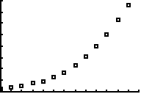
How to do Exponential Regressions on TI Calculator
Example 1 The population of the United States , in millions, in the decades from 1780 to 1900 is shown in Table 5.1 on the right. Find an exponential function that fits these data and discuss its characteristics.
Create a scatterplot
Make sure the rest of the screen looks like this
Adjust window
(Why these values?)

Slide 4
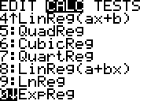
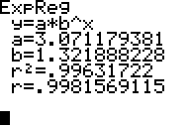
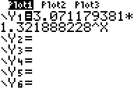
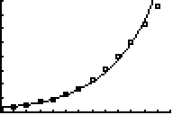

How to do Exponential Regressions on TI Calculator
Determine the equation
Enter the equation
$$P=P\left(t\right)=3.071∙{1.322}^{t}$$
The growth factor, 1.322, indicates the U.S. population grew at a rate of 32.2% per decade from 1780 to 1900. The curve fits the data very well, so the exponential function is a good fit to the population data from 1780 to 1900

Slide 5
The Base e
Had we solved the previous problem in excel, the graph would have looked identical, but the equation would have looked different.
In Excel
Excel uses a special base denoted by e; it stands for the irrational number e = 2.71828

Slide 6







The Base e continued
Here’s the equation from the previous slide:
Using the definition of e we get:
Using the law of exponents we get:
Raising 2.71828 to the 0.2791 power
Now compare to our original answer
$$y=3.071∙e^{0.2791∙x}$$
$$y=3.071∙{2.71828}^{0.2791∙x}$$
$$y=3.071$$
$${({2.71828}^{0.2791})}^{x}$$
$$y=3.071$$
$${(1.322)}^{x}$$
$$P=P\left(t\right)=3.071∙{1.322}^{t}$$

Slide 7





The Base e with a negative exponent
Example
$$y=100∙e^{−1.025∙x}$$
$$y≈100$$
$${({2.71828}^{−1.025})}^{x}$$
$$y≈100$$
$${(0.3588)}^{x}$$
The exponential decay factor is approximately 0.3588 so the decay rate = 1 – 0.3588 = .6412

Slide 8
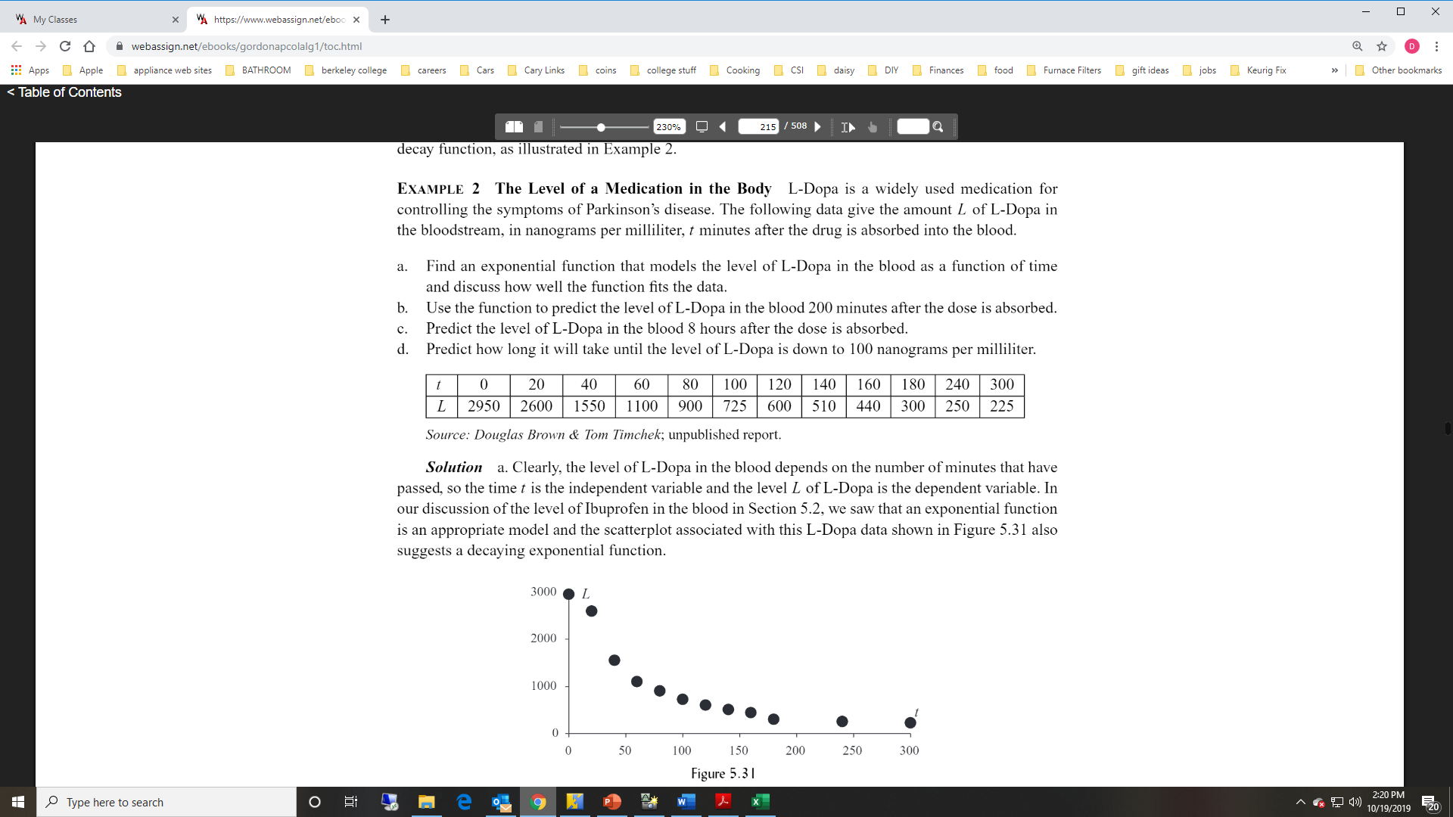
Exponential Decay Example 2

Slide 9
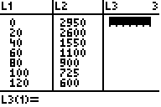
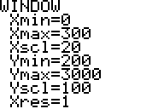
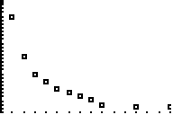
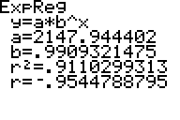
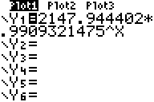
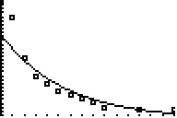
Exponential Decay Example (Solution Part A)
Make sure the rest of the screen looks like this
Adjust window
(Why these values?)
Shape of exponential
decay
Enter the
equation

Slide 10
Exponential Decay Example (Solution Part A)
The exponential decay factor is approximately 0.9909 so the decay rate = 1 – 0.9909 = .0091 so the level of L-Dopa decreases by almost 1% every minute.
The model fits the data very well, especially after the first two points.

Slide 11

Exponential Decay Solution Part B
$$L\left(t\right)=2147.9∙{0.9909}^{t}$$
Let t = 200
$$L\left(200\right)=2147.9∙{0.9909}^{200}≈345.1 nanograms per milliliter$$

Slide 12
Exponential Decay Solution Part C
$$L\left(t\right)=2147.9∙{0.9909}^{t}$$
Let t = 8 * 60 = 480 (Why?)
$$L\left(480\right)=2147.9∙{0.9909}^{480}$$
$$≈26.7 nanograms per milliliter$$

Slide 13


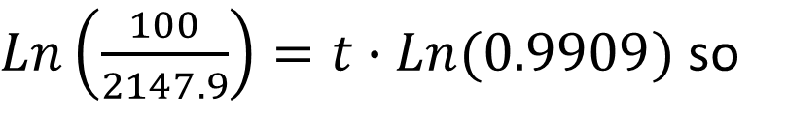
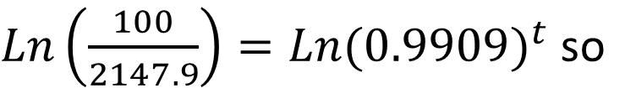
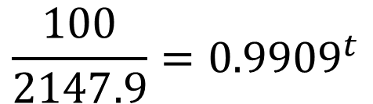

Exponential Decay Solution Part D
$$L\left(t\right)=2147.9∙{0.9909}^{t}$$
We now know the value of L(t) and are looking for the value of t
$$\frac{100}{2147.9}={0.9909}^{t}$$
$$100=2147.9∙{0.9909}^{t} so$$
Use logs to solve for t
$Ln\left(\frac{100}{2147.9}\right)=Ln({0.9909)}^{t}$ so
$Ln\left(\frac{100}{2147.9}\right)=t∙Ln(0.9909)$ so
$$335.5=t$$
The L-Dopa level will be down to 100 nanograms per milliliter in approximately 335 minutes or slightly more than 3 and one-half hours.

Slide 14
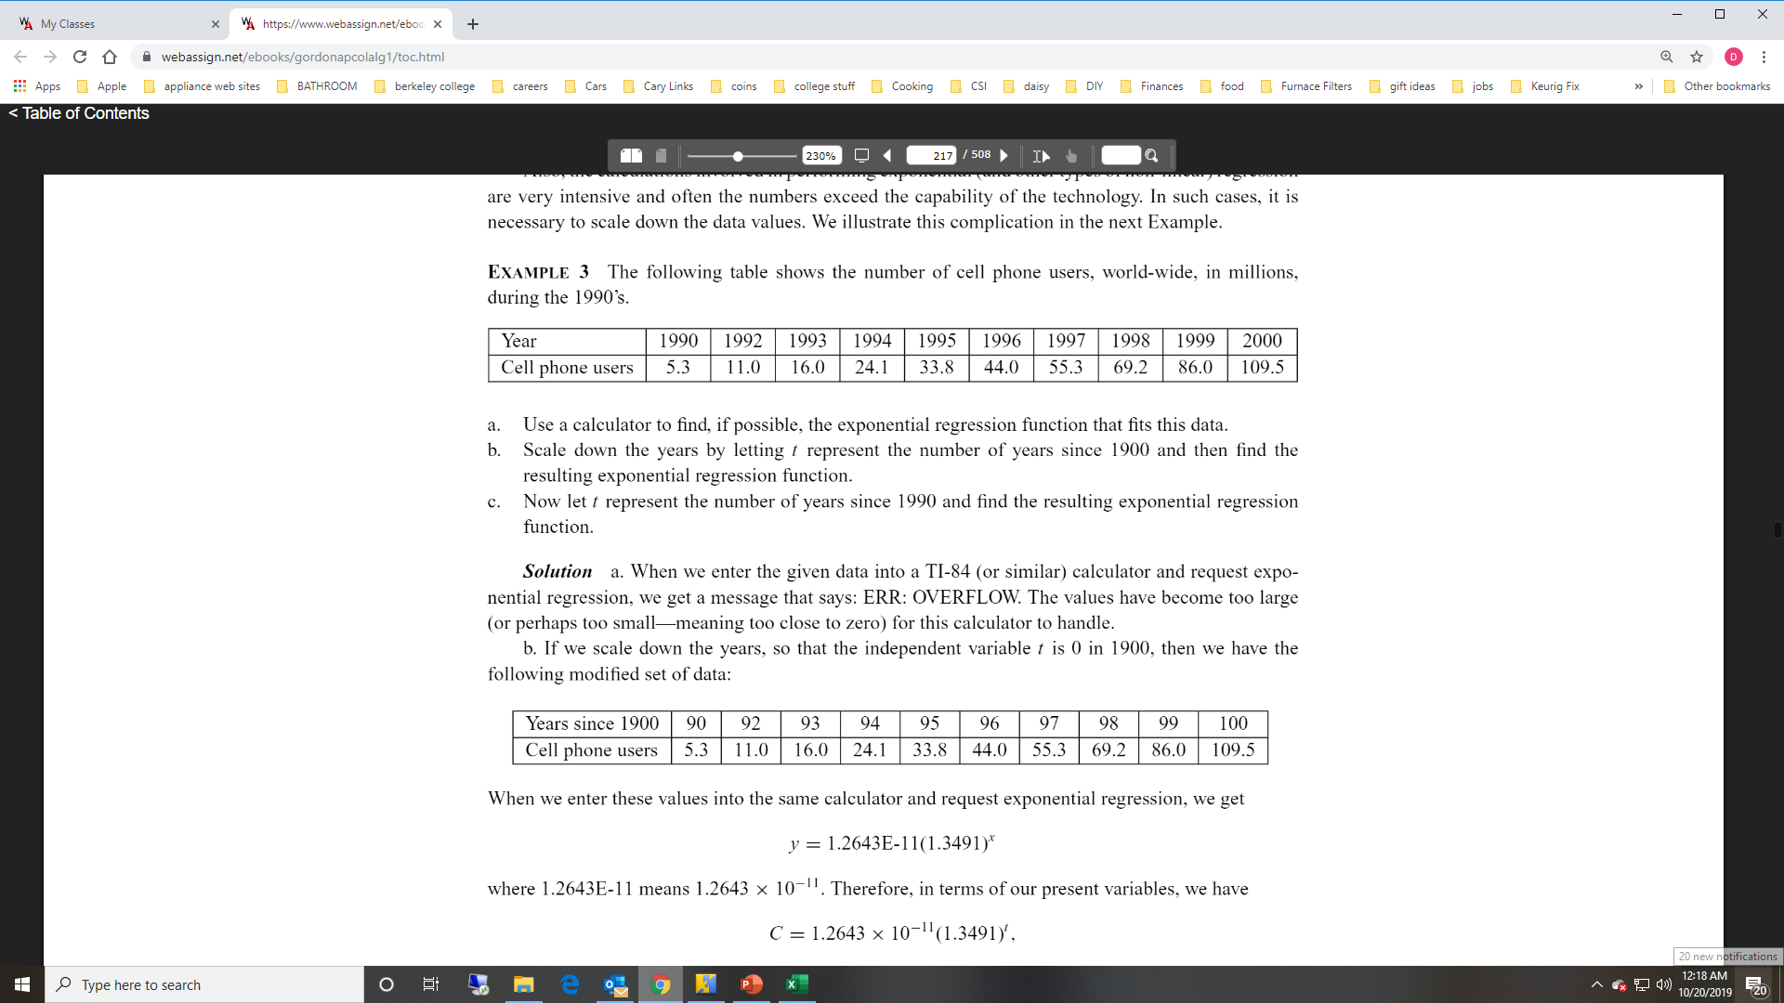
Exponential Decay Example 3

Slide 15
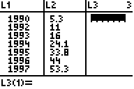

Example 3 Solution Part A
e
Numbers are too large for the calculator to handle.

Slide 16
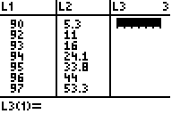
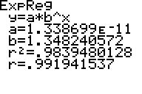

Example 3 Solution Part B
Years since 1990 | 90 | 92 | 93 | 94 | 95 | 96 | 97 | 98 | 99 | 100
Cell Phone Users | 5.3 | 11 | 16 | 24.1 | 33.8 | 44 | 55.3 | 69.2 | 86 | 109.5
e
$$C\left(t\right)=1.264∙{10}^{−11}∙{1.349}^{t}$$
Growth Factor = 1.349
Growth Rate = 34.9%

Slide 17
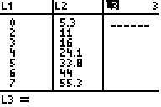
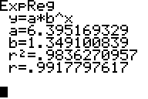

Example 3 Solution Part C
Years since 1990 | 0 | 2 | 3 | 4 | 5 | 6 | 7 | 8 | 9 | 10
Cell Phone Users | 5.3 | 11 | 16 | 24.1 | 33.8 | 44 | 55.3 | 69.2 | 86 | 110
e
$$C\left(t\right)=.395∙{1.349}^{t}$$
Notice the parameter A is much more manageable in this model compared to the solution in Part B

