Slide 1
Laws of Logarithms

Slide 2
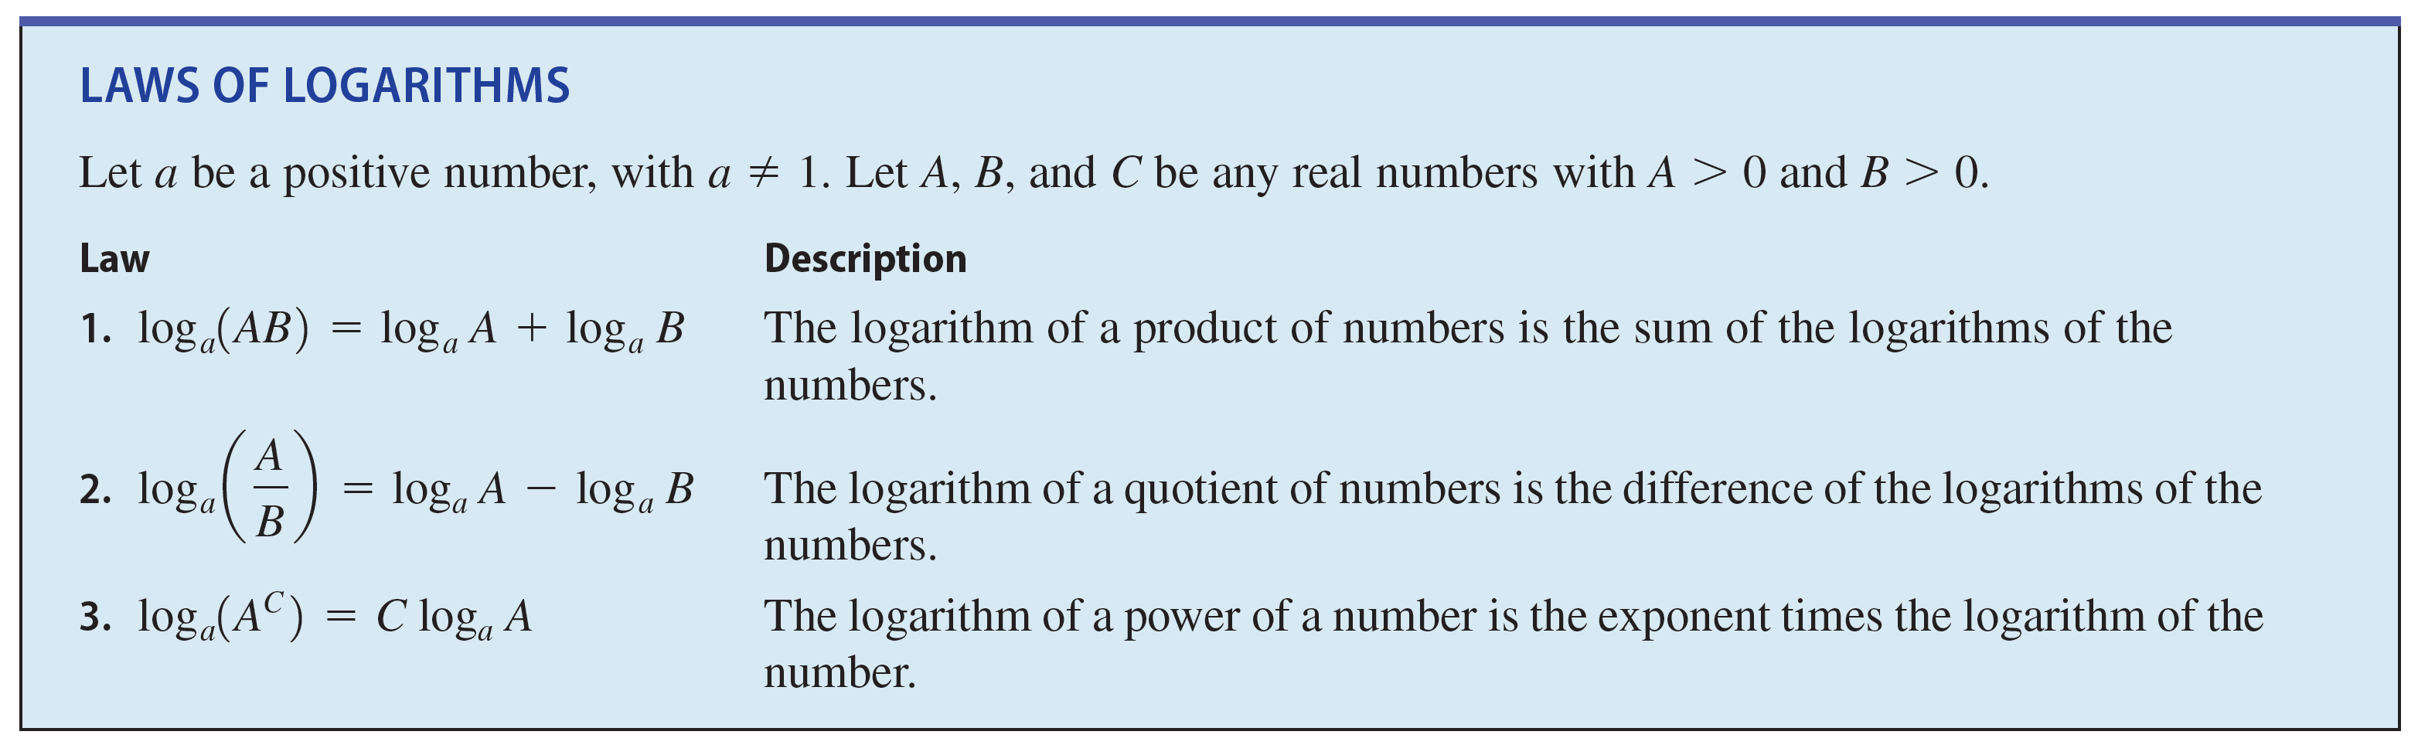
Laws of Logarithms
Since logarithms are exponents, the Laws of Exponents give rise to the Laws of Logarithms.

Slide 3
Example 1 – Using the Laws of Logarithms to Evaluate Expressions
Evaluate each expression.
(a) log 0.01 + log 10,000
(b) log 160 – (log 5 + Log 2)
(c) log 8
Solution: (a) log 0.01 + log 10,000 = log (0.01  10,000)
= log 100 = 2
Law 1
Because 100 = 10²

Slide 4

Example 1 – Solution
cont’d
(b) log 160 – (log 8 + log 2)
= $\log{160−\log{16}}$
= log $\frac{160}{16}$
= log 10 = 1
(c) log 8 = log 8^{–1/3}
= log
≈ –0.301
Law 1
Law 2
Because 10 = 10¹
Law 3
Property of negative exponents
Calculator

Slide 5
Expanding and Combining Logarithmic Expressions

Slide 6
Expanding and Combining Logarithmic Expressions
The Laws of Logarithms allow us to write the logarithm of a product or a quotient as the sum or difference of logarithms.
This process, called expanding a logarithmic expression, is illustrated in the next example.

Slide 7
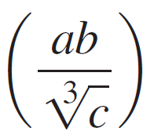
Example 2 – Expanding Logarithmic Expressions
Use the Laws of Logarithms to expand each expression.
(a) log (6x) (b) log (x³y⁶) (c) ln
Solution: (a) log (6x) = log 6 + log x
(b) log (x³y⁶) = log x³ + log y⁶
= 3 log x + 6 log y
Law 1
Law 1
Law 3

Slide 8
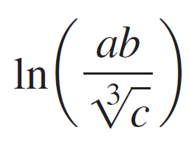

Example 2 – Solution
cont’d
(c) = ln(ab) –
= ln a + ln b – ln c^{1/3}
= ln a + ln b – ln c
Law 2
Law 1
Law 3

Slide 9
Expanding and Combining Logarithmic Expressions
The Laws of Logarithms also allow us to reverse the process of expanding that was done in Example 2.
That is, we can write sums and differences of logarithms as a single logarithm.
This process, called combining logarithmic expressions, is illustrated in the next example.

Slide 10

Example 3 – Combining Logarithmic Expressions
Use the Laws of Logarithms to combine each expression into a single logarithm.
(a) 3 log x + log(x + 1)
(b) 3 ln s + ln t – 4 ln(t² + 1)
Solution: (a) 3 log x + log(x + 1) = log x³ + log(x + 1)^{1/2}
= log(x³(x + 1)^{1/2})
Law 3
Law 1

Slide 11
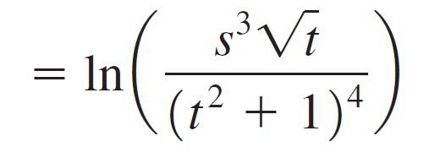
Example 3 – Solution
cont’d
(b) 3 ln s + ln t – 4 ln(t² + 1)
= ln s³ + ln t^{1/2} – ln(t² + 1)⁴
= ln(s³t^{1/2}) – ln(t² + 1)⁴
Law 3
Law 1
Law 2

