Slide 1
Linear Regression
Finding the Line of Best Fit
All slides in this presentations are based on the book Functions, Data and Models, S.P. Gordon and F. S Gordon ISBN 978-0-88385-767-0

Slide 2
Linear Regression: Finding the Line of Best Fit
Example 1:
Independent variable is t – number of years since 1900
Dependent variable is G – gross receipts of movie industry, in billions of dollars

Slide 3
Linear Regression: Finding the Best Fit Line Example 1
Scatter Plot
Possible Line Fits

Slide 4
Linear Regression: Finding the Best Fit Line Example 1
How to determine the line that fits this data set in the best possible way?
Line that passes as close as possible to ALL data points.
Note: This line may not necessarily contain any of the points in the data set
Example 1a: Find the equation of the line of best fit in this example.
We use our TI-84/83 Calculator
We use a spreadsheet on Excel

Slide 5
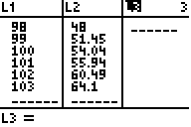

Example 1a: Solution on a Calculator
Enter data in your calculator. Hit Stat button and then Enter; Time t in years since 1900, is the independent variable, so we enter its values in L1
Next enter the values of Gross Receipts, G, in L2
Your input should look like the picture to the left.
$$∆f(x)$$

Slide 6
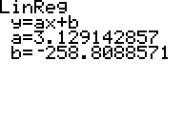
Example 1a: Solution on a calculator
Find the equation of the line of best fit.
We need to do the following
Hit STAT button
Move the cursor one place to the right to highlight CALC
Press (or scroll down to) 4 on the CALC menu
Look at the table on the right. This linear function tells us the slope is 3.129 and the vertical intercept is -258.81

Slide 7
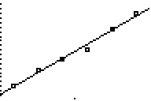
Example 1a: Solution on a calculator
So we have: G = 3.129t – 258.81. The graph below shows our scatterplot with the regression line on the same set of axes.
$$∆f(x)$$

Slide 8
Example 1a – Solution on Excel
Scatter plot and best fit line in MS Excel
$$∆f(x)$$

Slide 9
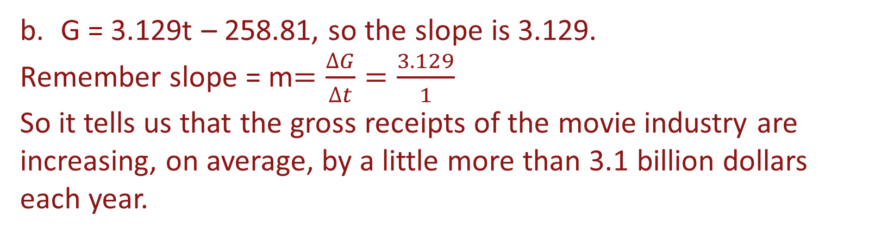
Example 1b – meaning of slope
Example 1b: What is the practical significance of the slope of this line?
G = 3.129t – 258.81, so the slope is 3.129.
Remember slope = m$=\frac{∆G}{∆t}=\frac{3.129}{1}$
So it tells us that the gross receipts of the movie industry are increasing, on average, by a little more than 3.1 billion dollars each year.

Slide 10
Example 1c - Solution
Example 1c: Use this function G = 3.129t - 258.81,
to estimate gross receipts of movie industry in the year 2010
The year 2010 would be represented by 110 in our model (why?) So we take the equation: G = 3.129t – 258.81 and let t = 110.
G = 3.129(110) – 258.81 So G = $85.38 Billion

Slide 11
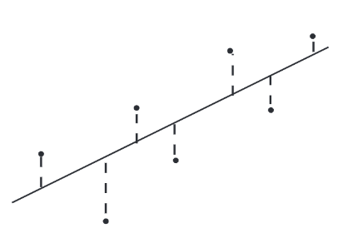
The Least Squares Criterion
The least-squares criterion - the line that best fits a set of data points is the one having the smallest possible sum of squared errors
Note if we sum these errors some will be positive, others will be negative so they would cancel out – something to be avoided
So we SQUARE all these differences(errors) before summing them up

Slide 12
Example 2 – Line of Best Fit

Slide 13
Example 2 – Line of Best Fit
Which of the 3 lines captures the pattern in the data in the best possible way?
Need to compute the sum of the squares

Slide 14
Example 2 – Line of Best Fit (continued)

Slide 15
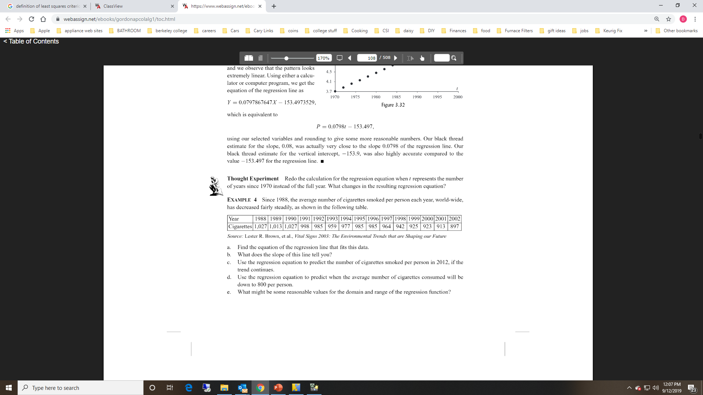
An Additional Example – Cigarette Smoking

Slide 16
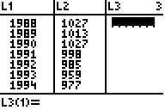
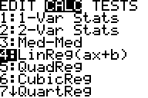
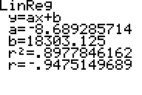
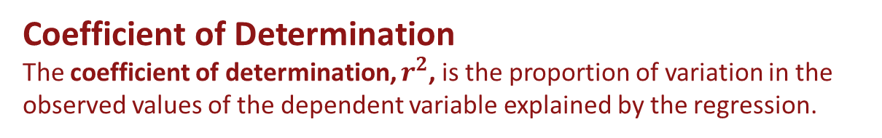
Example – Cigarette Smoking Part (a)
Go to Regression Window
Enter data
Result
$$Here is the model: C=−8.689t+18303$$
Coefficient of Determination
The coefficient of determination, $r^{2}$, is the proportion of variation in the
observed values of the dependent variable explained by the regression.

Slide 17
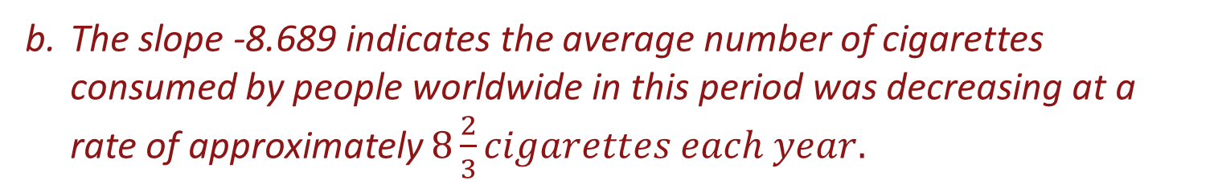
Example – Cigarette Smoking Part (b)
The slope -8.689 indicates the average number of cigarettes consumed by people worldwide in this period was decreasing at a rate of approximately $8\frac{2}{3}cigarettes each year.$

Slide 18
Example – Cigarette Smoking Part (c)
To predict the number of cigarettes consumed, on average, in 2012, we substitute t = 2012 in the regression equation to get:
$$C=−8.689\left(2012\right)+18,303=−17,448+18,303≈821 cigarettes per year$$

Slide 19
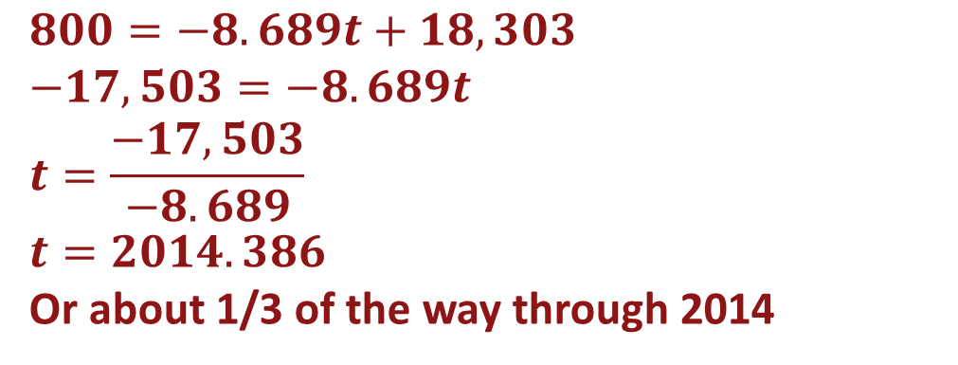

Example – Cigarette Smoking Part (d)
For this problem we let C = 800 and solve the equation for t.
$$C=−8.689t+18,303$$
$$800=−8.689t+18,303$$
$$−17,503=−8.689t$$
$$t=\frac{−17,503}{−8.689}$$
$$t=2014.386$$
Or about 1/3 of the way through 2014

Slide 20
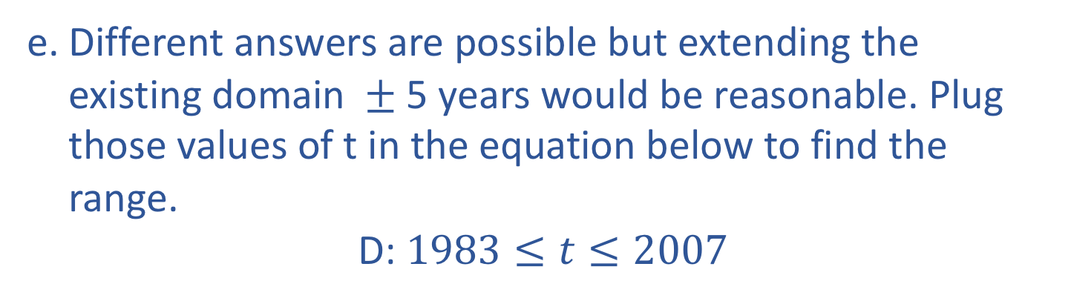

Example – Cigarette Smoking Part (e)
Different answers are possible but extending the existing domain $±$5 years would be reasonable. Plug those values of t in the equation below to find the range.
D: $1983≤t≤2007$
$$C=−8.689t+18,303$$

Slide 21
Correlation between two variables
A relationship between two variables.
The data can be represented by ordered pairs (x, y)
x is the independent variable
y is the dependent variable

Slide 22
Correlation
A scatter plot can be used to determine whether a linear (straight line) correlation exists between two variables.
Example:
y
x | 1 | 2 | 3 | 4 | 5
y | – 4 | – 2 | – 1 | 0 | 2
2
x
2
4
6
–2
– 4

Slide 23
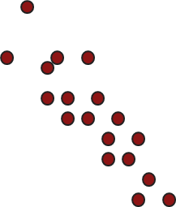
Types of Correlation
y
y
As x increases, y tends to decrease.
As x increases, y tends to increase.
x
x
Negative Linear Correlation
Positive Linear Correlation
y
y
x
x
No Correlation
Nonlinear Correlation

Slide 24
Linear Correlation
A number that measures the strength of a linear relationship
Symbol: r
Always between –1 and +1
r values close to –1 or +1 indicate a strong linear association
r values close to 0 indicate a weak association
A strong correlation between x and y means that there is a strong linear association that exists between the two variables, but it does not necessarily mean that x causes y to change.

Slide 25
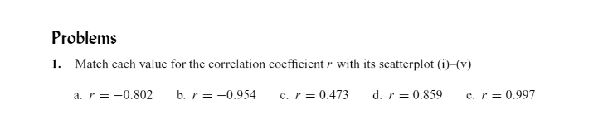
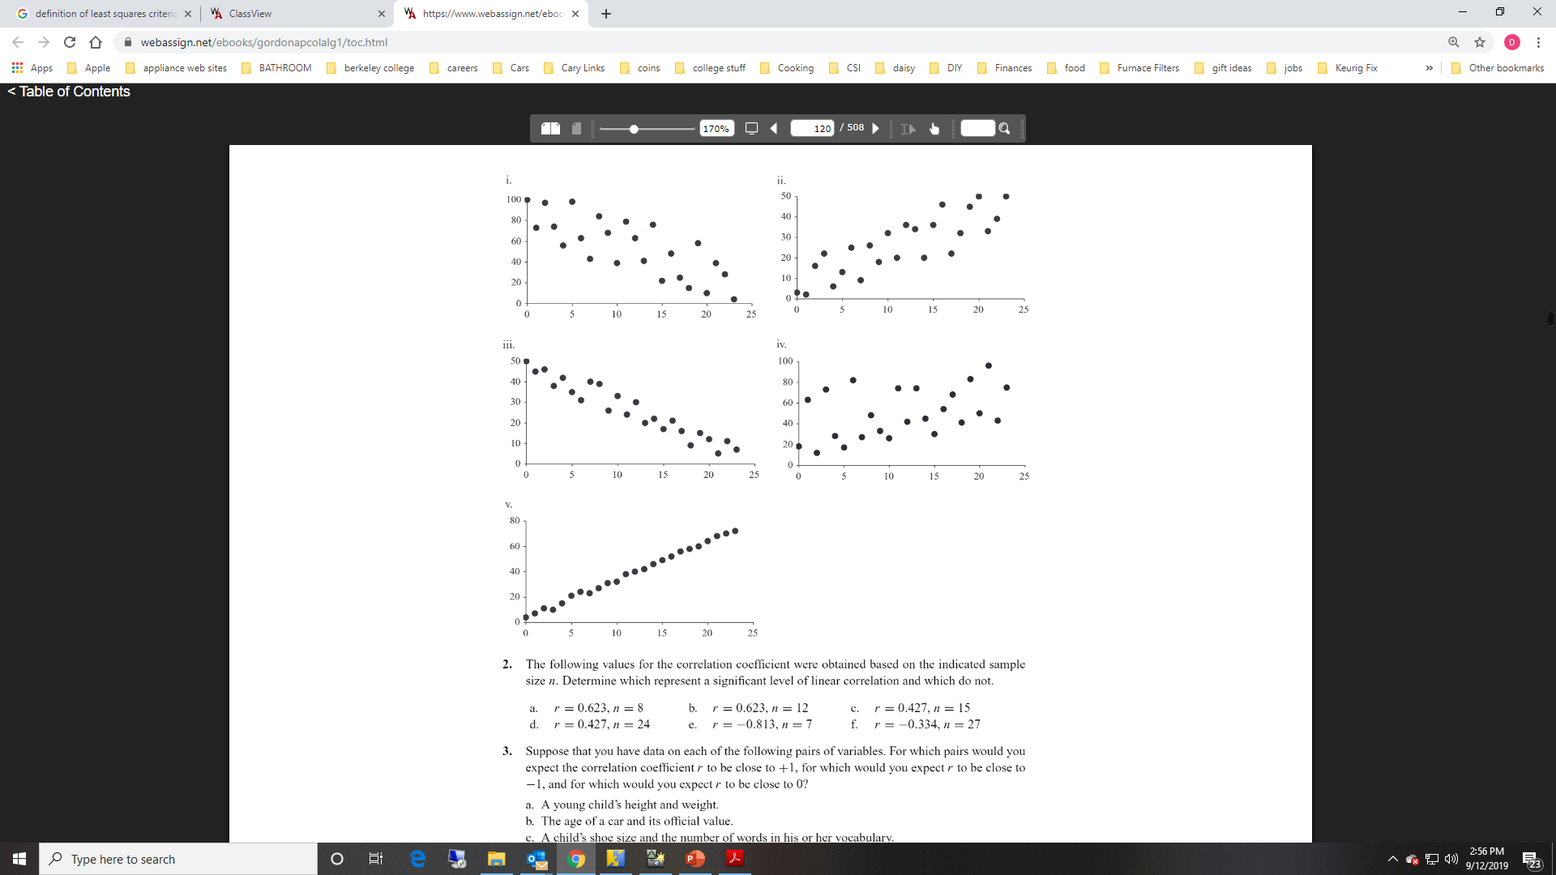
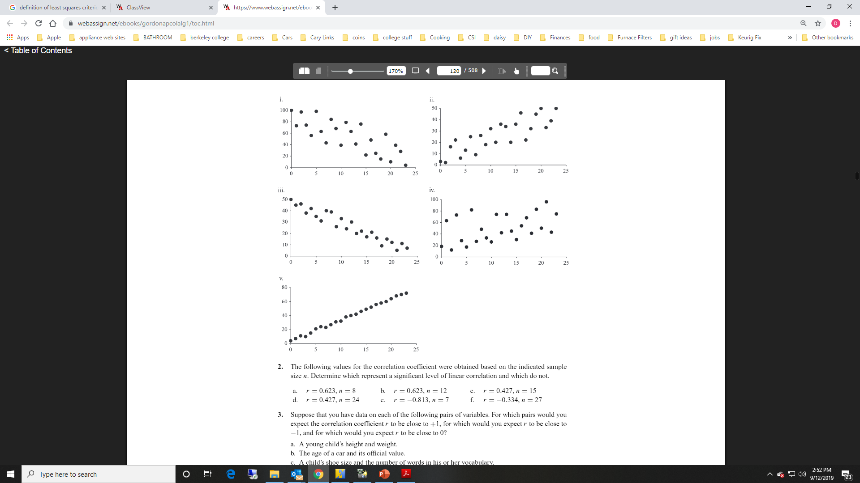
Example Identifying Strength of Correlation

Slide 26
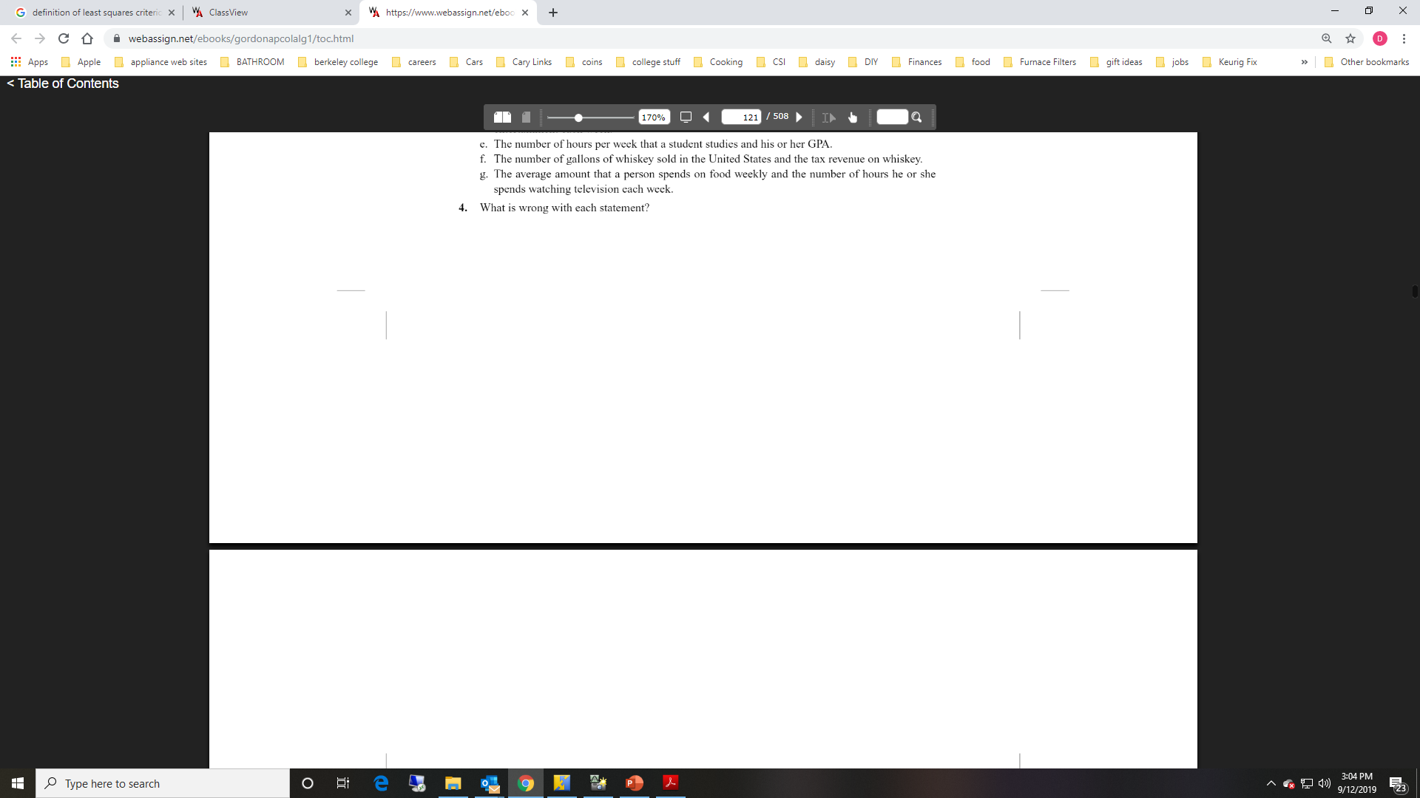
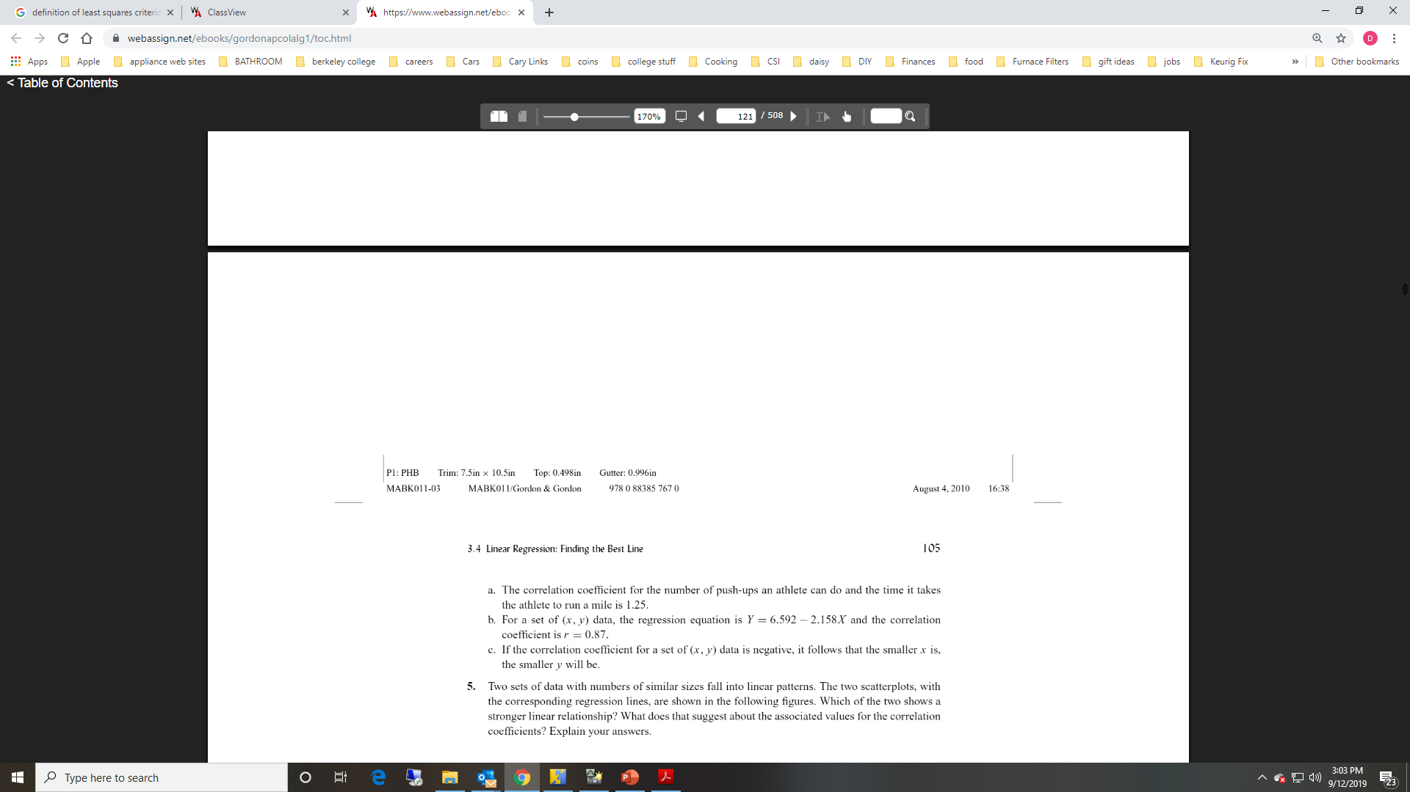
Example Knowing Correlations

