Slide 1
Systems of Linear Equations
All slides in this presentations are based on the book Functions, Data and Models, S.P. Gordon and F. S Gordon ISBN 978-0-88385-767-0

Slide 2

Comparison of 100-meter dash for men and women
$$R=−0.0062t+10,438 men$$
R = $−$0.0206t $+$ 12.48 women
If the trends continue when will the women’s world record surpass the men’s one?
Need to find the point where the extensions of the two lines intersect one another.
There 3 ways to do this:
Trial and error
Graphically
By solving the two equations simultaneously

Slide 3
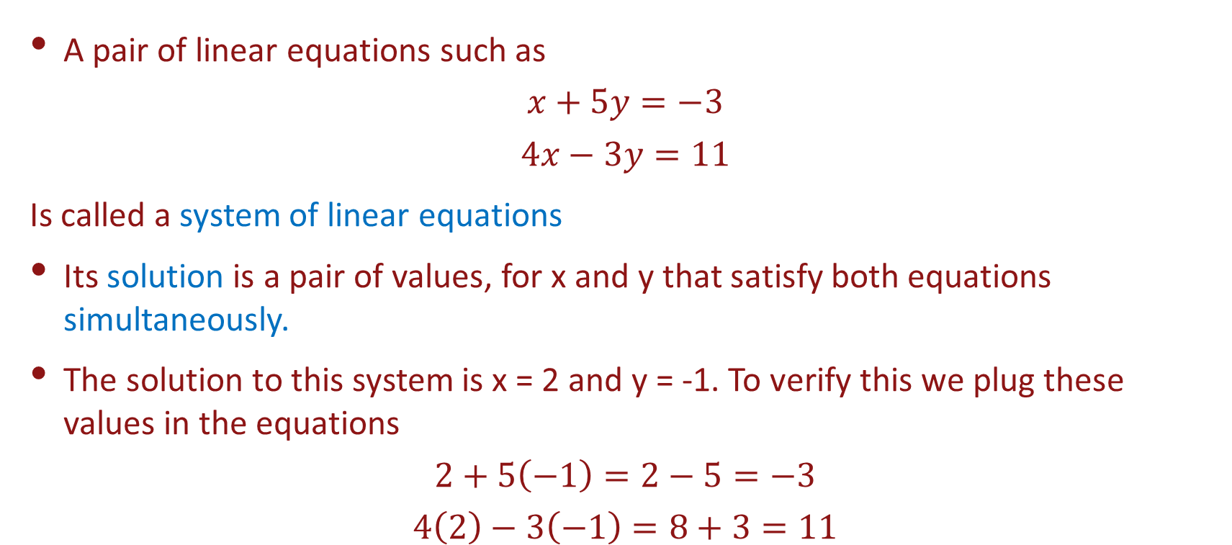
Systems of Linear Equations
A pair of linear equations such as
$$x+5y=−3$$
$$4x−3y=11$$
Is called a system of linear equations
Its solution is a pair of values, for x and y that satisfy both equations simultaneously.
The solution to this system is x = 2 and y = -1. To verify this we plug these values in the equations
$$2+5\left(−1\right)=2−5=−3$$
$$4\left(2\right)−3\left(−1\right)=8+3=11$$

Slide 4
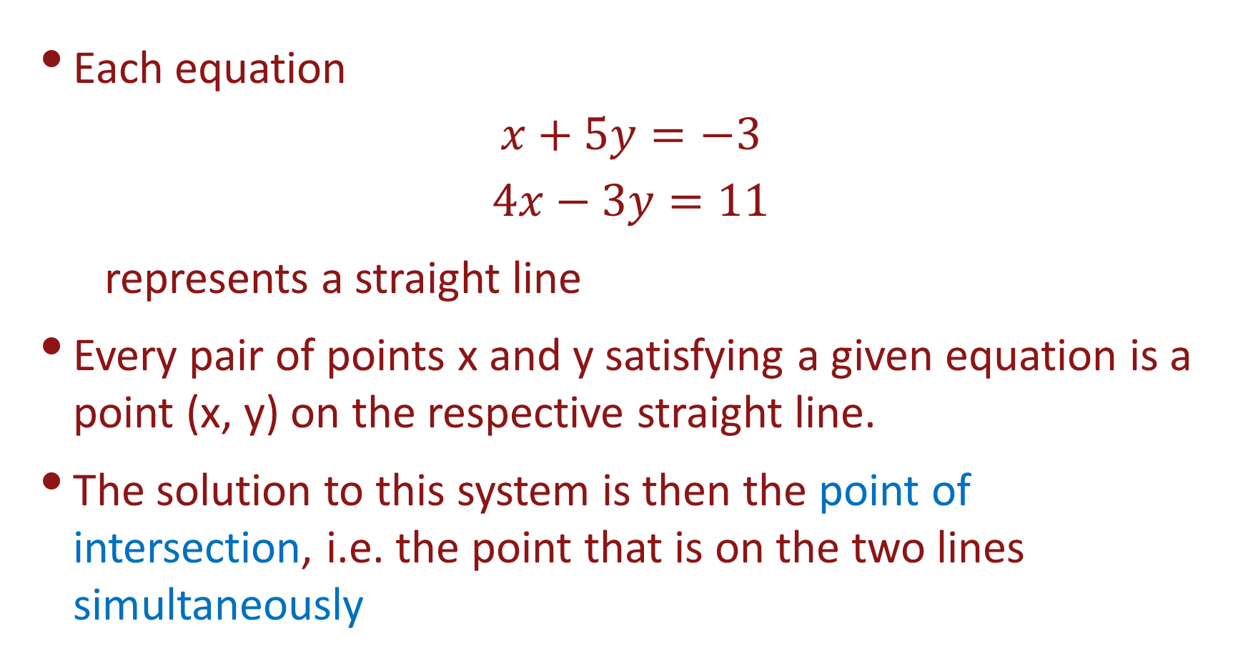
Systems of Linear Equations Geometric Solution
Each equation
$$x+5y=−3$$
$$4x−3y=11$$
represents a straight line
Every pair of points x and y satisfying a given equation is a point (x, y) on the respective straight line.
The solution to this system is then the point of intersection, i.e. the point that is on the two lines simultaneously

Slide 5

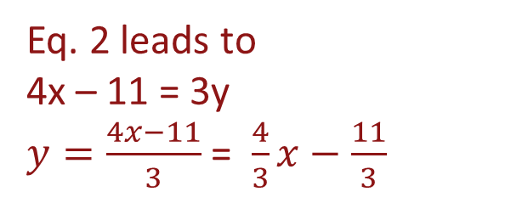
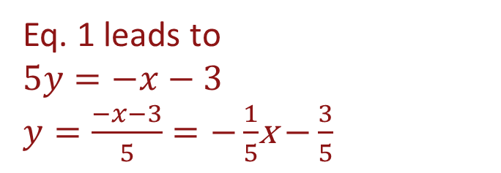
Systems of Linear Equations Geometric Solution
To graph the equations we need to solve for y typically
$$x+5y=−3$$
$$4x−3y=11$$
Eq. 1 leads to
$$5y=−x−3$$
$y=\frac{−x−3}{5}=−\frac{1}{5}$x $−\frac{3}{5}$
Eq. 2 leads to
4x – 11 = 3y
$y=\frac{4x−11}{3}$ = $\frac{4}{3}x−\frac{11}{3}$

Slide 6
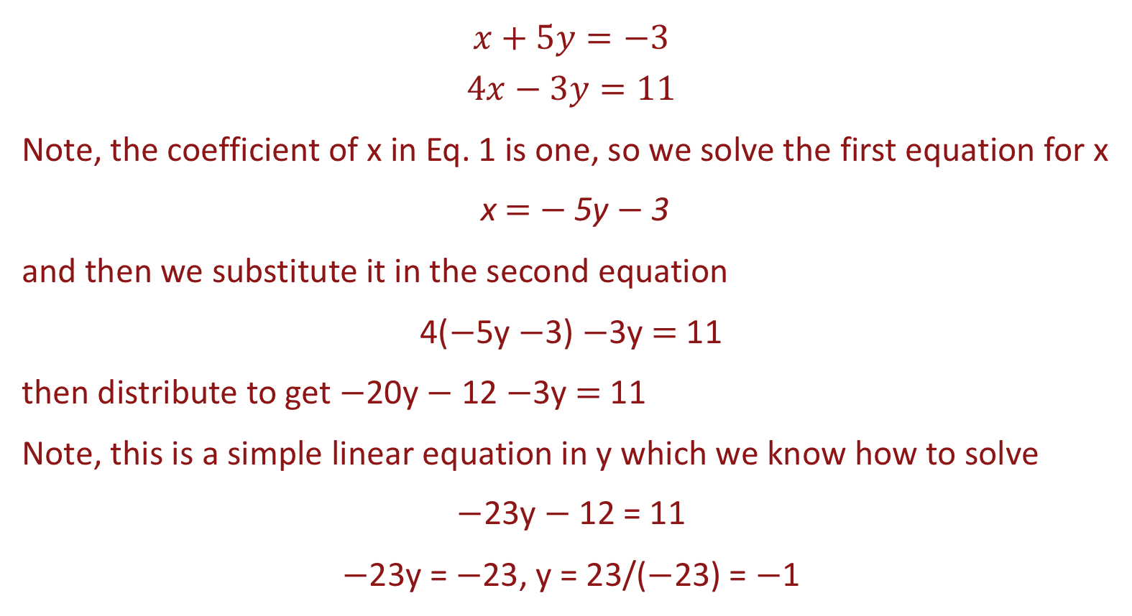
Systems of Linear Equations Method of Substitution
$$x+5y=−3$$
$$4x−3y=11$$
Note, the coefficient of x in Eq. 1 is one, so we solve the first equation for x
x $=$ $−$5y $−$3
and then we substitute it in the second equation
4($−$5y $−$3) $−$3y $=$ 11
then distribute to get $−$20y $−$ 12 $−$3y $=$ 11
Note, this is a simple linear equation in y which we know how to solve
$−$23y $−$ 12 = 11
$−$23y = $−$23, y = 23/($−$23) = $−$1

Slide 7
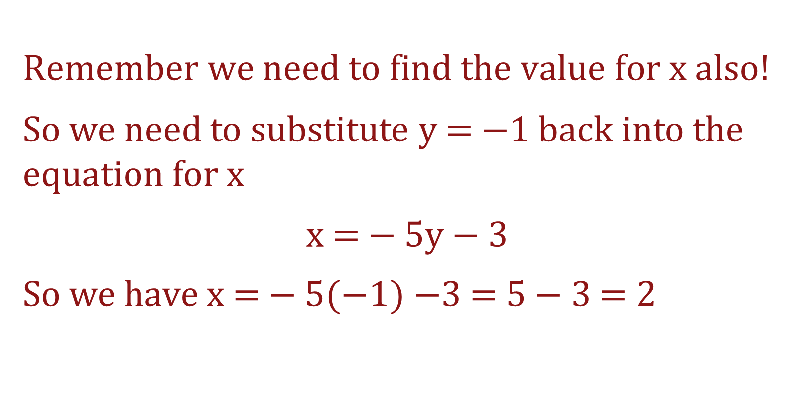
Systems of Linear Equations Method of Substitution
$$Remember we need to find the value for x also!$$
So we need to substitute y = $−$1 back into the equation for x
x $=$ $−$5y $−$3
So we have x $=$ $−$5($−1)−$3 = 5 $−$ 3 = 2

Slide 8
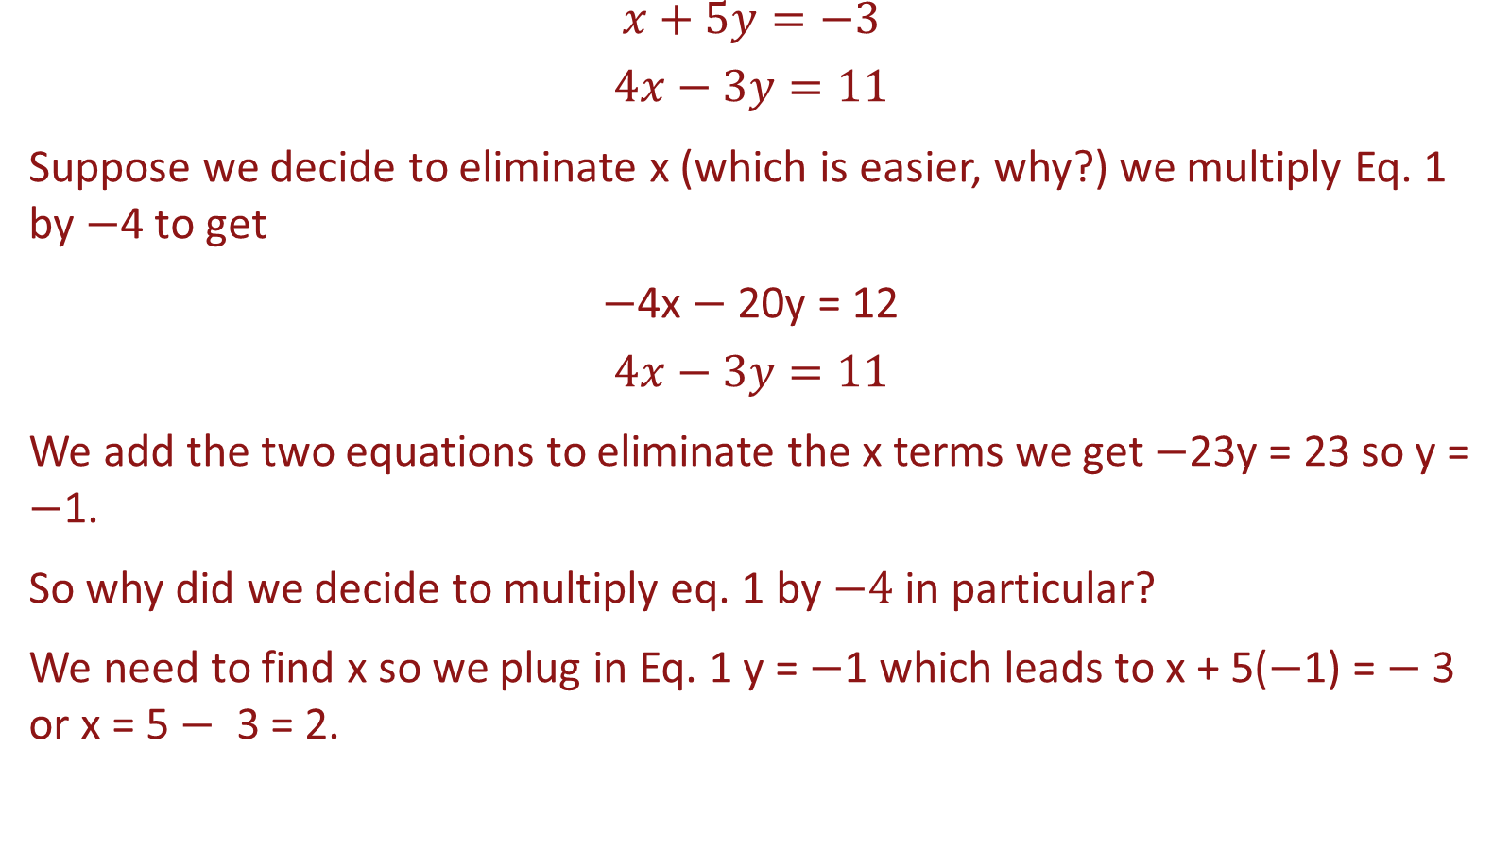
Systems of Linear Equations - Method of Elimination
$$x+5y=−3$$
$$4x−3y=11$$
Suppose we decide to eliminate x (which is easier, why?) we multiply Eq. 1 by $−$4 to get
$−$4x $−$ 20y = 12
$$4x−3y=11$$
We add the two equations to eliminate the x terms we get $−$23y = 23 so y = $−$1.
So why did we decide to multiply eq. 1 by $−4$in particular?
We need to find x so we plug in Eq. 1 y = $−$1 which leads to x + 5($−$1) = $−$3 or x = 5 $−$ 3 = 2.

Slide 9
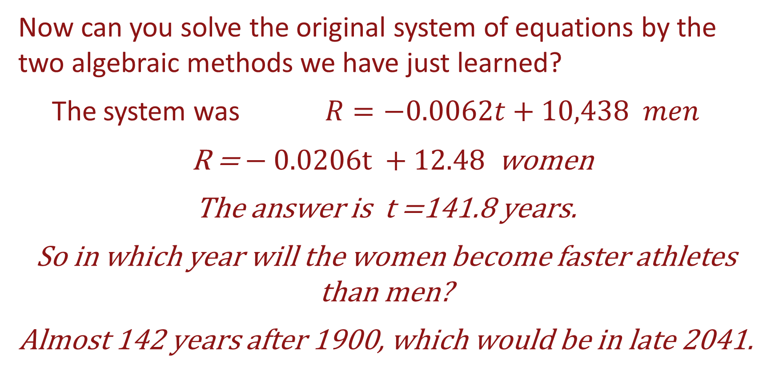
Systems of Linear Equations – Original Example
Now can you solve the original system of equations by the two algebraic methods we have just learned?
The system was $R=−0.0062t+10,438 men$
R = $−$0.0206t $+$ 12.48 women
The answer is t =141.8 years.
So in which year will the women become faster athletes than men?
Almost 142 years after 1900, which would be in late 2041.

Slide 10
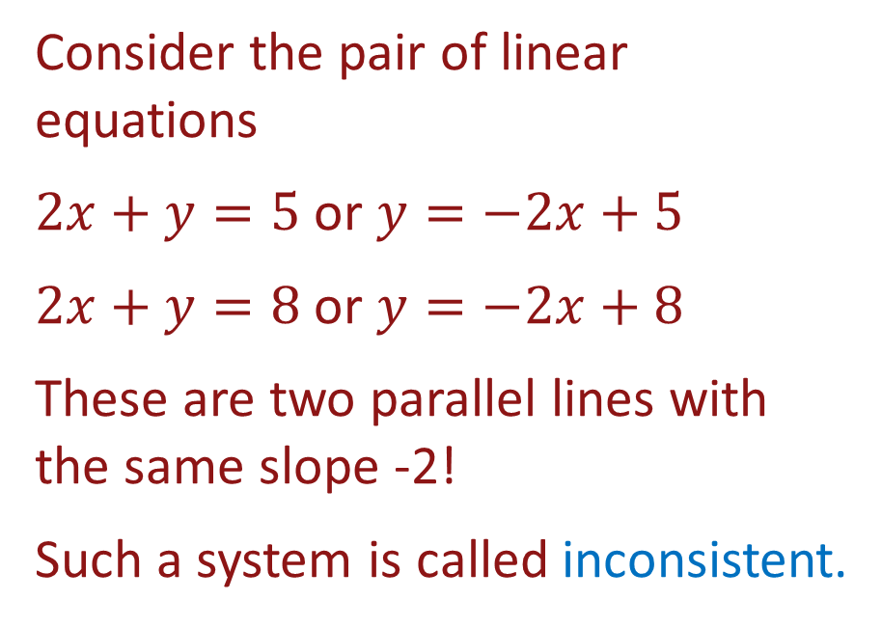
Systems of Linear Equations that have no solution
Consider the pair of linear equations
$2x+y=5$ or $y=−2x+5$
$2x+y=8$ or $y=−2x+8$
These are two parallel lines with the same slope -2!
Such a system is called inconsistent.

Slide 11
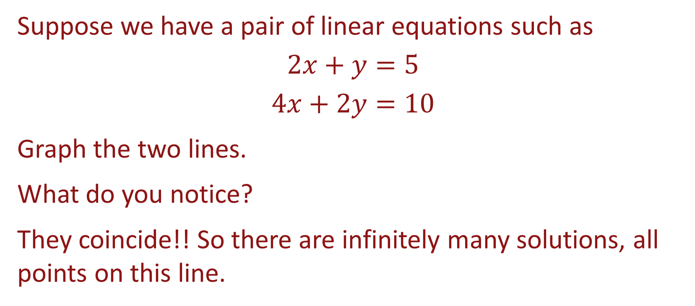
Systems of Linear Equations that have multiple solutions
Suppose we have a pair of linear equations such as
$$2x+y=5$$
$$4x+2y=10$$
Graph the two lines.
What do you notice?
They coincide!! So there are infinitely many solutions, all points on this line.

