Slide 1
2.4 Mathematical Models
All slides in this presentations are based on the book Functions, Data and Models, S.P. Gordon and F. S Gordon ISBN 978-0-88385-767-0

Slide 2
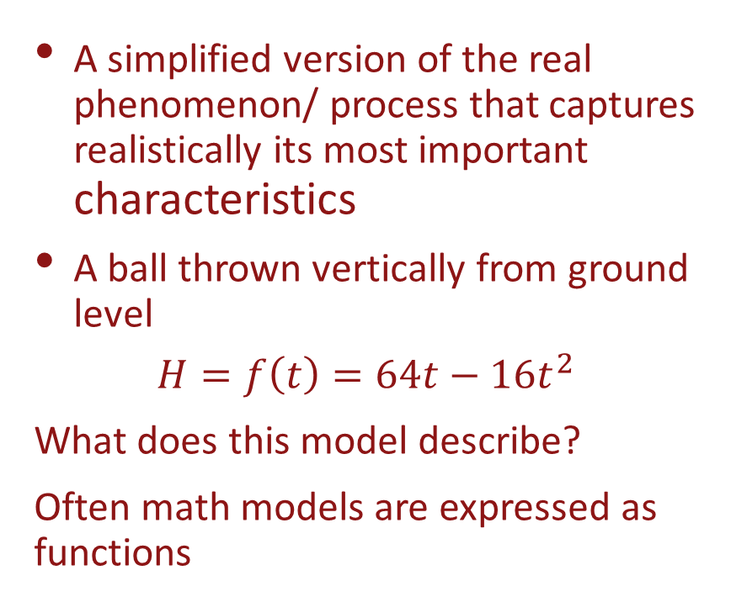
What is a Math Model
A simplified version of the real phenomenon/ process that captures realistically its most important characteristics
A ball thrown vertically from ground level
$$H=f\left(t\right)=64t−16t^{2}$$
What does this model describe?
Often math models are expressed as functions

Slide 3
Avg. daily intake of animal fats and death rates from breast cancer in different countries
D = 0.2F – 1 is the mathematical model of this example
The avg. daily animal fat intake in Mexico is F = 23 grams and that in Denmark is F = 135 grams. What can you say about the death rate in these countries?

Slide 4
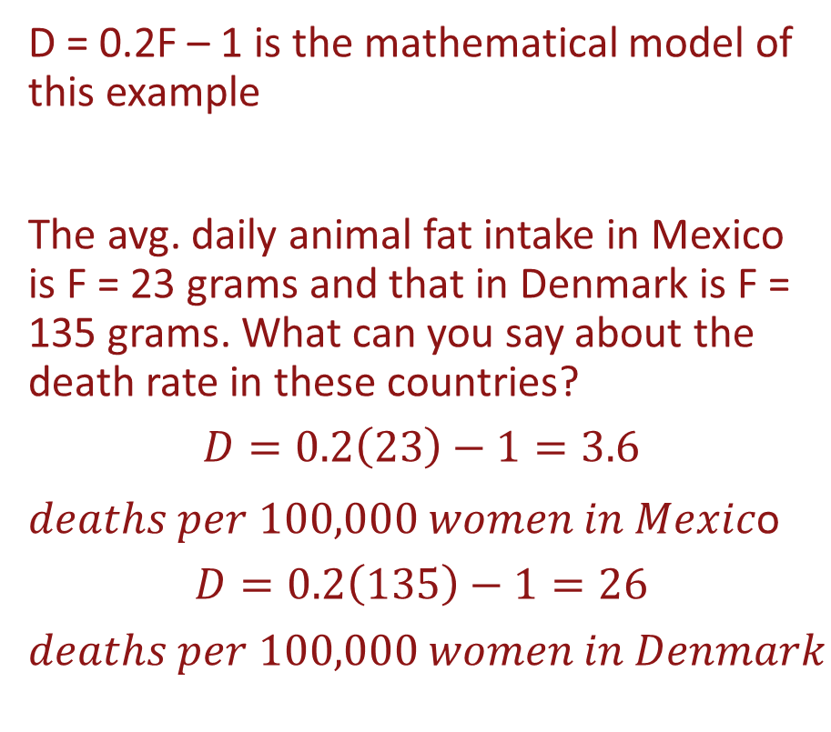
Avg. daily intake of animal fats and death rates from breast cancer in different countries
D = 0.2F – 1 is the mathematical model of this example
The avg. daily animal fat intake in Mexico is F = 23 grams and that in Denmark is F = 135 grams. What can you say about the death rate in these countries?
$$D=0.2\left(23\right)−1=3.6$$
$deaths per 100,000 women in Mexic$o
$$D=0.2\left(135\right)−1=26$$
$$deaths per 100,000 women in Denmark$$

Slide 5
Avg. daily intake of animal fats and death rates from breast cancer in different countries
The prediction in Mexico is called interpolation since 23 is between 20 and 120 (values of F in the data set)
The prediction in Denmark is called extrapolation since 135 is outside of the data range, 20 to 120
It is more realistic to assume that the incidence of breast cancer depends on many other factors in combination with animal fat intake.
This leads to a function of several variables – outside the scope of our course.

Slide 6
Snowy Tree Cricket in Colorado Rockies
Data relating cricket’s rate of chirping, in chirps per minute, and air temperature in degrees Fahrenheit.
Which is the dependent variable? Which is the independent one?

Slide 7
Snowy Tree Cricket in Colorado Rockies
Data relating cricket’s rate of chirping, in chirps per minute, and air temperature in degrees Fahrenheit.
Which is the dependent variable? Which is the independent one?
R is the dependent variable
T is the independent variable
Want to visualize the data. Use it to predict R when the temperature is 82 degrees.

Slide 8
Graph of the model; Formula

Slide 9
Cricket chirps continued
Every 5 degrees increase in the temperature lead to an increase of 20 chirps per minute
A 1 degree increase in temperature would lead to an increase of how many chirps per minute?
We see that R(80)=160 so at 82 degrees there is an increase of 2 degrees or 2(4)=8 chirps per minute; therefore R(82)=160 + 8=168

Slide 10
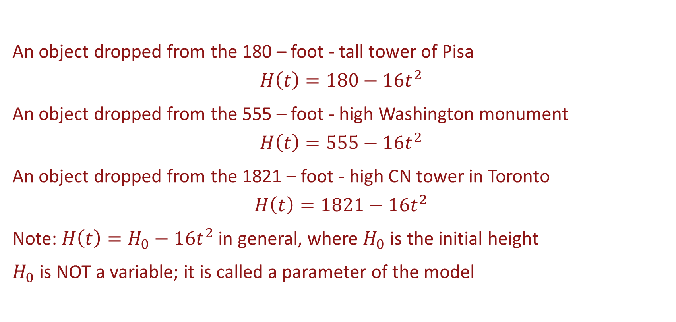
Parameters and Mathematical Models
An object dropped from the 180 – foot - tall tower of Pisa
$$H\left(t\right)=180−16t^{2}$$
An object dropped from the 555 – foot - high Washington monument
$$H\left(t\right)=555−16t^{2}$$
An object dropped from the 1821 – foot - high CN tower in Toronto
$$H\left(t\right)=1821−16t^{2}$$
Note: $H\left(t\right)=H_{0}−16t^{2}$ in general, where $H_{0}$ is the initial height
$H_{0}$ is NOT a variable; it is called a parameter of the model

Slide 11
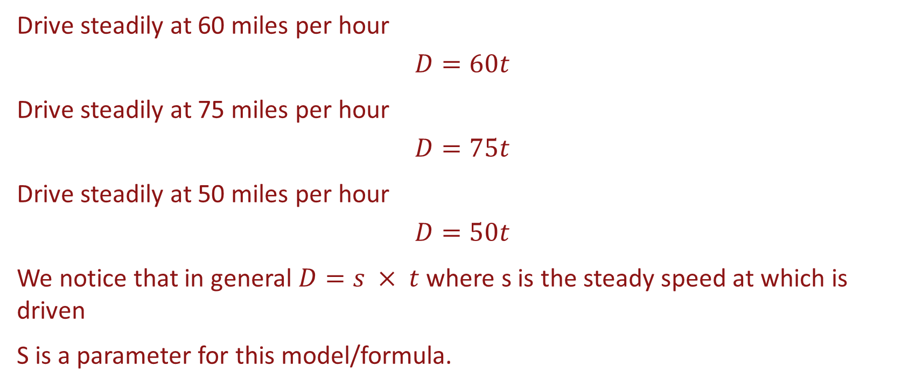
Example 2 - Parameters
Drive steadily at 60 miles per hour
$$D=60t$$
Drive steadily at 75 miles per hour
$$D=75t$$
Drive steadily at 50 miles per hour
$$D=50t$$
We notice that in general $D=s × t$ where s is the steady speed at which is driven
S is a parameter for this model/formula.

