Slide 1
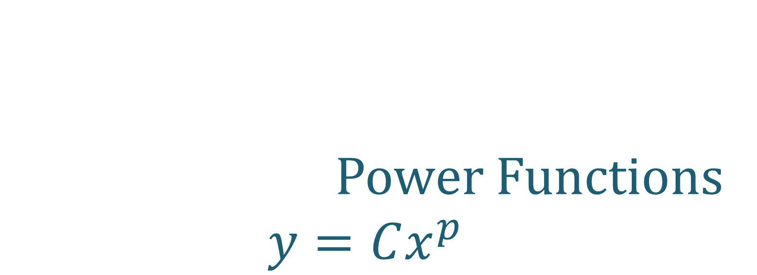
Power Functions $$y=Cx^{p}$$
All slides in this presentations are based on the book Functions, Data and Models, S.P. Gordon and F. S Gordon ISBN 978-0-88385-767-0

Slide 2
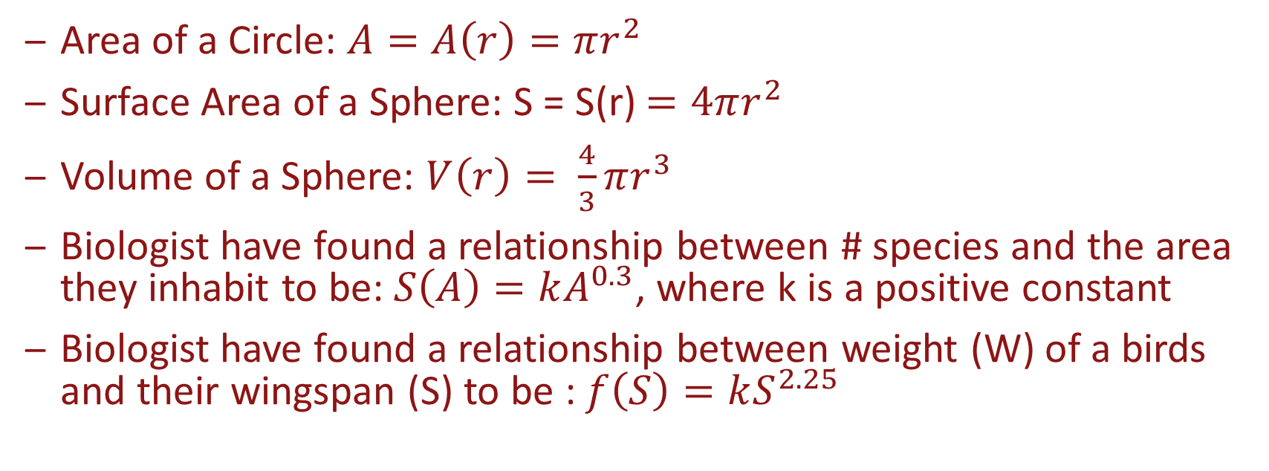
Examples of Power Functions
Area of a Circle: $A=A\left(r\right)=πr^{2}$
Surface Area of a Sphere: S = S(r) $=4πr^{2}$
Volume of a Sphere: $V\left(r\right)= \frac{4}{3}πr^{3}$
Biologist have found a relationship between # species and the area they inhabit to be: $S\left(A\right)=kA^{0.3}$, where k is a positive constant
Biologist have found a relationship between weight (W) of a birds and their wingspan (S) to be : $f\left(S\right)=kS^{2.25}$
All these functions fit the form: $f\left(x\right)=Cx^{p}$

Slide 3
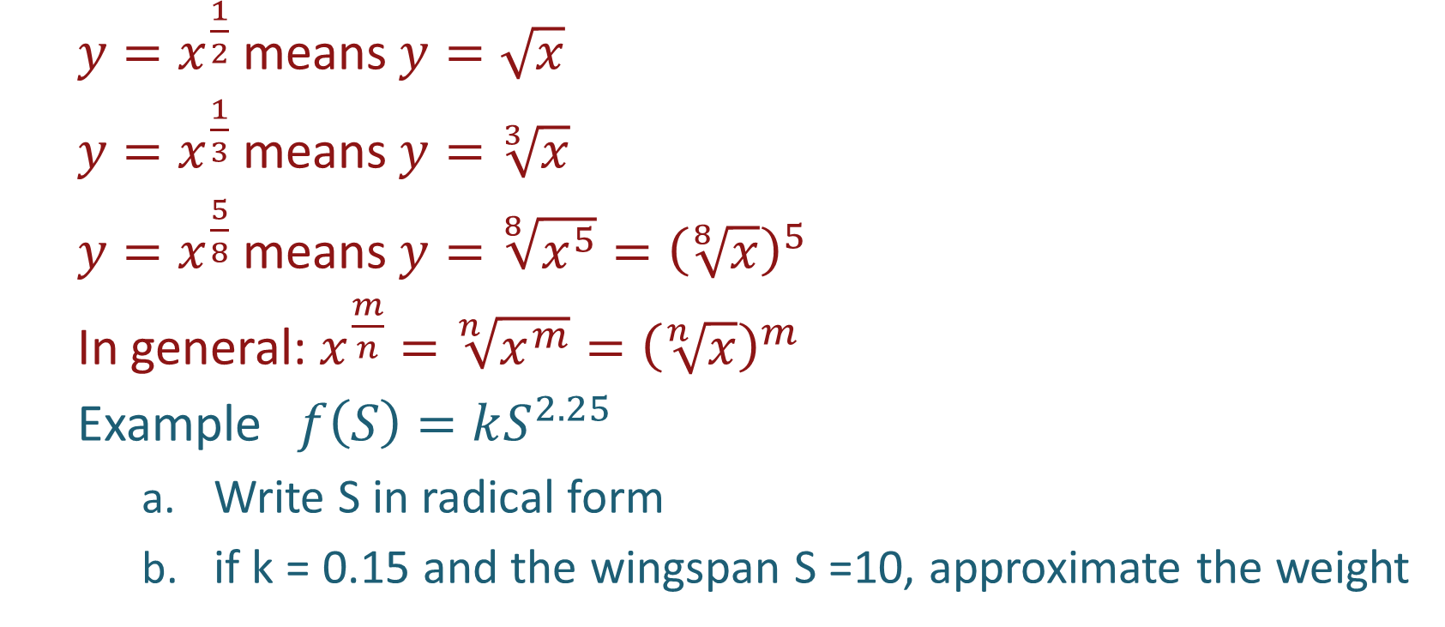
Algebra Review
$y=x^{\frac{1}{2}}$ means $y=\sqrt{x}$
$y=x^{\frac{1}{3}}$ means $y=\sqrt[3]{x}$
$y=x^{\frac{5}{8}}$ means $y=\sqrt[8]{x^{5}}={\left(\sqrt[8]{x}\right)}^{5}$
In general: $x^{\frac{m}{n}}=\sqrt[n]{x^{m}}={\left(\sqrt[n]{x}\right)}^{m}$
Example $f\left(S\right)=kS^{2.25}$
Write S in radical form
if k = 0.15 and the wingspan S =10, approximate the weight

Slide 4
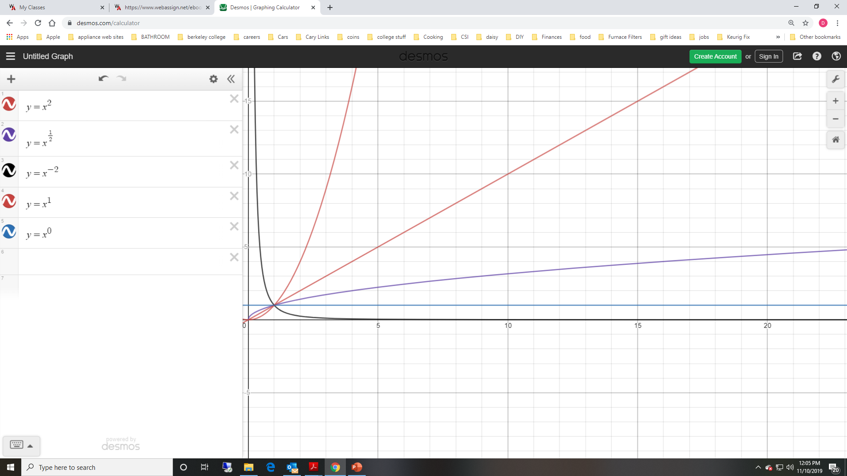
Behavior of Power Function for x > 0
a
c
a
b
d
c
d
Special cases when p =1 and p = 0
b
e
e

Slide 5
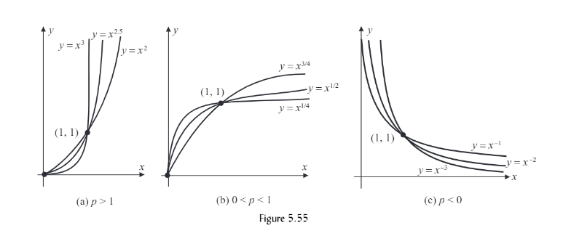

Summary of Power Function for x $≥$ 0

Slide 6
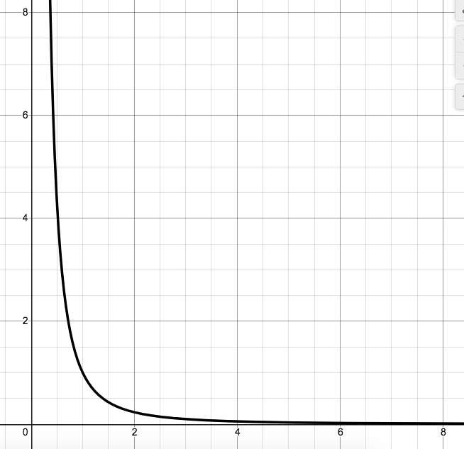
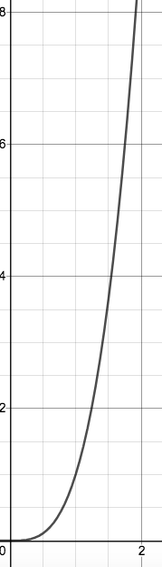
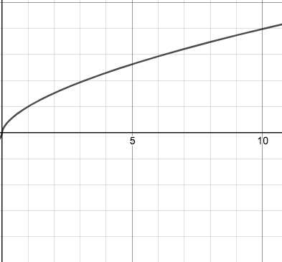

Example

Slide 7
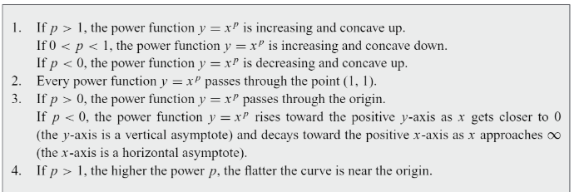

Facts for Power Function for x $≥$ 0

Slide 8
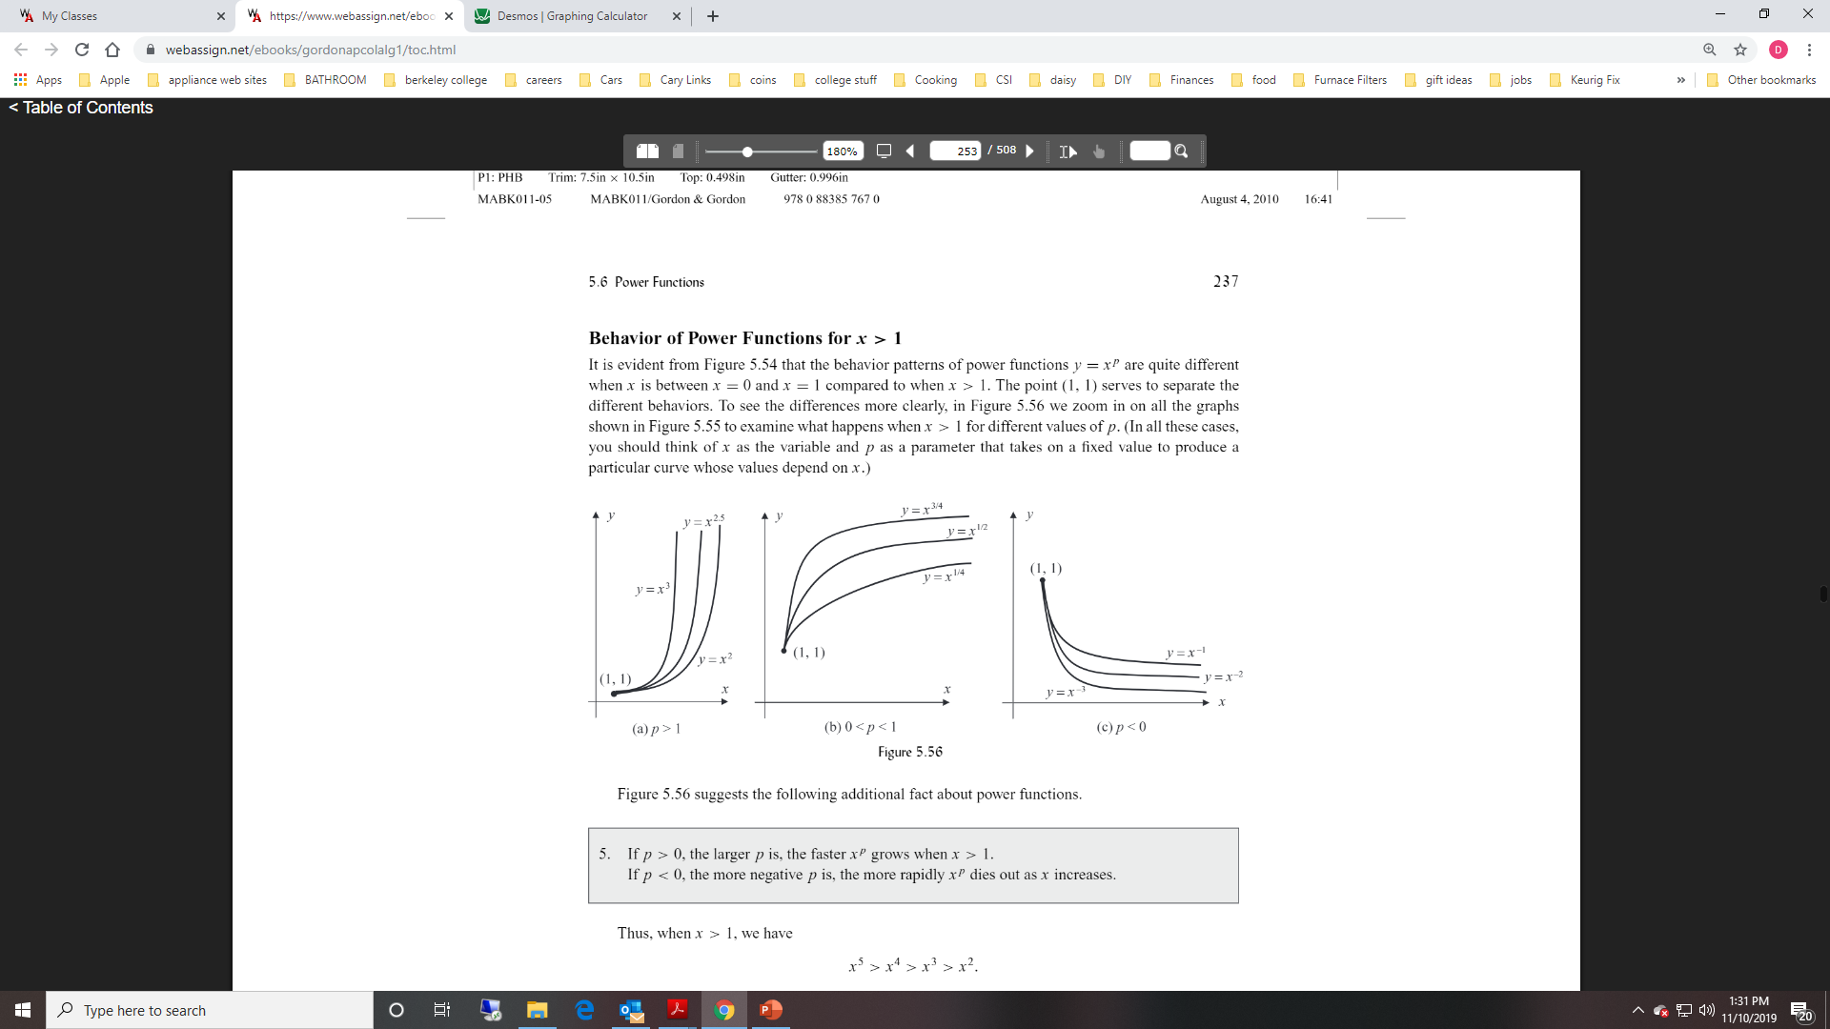

Behavior of Power Function for x $>$ 1

Slide 9
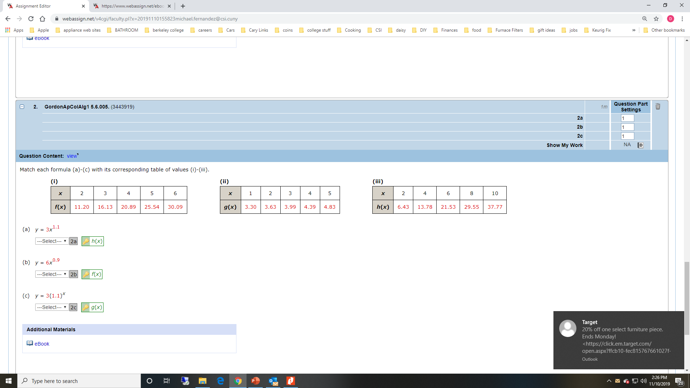
Behavior of Power Function for x $>$ 1

Slide 10
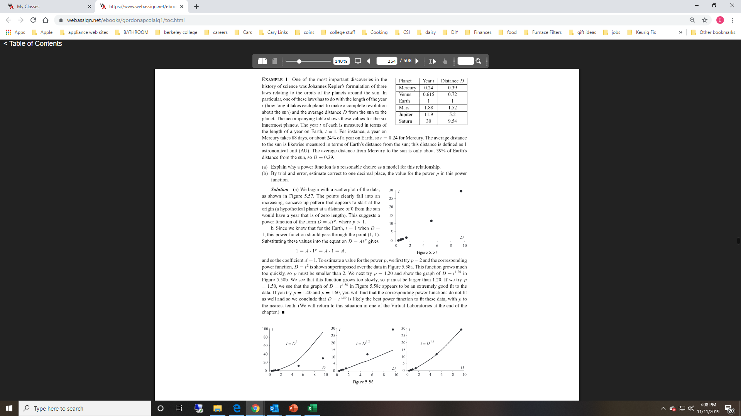
Example
Planet | Distance (D) | Year (t)
Mercury | 0.39 | 0.24
Venus | 0.72 | 0.615
Earth | 1 | 1
Mars | 1.52 | 1.88
Saturn | 5.2 | 11.9
Jupiter | 9.54 | 30
Explain why a power function is a reasonable choice as a model for this relationship.

Slide 11
Example
Explain why a power function is a reasonable choice as a model for this relationship.
Scatterplot suggests that data fits a power function.
Curve passes through point (1, 1)

Slide 12
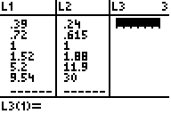
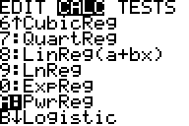
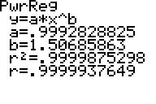
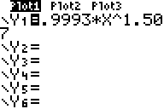
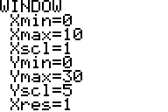
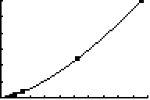
Example Continued
Using your calculator, create a power model to predict t.
STAT
EDIT
STAT
CALC
A
Y=
WINDOW
WHY THESE VALUES FOR X AND Y?
GRAPH

Slide 13
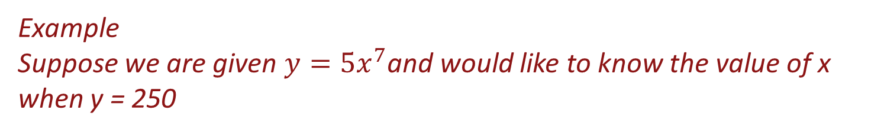

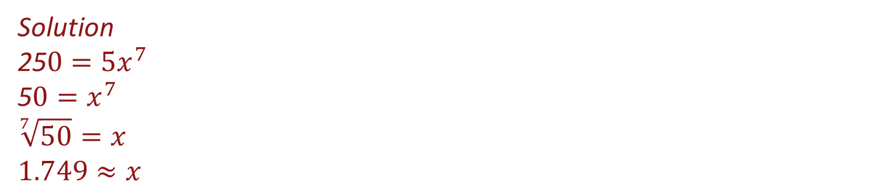
Applications of Power Models
Form of Model: $y=Ax^{P}$
Example
Suppose we are given $y=5x^{7}$and would like to know the value of x when y = 250
Solution
25$0=5x^{7}$
5$0=x^{7}$
$$\sqrt[7]{50}=x$$
$$1.749≈x$$

Slide 14
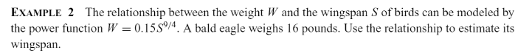
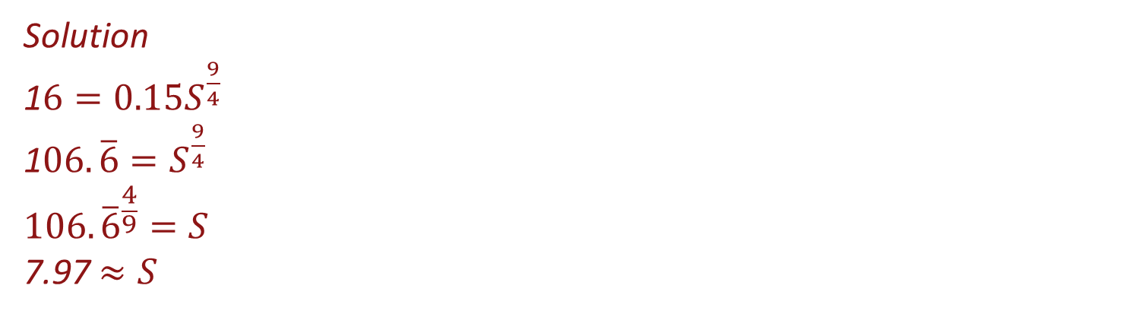
Example
Solution
1$6=0.15S^{\frac{9}{4}}$
1$06.\overline{6}=S^{\frac{9}{4}}$
$${106.\overline{6}}^{\frac{4}{9}}=S$$
7.97 $≈S$
The wingspan is approximately 8 feet.

Slide 15
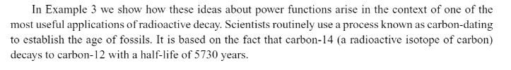
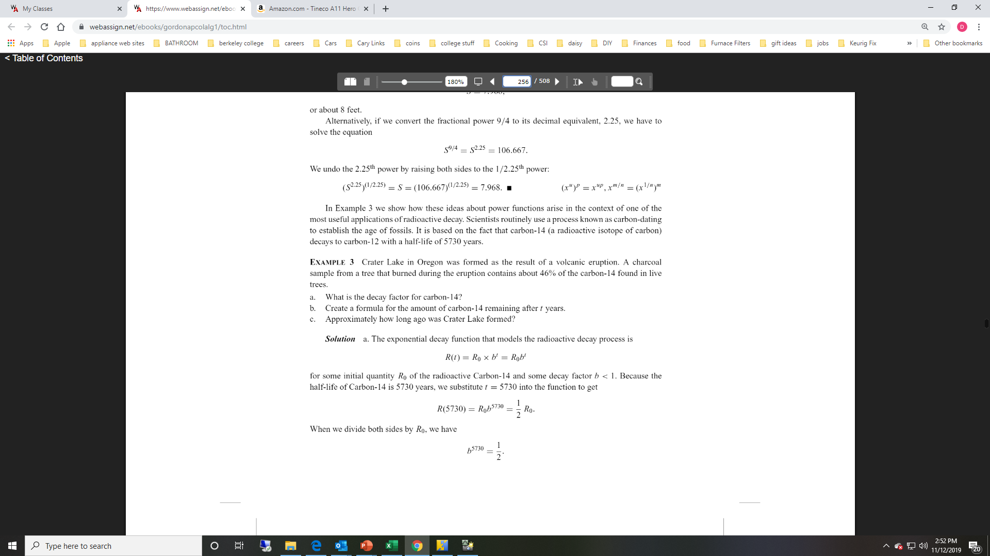
Example

Slide 16

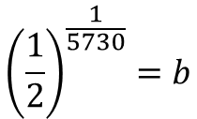



Example Continued
$$R\left(t\right)=R_{0}b^{t}$$
$$\frac{1}{2}R_{0}=R_{0}b^{5730}$$
$$\frac{1}{2}=b^{5730}$$
$${\left(\frac{1}{2}\right)}^{\frac{1}{5730}}=b$$
$$0.99988≈b$$

Slide 17









Example Continued
$$R\left(t\right)=R_{0}b^{t}$$
$$R\left(t\right)=R_{0}{(0.99988)}^{t}$$
$$R\left(t\right)=R_{0}{(0.99988)}^{t}$$
0$.46R_{0}=R_{0}{(0.99988)}^{t}$
$$0.46={(0.99988)}^{t}$$
$$log⁡(0.46)={log(0.99988)}^{t}$$
$$log⁡(0.46)=t∙log⁡(0.99988)$$
$$\frac{log⁡(0.46)}{log⁡(0.99988)}=t$$
$$6470.7=t$$

Slide 18
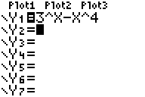
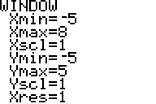
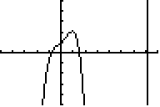
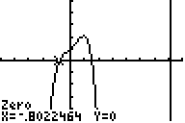
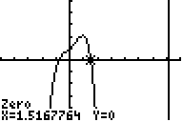
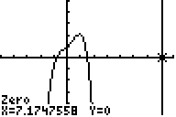
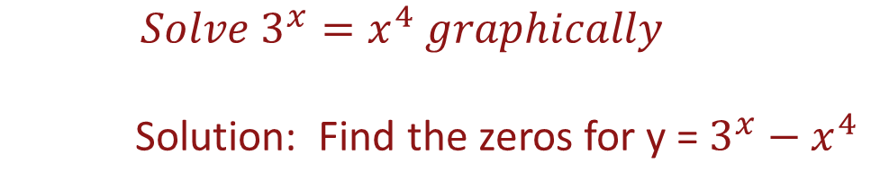
Example
$$Solve 3^{x}=x^{4} graphically$$
Solution: Find the zeros for y = $3^{x}−x^{4}$
Y=
WINDOW
GRAPH
2nd
CALC
2
2nd
CALC
2
2nd
CALC
2

Slide 19
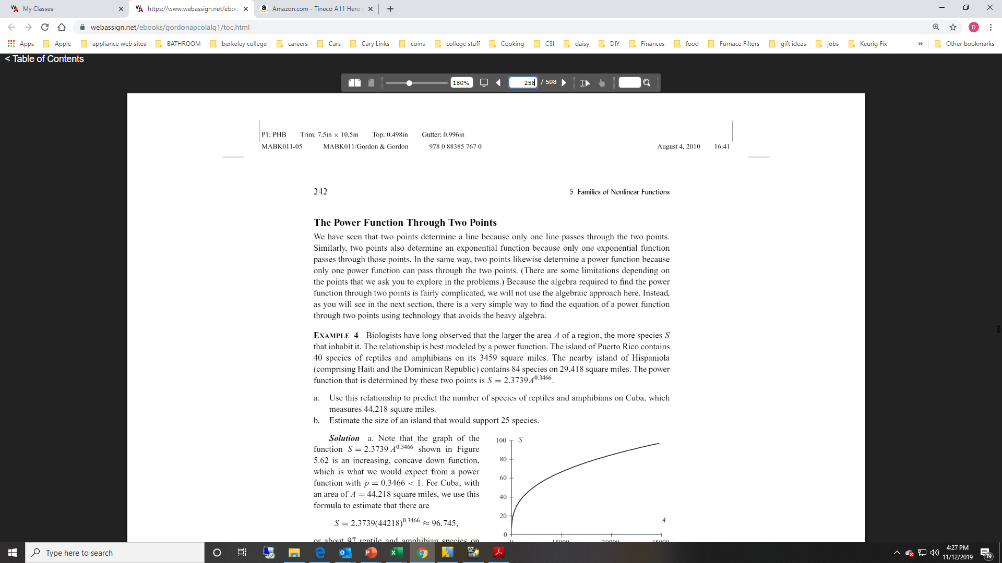
Power Function Through Two Points

Slide 20



Power Function Through Two Points
$$S=2.3739∙A^{0.3466}$$
$$S=2.3739∙{44,218}^{0.3466}$$
$$S=96.7$$
The best estimate would be 97 species of reptiles and amphibians

Slide 21



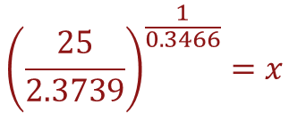
Power Function Through Two Points
$$25=2.3739∙A^{0.3466}$$
$$\frac{25}{2.3739}=x^{0.3466}$$
$${\left(\frac{25}{2.3739}\right)}^{\frac{1}{0.3466}}=x$$
$$891.3=x$$
An area of approximately 891 square miles would support 25 species.

