Slide 1
Polynomial Functions
All slides in this presentations are based on the book Functions, Data and Models, S.P. Gordon and F. S Gordon ISBN 978-0-88385-767-0

Slide 2
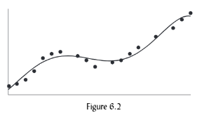
Introduction to Polynomial functions
We have studied
Linear Functions
Exponential Functions
Power Functions
Logarithmic Functions
But none of these functions have the type of behavior pattern shown in figure 6.2
Some behavior patterns for figure 6.2
Function increase and decreases
Multiple turning points
Multiple inflection points

Slide 3
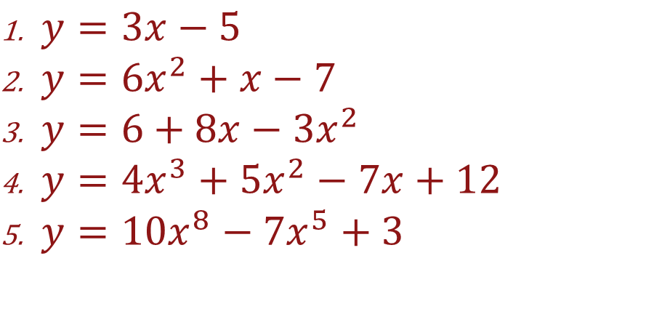
Examples of Polynomial functions
Polynomial functions can change both their direction and concavity. Specifically a polynomial is any finite sum of power functions with nonnegative integer powers. Here are some examples:
$y=3x−5$
$y=6x^{2}+x−7$
$y=6+8x−3x^{2}$
$y=4x^{3}+5x^{2}−7x+12$
$y=10x^{8}−7x^{5}+3$

Slide 4
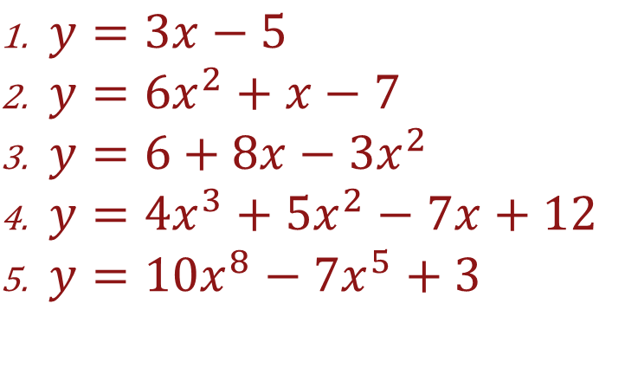
Polynomial Functions: Degree of Polynomial
Degree of Polynomial – Highest power of the variable present. See the example to the right
Degree equals 1
Degree equals 2
Degree equals 2
Degree equals 3
Degree equals 8
Example
$y=3x−5$
$y=6x^{2}+x−7$
$y=6+8x−3x^{2}$
$y=4x^{3}+5x^{2}−7x+12$
$y=10x^{8}−7x^{5}+3$

Slide 5
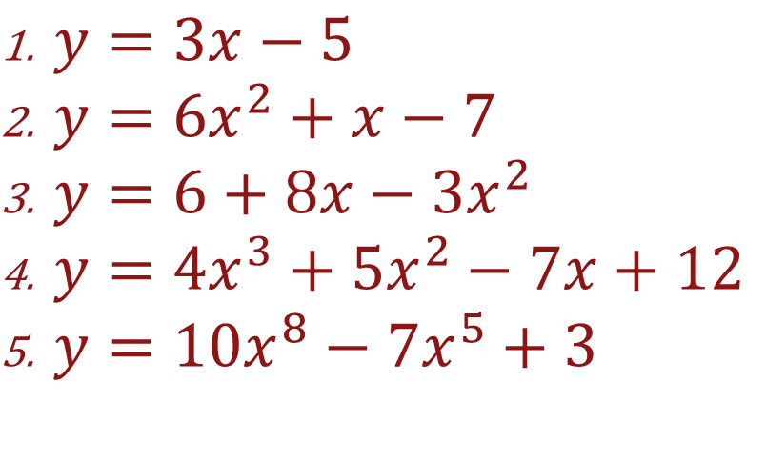
Polynomial Functions: Coefficients
Coefficients – The numbers that multiply each power term in the polynomial.
Coefficients are: 3, -5
Coefficients are 6, 1, -7
Example
$y=3x−5$
$y=6x^{2}+x−7$
$y=6+8x−3x^{2}$
$y=4x^{3}+5x^{2}−7x+12$
$y=10x^{8}−7x^{5}+3$

Slide 6
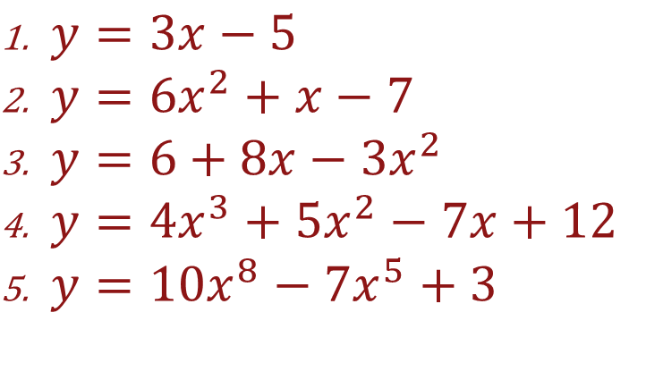
Polynomial Functions: Terminology
Example
Leading Coefficient – Coefficient of the highest power term.
Leading Coefficients = 3
Leading Coefficients = 6
Leading Coefficients = -3
Leading Coefficients = 4
Leading Coefficients = 10
$y=3x−5$
$y=6x^{2}+x−7$
$y=6+8x−3x^{2}$
$y=4x^{3}+5x^{2}−7x+12$
$y=10x^{8}−7x^{5}+3$

Slide 7
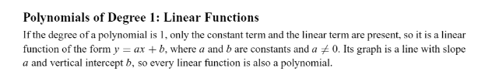
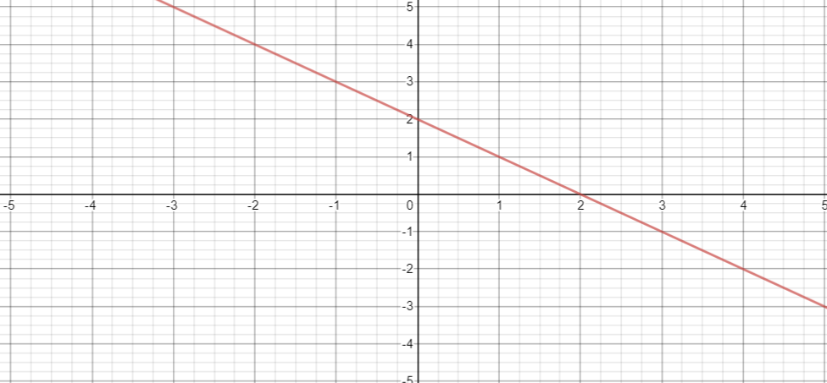
Polynomials of Degree 1
Y = -x + 2
Run = 1
b = 2
Rise = -1

Slide 8
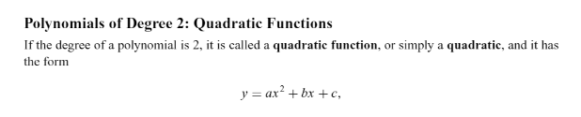
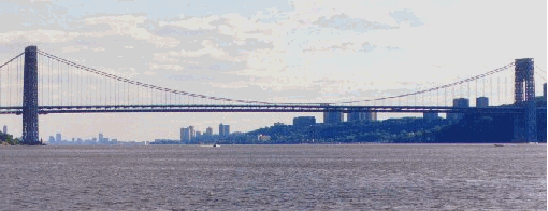
Polynomials of Degree 2

Slide 9
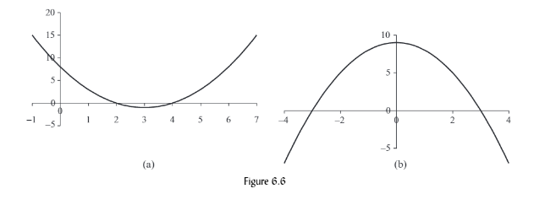


Parabola
The graph of any quadratic function is called a parabola
Figure 6.6 shows the graphs of two parabolas
$$y=x^{2}−6x+8$$
$$y=9−x^{2}$$

Slide 10
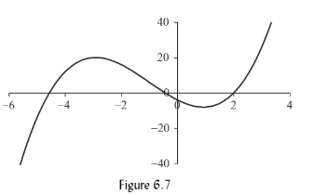
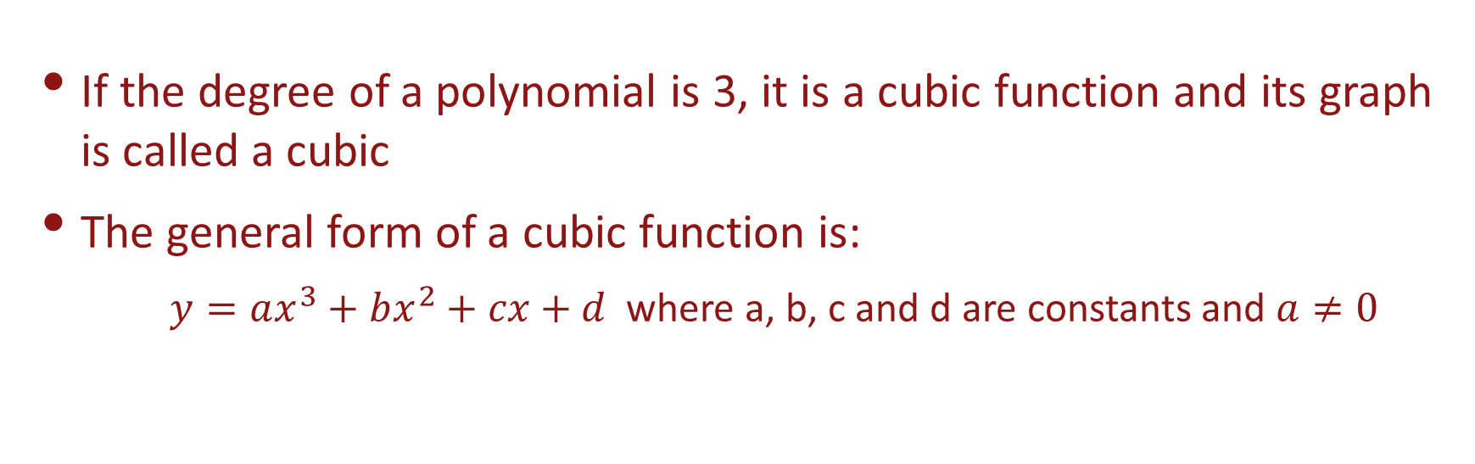
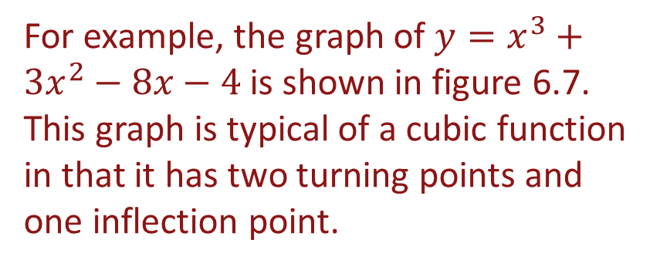
Polynomials of Degree 3
If the degree of a polynomial is 3, it is a cubic function and its graph is called a cubic
The general form of a cubic function is:
$y=ax^{3}+bx^{2}+cx+d$ where a, b, c and d are constants and $a≠0$
For example, the graph of $y=x^{3}+3x^{2}−8x−4$ is shown in figure 6.7. This graph is typical of a cubic function in that it has two turning points and one inflection point.
Note: A cubic function has either 0 turning points or two turning points and always has 1 point of inflection

Slide 11
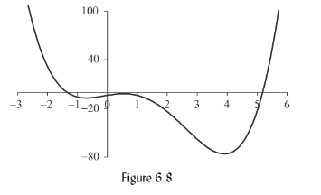
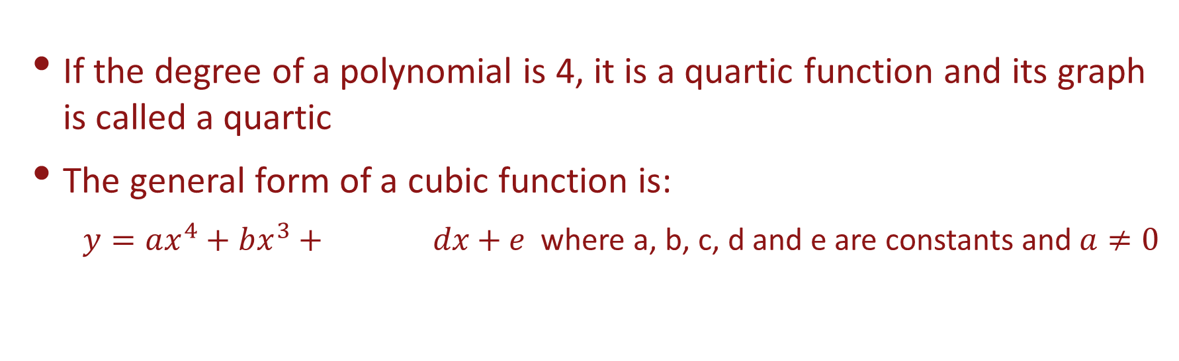

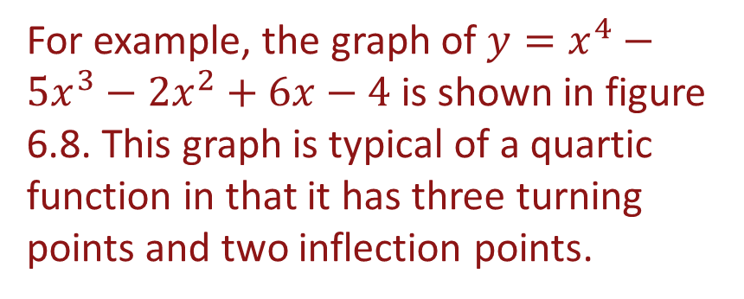
Polynomials of Degree 4
If the degree of a polynomial is 4, it is a quartic function and its graph is called a quartic
The general form of a cubic function is:
$y=ax^{4}+bx^{3}+ dx+e$ where a, b, c, d and e are constants and $a≠0$
$cx^{2}$ $+$
For example, the graph of $y=x^{4}−5x^{3}−2x^{2}+6x−4$ is shown in figure 6.8. This graph is typical of a quartic function in that it has three turning points and two inflection points.
Note: A quartic function has either 1 turning points or three turning points

Slide 12
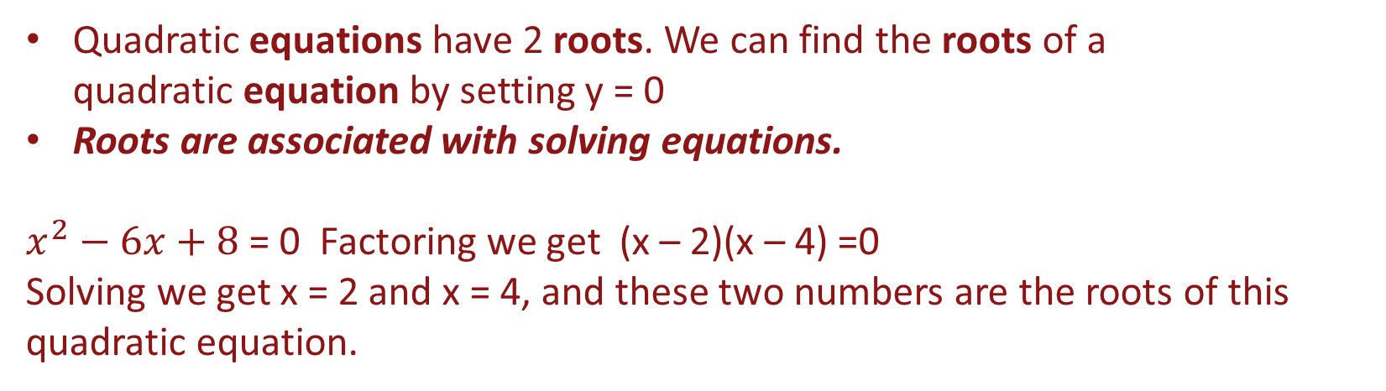
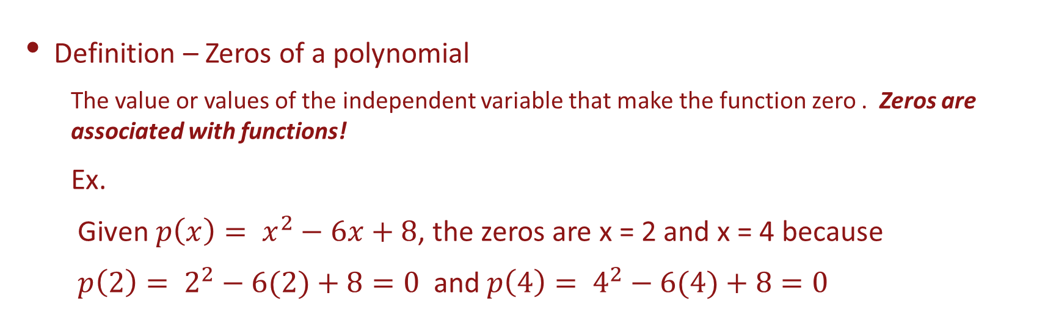
Zeros and Roots of a Polynomial
Definition – Zeros of a polynomial
The value or values of the independent variable that make the function zero . Zeros are associated with functions!
Ex.
Given $p\left(x\right)= x^{2}−6x+8$, the zeros are x = 2 and x = 4 because
$p\left(2\right)= 2^{2}−6(2)+8=0$ and $p\left(4\right)= 4^{2}−6(4)+8=0$
Quadratic equations have 2 roots. We can find the roots of a quadratic equation by setting y = 0
Roots are associated with solving equations.
$x^{2}−6x+8$ = 0 Factoring we get (x – 2)(x – 4) =0
Solving we get x = 2 and x = 4, and these two numbers are the roots of this quadratic equation.

Slide 13
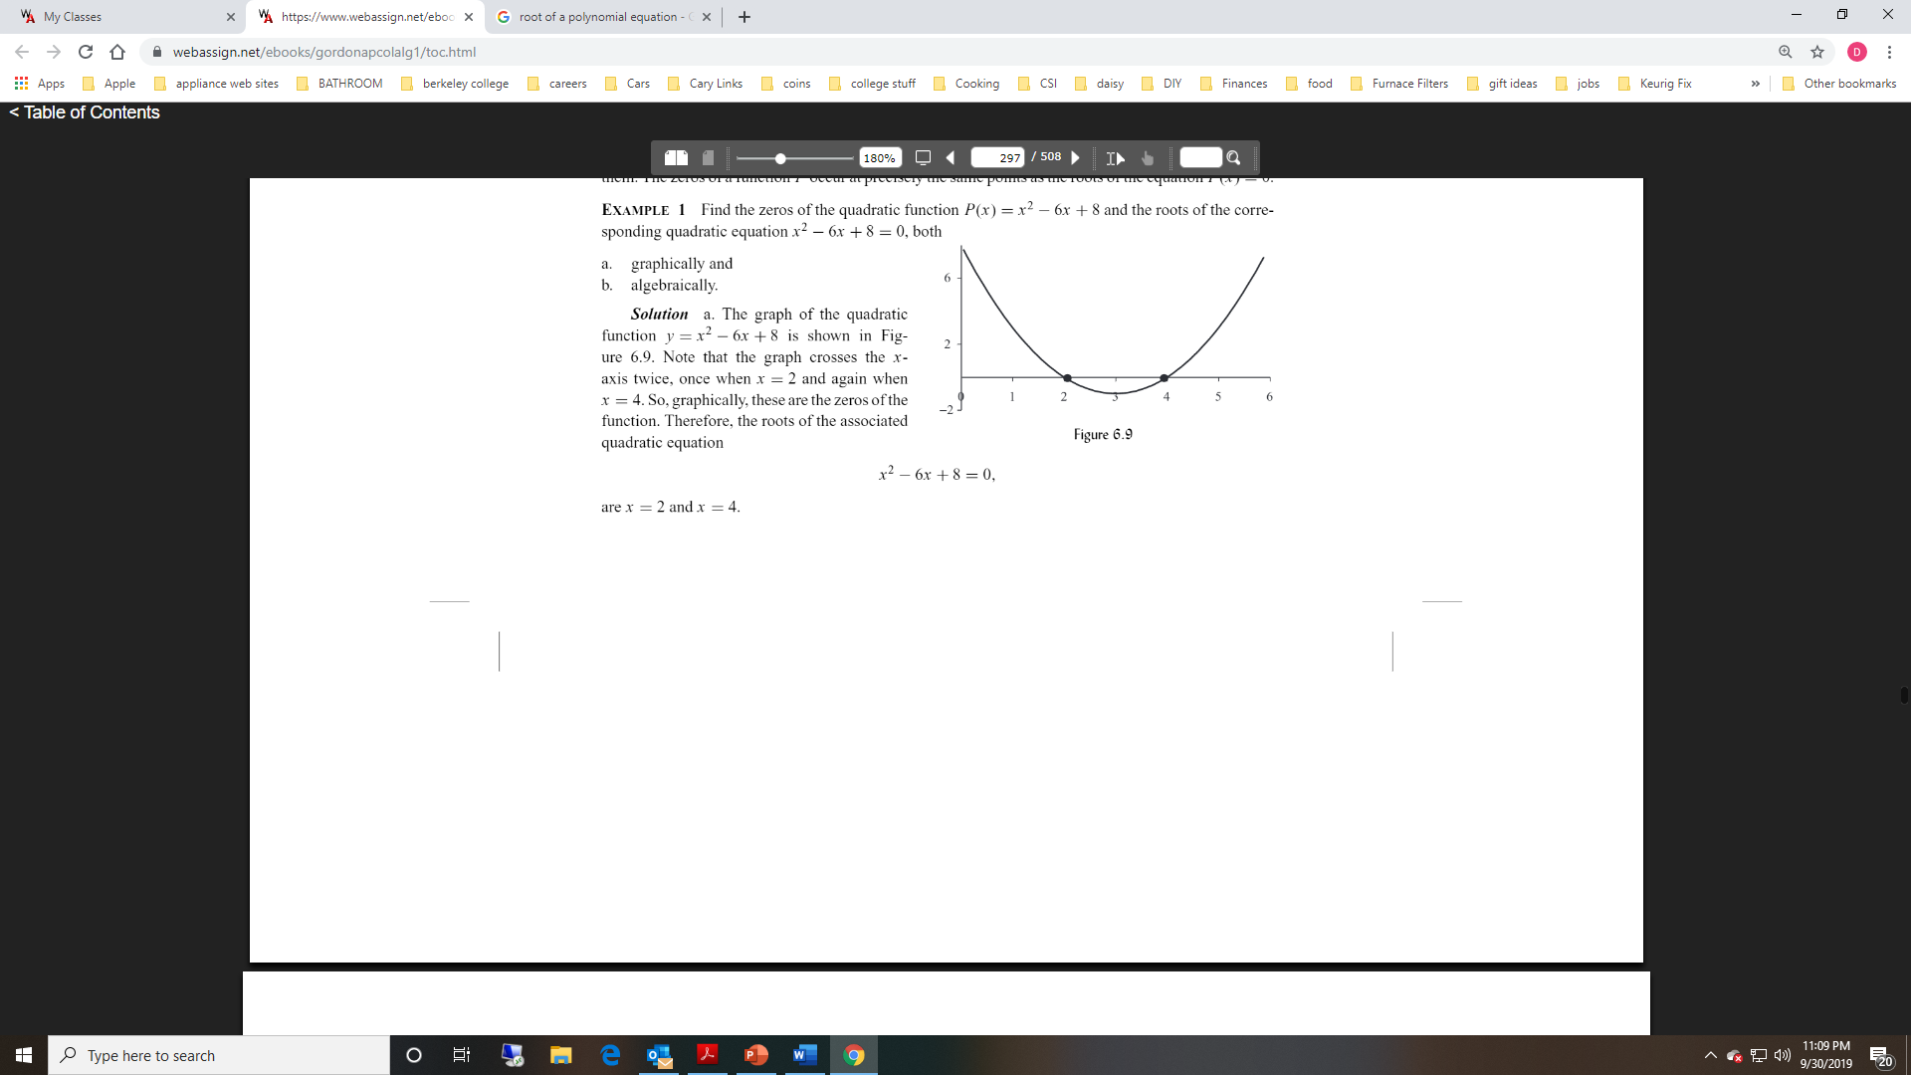
Example

Slide 14
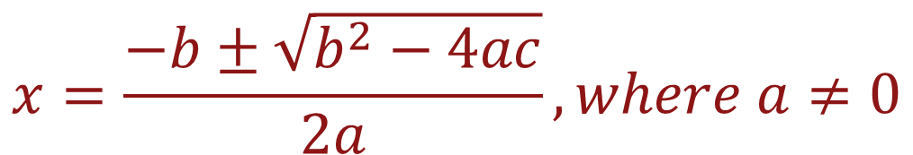
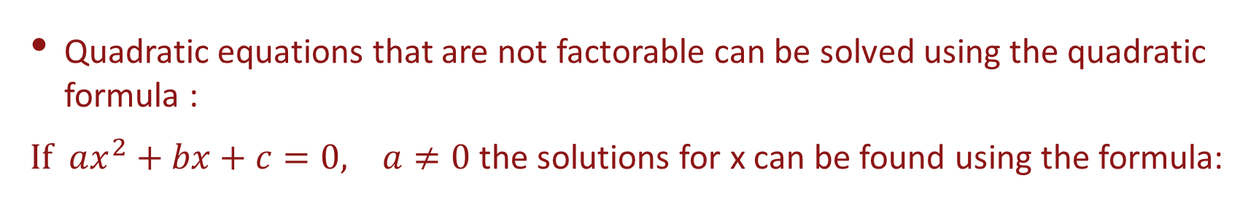
Quadratic Formula
Quadratic equations that are not factorable can be solved using the quadratic formula :
$If ax^{2}+bx+c=0, a≠0$ the solutions for x can be found using the formula:
$$x=\frac{−b±\sqrt{b^{2}−4ac}}{2a}, where a≠0$$

Slide 15
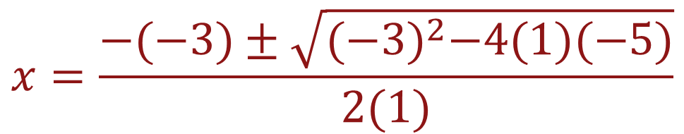
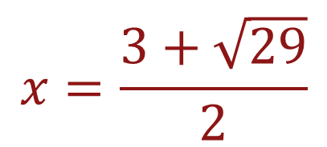
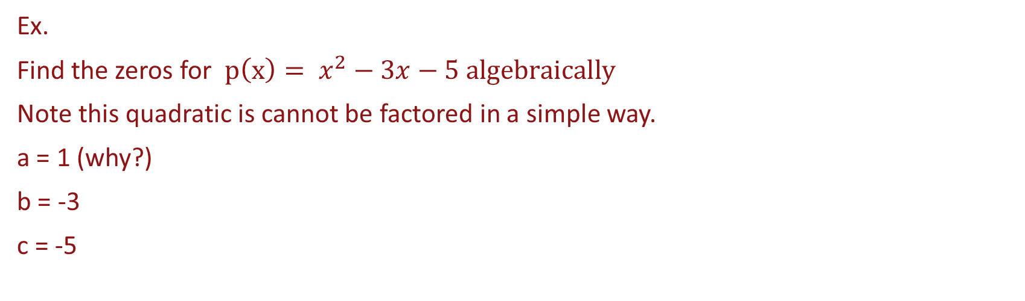
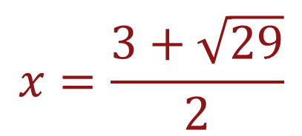
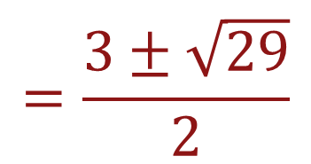
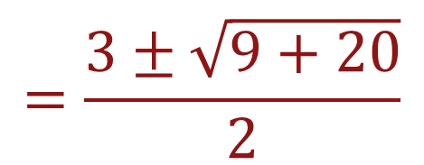
Quadratic Formula Example
Ex.
Find the zeros for $p\left(x\right)= x^{2}−3x−5 algebraically$
Note this quadratic is cannot be factored in a simple way.
a = 1 (why?)
b = -3
c = -5
$$x=\frac{−(−3)±\sqrt{{(−3)}^{2}−4(1)(−5)}}{2(1)}$$
$$=\frac{3±\sqrt{9+20}}{2}$$
$$x=\frac{3+\sqrt{29}}{2}$$
$$x=\frac{3+\sqrt{29}}{2}$$
$$=\frac{3±\sqrt{29}}{2}$$

Slide 16
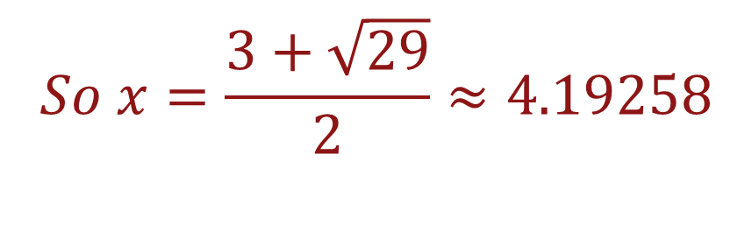
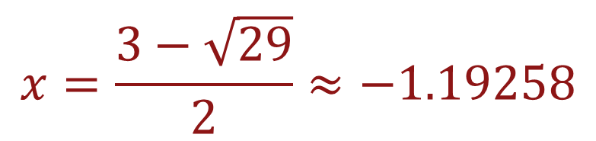
Quadratic Formula Example
$$So x=\frac{3+\sqrt{29}}{2}≈4.19258$$
and
$$x=\frac{3−\sqrt{29}}{2}≈−1.19258$$

Slide 17
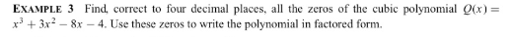
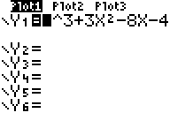
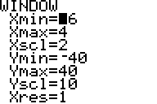
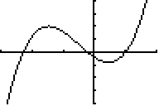
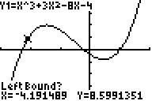
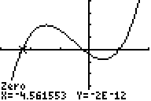
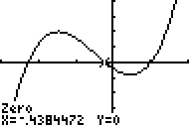
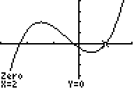
Solving Polynomial Equations Graphically
[ Y = ]
[WINDOWS]
[GRAPH]
[2ND] [CALC] [2]
1st zero = -4.5616
2nd zero = -0.4384
3rd zero = 2

Slide 18

Solving Polynomial Equations Graphically
We found all the zeros for
We will now use the zeros to factor the polynomial.
$$Q\left(x\right)=x^{3}−8x−4$$
(see below)
1st zero = -4.5616
2nd zero = -0.4384
3rd zero = 2
$$Q\left(x\right)=(x −\left(−4.5616\right))(x −\left(−0.4384\right))(x−2)$$
$$Q\left(x\right)=(x+4.5616)(x+0.4384)(x−2)$$

