Slide 1
Exponential Growth Functions Doubling Time; Fitting Exponential to Two Points
All slides in this presentations are based on the book Functions, Data and Models, S.P. Gordon and F. S Gordon ISBN 978-0-88385-767-0

Slide 2
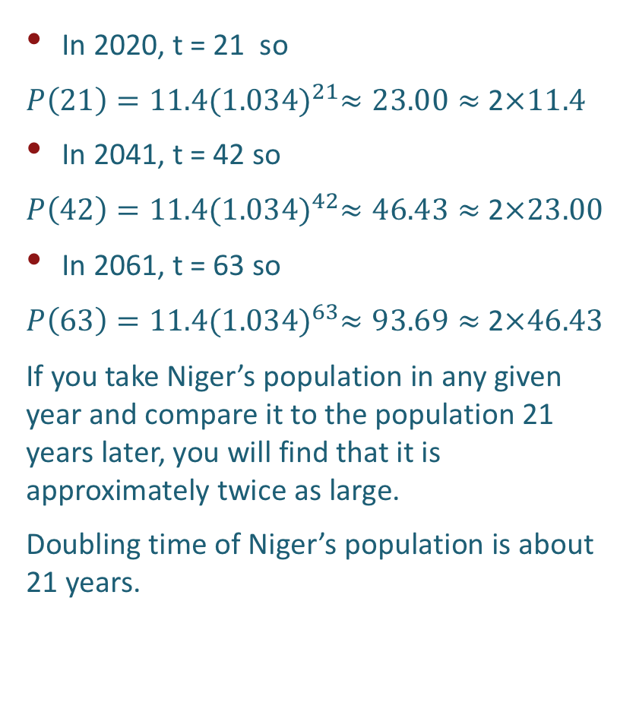
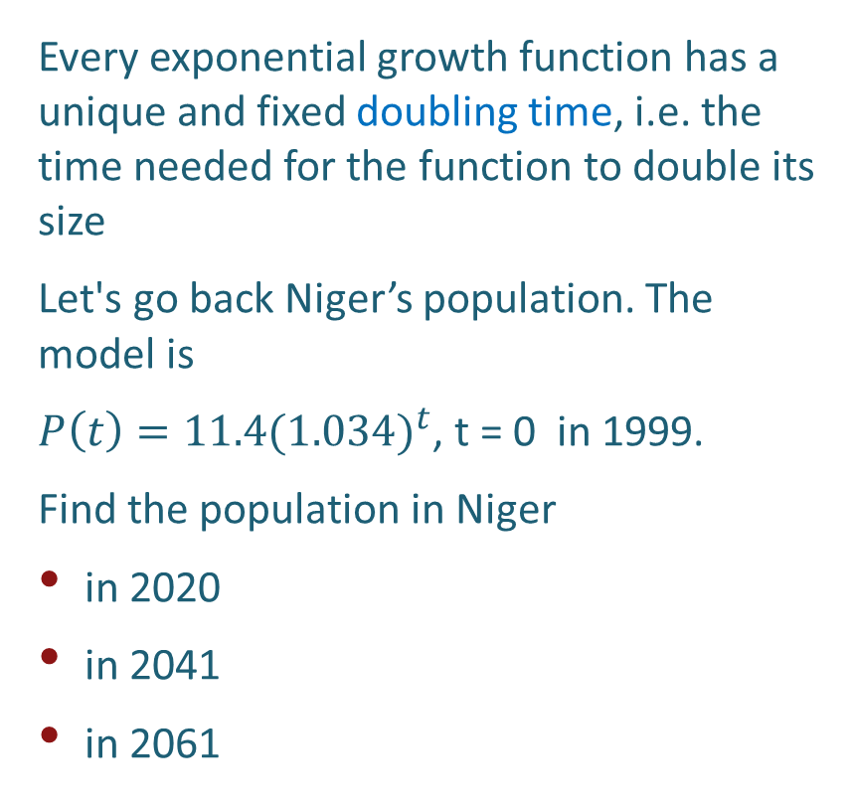
Doubling Time of Niger’s Population
Every exponential growth function has a unique and fixed doubling time, i.e. the time needed for the function to double its size
Let's go back Niger’s population. The model is
$P\left(t\right)=11.4{(1.034)}^{t}$, t = 0 in 1999.
Find the population in Niger
in 2020
in 2041
in 2061
In 2020, t = 21 so
$P\left(21\right)=11.4{(1.034)}^{21}≈23.00≈$ 2$×11.4$
In 2041, t = 42 so
$P\left(42\right)=11.4{(1.034)}^{42}≈46.43≈$ 2$×23.00$
In 2061, t = 63 so
$P\left(63\right)=11.4{(1.034)}^{63}≈93.69≈$ 2$×46.43$
If you take Niger’s population in any given year and compare it to the population 21 years later, you will find that it is approximately twice as large.
Doubling time of Niger’s population is about 21 years.

Slide 3
Doubling time of exponential growth
In general, the doubling time t for any exponential growth process is the same at any point on the curve
If you pick up any point (t, y) on the curve, the height y will always increase to 2y after t time units.

Slide 4
Doubling time of world population
The world’s population grows exponentially, with annual growth rate of 1.2%, and it has a doubling time of about 58 years
The population in 2019 is about 7.7 billion people
How much will it be in 2077?
When will it be about 30.8 billion people?

Slide 5
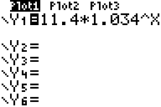
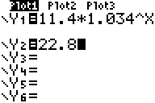
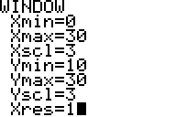
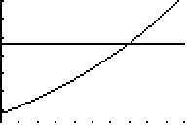
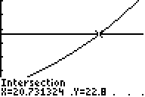


Example 6: Doubling Time
Example 6
Estimate the doubling time for the population of Niger using the equation:
$$p\left(t\right)=11.40({1.034)}^{t}$$
Solution
Adjust window
(Why these values?)
Intersection of two curves is solution
Since we are interested when p(t) will double, 2 times 11.4 is 22.8
Find the value of x where lines intersect
Enter the equation
$The solution is x=Doubling Time≈$ 20.73
or about 20 and ¾ years.

Slide 6

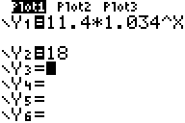
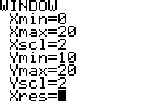
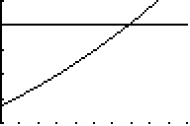
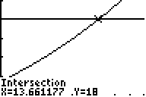
Solving Equations Graphically: TI 83/84
Example 5
Estimate when the population of Niger will reach 18 million if the population of Niger is represented by:
$$p\left(t\right)=11.40({1.034)}^{t}$$
(Assume t = 0 is the year 1999)
Solution
Adjust window
(Why these values?)
Intersection of two curves is solution
Find the value of y where lines intersect
Since we are interested when p(t) will be 18, we write a second equation
Enter the equation
!
@
%
`
è
5
$$The solution is y= p\left(t\right)≈13.66$$

Slide 7
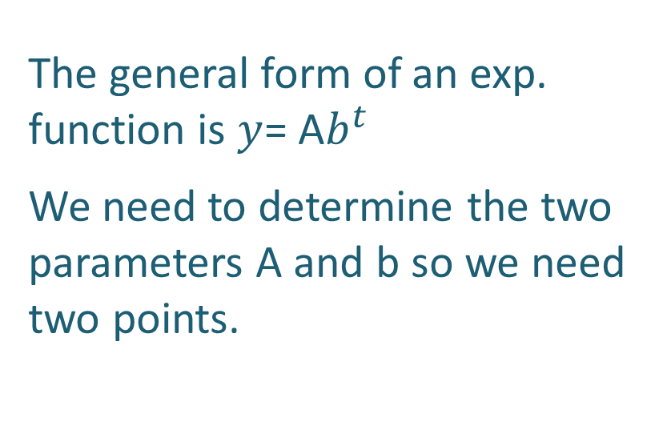
Finding an Exponential Function Through Two Points
The general form of an exp. function is $y$= A$b^{t}$
We need to determine the two parameters A and b so we need two points.

Slide 8
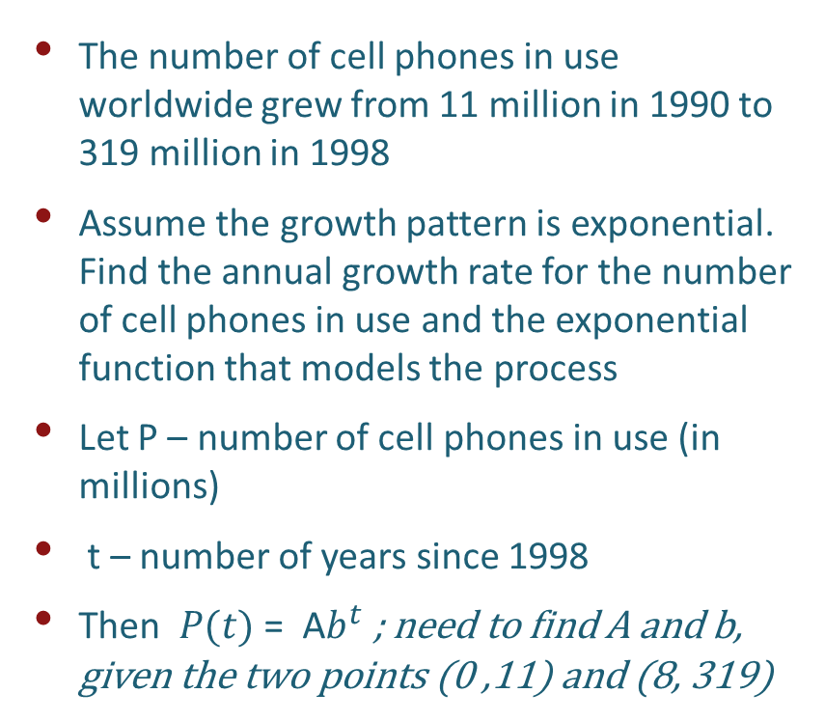
Number of Cell Phones in the World
The number of cell phones in use worldwide grew from 11 million in 1990 to 319 million in 1998
Assume the growth pattern is exponential. Find the annual growth rate for the number of cell phones in use and the exponential function that models the process
Let P – number of cell phones in use (in millions)
t – number of years since 1998
Then $P(t)$ = A$b^{t}$; need to find A and b, given the two points (0 ,11) and (8, 319)

Slide 9
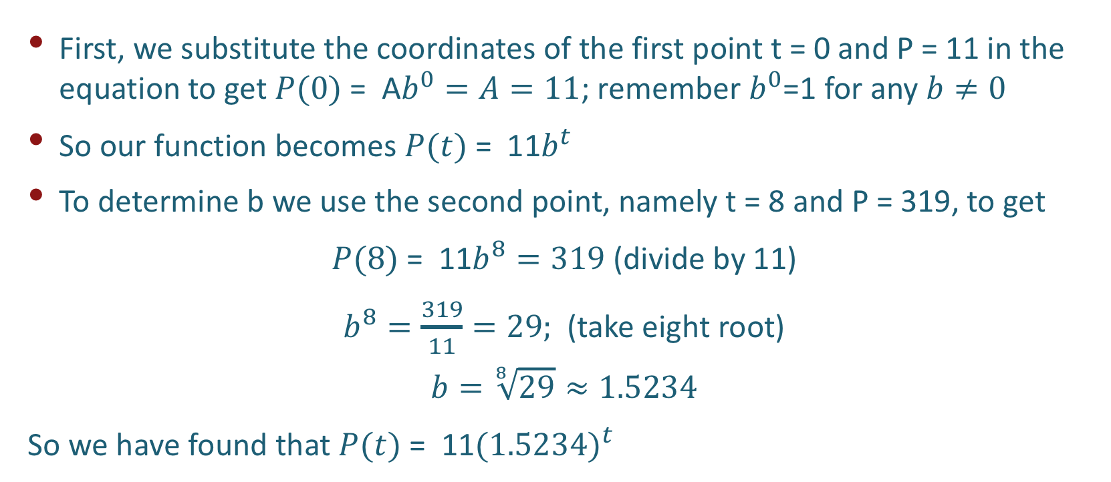
Number of Cell Phones in the World
First, we substitute the coordinates of the first point t = 0 and P = 11 in the equation to get $P(0)$ = A$b^{0}=A=11$; remember $b^{0}$=1 for any $b≠0$
So our function becomes $P(t)$ = 11$b^{t}$
To determine b we use the second point, namely t = 8 and P = 319, to get
$P(8)$ = 11$b^{8}=319$ (divide by 11)
$b^{8}=\frac{319}{11}=29;$ (take eight root)
$$b=\sqrt[8]{29}≈1.5234$$
So we have found that $P(t)$ = 11${(1.5234)}^{t}$

Slide 10
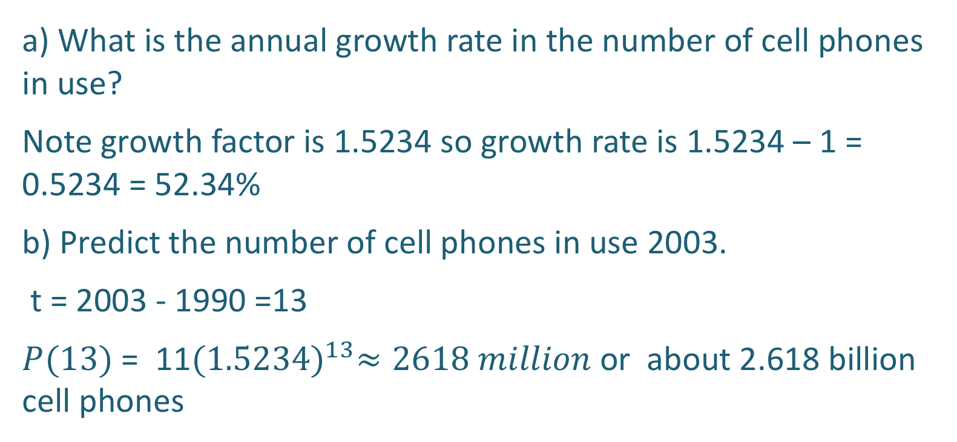
Number of Cell Phones in the World
a) What is the annual growth rate in the number of cell phones in use?
Note growth factor is 1.5234 so growth rate is 1.5234 – 1 = 0.5234 = 52.34%
b) Predict the number of cell phones in use 2003.
t = 2003 - 1990 =13
$P(13)$ = 11${(1.5234)}^{13}≈2618 million$ or about 2.618 billion cell phones

Slide 11
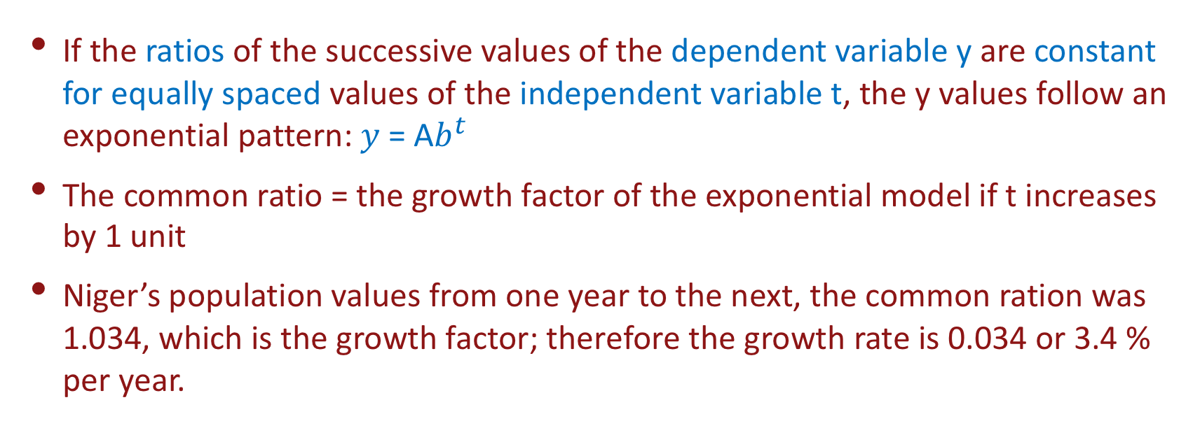
Determining if a Set of Data is Exponential
If the ratios of the successive values of the dependent variable y are constant for equally spaced values of the independent variable t, the y values follow an exponential pattern: $y$ = A$b^{t}$
The common ratio = the growth factor of the exponential model if t increases by 1 unit
Niger’s population values from one year to the next, the common ration was 1.034, which is the growth factor; therefore the growth rate is 0.034 or 3.4 % per year.

Slide 12
Is the given data set exponential? If yes, what its growth rate?
Exponential Data Set - Example

Slide 13
Is the given data set exponential? If yes, what its growth rate?
Exponential Data Set - Example

