Slide 1
Exponential Decay
All slides in this presentations are based on the book Functions, Data and Models, S.P. Gordon and F. S Gordon ISBN 978-0-88385-767-0

Slide 2
Ibuprofen Example
Ibuprofen is used to treat pain and to reduce joint swelling caused by conditions like arthritis.
When you take a dose it is absorbed into your bloodstream and is then filtered out of the blood by the kidney
The kidney eliminates approximately 30% of the ibuprofen in the bloodstream during any 1-hour period.
Therefore 70% of the drug remains.
Suppose we take a 400mg dosage of ibuprofen.
How much remains after 1 hour?

Slide 3
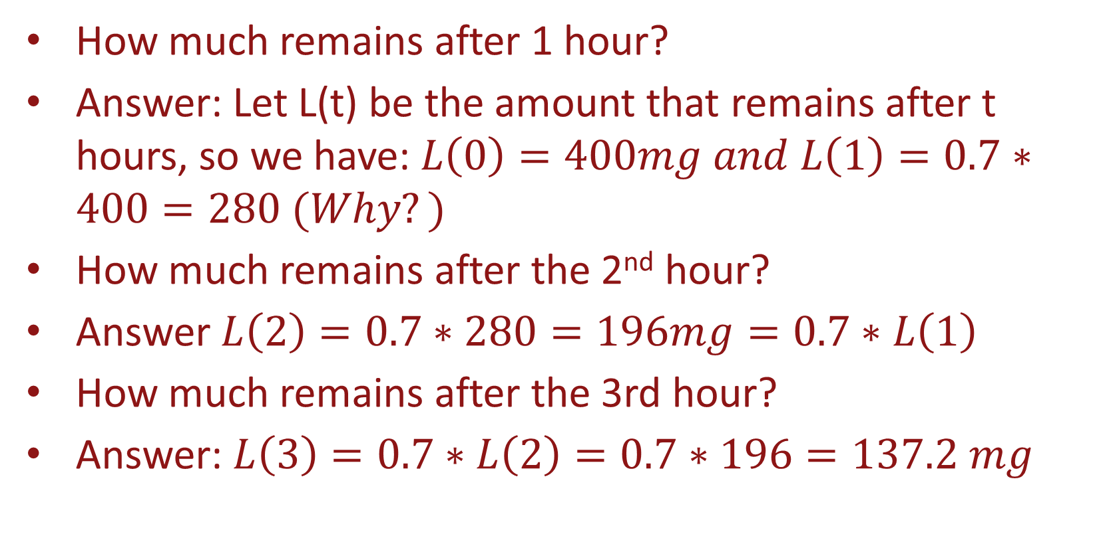
Ibuprofen Example Continued
How much remains after 1 hour?
Answer: Let L(t) be the amount that remains after t hours, so we have:$L\left(0\right)=400mg and L\left(1\right)=0.7∗400=280 (Why?)$
How much remains after the 2nd hour?
Answer $L\left(2\right)=0.7∗280=196mg=0.7∗L\left(1\right)$
How much remains after the 3rd hour?
Answer: $L\left(3\right)=0.7∗L\left(2\right)=0.7∗196=137.2 mg$

Slide 4
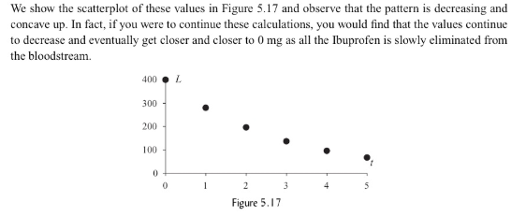
Scatterplot of the Data

Slide 5
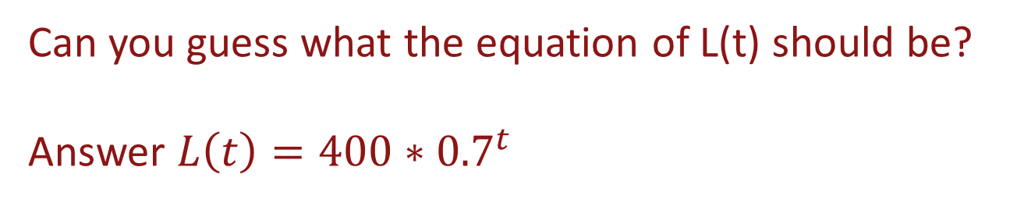



Finding the Exponetial Equation
$Recall L\left(0\right)=400mg$
$L\left(1\right)=0.7∗L\left(0\right)=280mg$
$L\left(2\right)=0.7∗L\left(1\right) we now substitute the value of L\left(1\right)from above and get$
$L\left(2\right)=0.7∗0.7∗L\left(0\right)={0.7}^{2}∗400$
$L\left(3\right)=0.7∗L\left(2\right)={0.7∗(0.7}^{2}∗400)={0.7}^{3}∗400$
Can you guess what the equation of L(t) should be?
Answer $L\left(t\right)=400∗{0.7}^{t}$

Slide 6
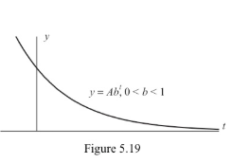
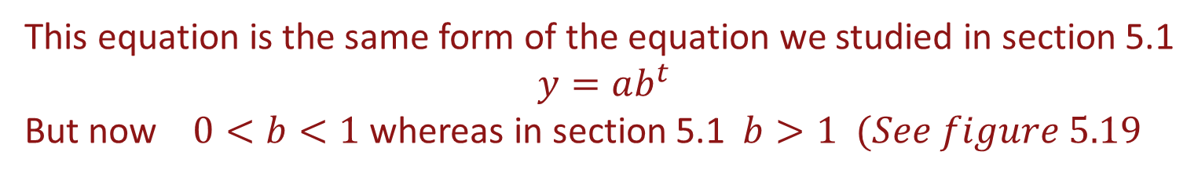

Exponential Decay
O$ur equation is L\left(t\right)=400∗{0.7}^{t}$
This equation is the same form of the equation we studied in section 5.1
$$y=ab^{t}$$
But now $0<b<1$ whereas in section 5.1 $b>1 (See figure 5.19$

Slide 7
Decay Factor
Suppose that some process decreases at a rate of 12% per year. This 12% = 0.12 is known as the decay rate and the associated factor b is
Decay Factor = 1 – Decay Rate
In our example, the Decay Factor b = 1 – Decay Rate = 1 -0.12 = 0.88
By comparison, for exponential growth, we have:
Growth factor = 1 + Growth Rate

Slide 8
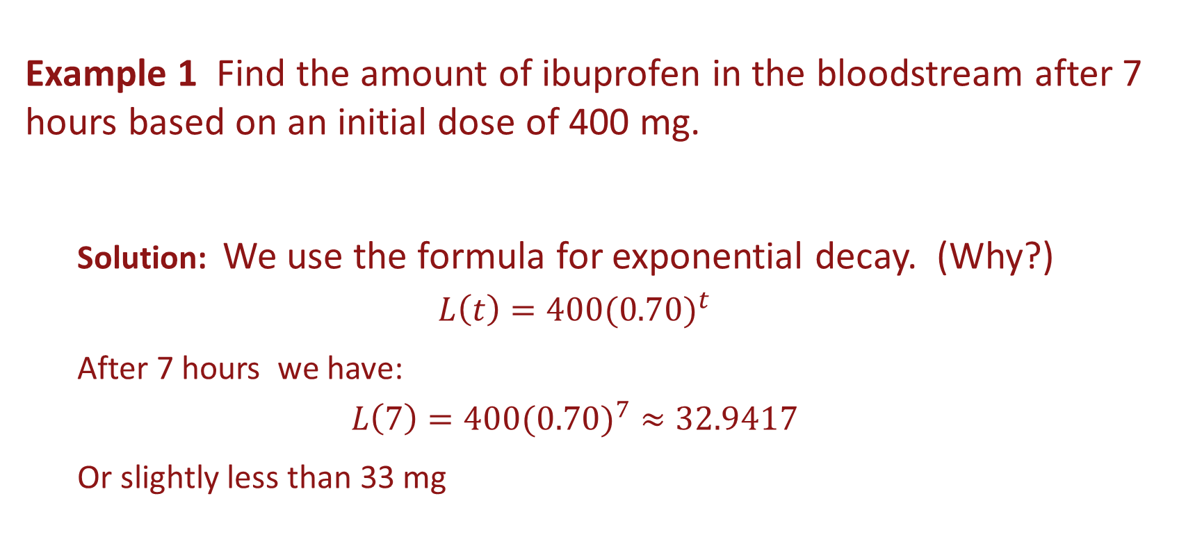
Example
Example 1 Find the amount of ibuprofen in the bloodstream after 7 hours based on an initial dose of 400 mg.
Solution: We use the formula for exponential decay. (Why?)
$$L\left(t\right)=400{(0.70)}^{t}$$
After 7 hours we have:
$$L\left(7\right)=400({0.70)}^{7}≈32.9417$$
Or slightly less than 33 mg

Slide 9
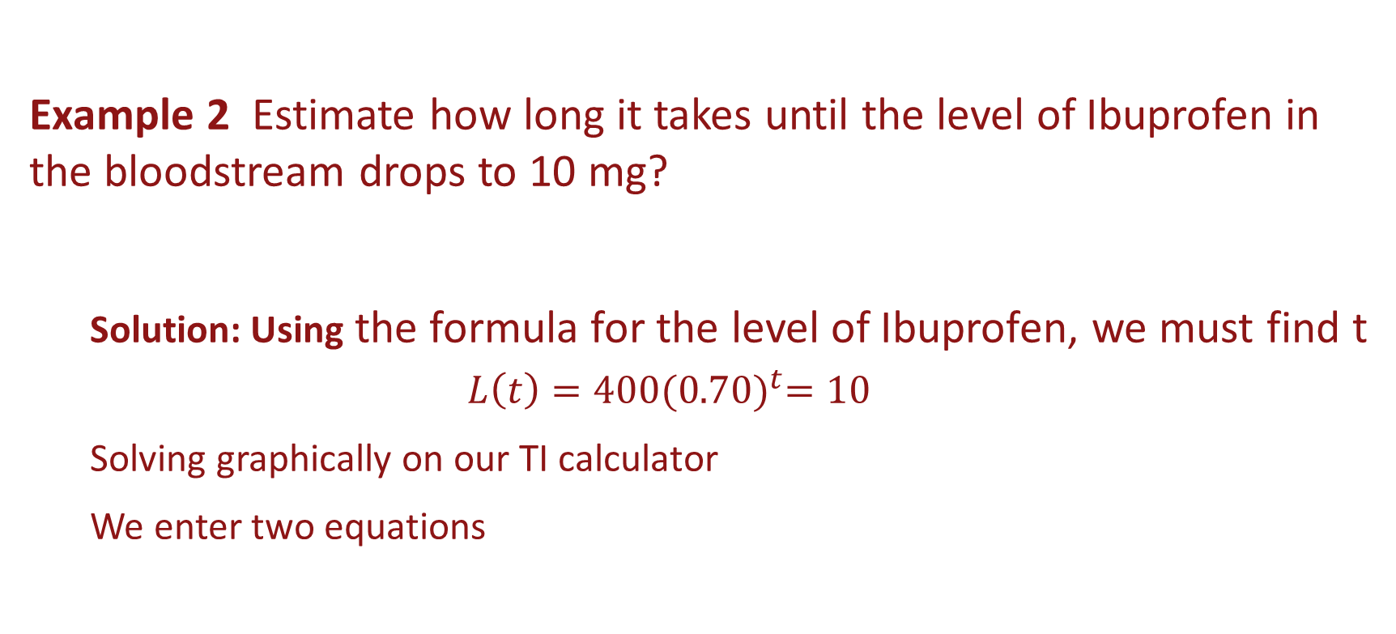
Example
Example 2 Estimate how long it takes until the level of Ibuprofen in the bloodstream drops to 10 mg?
Solution: Using the formula for the level of Ibuprofen, we must find t
$$L\left(t\right)=400{(0.70)}^{t}=10$$
Solving graphically on our TI calculator
We enter two equations

Slide 10
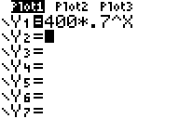
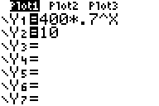
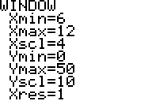
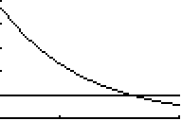
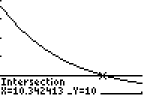
Example Continued
Solution
Intersection of two curves is solution
Since we are interested when L(t) will be 10, we write a second equation
Adjust window
(Why these values?)
Find the value of x where lines intersect
Enter the equations
After 7 hours approximately 10.34 mg of Ibuprofen will remain in the bloodstream

Slide 11
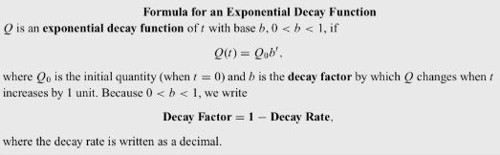
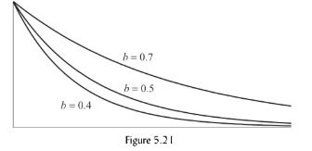
Exponential Decay Formula
See figure 5.21
The larger the decay rate, and hence the smaller the decay factor b, the faster the function dies out and approaches 0.

Slide 12
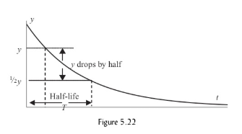
Half Life
Just as the doubling time for an exponential growth process is the time needed for the quantity to double, the half life for an exponential decay process is the time T needed for the quantity to be reduced by half. (see figure 5.22)

Slide 13
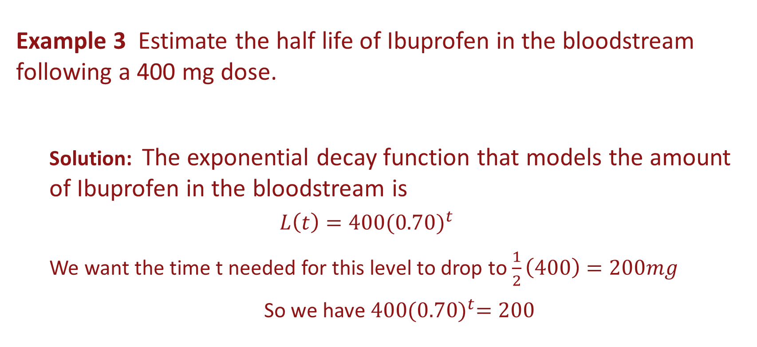
Example Half Life
Example 3 Estimate the half life of Ibuprofen in the bloodstream following a 400 mg dose.
Solution: The exponential decay function that models the amount of Ibuprofen in the bloodstream is
$$L\left(t\right)=400{(0.70)}^{t}$$
We want the time t needed for this level to drop to $\frac{1}{2}\left(400\right)=200mg$
So we have $400{(0.70)}^{t}=200$

Slide 14
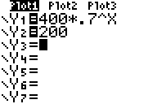
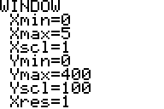
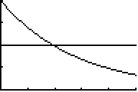
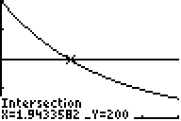
Example Half Life Continued
Solution
Intersection of two curves is solution
Since we are interested when L(t) will be 200, we write a second equation
Adjust window
(Why these values?)
Find the value of x where lines intersect
Enter the equations
It takes almost 2 hours (1.94 hours) for the level of Ibuprofen in your bloodstream to be half the amount present, two hours earlier.

Slide 15
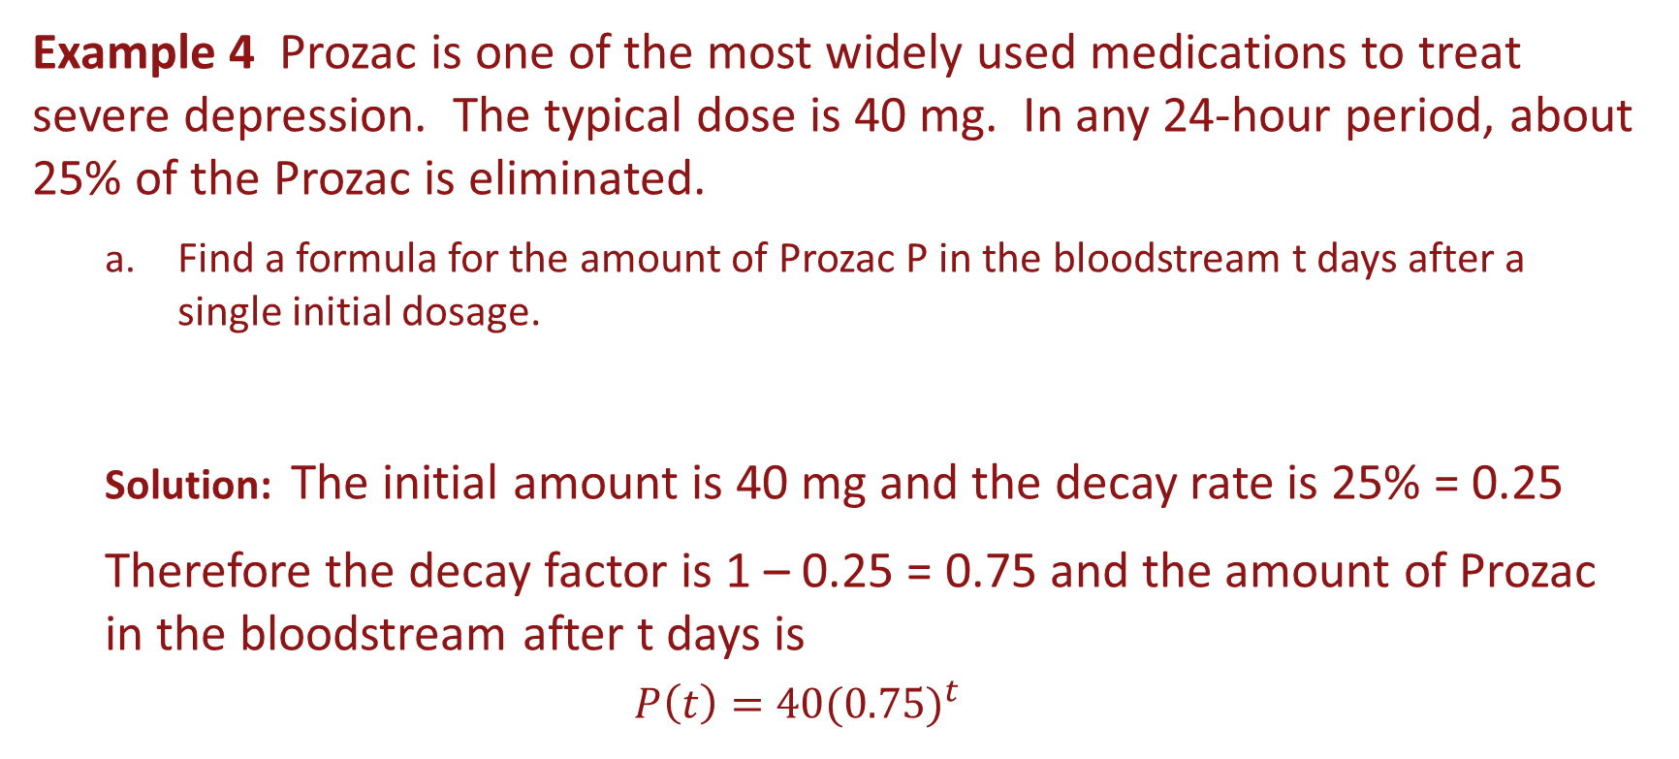
Example
Example 4 Prozac is one of the most widely used medications to treat severe depression. The typical dose is 40 mg. In any 24-hour period, about 25% of the Prozac is eliminated.
Find a formula for the amount of Prozac P in the bloodstream t days after a single initial dosage.
Solution: The initial amount is 40 mg and the decay rate is 25% = 0.25
Therefore the decay factor is 1 – 0.25 = 0.75 and the amount of Prozac in the bloodstream after t days is
$$P\left(t\right)=40{(0.75)}^{t}$$

Slide 16
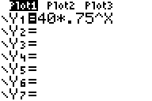
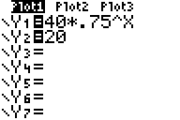
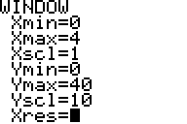
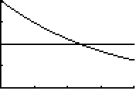
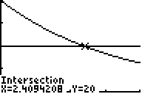
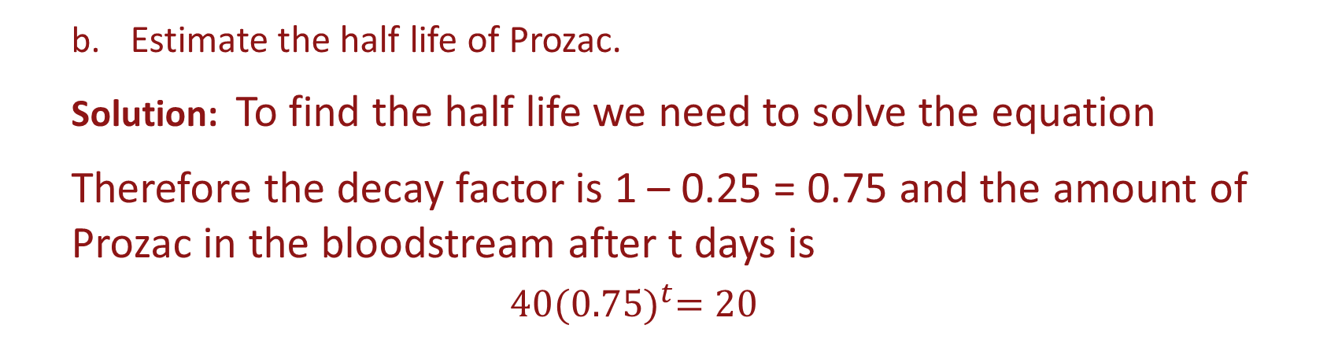
Example Continued
Estimate the half life of Prozac.
Solution: To find the half life we need to solve the equation
Therefore the decay factor is 1 – 0.25 = 0.75 and the amount of Prozac in the bloodstream after t days is
$$40{(0.75)}^{t}=20$$
Solution
Intersection of two curves is solution
Since we are interested when P(t) will be 20, we write a second equation
Adjust window
(Why these values?)
Find the value of x where lines intersect
Enter the equations
The half life of Prozac is about 2.4 days

Slide 17



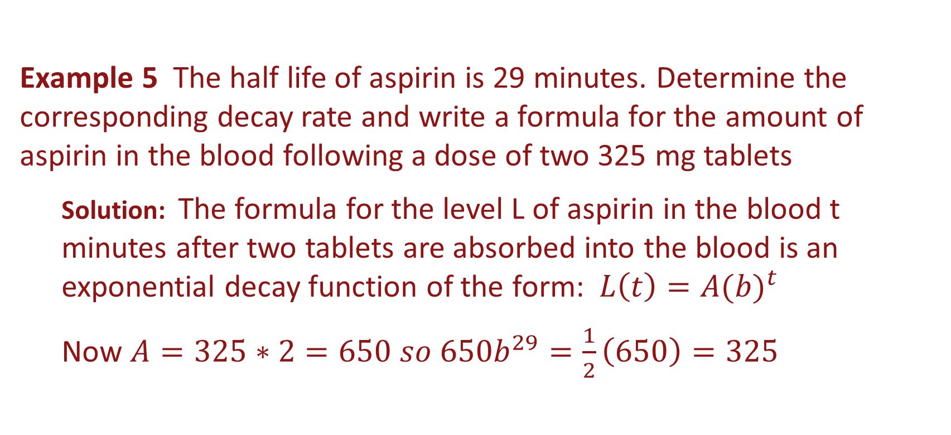



Example
Example 5 The half life of aspirin is 29 minutes. Determine the corresponding decay rate and write a formula for the amount of aspirin in the blood following a dose of two 325 mg tablets
Solution: The formula for the level L of aspirin in the blood t minutes after two tablets are absorbed into the blood is an exponential decay function of the form: $L\left(t\right)=A{(b)}^{t}$
Now $A=325∗2=650 so 650b^{29}=\frac{1}{2}\left(650\right)=325$
$$650b^{29}=325 so$$
$$b^{29}=\frac{325}{650}=0.5$$
$$b=\sqrt[29]{.5}={0.5}^{\frac{1}{29}}$$
$$650b^{29}=325$$
$$≈0.9764$$
Decay Rate = 1 – Decay Factor = 1 – 0.9764 = 0.0236 = 2.36%
The formula for the amount of aspirin that remains in the blood after t minutes is for a 650 mg dose
$$L\left(t\right)=650{(0.9764)}^{t}$$

Slide 18
Radioactive Decay
Radioactive substances transform or decay into other elements, often lead, as time passes.
The rate at which an element decays is specific to that element.
Over the course of 100 years, approximately 4.3% of any radium will decay to lead.
Therefore 95.7% of the original amount of the radium remains after 100 years.
This situation can be represented by an exponential decay function

Slide 19
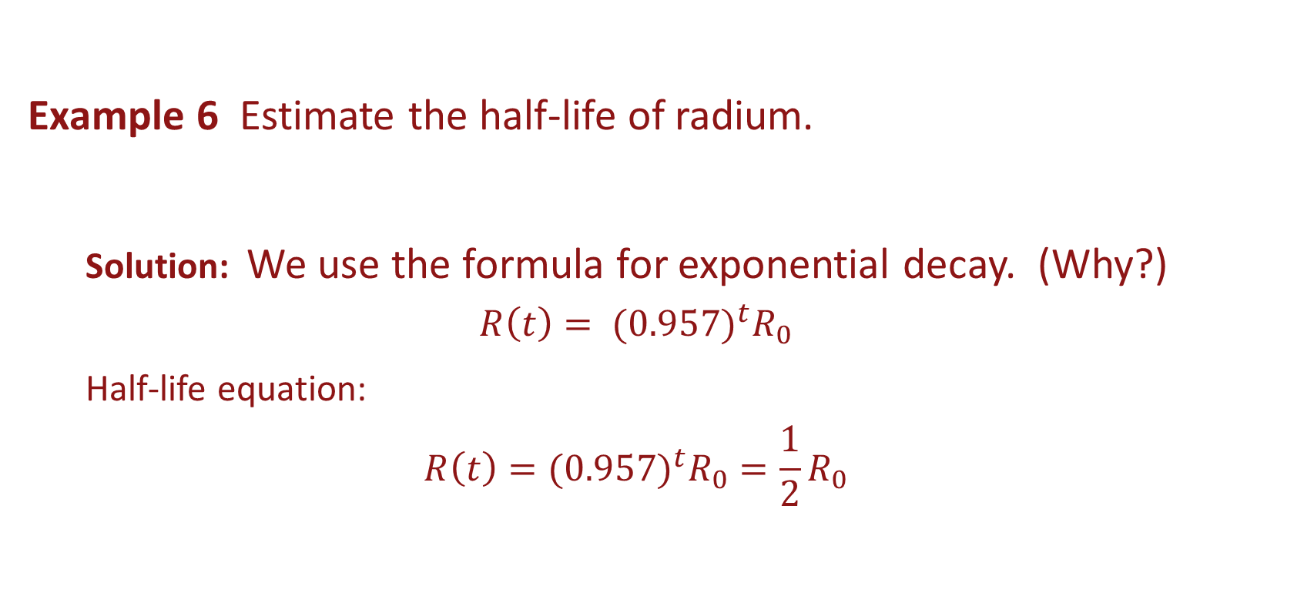
Example
Example 6 Estimate the half-life of radium.
Solution: We use the formula for exponential decay. (Why?)
$$R\left(t\right)= {{(0.957)}^{t}R}_{0}$$
Half-life equation:
$${{R\left(t\right)=(0.957)}^{t}R}_{0}={\frac{1}{2}R}_{0}$$

Slide 20
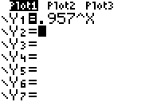
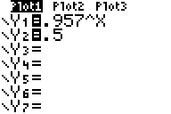
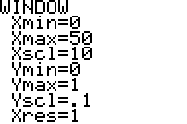
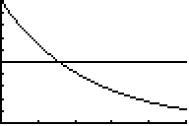
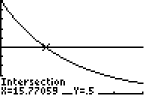
Example Continued
Solution
Intersection of two curves is solution
Since we are interested when R(t) will be 0.5, we write a second equation
Adjust window
(Why these values?)
Find the value of x where lines intersect
Enter the equations
The half life of Radium is about 1577 years (100*15.77)

Slide 21
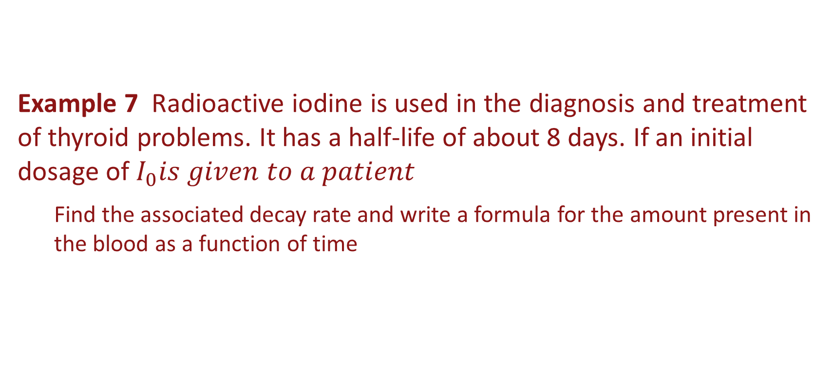
Example
Example 7 Radioactive iodine is used in the diagnosis and treatment of thyroid problems. It has a half-life of about 8 days. If an initial dosage of $I_{0}is given to a patient$
Find the associated decay rate and write a formula for the amount present in the blood as a function of time

Slide 22



Example
Solution: Half-life equation:
$I_{0}∙b^{8}=\frac{1}{2}I_{0}$ $b^{8}=\frac{1}{2}$
$$b=\sqrt[8]{0.5}≈0.9170$$
Decay Rate = 1 – 0.9170 = 0.0830
The formula for the amount present in the blood at time t is:
$$I\left(t\right)=I_{0}{0.9170}^{t}$$

