Slide 1
Behavior of Quadratics
All slides in this presentations are based on the book Functions, Data and Models, S.P. Gordon and F. S Gordon ISBN 978-0-88385-767-0

Slide 2
Behavior of Polynomial Functions
Behavior of Polynomial Functions depend on:
Degree of the polynomial (most important)
Value of the zeros
Sign of the leading coefficient

Slide 3
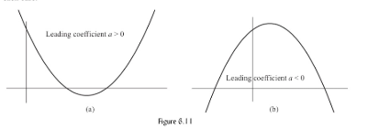
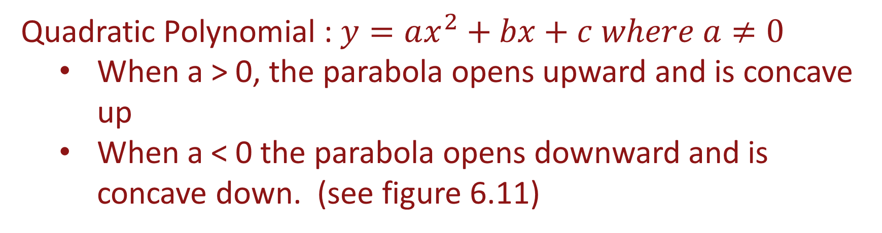
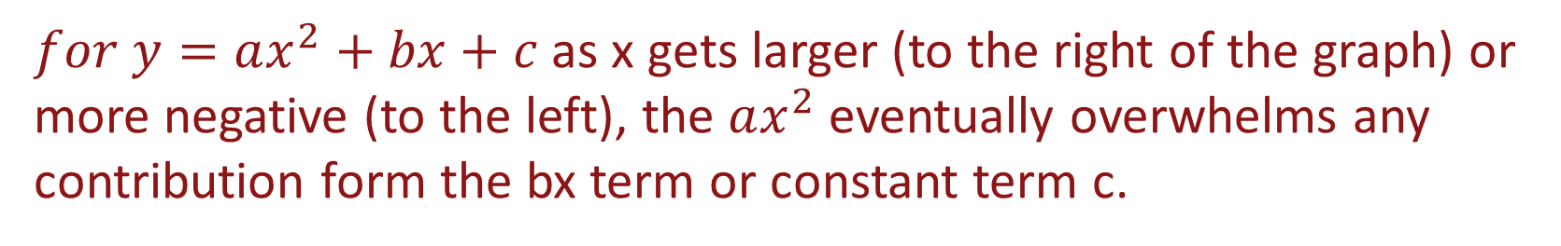
Quadratic Polynomials
Quadratic Polynomial : $y=ax^{2}+bx+c where a≠0$
When a > 0, the parabola opens upward and is concave up
When a < 0 the parabola opens downward and is concave down. (see figure 6.11)
$for y=ax^{2}+bx+c$ as x gets larger (to the right of the graph) or more negative (to the left), the $ax^{2}$ eventually overwhelms any contribution form the bx term or constant term c.

Slide 4
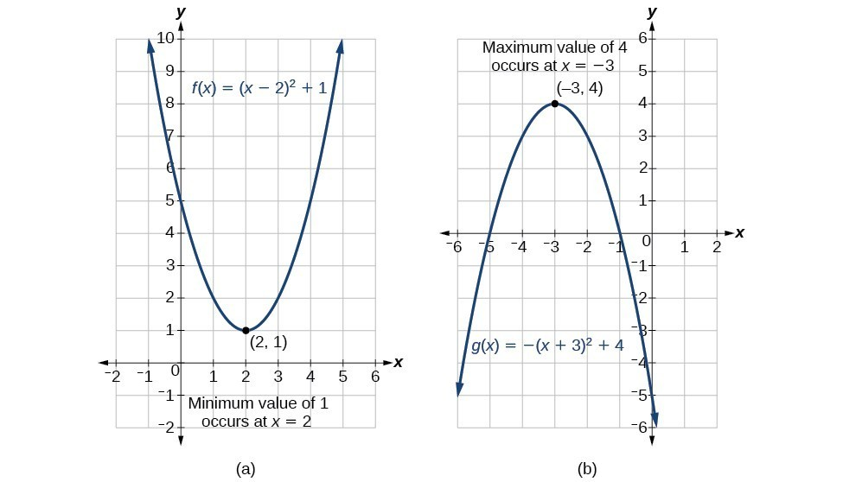
Vertex of a Parabola
The turning point of a parabola is called the vertex.
When a parabola opens upward, the turning point is a minimum
When the parabola opens downward, the turning point is a maximum (see graphs below)

Slide 5
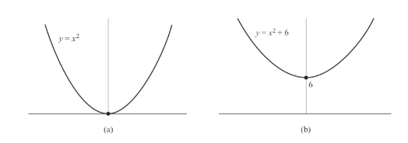
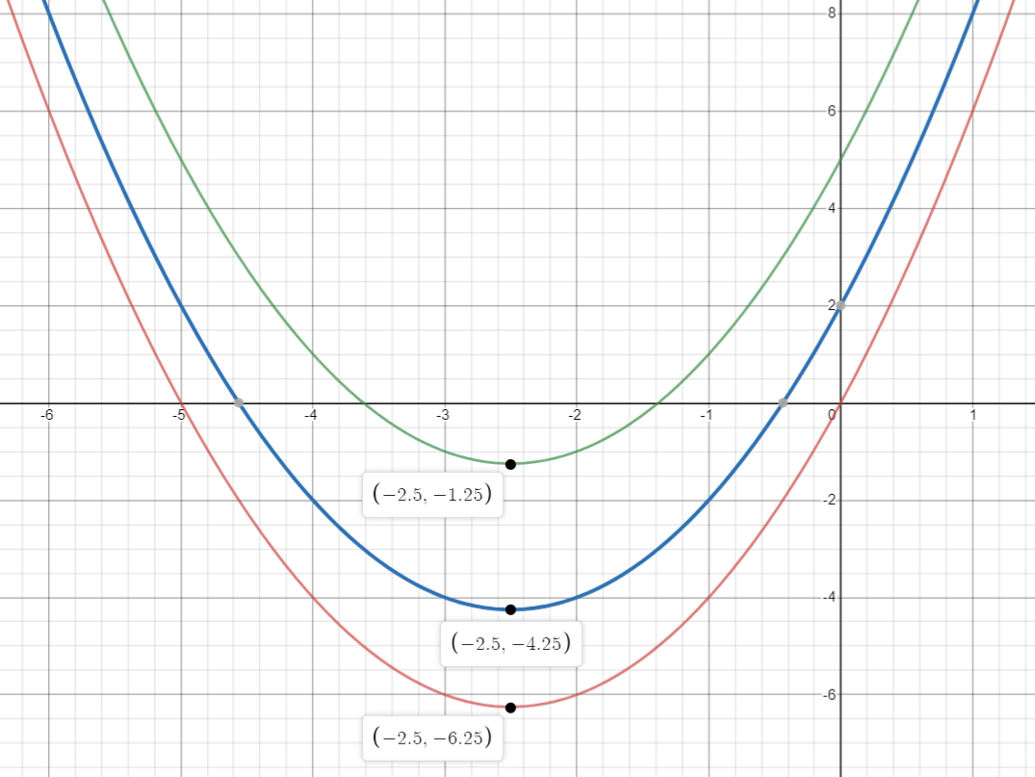



Quadratic Function: Effect of Constant Term
Here are the graphs of two quadratic functions where the constants differ.
Notice the 2nd graph is shifted upward 6 units.
Here are the graphs of three quadratic functions where only the constants differ.
Notice the blue graph is shifted upward 2 units compared to the red graph, while the green graph is shifted 5 units higher than the red graph
$$y=x^{2}+5x+5$$
$$y=x^{2}+5x+2$$
$$y=x^{2}+5x$$

Slide 6
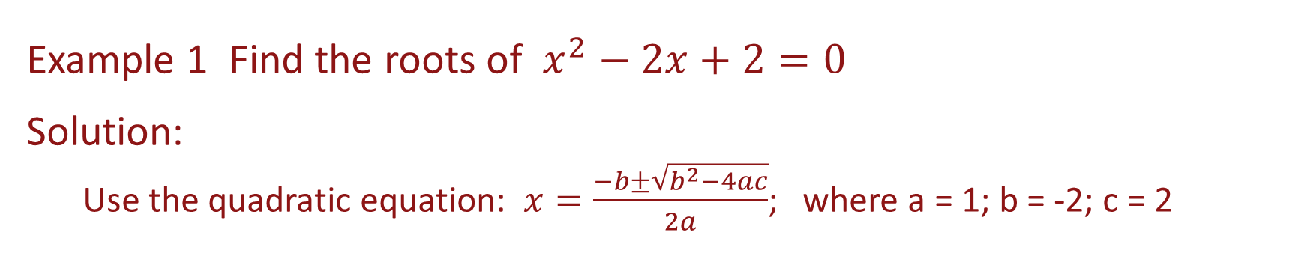

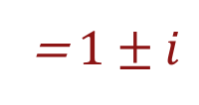

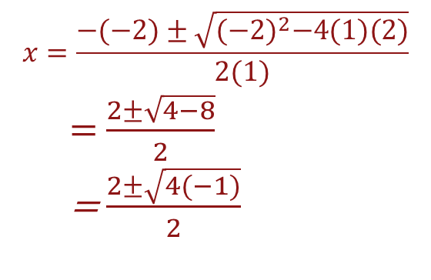
Roots of a Quadratic Equation
Example 1 Find the roots of $x^{2}−2x+2=0$
Solution: Use the quadratic equation: $x=\frac{−b±\sqrt{b^{2}−4ac}}{2a}$; where a = 1; b = -2; c = 2
$$x=\frac{−(−2)±\sqrt{{(−2)}^{2}−4(1)(2)}}{2(1)}$$
= $\frac{2±\sqrt{4−8}}{2}$
= $\frac{2±\sqrt{4(−1)}}{2}$
= $\frac{2±2i}{2}$
= $1±i$
$$x=1+i or x=1−i$$

Slide 7
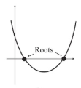
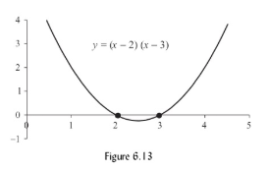
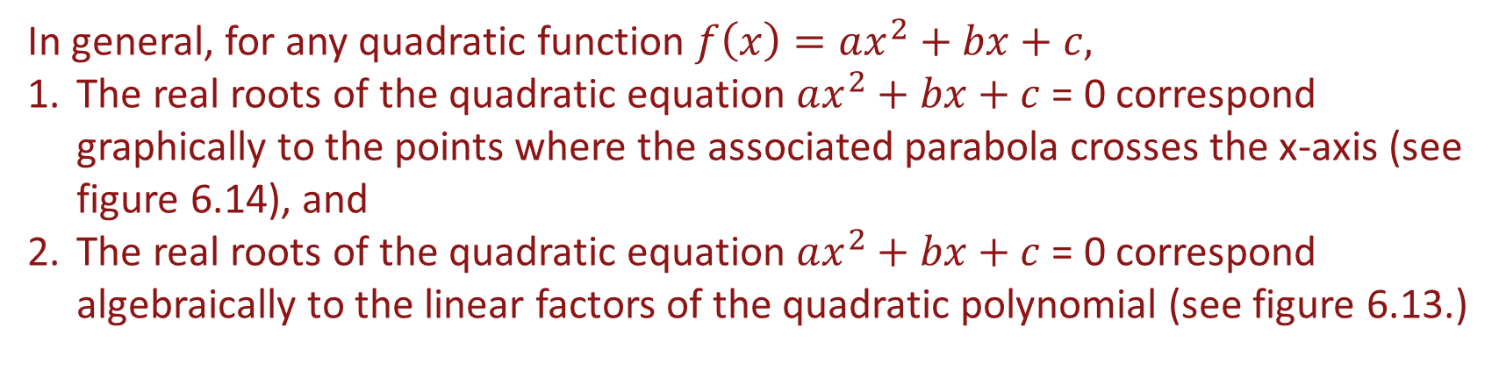
Roots of a Quadratic Equation
In general, for any quadratic function $f\left(x\right)=ax^{2}+bx+c,$
The real roots of the quadratic equation $ax^{2}+bx+c$ = 0 correspond graphically to the points where the associated parabola crosses the x-axis (see figure 6.14), and
The real roots of the quadratic equation $ax^{2}+bx+c$ = 0 correspond algebraically to the linear factors of the quadratic polynomial (see figure 6.13.)
Figure 6.14

Slide 8
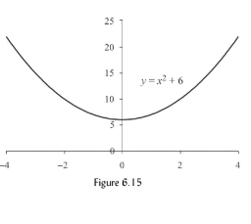
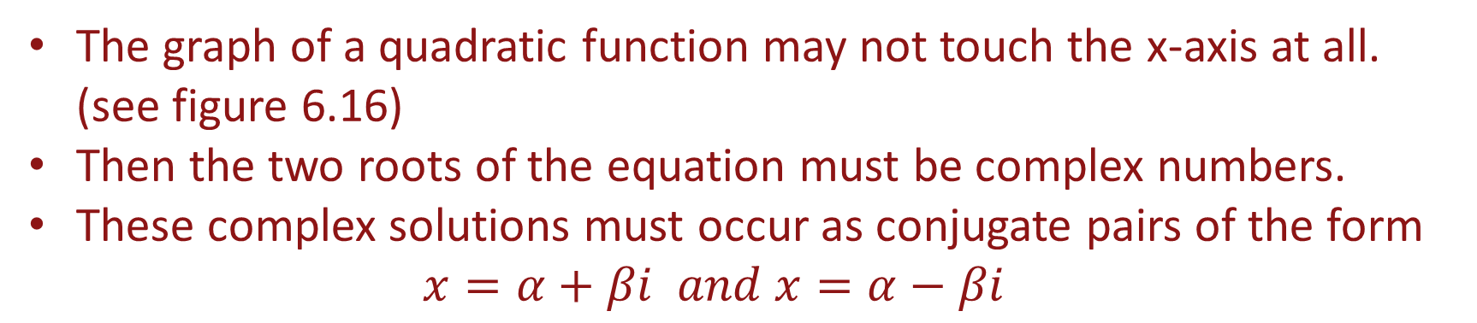
Complex Solutions
The graph of a quadratic function may not touch the x-axis at all. (see figure 6.16)
Then the two roots of the equation must be complex numbers.
These complex solutions must occur as conjugate pairs of the form
$$x=α+βi and x=α−βi$$

Slide 9
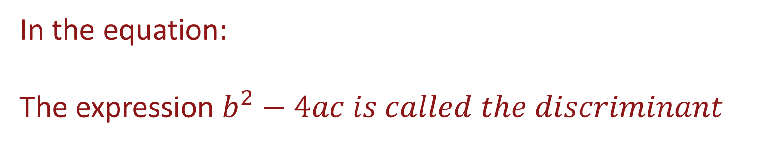

Discriminant
$$x=\frac{−b±\sqrt{b^{2}−4ac}}{2a}$$
In the equation:
The expression $b^{2}−4ac is called the discriminant$
When the discriminant is greater than zero there are two real solutions;
When the discriminant is less than zero there are two complex solutions.
When the discriminant is equal to zero; the solution is a double root.

Slide 10
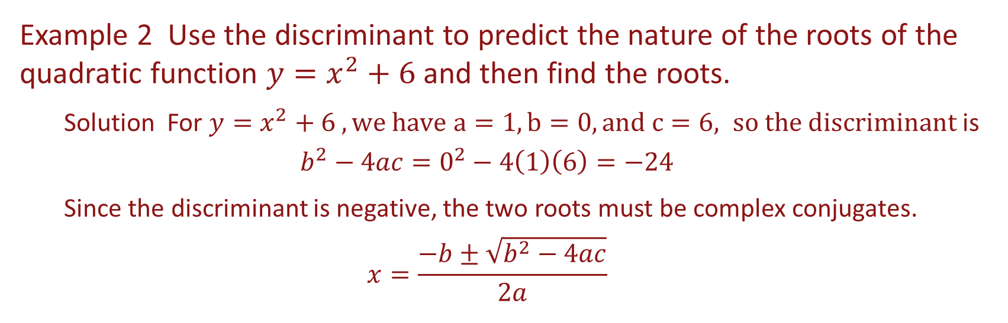
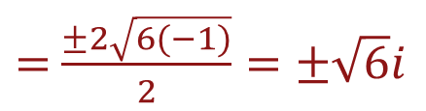
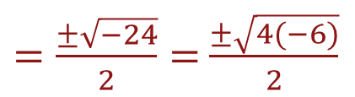
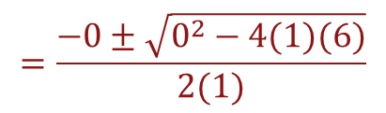
Example
Example 2 Use the discriminant to predict the nature of the roots of the quadratic function $y=x^{2}+6$ and then find the roots.
Solution For $y=x^{2}+6 , we have a=1, b=0, and c=6, so the discriminant$ is
$$b^{2}−4ac=0^{2}−4\left(1\right)\left(6\right)=−24$$
Since the discriminant is negative, the two roots must be complex conjugates.
$$x=\frac{−b±\sqrt{b^{2}−4ac}}{2a}$$
$$=\frac{−0±\sqrt{0^{2}−4(1)(6)}}{2(1)}$$
$=\frac{±\sqrt{−24}}{2}=$ $\frac{±\sqrt{4(−6)}}{2}$
$=$ $\frac{±2\sqrt{6(−1)}}{2}=±\sqrt{6}i$

Slide 11
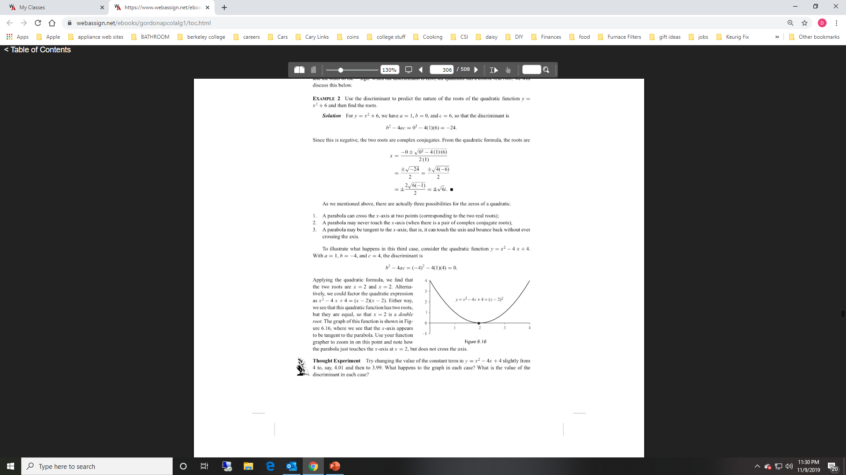

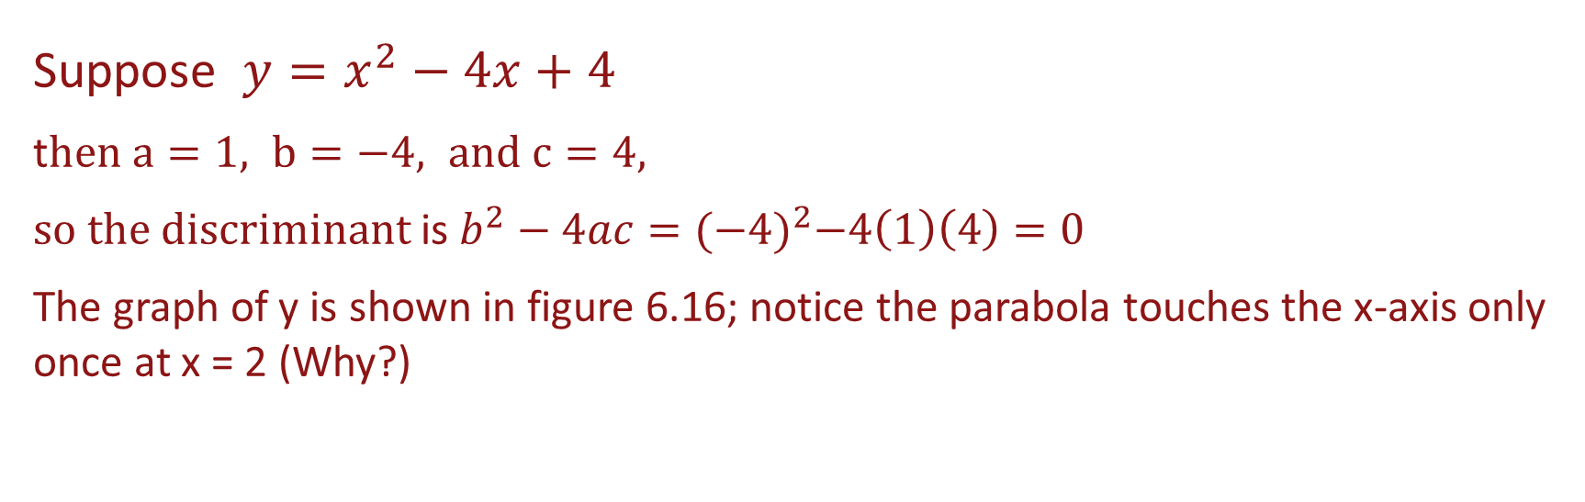
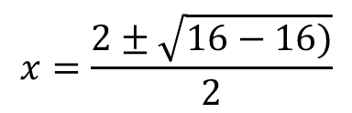
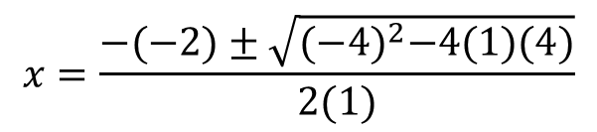
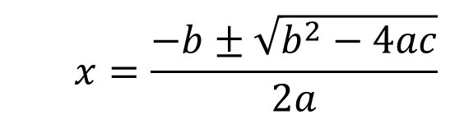
Discriminant Equal to Zero
Suppose $y=x^{2}−4x+4$
t$hen a=1, b=−4, and c=4,$
$so the discriminant$ is $b^{2}−4ac={(−4)}^{2}−4\left(1\right)\left(4\right)=0$
The graph of y is shown in figure 6.16; notice the parabola touches the x-axis only once at x = 2 (Why?)
$$x=\frac{−b±\sqrt{b^{2}−4ac}}{2a}$$
$$x=\frac{−(−2)±\sqrt{{(−4)}^{2}−4(1)(4)}}{2(1)}$$
$$x=\frac{2±\sqrt{16−16)}}{2}$$
$$x=2±0=2$$

Slide 12
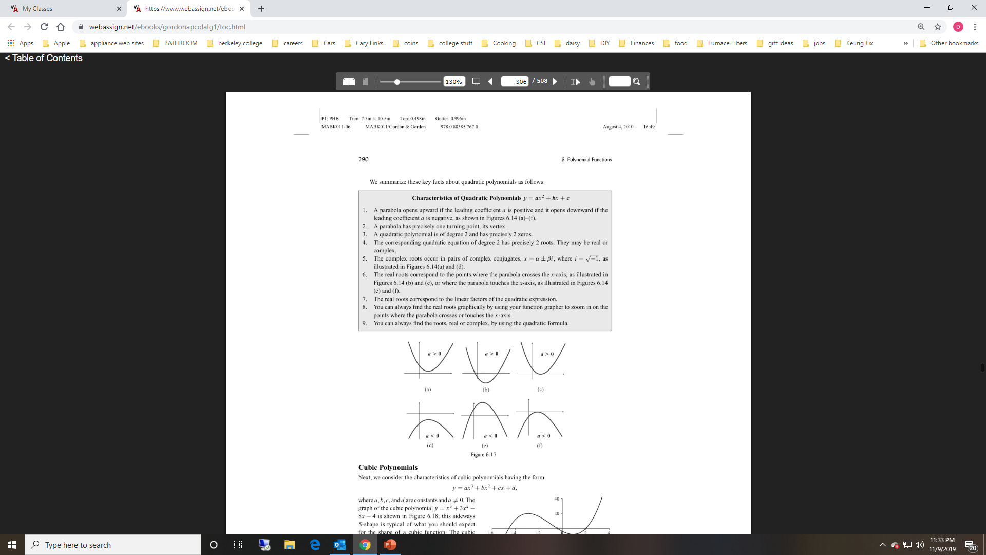
Quadratic Polynomial Summary

