Slide 1
Functions
Tables, Graphs, Formulas
All slides in this presentations are based on the book Functions, Data and Models, S.P. Gordon and F. S Gordon ISBN 978-0-88385-767-0

Slide 2
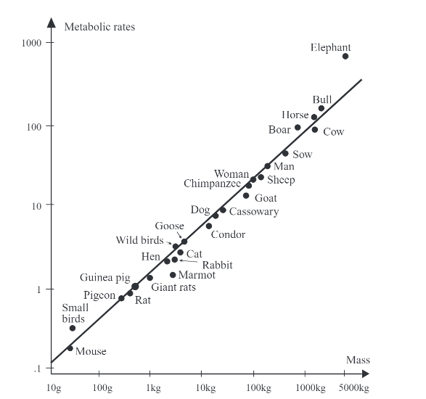
Functions in the Real World
What are the two variables?
Which one depends on which?

Slide 3
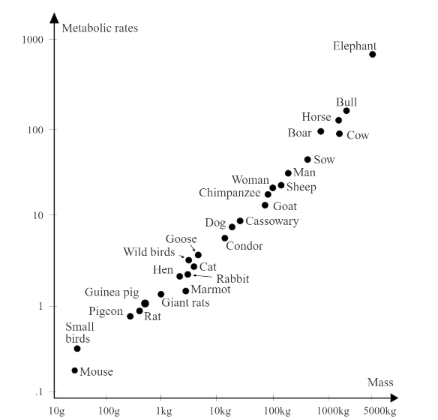
Functions in the Real World
What are the two variables?
Which one depends on which?
Metabolic rate R depends on the body mass M of an organism
R is a function of M; a rule assigning values to R given a value of M

Slide 4
Body mass of mammals and birds (kg) versus their metabolic rates (watts)
R is a linear function of M.
How is it represented?
Answer: Graphically

Slide 5

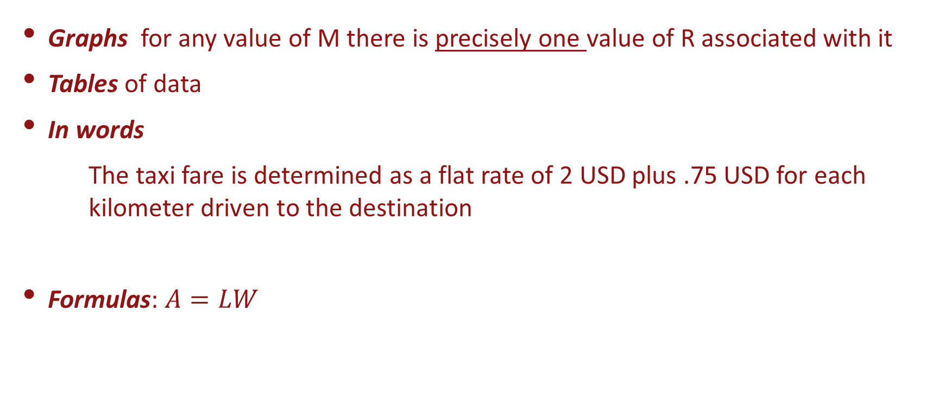
Four Representations of Functions
Graphs for any value of M there is precisely one value of R associated with it
Tables of data
In words
The taxi fare is determined as a flat rate of 2 USD plus .75 USD for each kilometer driven to the destination
Formulas: $A=LW$
L
W

Slide 6

Formulas
Area of a rectangle $A=LW$
Example
A = 10 x 4 = 40 Sq cm
Perimeter of a rectangle P = 2W + 2L
Example P = 2x10 + 2x4 = 28 cm
W
L
4 cm
10 cm

Slide 7
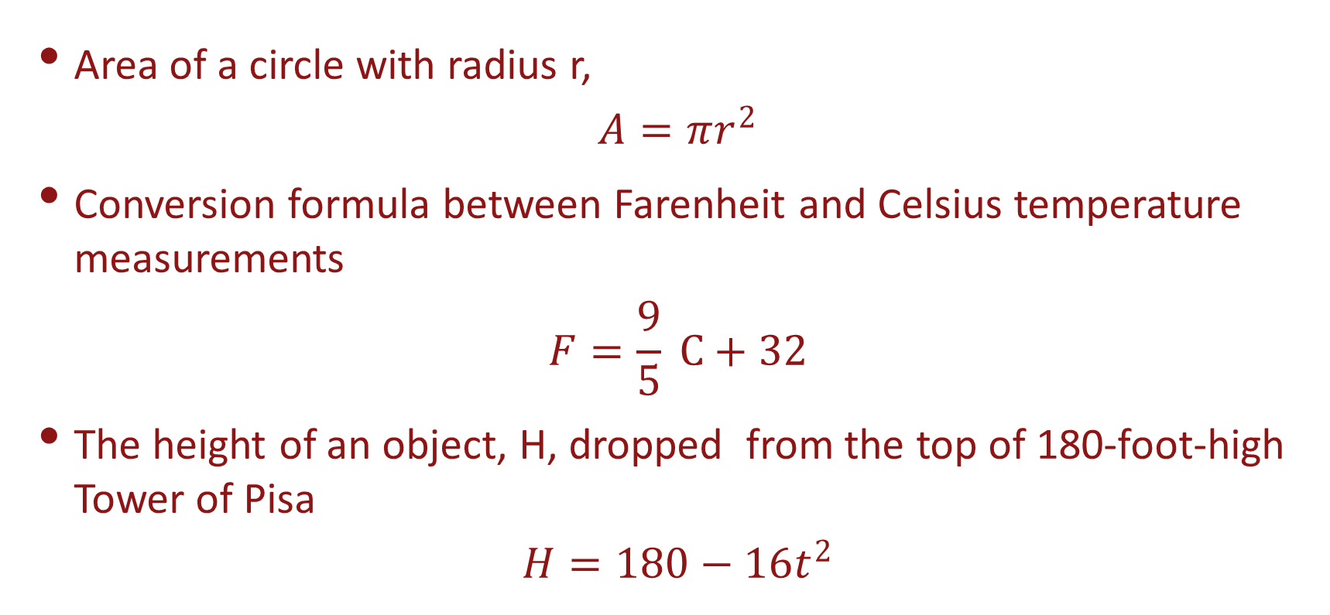
Formulas
Area of a circle with radius r,
$$A=πr^{2}$$
Conversion formula between Farenheit and Celsius temperature measurements
$$F=\frac{9}{5} C+32$$
The height of an object, H, dropped from the top of 180-foot-high Tower of Pisa
$$H=180−16t^{2}$$

Slide 8
Data Tables
U.S. population (in millions)
in the years 1780 to 1900
This is a function since for each year there is precisely one value of the population

Slide 9
Data Tables Example
Population of a given country (in millions) in the years 1900 to 2000
Is this a function?

Slide 10
Data Tables
Population of a given country (in millions) in the years 1900 to 2000
Is this a function?
No, there are two different values of the population in 1950

Slide 11
Graphs Life expectancy in the US in 1900 to 2000
Show clearly any trends/patterns
Life expectancy in the US in 1900 to 2000
For any given year there is exactly one value of the life expectancy for a child born in this year
A child born in 1960 will have a life expectancy of about 70 years

Slide 12
Graphs
Does every graph represent a function?
How about a circle?

Slide 13
Why we study Functions
Is a given quantity a function of another one?
If there is a functional relationship, can we find a formula for it?
If not, can construct a table or graph relating the two quantities?
If we can find a formula, a table or a graph, how do we use it?

Slide 14
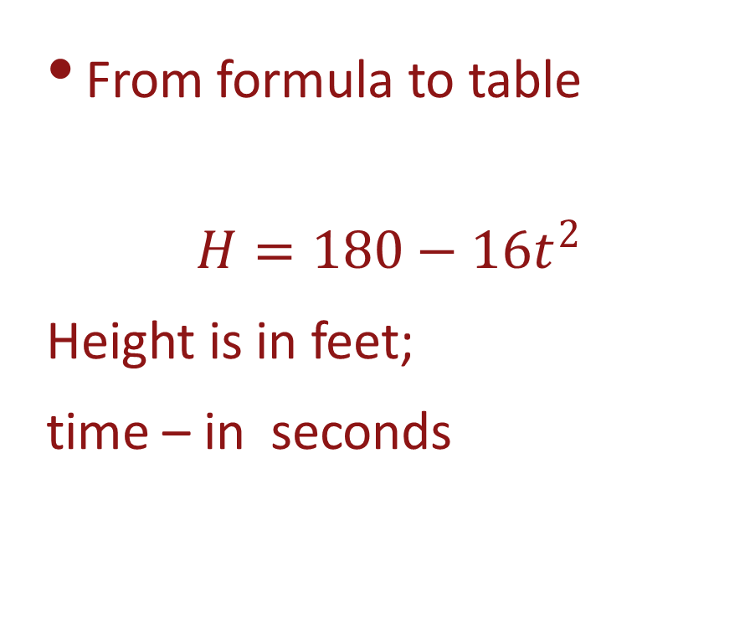
Connection between different representations of a function
From formula to table
$$H=180−16t^{2}$$
Height is in feet;
time – in seconds

Slide 15
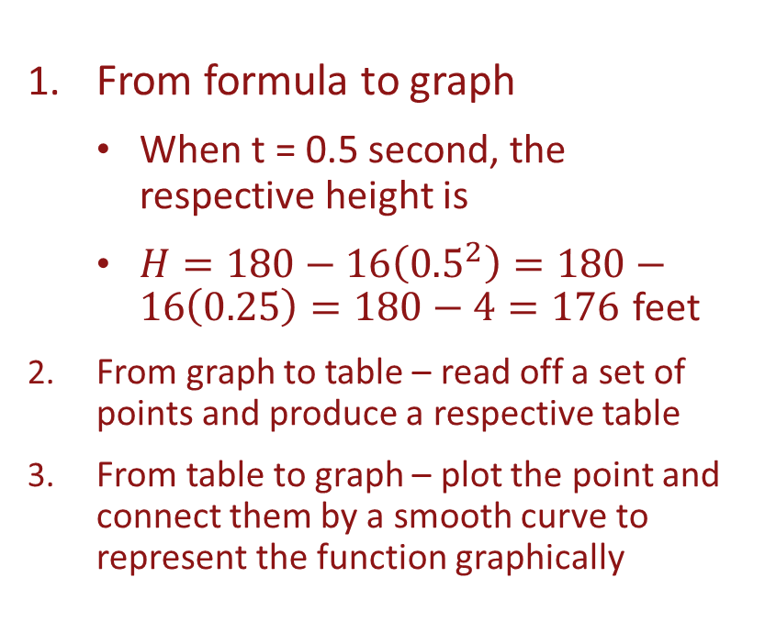
Connection between different representations of a function
From formula to graph
When t = 0.5 second, the respective height is
$H=180−16\left({0.5}^{2}\right)=180−16\left(0.25\right)=180−4=176$ feet
From graph to table – read off a set of points and produce a respective table
From table to graph – plot the point and connect them by a smooth curve to represent the function graphically

Slide 16
From table to formula; from graph to formula
Often in real life we have a data table and need to produce a formula to fit the given data points
This is difficult but is made possible using modern technology
We’ll revisit this approach several times in our course in future classes

Slide 17
Behavior of Functions
Increasing/Decreasing function

Slide 18
Behavior of Functions
Not every quantity only increases/decreases
Height of a bouncing ball
Value of the Dow-Jones average
Min temperature readings in a given location
Local minimum/maximum (Turning Points)

Slide 19
Examples
For each of the following functions, determine which are strictly increasing, strictly decreasing, or neither.
The closing price of one share of Apple stock for each trading day on the stock exchange.
The height H of a bungee jumper t seconds after leaping off a bridge.

Slide 20
Local Extrema
On what intervals is the function increasing/decreasing?
Decreases on the intervals t=0 to t=4 and t=6 to t=10
Increases on the intervals t=4 to t=6 and t=10 onwards
Where are the turning points?
Turning point at t=4, t=6 and t=10
What are the max/min values?
Local minimum at t=4 and t=10
Local maximum at t=6

Slide 21
Concavity – how a function bends
Suppose we have a strictly increasing or a strictly decreasing function.
Increasing - graph rises from left to right
Decreasing – graph falls from left to right
What is the difference between the given functions?

Slide 22
Concavity – how a function bends
Suppose we have a strictly increasing or a strictly decreasing function.
What is the difference between the given functions?
The way it bends.
How fast does it increase/decrease initially and afterwards?

Slide 23
Concavity – how a function bends
How fast does it increase/decrease initially and afterwards?
First increase slowly then faster, fig. 2.11
First increases rapidly then more slowly, fig. 2.11
How about the decreasing function?

Slide 24
Concavity – how a function bends
Concavity is different from monotonicity
Concave UP
Concave DOWN

Slide 25
Intervals of Concavity; Inflection points
An Inflection point is where the graph changes it concavity

Slide 26
Logistic Growth Model
It is important where the inflection point occurs
Growth of a population
Starts slowly
Grows more and more rapidly
Eventually the growth slows down again
Limited resources play a role
– food, diseases, competition, etc.
Sales of electronics

Slide 27
Summary
A function is
Increasing if its values increase as the argument increases
Decreasing if its values decrease as the argument increases
Turning point – where the monotonicity changes
Concave UP if the graph bends upwards
Concave DOWN if the graphs bends downwards
Inflection point - where bending of graph changes

Slide 28
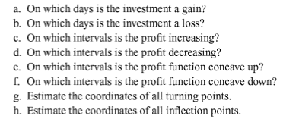
Example
Amount of profit from an investment over the course of 40 days from the day on which it was purchased

Slide 29
Periodic Behavior
The tide at different times of the day near Montauk Point at the eastern end of Long Island

