Slide 1
Representing Functions Symbolically
All slides in this presentations are based on the book Functions, Data and Models, S.P. Gordon and F. S Gordon ISBN 978-0-88385-767-0

Slide 2
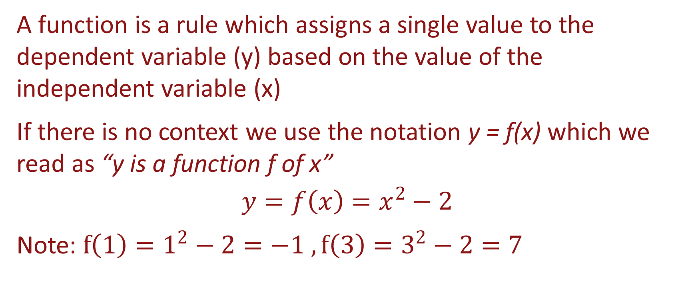
Function is a Rule
A function is a rule which assigns a single value to the dependent variable (y) based on the value of the independent variable (x)
If there is no context we use the notation y = f(x) which we read as “y is a function f of x”
$$y=f\left(x\right)=x^{2}−2$$
Note: $f\left(1\right)=1^{2}−2=−1 , f\left(3\right)=3^{2}−2=7$

Slide 3
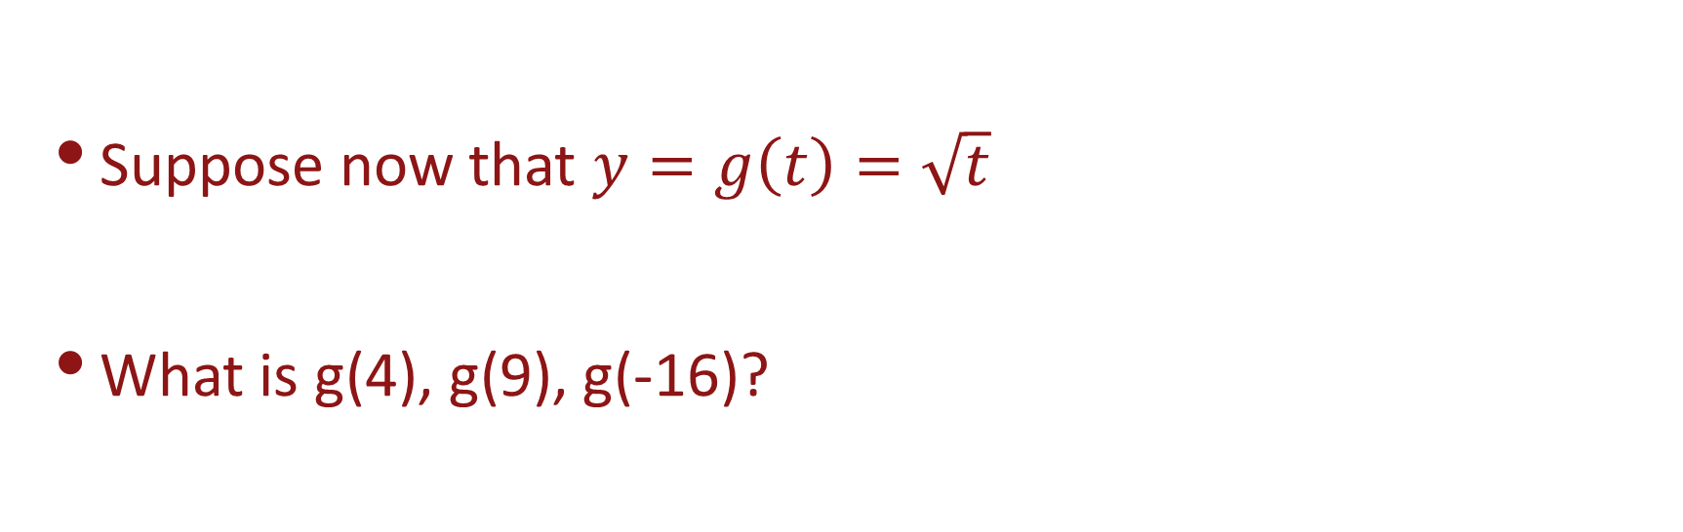
Function is a Rule
Suppose now that $y=g\left(t\right)=\sqrt{t}$
What is g(4), g(9), g(-16)?

Slide 4

Function is a rule
Suppose now that $y=g\left(t\right)=\sqrt{t}$
What is g(4), g(9), g(-16)?
$g\left(4\right)=\sqrt{4}=2$
$g\left(9\right)=\sqrt{9}=3$
$g\left(−16\right)=\sqrt{−16}=undefined$

Slide 5
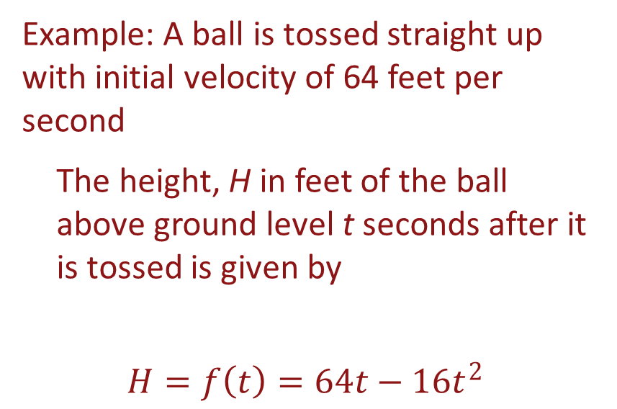
Functions with a context
In a real-world context we use other letters that convey the meaning of the variables, e.g.
t – time
H – height
P – population
C – cost
A – area
Example: A ball is tossed straight up with initial velocity of 64 feet per second
The height, H in feet of the ball above ground level t seconds after it is tossed is given by
$$H=f\left(t\right)=64t−16t^{2}$$

Slide 6
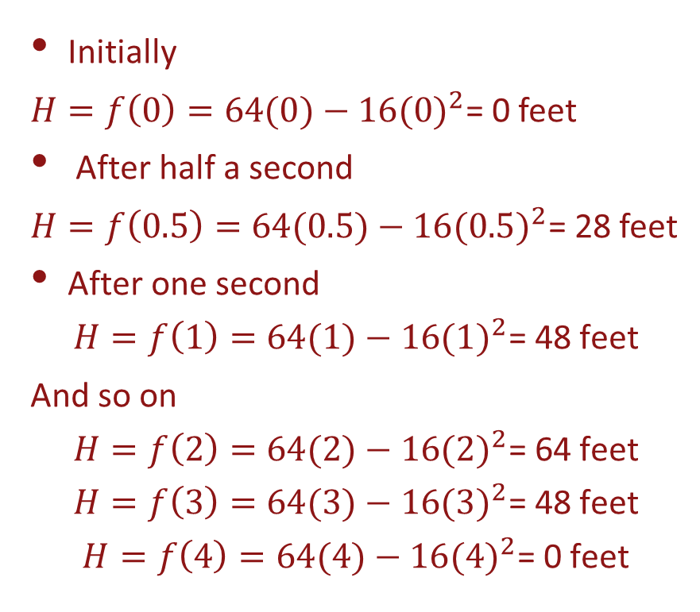
Tossed Ball Example
Initially
$H=f\left(0\right)=64(0)−16({0)}^{2}\text{= 0}$ feet
After half a second
$H=f\left(0.5\right)=64(0.5)−16({0.5)}^{2}\text{= }\text{28}$ feet
After one second
$$H=f\left(1\right)=64(1)−16({1)}^{2}\text{= }\text{48 }\text{feet}$$
And so on
$$H=f\left(2\right)=64(2)−16({2)}^{2}\text{= }\text{64 }\text{feet}$$
$$H=f\left(3\right)=64(3)−16({3)}^{2}\text{= }\text{48 }\text{feet}$$
$$H=f\left(4\right)=64(4)−16({4)}^{2}\text{= }\text{0 }\text{feet}$$

Slide 7
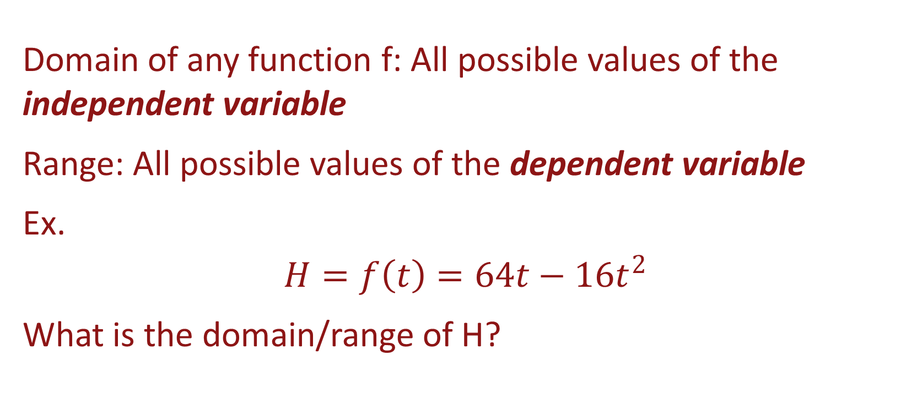
Domain and Range of a Function
Domain of any function f: All possible values of the independent variable
Range: All possible values of the dependent variable
Ex.
$$H=f\left(t\right)=64t−16t^{2}$$
What is the domain/range of H?

Slide 8
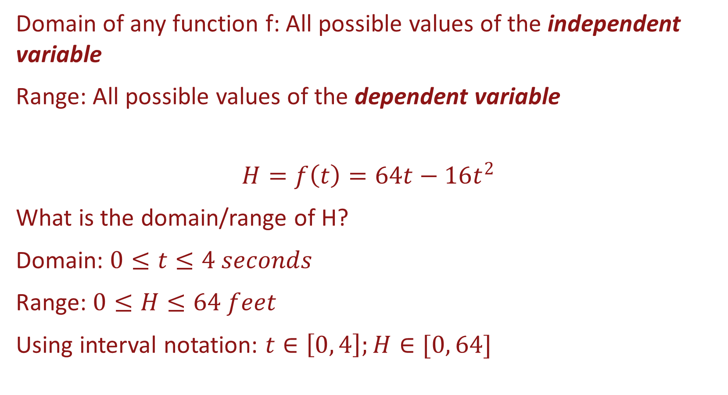
Domain and Range of a Function
Domain of any function f: All possible values of the independent variable
Range: All possible values of the dependent variable
$$H=f\left(t\right)=64t−16t^{2}$$
What is the domain/range of H?
Domain: $0≤t≤4 seconds$
Range: $0≤H≤64 feet$
Using interval notation: $t∈\left[0, 4\right];H∈[0, 64]$

Slide 9
Domain and Range of a Function
Estimate the domain and the range of the given function

Slide 10
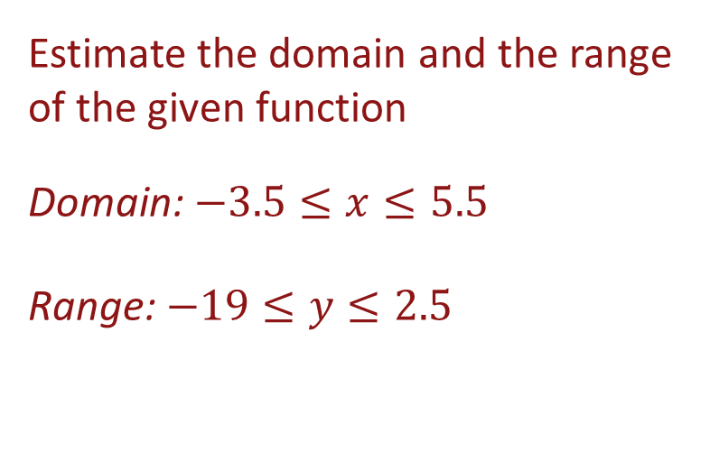
Domain and Range of a Function
Estimate the domain and the range of the given function
Domain: $−3.5≤x≤5.5$
Range: $−19≤y≤2.5$

Slide 11

Domain and Range of a Function
How about
$y=g\left(t\right)=\sqrt{t}$?
$$y=h\left(x\right)=\frac{1}{x−2}$$
$$y=w\left(z\right)=z^{2}$$

Slide 12
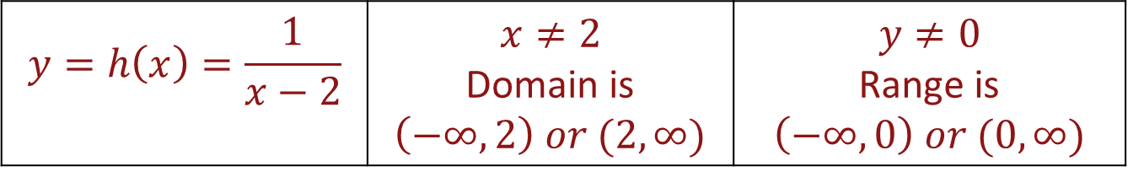
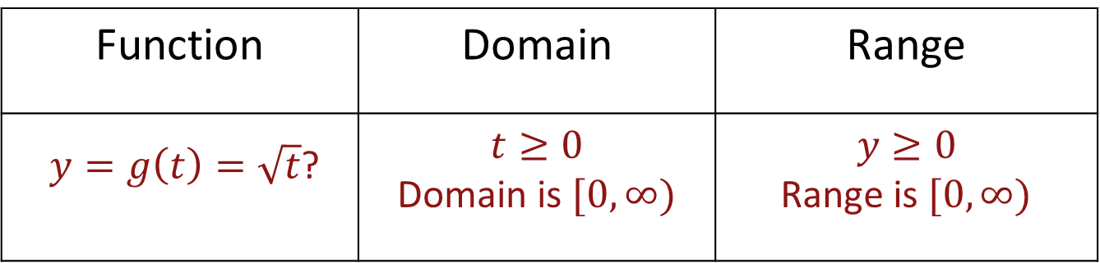
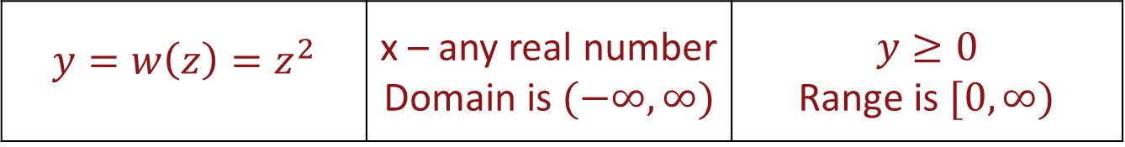
Domain and Range of a Function
Function | Domain | Range
$y=g\left(t\right)=\sqrt{t}$? | $$t≥0$$ Domain is $[0,∞)$ | $$y≥0$$ Range is $[0,∞)$
$$y=h\left(x\right)=\frac{1}{x−2}$$ | $$x≠2$$ Domain is $\left(−∞,2\right) or (2,∞)$ | $$y≠0$$ Range is $\left(−∞,0\right) or (0,∞)$
$$y=w\left(z\right)=z^{2}$$ | x – any real number Domain is $(−∞,∞)$ | $$y≥0$$ Range is $[0,∞)$

Slide 13
Distance covered at steady speed
The distance (in miles) a car drives at steady speed is a function of the number of hours
Denote the variables; Which is the independent variable? Which is the dependent variable?

Slide 14
Distance covered at steady speed
The distance (in miles) a car drives at steady speed is a function of the number of hours
Denote the variables; Which is the independent variable? Which is the dependent variable?
D – distance traveled, in miles, since beginning – dependent variable
t – total time of trip, in hours - independent variable

Slide 15
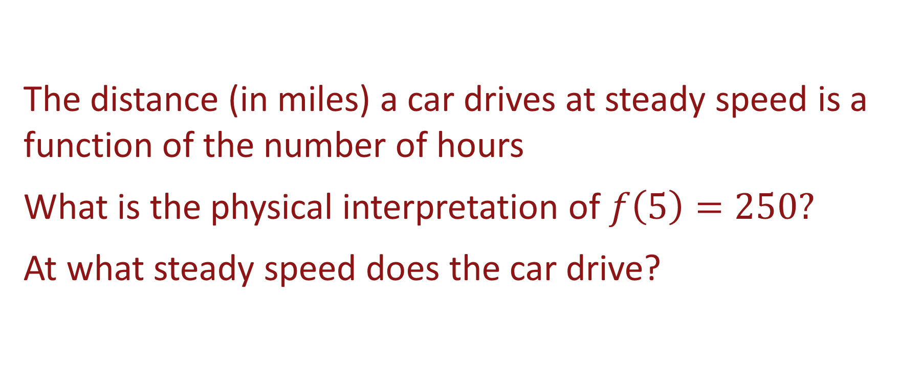
Distance covered at steady speed
The distance (in miles) a car drives at steady speed is a function of the number of hours
What is the physical interpretation of $f\left(5\right)=250?$
At what steady speed does the car drive?

Slide 16
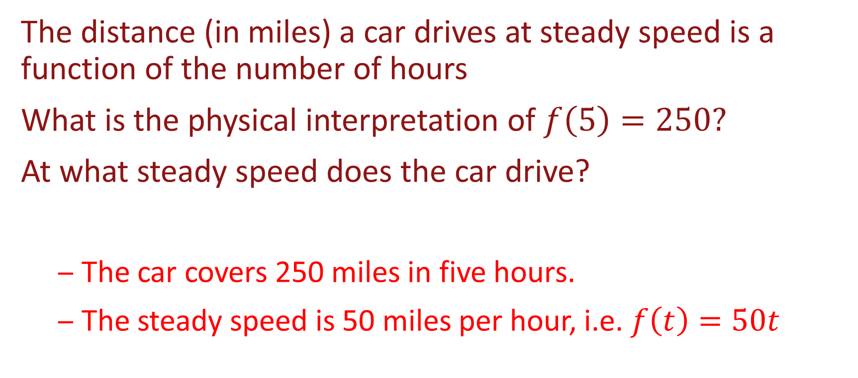
Distance covered at steady speed
The distance (in miles) a car drives at steady speed is a function of the number of hours
What is the physical interpretation of $f\left(5\right)=250?$
At what steady speed does the car drive?
The car covers 250 miles in five hours.
The steady speed is 50 miles per hour, i.e. $f\left(t\right)=50t$

Slide 17
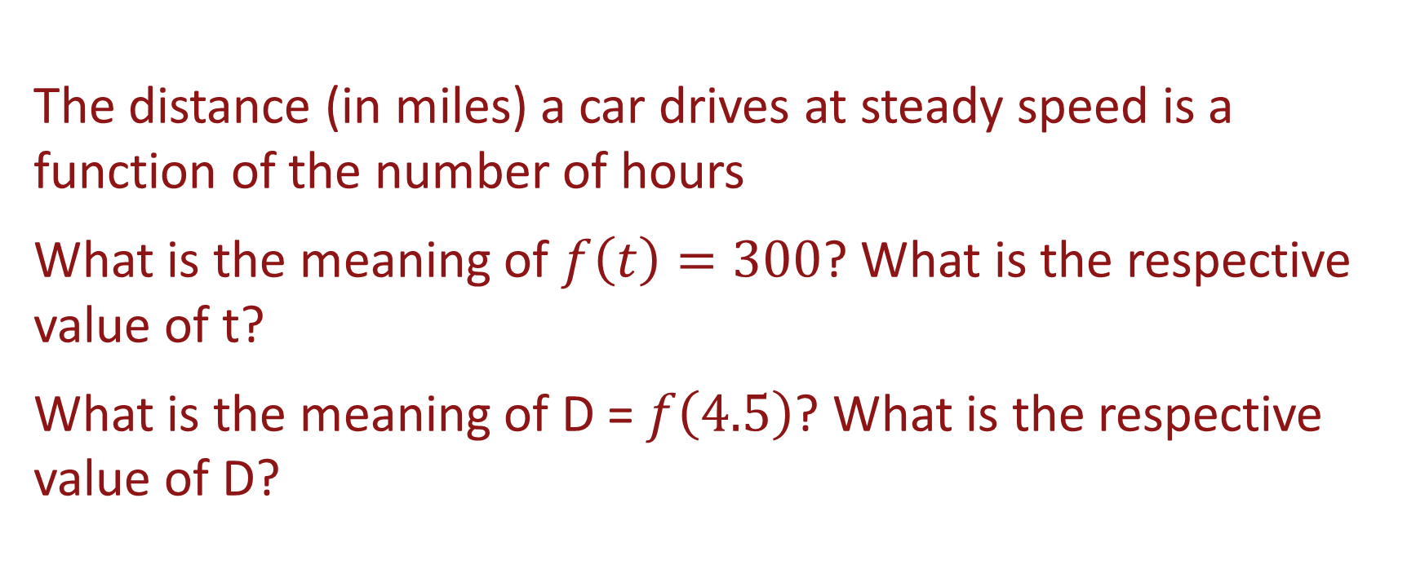
Distance covered at steady speed
The distance (in miles) a car drives at steady speed is a function of the number of hours
What is the meaning of $f\left(t\right)=300$? What is the respective value of t?
What is the meaning of D =$f\left(4.5\right)$? What is the respective value of D?

Slide 18
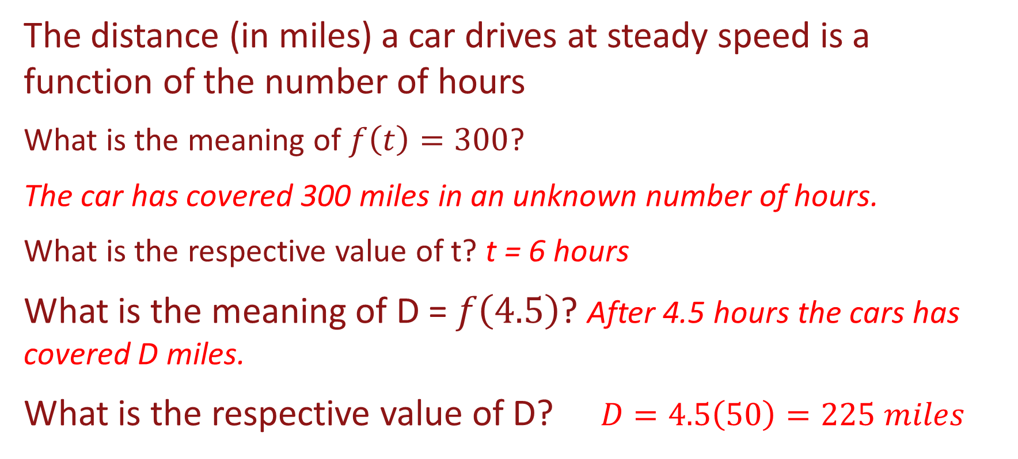
Distance covered at steady speed
The distance (in miles) a car drives at steady speed is a function of the number of hours
What is the meaning of $f\left(t\right)=300$?
The car has covered 300 miles in an unknown number of hours.
What is the respective value of t? t = 6 hours
What is the meaning of D =$f\left(4.5\right)$? After 4.5 hours the cars has covered D miles.
What is the respective value of D? $D=4.5\left(50\right)=225 miles$

Slide 19
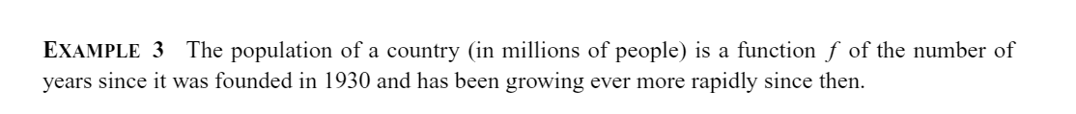
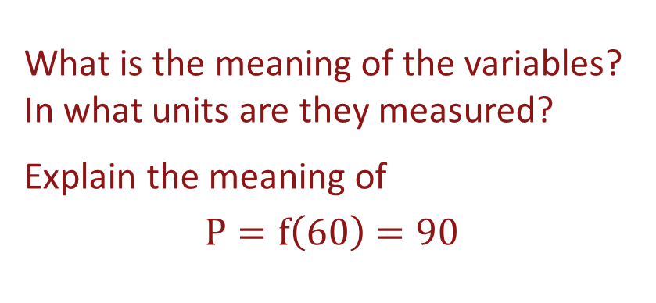
Population of a Country since 1930
Suppose you are given the following graph
What is the meaning of the variables? In what units are they measured?
Explain the meaning of
$$P=f\left(60\right)=90$$

Slide 20
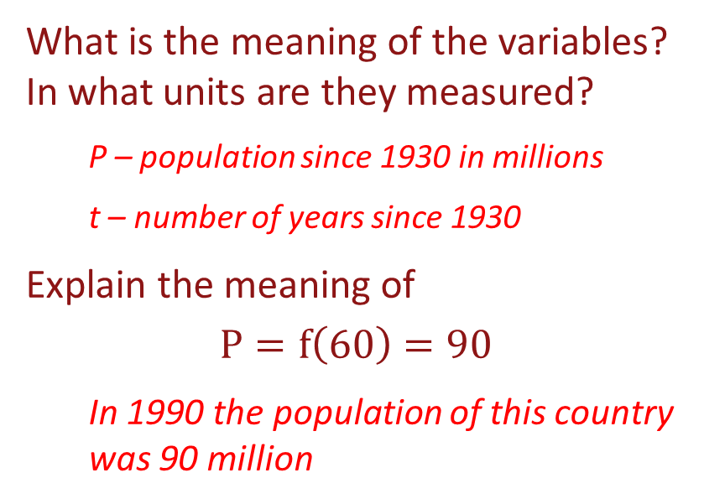
Population of a Country since 1930
What is the meaning of the variables? In what units are they measured?
P – population since 1930 in millions
t – number of years since 1930
Explain the meaning of
$$P=f\left(60\right)=90$$
In 1990 the population of this country was 90 million
Suppose you are given the following graph

Slide 21
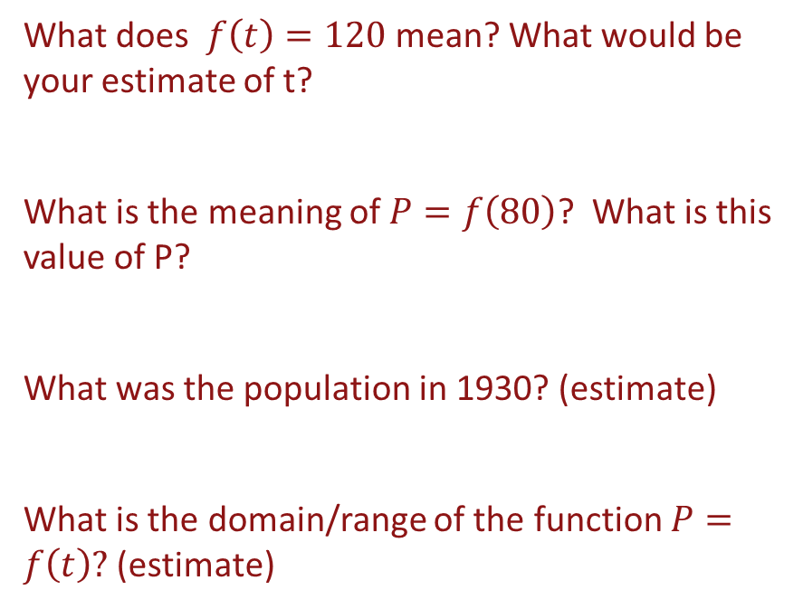
Population of a Country since 1930
Suppose you are given the following graph
What does $f\left(t\right)=120$ mean? What would be your estimate of t?
What is the meaning of$P=f\left(80\right)$? What is this value of P?
What was the population in 1930? (estimate)
What is the domain/range of the function $P=f\left(t\right)?$ (estimate)

Slide 22
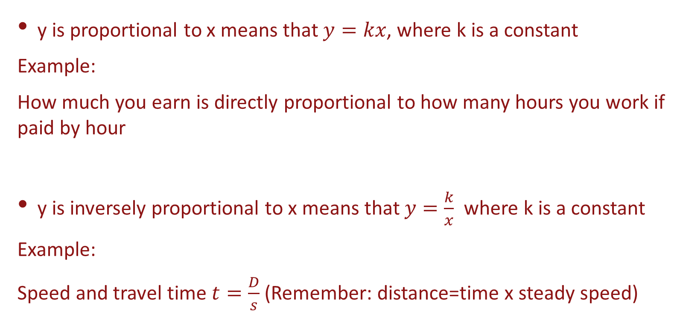
Proportionality
y is proportional to x means that $y=kx$, where k is a constant
Example:
How much you earn is directly proportional to how many hours you work if paid by hour
y is inversely proportional to x means that $y=\frac{k}{x}$ where k is a constant
Example:
Speed and travel time $t=\frac{D}{s}$ (Remember: distance=time x steady speed)

