Slide 1
Exponential Growth Functions
All slides in this presentations are based on the book Functions, Data and Models, S.P. Gordon and F. S Gordon ISBN 978-0-88385-767-0

Slide 2
Review: Algebra with Exponents

Slide 3
A Few Problems

Slide 4
Example 1
We’ll study functions that increase in a concave up or a concave down fashion. Consider the population of Niger, growing at rate 3.4% per year (one of the fastest in the world)

Slide 5
Example 1 – Finding a Formula for the Model
Note, the population is increasing at an increasing rate, i.e. following a concave up fashion. How to find the respective formula of the function?
In general, we have

Slide 6
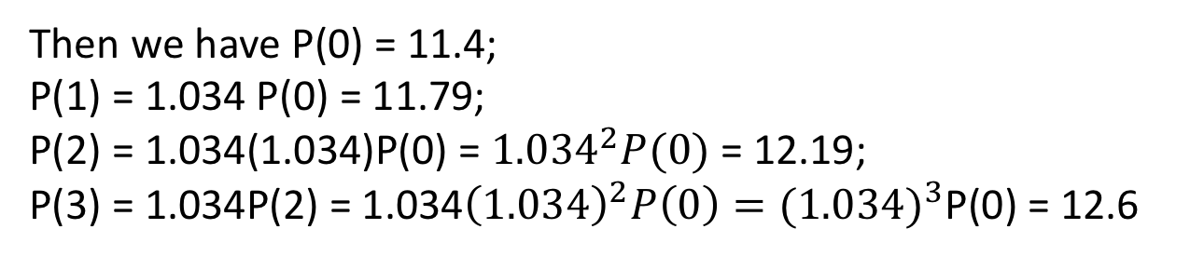
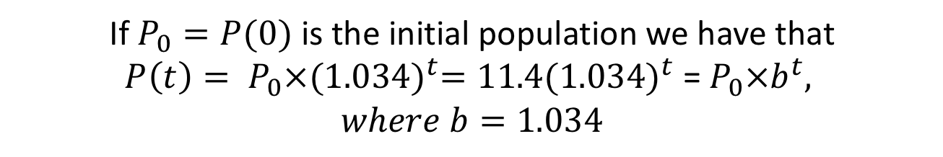
Example 1 – Finding a Formula for the Model
Let t - number of years since 1999 and P(t) – population of Niger (in millions) t years after 1999.
Then we have P(0) = 11.4;
P(1) = 1.034 P(0) = 11.79;
P(2) = 1.034(1.034)P(0) = ${1.034}^{2}P(0)$ = 12.19;
P(3) = 1.034P(2) = 1.034${\left(1.034\right)}^{2}P\left(0\right)={(1.034)}^{3}$P(0) = 12.6
If $P_{0}=P(0)$ is the initial population we have that
$P\left(t\right)= P_{0}×{(1.034)}^{t}=11.4{(1.034)}^{t}$ = $P_{0}×b^{t},$
$$where b=1.034$$

Slide 7

Example 1 - Terminology
$$P\left(t\right)= P_{0}×{(1.034)}^{t}=11.4{(1.034)}^{t}$$
Exponential growth function/model with base b = 1.034. Note, t appears in the exponent.
The population in each year is 1.034 times the population of the preceding year.
The quantity is 0.034 = 3.4% is the respective annual growth rate, r.
Recall that the population of Niger grows at 3.4% per year.
Growth Factor = 1 + Growth Rate; b = 1 + r
Growth Rate = Growth Factor -1; r = b - 1
Growth rate, r, must be written as a decimal, not a percent.

Slide 8
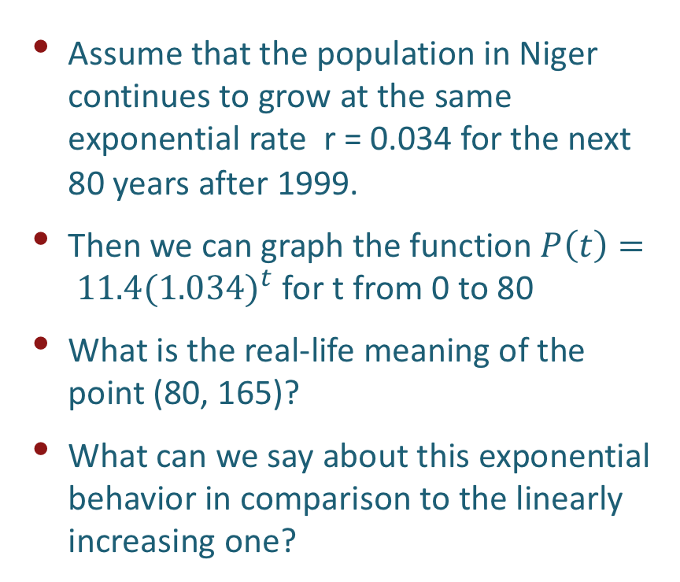
Population growth of Niger - Graph
Assume that the population in Niger continues to grow at the same exponential rate r = 0.034 for the next 80 years after 1999.
Then we can graph the function $P\left(t\right)= 11.4{(1.034)}^{t}$ for t from 0 to 80
What is the real-life meaning of the point (80, 165)?
What can we say about this exponential behavior in comparison to the linearly increasing one?
We note that even though this exponential model grows quite slowly at the beginning, eventually peaks up to reach very rapid increase leading to huge population for which there may not be enough resources.

Slide 9
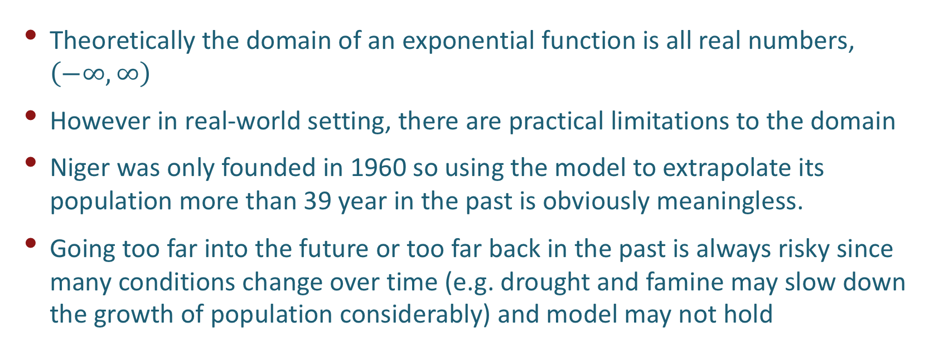
Domain of an Exponential Function
Theoretically the domain of an exponential function is all real numbers, $\left(−∞,∞\right)$
However in real-world setting, there are practical limitations to the domain
Niger was only founded in 1960 so using the model to extrapolate its population more than 39 year in the past is obviously meaningless.
Going too far into the future or too far back in the past is always risky since many conditions change over time (e.g. drought and famine may slow down the growth of population considerably) and model may not hold

Slide 10
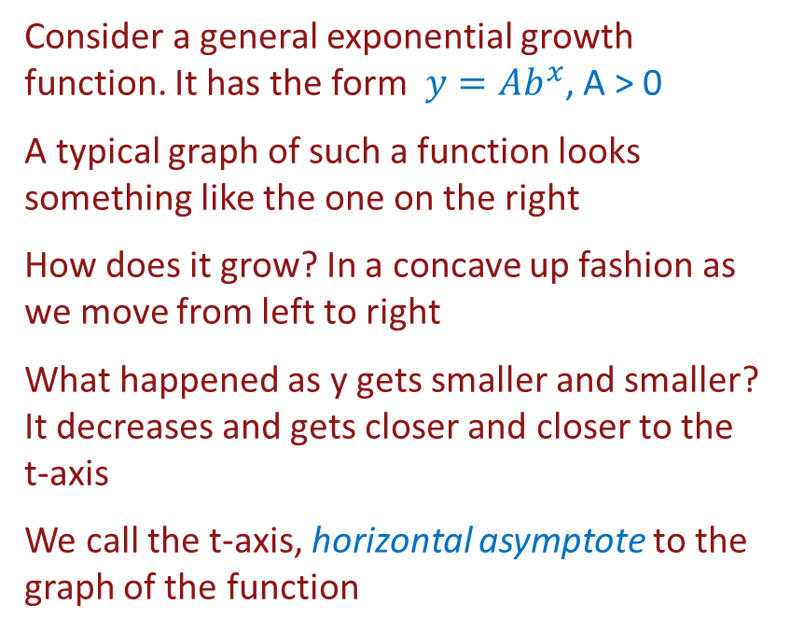
Range of an Exponential Function
Consider a general exponential growth function. It has the form $y=Ab^{x}$, A > 0
A typical graph of such a function looks something like the one on the right
How does it grow? In a concave up fashion as we move from left to right
What happened as y gets smaller and smaller? It decreases and gets closer and closer to the t-axis
We call the t-axis, horizontal asymptote to the graph of the function

Slide 11
Range of an Exponential Function
Remember that
So we have numerically,
Hence as x gets smaller and smaller, the values of the function approach 0

Slide 12
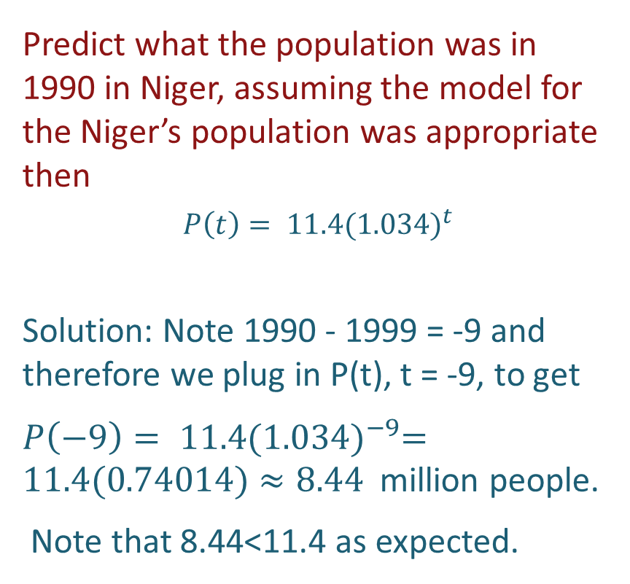
Population growth of Niger – Negative Values of the Independent Variable
Predict what the population was in 1990 in Niger, assuming the model for the Niger’s population was appropriate then
$$P\left(t\right)= 11.4{(1.034)}^{t}$$
Solution: Note 1990 - 1999 = -9 and therefore we plug in P(t), t = -9, to get
$P\left(−9\right)= 11.4{(1.034)}^{−9}=11.4(0.74014)≈8.44$ million people.
Note that 8.44<11.4 as expected.

Slide 13
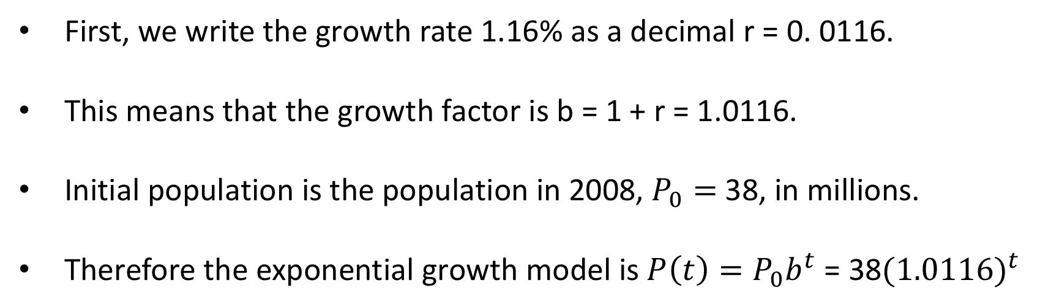
Example 2 – California Population
Example 2 The population of California in 2008 was 38 million with an annual growth rate of 1.16%. Write a formula for the population of California at any time after 2008.
First, we write the growth rate 1.16% as a decimal r = 0. 0116.
This means that the growth factor is b = 1 + r = 1.0116.
Initial population is the population in 2008, $P_{0}=$38, in millions.
Therefore the exponential growth model is $P\left(t\right)=P_{0}b^{t}$ = 38${(1.0116)}^{t}$

Slide 14
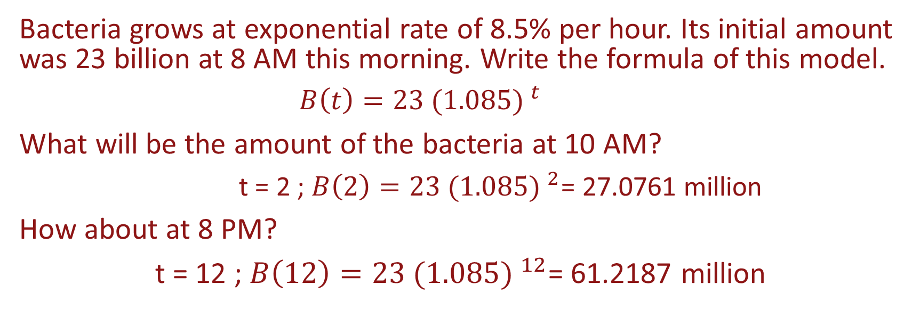
Other Examples of Exponential Growth
Bacteria grows at exponential rate of 8.5% per hour. Its initial amount was 23 billion at 8 AM this morning. Write the formula of this model.
$$B\left(t\right)=23 {(1.085) }^{t}$$
What will be the amount of the bacteria at 10 AM?
t = 2 ; $B\left(2\right)=23 {(1.085) }^{2}$= 27.0761 million
How about at 8 PM?
t = 12 ; $B\left(12\right)=23 {(1.085) }^{12}$= 61.2187 million

Slide 15
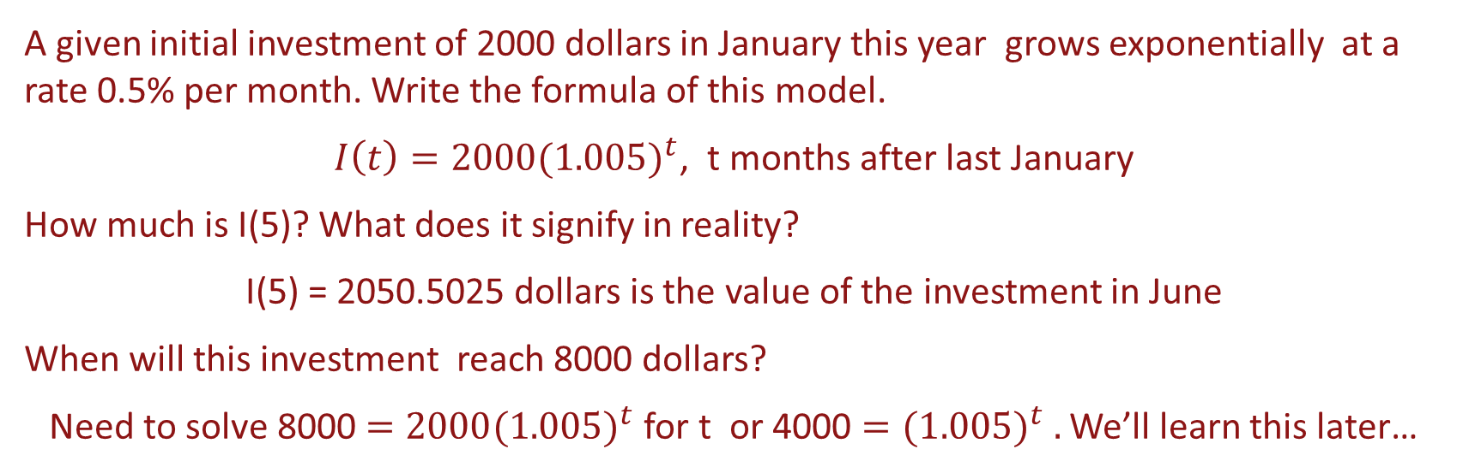
Other Examples of Exponential Growth
A given initial investment of 2000 dollars in January this year grows exponentially at a rate 0.5% per month. Write the formula of this model.
$I\left(t\right)=2000{(1.005)}^{t}$, t months after last January
How much is I(5)? What does it signify in reality?
I(5) = 2050.5025 dollars is the value of the investment in June
When will this investment reach 8000 dollars?
Need to solve 8000 $=2000{(1.005)}^{t}$ for t or 4000 $={(1.005)}^{t} .$ We’ll learn this later…

Slide 16
Mathematical Role of Growth Factor
$P\left(t\right)$= $P_{0}×b^{t}$
The role of the growth factor b is similar to that of the slope of a linear function. The larger b is, the faster the exponential function grows.
Where does the curve lie if b = 1.045? What if b = 1.032?

Slide 17
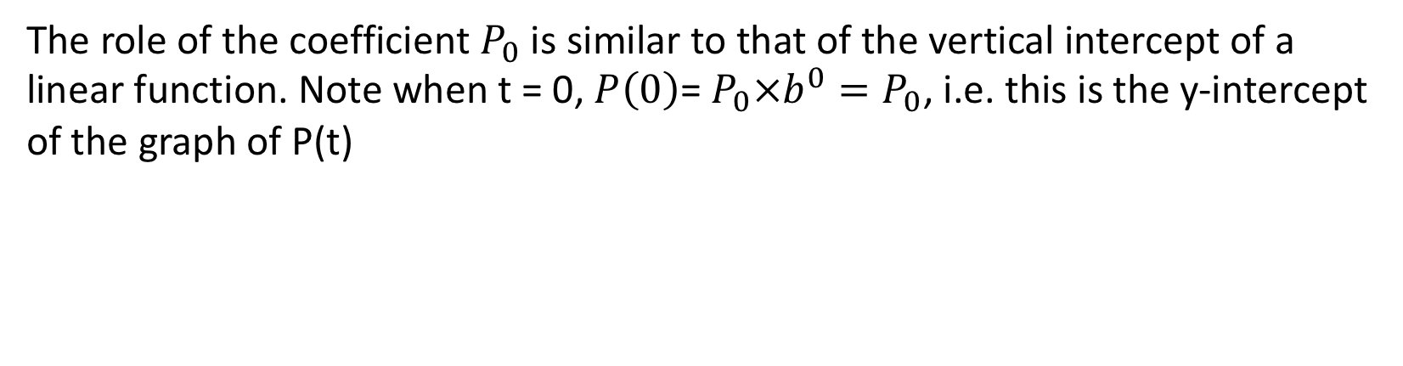
Mathematical Role of Initial Population
$P\left(t\right)$= $P_{0}×b^{t}$
The role of the coefficient $P_{0}$is similar to that of the vertical intercept of a linear function. Note when t = 0, $P\left(0\right)$= $P_{0}×b^{0}=P_{0}$, i.e. this is the y-intercept of the graph of P(t)

Slide 18
Linear Growth versus Exponential Growth
Linear growth – increase by a fixed amount (slope=m);
Exponential growth – increases by a fixed percent

Slide 19
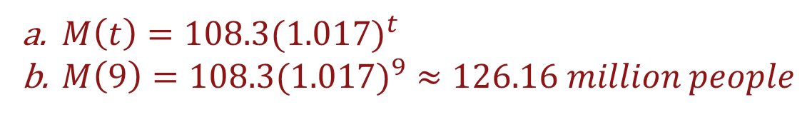
Example 3 – Population of Mexico
Example 3 In 2006, the population of Mexico was 108.3 million and was growing exponentially at a rate of 1.7% per year.
Find a formula for the population of Mexico at any time t
Predict the population of Mexico in 2015.
Solution:
$M\left(t\right)=108.3({1.017)}^{t}$
$M\left(9\right)=108.3({1.017)}^{9}≈126.16 million people$

Slide 20
Example 4 – Loan of NYC
Example 4 In the early 1990s, a historian discovered a million-dollar loan that the New York City had made to the U.S. government in 1812. At first, it appeared that the loan had never been repaid. Assuming a 6% annual compound interest rate, what would the value V of this loan have become by 2010?
Solution: what is the value of the growth factor?
It is = 1 + 0.06
$$M\left(t\right)=M_{0}({1.06)}^{t}=1∙{1.06}^{t}$$
What does t equal to in 2010?
t = 2010 – 1812 = 198 years, so resulting balance would be
$$M\left(198\right)=1∙{1.06}^{198}≈102,462 million$$

Slide 21
Example 4 – Loan of NYC
How does the graph of M(t) look like?

