Slide 1
Logarithmic Functions
All slides in this presentations are based on the book Functions, Data and Models, S.P. Gordon and F. S Gordon ISBN 978-0-88385-767-0

Slide 2

Example 1
Consider the population of Niger, growing at rate 3.4% per year (one of the fastest in the world)
$$P\left(t\right)= P_{0}×{(1.034)}^{t}=11.4{(1.034)}^{t}$$

Slide 3
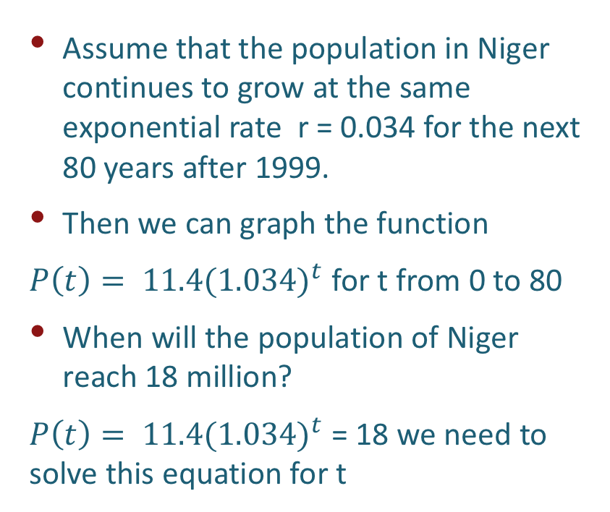
Population growth of Niger - Graph
Assume that the population in Niger continues to grow at the same exponential rate r = 0.034 for the next 80 years after 1999.
Then we can graph the function
$P\left(t\right)= 11.4{(1.034)}^{t}$ for t from 0 to 80
When will the population of Niger reach 18 million?
$P\left(t\right)= 11.4{(1.034)}^{t}$ = 18 we need to solve this equation for t
This exponential function is strictly increasing so for we know that there is exactly one time value for which P(t) = 18. How to find it algebraically?

Slide 4
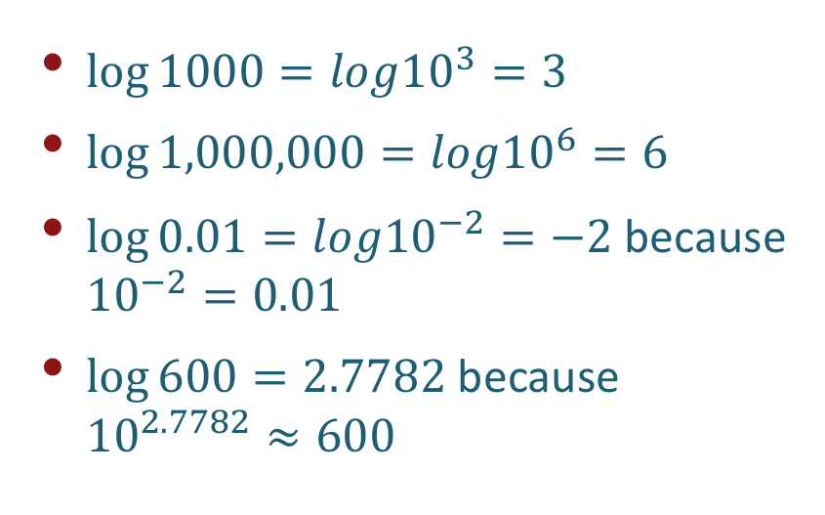
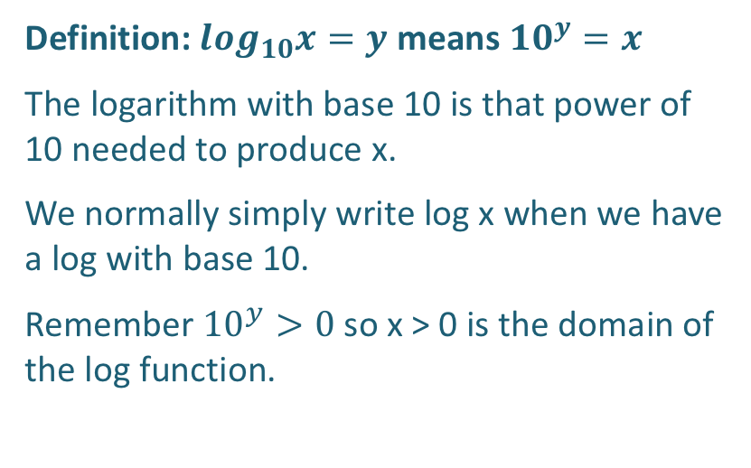

Definition of Logarithm with Base 10
Definition: $\log_{10}x=y$ means ${10}^{y}=x$
The logarithm with base 10 is that power of 10 needed to produce x.
We normally simply write log x when we have a log with base 10.
Remember ${10}^{y}>0$ so x > 0 is the domain of the log function.
$\log{1000=log{10}^{3}=3}$
$\log{1,000,000=log{10}^{6}=6}$
$\log{0.01=log{10}^{−2}=−2}$ because ${10}^{−2}=0.01$
$\log{600=2.7782}$ because ${10}^{2.7782}≈600$
Fundamental Logarithmic-Exponential Identities
$$log{10}^{x}=x for any real x;$$
${10}^{\log{x}}=x for x>0$

Slide 5
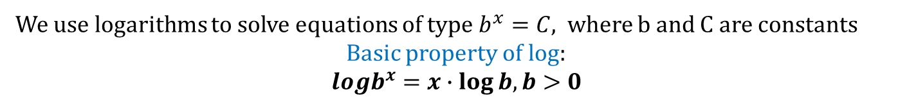





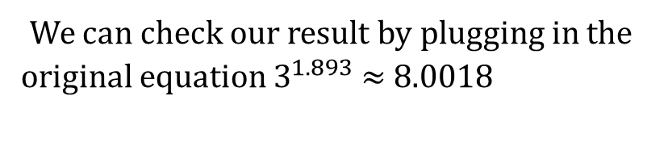

Example solving equations using logarithms
We use logarithms to solve equations of type $b^{x}=C,$ where b and C are constants
Basic property of log:
$$logb^{x}=x∙\log{b, b>0}$$
Example 1 Solve for x algebraically in the equation $3^{x}=8$
Solution
$$3^{x}=8$$
$${\log{3}}^{x}=\log{8}$$
$${\log{3}}^{x}=x∙\log{3=\log{8}}$$
$$\frac{x∙\log{3}}{\log{ 3}}=\frac{\log{8}}{\log{3}}$$
$$x=\frac{\log{8}}{\log{3}}≈1.893$$
We can check our result by plugging in the original equation $3^{1.893}$ $≈$ 8.0018

Slide 6
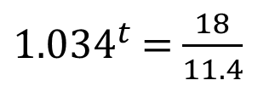

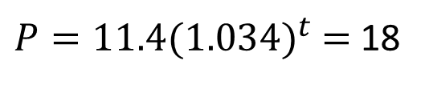
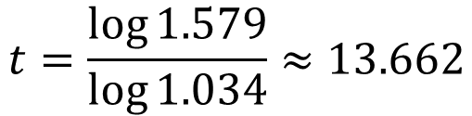

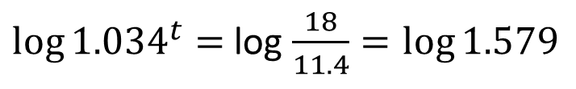
Example solving equations using logarithms
Example 2 Determine algebraically when the population of Niger will reach 18 million.
Solution
$P=11.4{(1.034)}^{t}$ $=$ 18
${1.034}^{t}$ $=$ $\frac{18}{11.4}$
${\log{1.034}}^{t}=$ log $\frac{18}{11.4}=\log{1.579}$
$t∙log{1.034}=$ $\log{1.579}$
$$t=\frac{\log{1.579}}{\log{1.034}}≈13.662$$
Niger’s population will double in about $13\frac{2}{3}$ years.

Slide 7

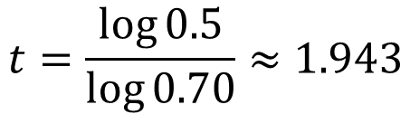


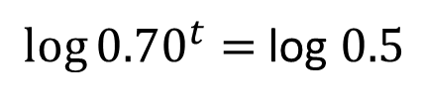
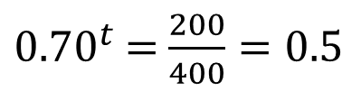
Example solving equations using logarithms
Example 3 Determine the half life of ibuprofen in blood given it follows the decay model
$$L(t)=400{(0.70)}^{t}$$
Solution
$$400{(0.70)}^{t}=200 Why?$$
${0.70}^{t}$ $=$ $\frac{200}{400}=0.5$
${\log{0.70}}^{t}=$ log $0.5$
$t∙log{0.70}=$ $\log{0.5}$
The level of ibuprofen in your blood will drop by half in just under two hours.
$$t=\frac{\log{0.5}}{\log{0.70}}≈1.943$$

Slide 8
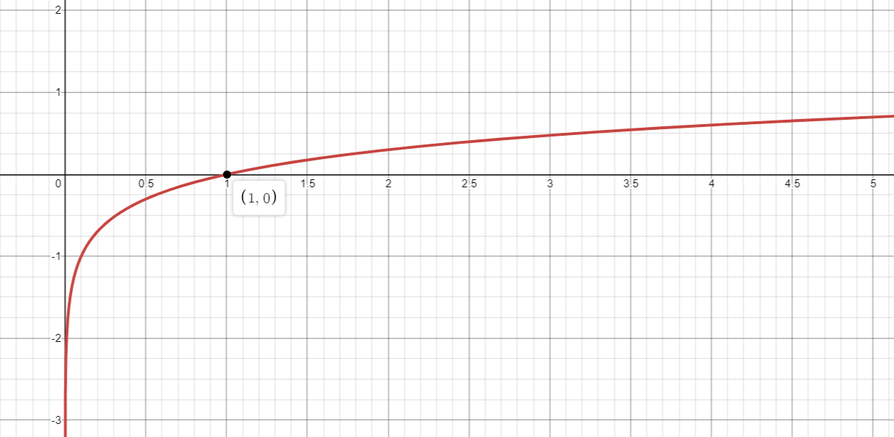

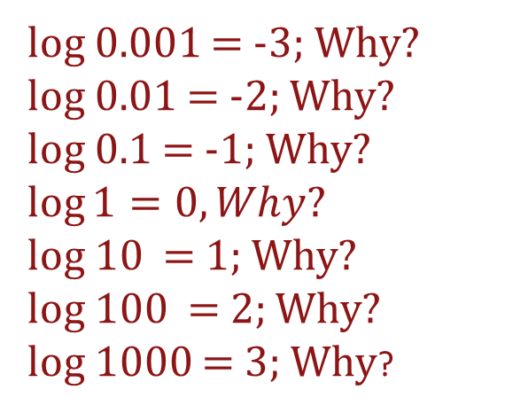
Behavior of the Logarithmic Function
Some questions:
What is the domain?
What is the range?
For what values of x is the function increasing (decreasing)?
For what values of x is the function concave up (concave down)?
log 0.001 = -3; Why?
log 0.01 = -2; Why?
log 0.1 = -1; Why?
$$\log{1=0, Why?}$$
log 10 = 1; Why?
log 100 = 2; Why?
log 1000 = 3; Why?
$$y=\log_{10}x$$

Slide 9
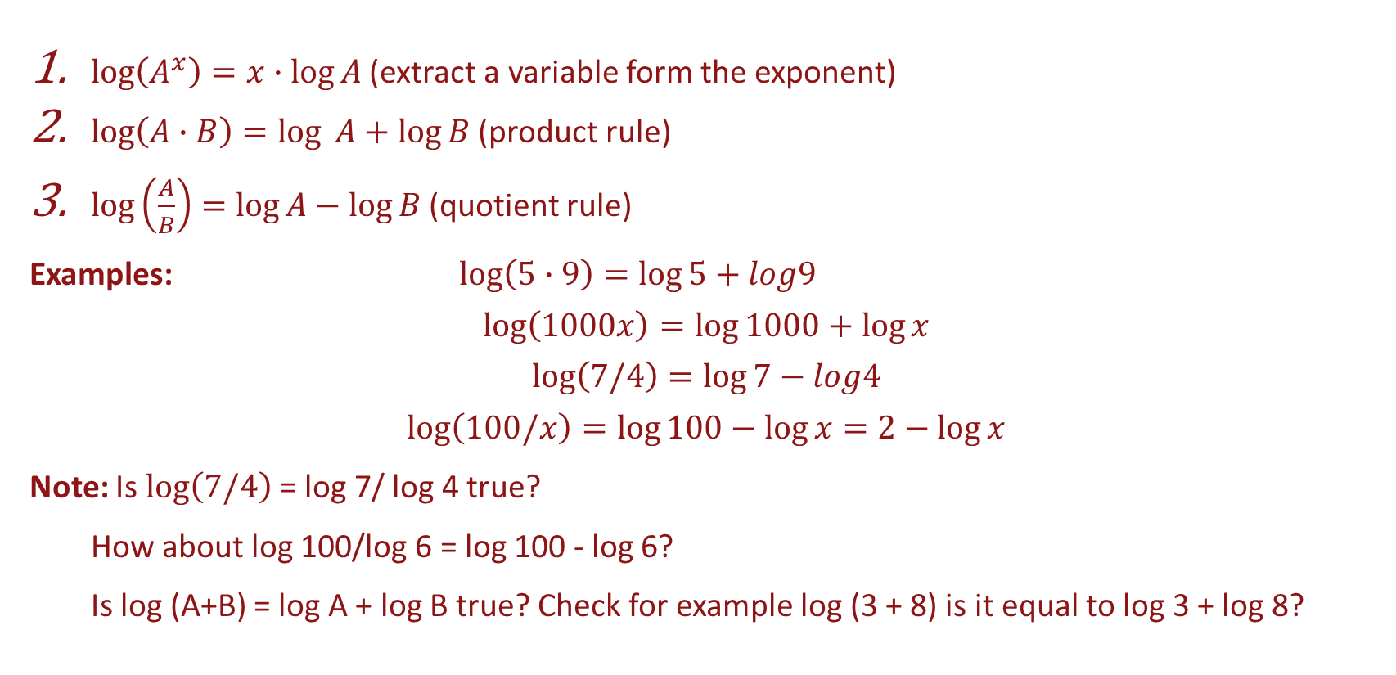
Additional Properties of Logarithms
$\log\left(A^{x}\right)=x∙\log{A}$ (extract a variable form the exponent)
$\log\left(A∙B\right)=\log{ A+\log{B}}$ (product rule)
$\log\left(\frac{A}{B}\right)=\log{A}−\log{B}$ (quotient rule)
Examples: $\log\left(5∙9\right)=\log{5+log9}$
$$\log\left(1000x\right)=\log{1000+\log{x}}$$
$$\log\left(7/4\right)=\log{7−log4}$$
$$\log\left(100/x\right)=\log{100−\log{x=2−\log{x}}}$$
Note: Is $\log\left(7/4\right)$ = log 7/ log 4 true?
How about log 100/log 6 = log 100 - log 6?
Is log (A+B) = log A + log B true? Check for example log (3 + 8) is it equal to log 3 + log 8?

Slide 10
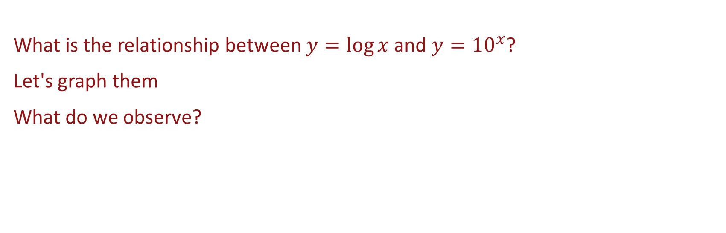
Comparing Exponential and Logarithmic Functions
What is the relationship between $y=\log{x}$and $y={10}^{x}$?
Let's graph them
What do we observe?

Slide 11
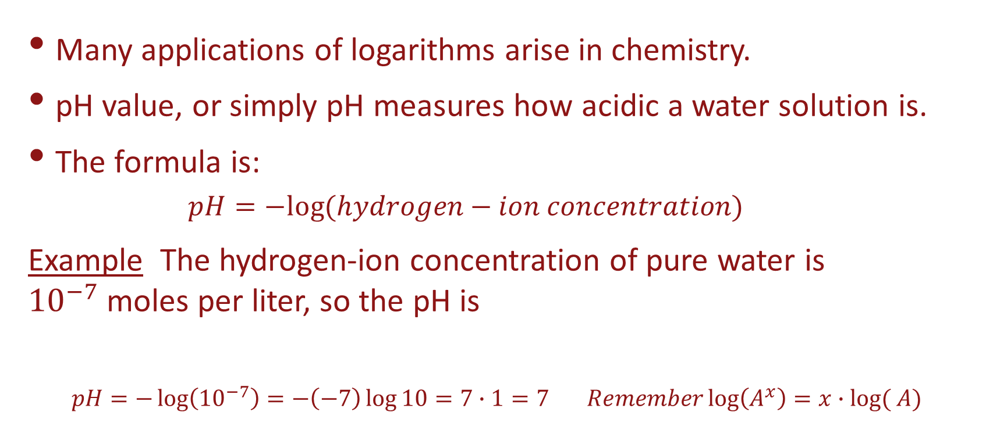
Modeling with Logarithms
Many applications of logarithms arise in chemistry.
pH value, or simply pH measures how acidic a water solution is.
The formula is:
$$pH=−log⁡(hydrogen−ion concentration)$$
Example The hydrogen-ion concentration of pure water is ${10}^{−7}$moles per liter, so the pH is
$$pH=−\log\left({10}^{−7}\right)=−\left(−7\right)\log{10}=7∙1=7 Remember\log\left(A^{x}\right)=x∙log⁡( A)$$

Slide 12
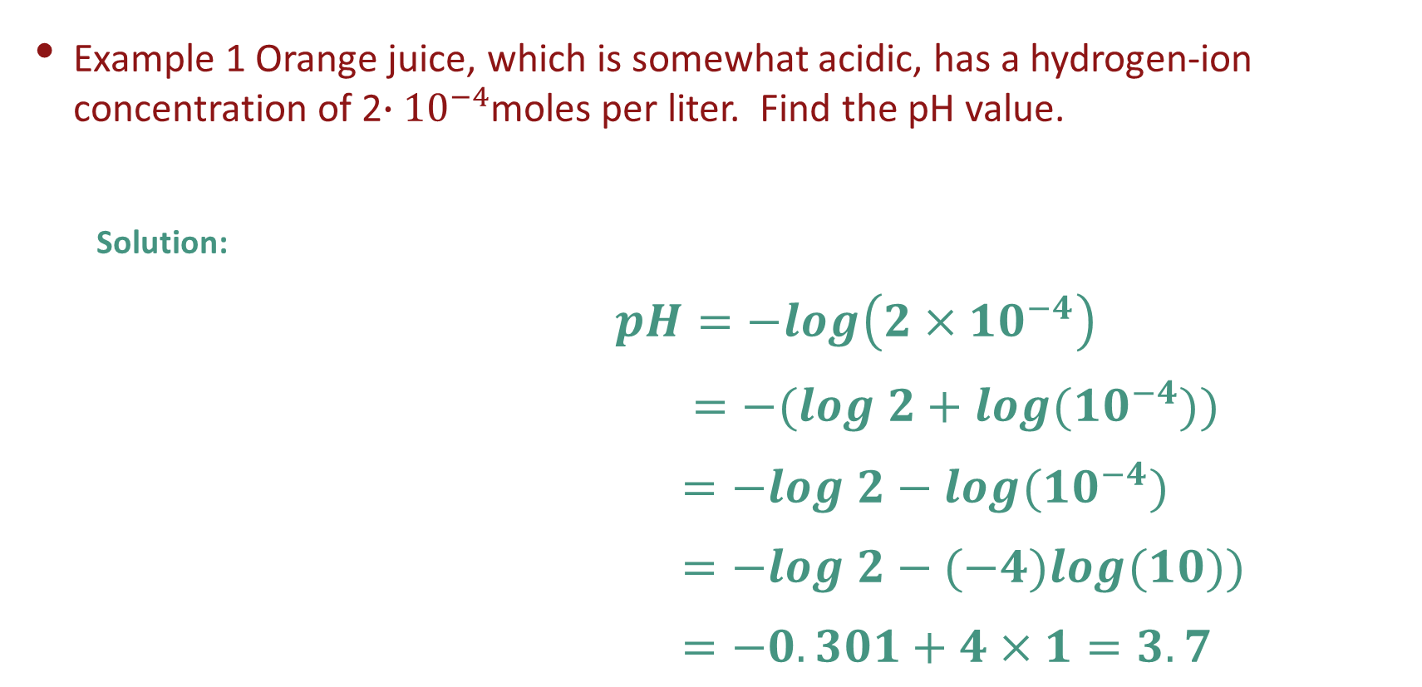
Modeling with Logarithms
Example 1 Orange juice, which is somewhat acidic, has a hydrogen-ion concentration of 2$∙{10}^{−4}$moles per liter. Find the pH value.
Solution:
$pH=−log\left(2×{10}^{−4}\right)$
$=−(log 2+log({10}^{−4}))$
$=−log 2−log({10}^{−4})$
$=−log 2−(−4)log(10))$
$=−0.301+4×1=3.7$

Slide 13
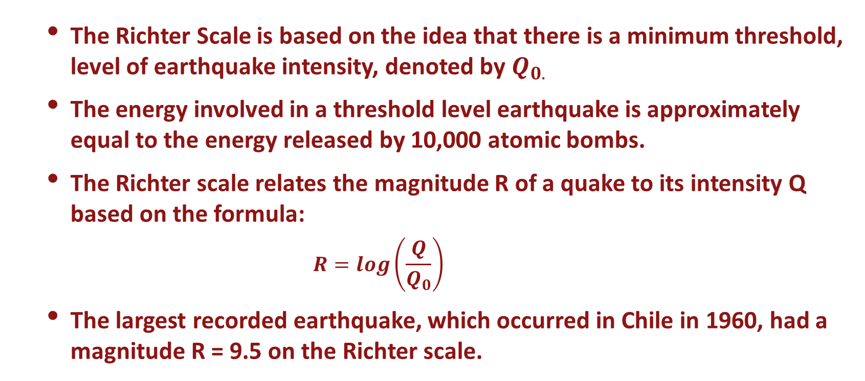
Earthquakes and the Richter Scale
The Richter Scale is based on the idea that there is a minimum threshold, level of earthquake intensity, denoted by $Q_{0.}$
The energy involved in a threshold level earthquake is approximately equal to the energy released by 10,000 atomic bombs.
The Richter scale relates the magnitude R of a quake to its intensity Q based on the formula:
$$R=log\left(\frac{Q}{Q_{0}}\right)$$
The largest recorded earthquake, which occurred in Chile in 1960, had a magnitude R = 9.5 on the Richter scale.

Slide 14
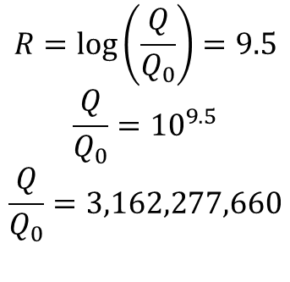
Earthquakes and the Richter Scale
$$R=\log\left(\frac{Q}{Q_{0}}\right)=9.5$$
$$\frac{Q}{Q_{0}}={10}^{9.5}$$
$$\frac{Q}{Q_{0}}=3,162,277,660$$
The largest recorded earthquake, which occurred in Chile in 1960, had a magnitude R = 9.5 on the Richter scale.
This quake had an intensity more than 3.1 billion times greater than the threshold level.

Slide 15
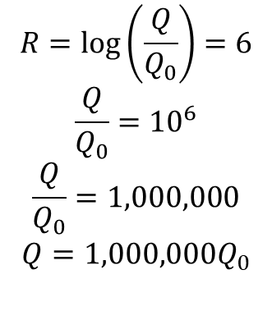
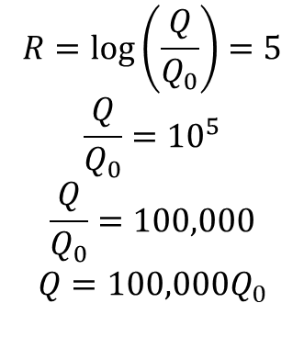
Earthquake Example
Example 2 How does a magnitude 6 earthquake on the Richter scale compare to a magnitude 5 earthquake?
Solution If R = 5 we have If R = 6 we have
$$R=\log\left(\frac{Q}{Q_{0}}\right)=5$$
$$\frac{Q}{Q_{0}}={10}^{5}$$
$$\frac{Q}{Q_{0}}=100,000$$
$$Q=100,000Q_{0}$$
$$R=\log\left(\frac{Q}{Q_{0}}\right)=6$$
$$\frac{Q}{Q_{0}}={10}^{6}$$
$$\frac{Q}{Q_{0}}=1,000,000$$
$$Q=1,000,000Q_{0}$$
The intensity of a magnitude 6 earthquake is 10 times greater than the magnitude 5 earthquake.

Slide 16
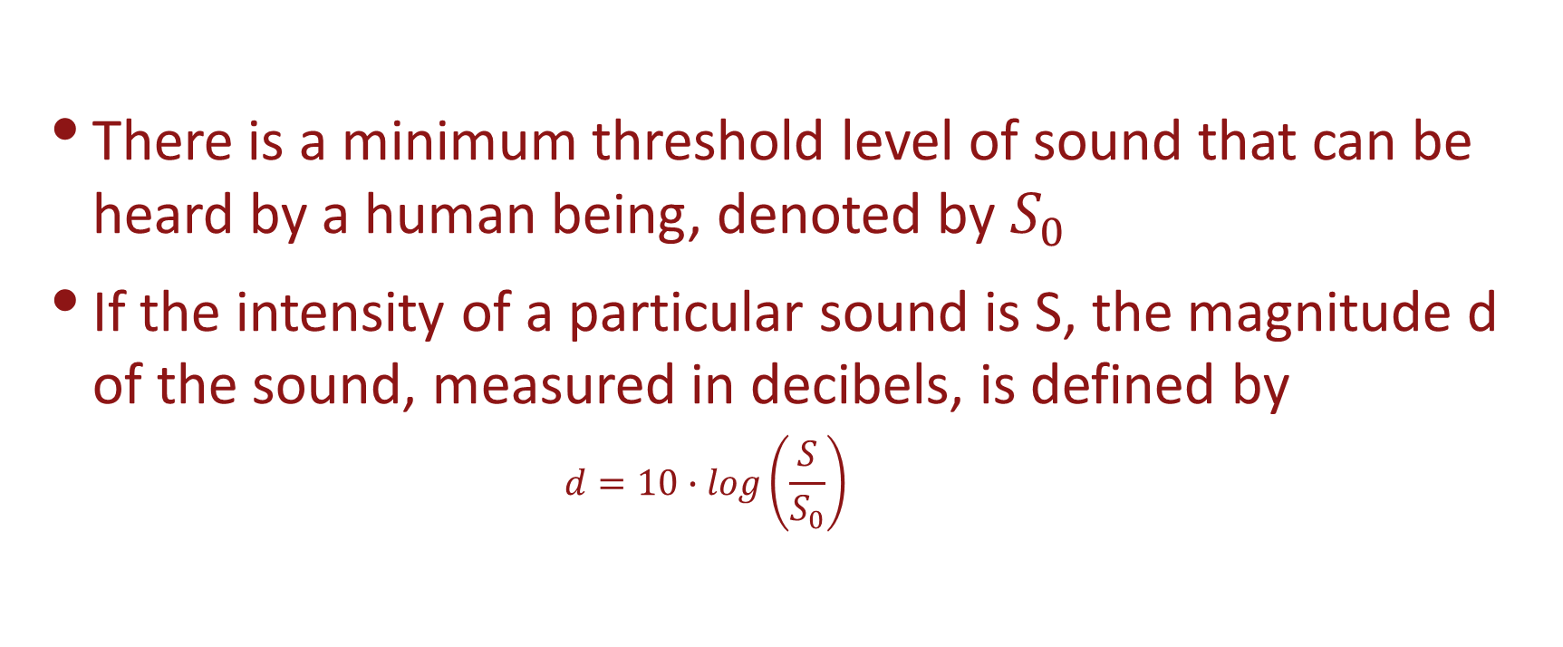
Sound Decibels
There is a minimum threshold level of sound that can be heard by a human being, denoted by $S_{0}$
If the intensity of a particular sound is S, the magnitude d of the sound, measured in decibels, is defined by
$$d=10∙log\left(\frac{S}{S_{0}}\right)$$

Slide 17
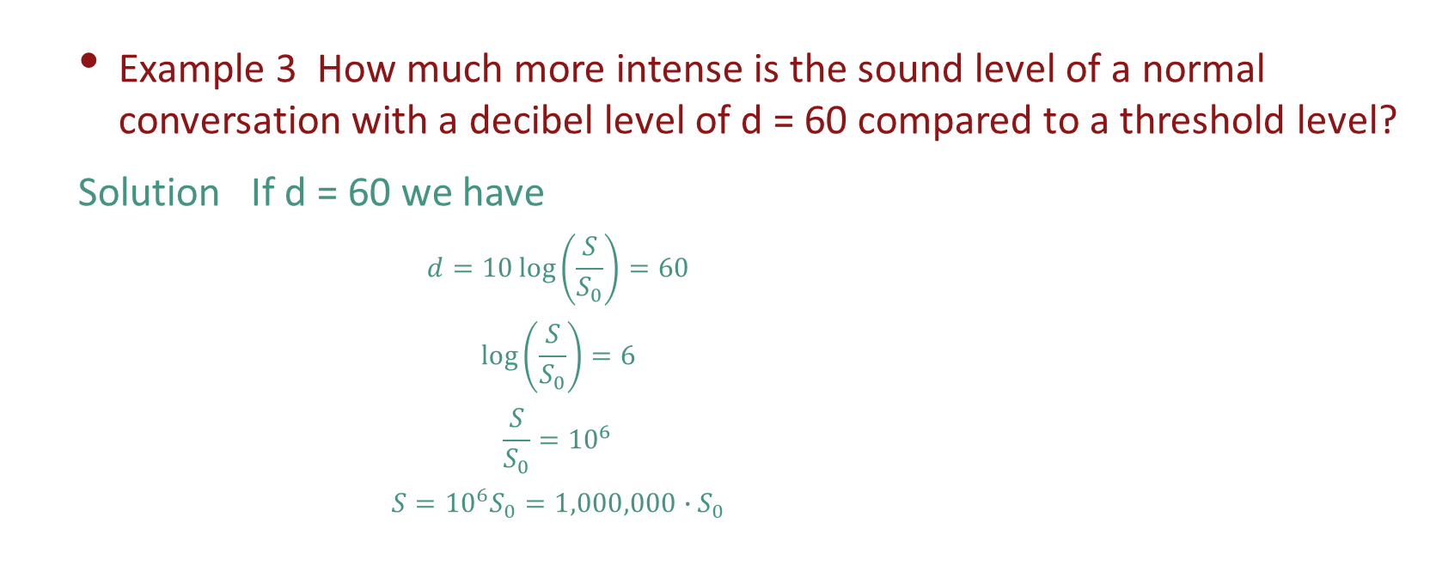
Sound Decibel Example
Example 3 How much more intense is the sound level of a normal conversation with a decibel level of d = 60 compared to a threshold level?
Solution If d = 60 we have
$$d=10\log\left(\frac{S}{S_{0}}\right)=60$$
$$\log\left(\frac{S}{S_{0}}\right)=6$$
$$\frac{S}{S_{0}}={10}^{6}$$
$$S={10}^{6}S_{0}=1,000,000∙S_{0}$$
The intensity of normal conversation is 1,000,000 times the threshold level.

