Slide 1
Geant4 Overview
  Marc Verderi (LLR)
  Subset de : John Apostolakis (CERN),
  “Hadronic Shower Simulation Workshop”
  FNAL, 6-8 Sept 2006”

Slide 2
Outline
Geant4 in general
Toolkit capabilities
Physics
  Organization of hadronics
Survey of hadronic models

Slide 3
Geant4 General Notes
Geant4 is an object-oriented C++ toolkit
  the goal is to provide all that is needed to build a wide variety of physics simulation applications
    range of physics models,
    tracking, geometry hit collection and scoring
    and auxiliary components
  code is open, modular – available for all to download
    Anyone can inspect, understand, tailor, revise, … improve.
  extensive documentation and tutorials provided
Principal references:
  NIM A506, 250 (2003) and IEEE Trans. Nucl. Sci. 53, 270 (2006)

Slide 4
Some application areas
High energy and nuclear physics experiments
  ATLAS, BaBar, CMS, LHCb, HARP, ..
Satellite and space applications
  GLAST, 15 ESA satellites, ..
Medical
  Imaging (eg GATE PET & SPECT tool)
  Hadrontherapy

Slide 5
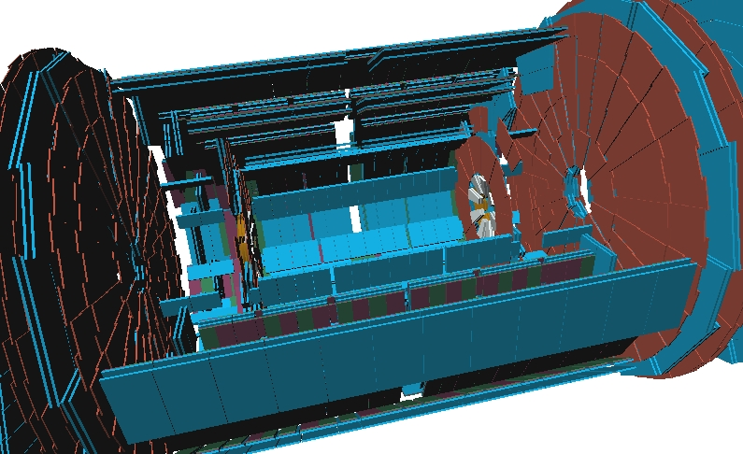
Geant4 Geometry
Large number of volume shapes (CSG + BREP)
Hierarchical combination of volumes
Extremely versatile
Materials
  isotopes, elements, compounds, phase, temp
  user-created or use NIST database

Slide 6
Physics Choices and ‘Physics Lists’
User has the final say on the physics chosen for the simulation. He/she must:
  select the relevant particles and physics processes from those provided, for each particle type
  validate the selection for the application area
‘Physics Lists’ represent this collection
Deciding or creating the physics list is the user's responsibility
  reference physics lists are provided by Geant4
    are continuously-tested and widely used configurations (eg QGSP)
  other ‘educated-guess’ configurations for use as starting points.

Slide 7
Electromagnetic Physics in Geant4
“standard” package (1 keV and up)
  multiple scattering, ionization, bremsstrahlung
  Compton, pair production, photo-electric, annihilation
  synchrotron, Cerenkov, transition radiation, high energy muon processes
“low energy” package
  uses database information to extend interactions below 1 keV
  many of the same processes as offered in “standard”
optical photons
  reflection/refraction, absorption, Rayleigh, wavelength shifting

Slide 8
Geant4 Hadronics Philosophy
Offer a choice of processes, models, and cross sections
Develop a hadronics framework which is modular
  allows users to substitute specialized physics
  easier to add new models, cross sections as they become available
Separate total and reaction cross sections from final state generators
  allows easy update, multiple implementations of cross sections
  final state generators maintain cross sections specific to model

Slide 9
Geant4 Hadronics Evolution
Original goal: develop hadronic toolkit for high energy interactions at LHC
  GHEISHA inherited from Geant3 and recast into C++
  Quark Gluon String model and pre-compound/evaporation
  Data driven neutron interaction
Expanded goals and modelling options (2001-)
  CHIPS and Cascade models (Binary, ‘Bertini’)
  Ion interactions: ablation/abrasion, EM dissociation
New models (high, low and intermediate energy) are added, with further improvements in existing models
  Different options available for most energies, particles

Slide 10
Hadronic Inelastic Model Inventory
CHIPS
At rest
Absorption
μ, π, K, anti-p
Photo-nuclear, lepto-nuclear (CHIPS)
High precision neutron
Evaporation
Fermi breakup
Pre-
compound
FTF String
Multifragment
QG String
γ de-excitation
Binary cascade
Radioactive
Decay
Bertini cascade
Fission
HEP
LEP
1 MeV 10 MeV 100 MeV 1 GeV 10 GeV 100 GeV 1 TeV

Slide 11
Survey of Hadronic Models
Three broad categories of processes/‘models’:
  Tabulated
    based on (large) databases
  Parameterized
    key aspects parameterised for speed
    Parameters determined from fits to data
  theory-based:
    based on (theoretical) models
    Parameters, if any, chosen by comparing with thin-target data

Slide 12
‘Theoretical’ models
Evaporation and pre-compound models
Cascade and CHIPS
  Bertini-like
  Binary Cascade
  Chiral Invariant Phase Space
Quark-Gluon String (QGS) model
  And ‘variant’ FTF model, using Fritiof approach

Slide 13
Hadronic Model Organization
Process
At rest
In-flight
Elastic
Inelastic
Model
Model
Model
Model
Further levels of abstraction

Slide 14
Hadronic Processes
At rest
  stopped μ⁻, π⁻, Κ⁻, anti-proton, Σ⁻, anti-Σ⁺ radioactive decay
Elastic
  models for π, Κ, p, n, hyperons
Inelastic
  different models for π, Κ, p, n, hyperons ions
  capture in flight
    (n,γ), π⁻
  fission
    neutron-induced
Photo-nuclear, lepto-nuclear
  (neutrino-nuclear not verified yet)

Slide 15
particle
at rest
process 1
in-flight
process 2
process
3
process
n
model 1
model 2
.
.
model n
Cross section
data store
Energy range
manager

Slide 16
Low and High Energy Parametrized Models
Re-engineered, C++ version of GHEISHA
Two pieces
  LEP inelastic: parameters tuned for 0 – 30 GeV
  HEP inelastic: parameters tuned for 20 GeV – 10 TeV
Valid for all long-lived hadrons
Also in this category:
  elastic (all hadrons)
  neutron capture
  neutron-induced fission

Slide 17
Low and High Energy Parametrized Models
Modelling
  initial interaction, fragmentation of hadrons, intra-nuclear cascade, nuclear de-excitation all simulated
  but each of these phases is parametrized
  no modelling of target nucleus
  no intra-nuclear tracking
  not intended to conserve energy/momentum event-by-event
Originally designed for shower studies
  fast
  originally used for higher energies ( > 10 GeV), but tuned for lower energies as well (LEP part)

Slide 18
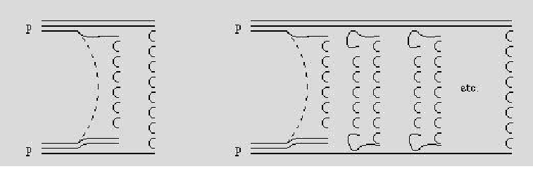
Quark Gluon String Model
Interaction modelled using pomerons
  Hadrons exchange one or several Pomerons
Parton interaction, colored quarks
  Valence and sea quarks
Strings hadronize

Slide 19
Binary Cascade
Hybrid between classical cascade and full QMD model
Detailed 3-D model of nucleus
  nucleons placed in space according to nuclear density
  nucleon momentum according to Fermi gas model
Collective effect of nucleus on participant nucleons described by optical potential
  numerically integrate equation of motion
Particle interaction by resonance formation and decay

Slide 20
Bertini-like Cascade
The Bertini model is a classical cascade:
  it is a solution to the Boltzmann equation on average
  no scattering matrix calculated
Core code:
  elementary particle collider: uses free-space cross sections to generate secondaries
  cascade in nuclear medium
  pre-equilibrium and equilibrium decay of residual nucleus
  Nucleus modelled as shells of different densities

Slide 21
Precompound and Nuclear De-excitation Models
Precompound Model – used to take the nucleus from a highly excited state down to equilibrium
May be used:
  by itself for p, n below 170 MeV or
  as a “back-end” for cascade or high energy models
Model begins with nuclear excitation energy, a set of excitons, and a parametrized level density
Excitons are decayed until equilibrium is reached, then control is transferred to competition of low energy models
  evaporation, fission, Fermi breakup, multi-fragmentation, photon evaporation

Slide 22
High Precision Neutrons
data-driven, based on G4NDL data library which consists of data from ENDF, JENDL, CENDL, BROND, JEF, MENDL
covers
  elastic
  inelastic (n, p, d, t, ³He, α in up to 4-body phase space final states)
  radiative capture (discrete + continuous gamma spectra)
  fission
incident energies from thermal to 20 MeV
modeling:
  cross sections, angular distributions, final states all tabulated
  sample from interpolated data tables

Slide 23
Chiral Invariant Phase Space (CHIPS) Model
Theory-driven model based on quasmons (an ensemble of massless partons uniformly distributed in invariant phase-space)
  a quasmon can be any ground state hadron or excited system of hadrons
Quasmon hadronizes by internal quark fusion and/or quark exchange with partons in neighbouring nucleon clusters
Originally developed as a final state generator
  now used for:
    nuclear capture of negatively charged hadrons
    gamma-nuclear reactions
    lepto-nuclear reactions

Slide 24
Hadronics Summary
Hadronic processes require physics models and cross sections
  user must choose (carefully)
  more than one model and/or cross section allowed
Many models offered – three main types:
  tabulated
  parameterized
  theory-driven
Most cross section sets provided by default
  alternative cross sections are available

Slide 25
Other Summary
G4 provides full detector simulation capabilities & more
  Flexible geometry modeler for many, complex volumes
  Tracking, event biasing, scoring, hit creation
Configurations of physics models provide physics options
  Tailored for sets of application areas
  Created, tested for key application areas
    QGSP, LHEP, QGSC, with emerging cascade options (eg QGSP_BIC)
  Starting points for further refinements, also by users
Standard models of EM interactions (EM physics)
    and extensions to low energies, specialized modeling

Slide 26
GDR & G4 (physique)
Muon-nucleaire:
  EM (standard), version plus ancienne
  CHIPS
Neutron:
  Modèle cascade
  QGS ou LHEP (LHEP ~ GHEISHA)
  Sous 20 MeV, data driven models
Proton (production neutrino)
  QGS (QGSP ou QGSC)
  Validation dans la gamme 20-70 GeV
Cherenkov:
  Pas de soucis « a priori »

Slide 27
GDR & G4 (collaboration)
Geant4 est une collaboration ouverte:
  Rappel: développement de G4 sous-tendu par des « user requirements »
Technologie orientée objet permet de couvrir des physiques variées
  Ce n’est pas un mythe
Input du GDR neutrino est bien entendu le bienvenu
  Pointer faiblesses et/ou manques actuels éventuels
Quid d’une journée de travail ou de meetings téléphoniques/vidéos entre les gens du GDR et les spécialistes G4 ?

