Slide 1
VTMS Method
Collin Blake

Slide 2
overview
4 Modules Total
Textile
Relaxation
Tow Modify
Mesh Generation
Spend a majority of our time in relaxation and tow modify

Slide 3
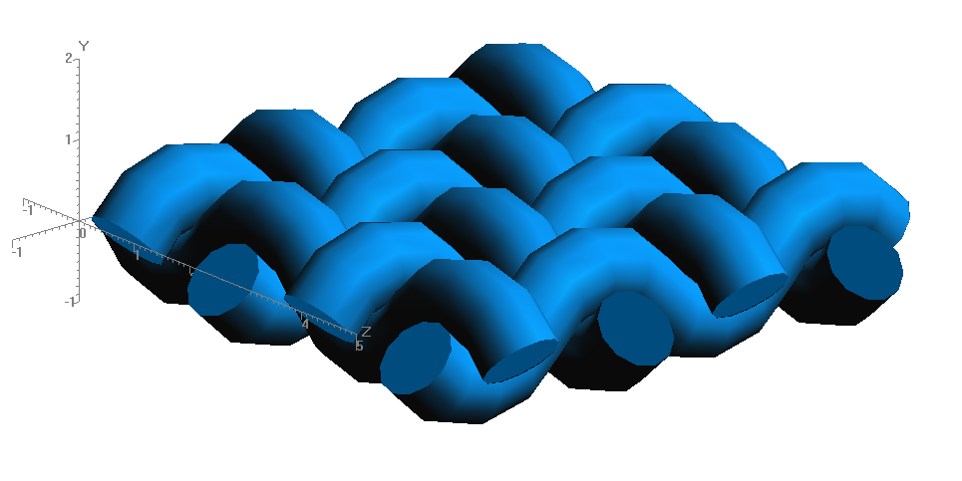
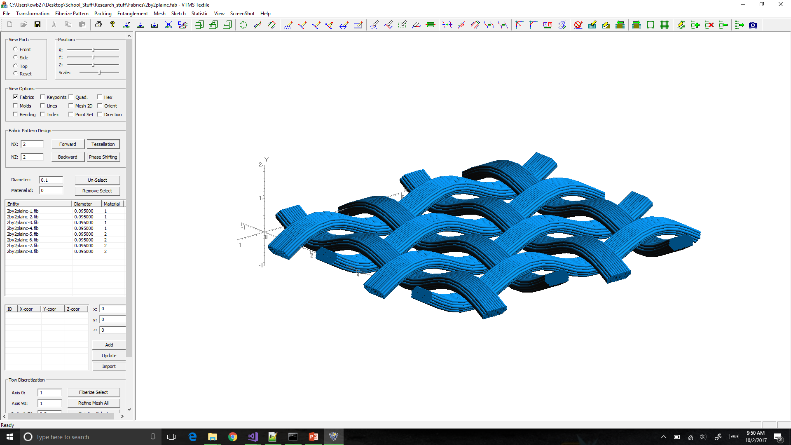
Textile
Imports woven geometry (basic) and discretizes idealized tubes

Slide 4
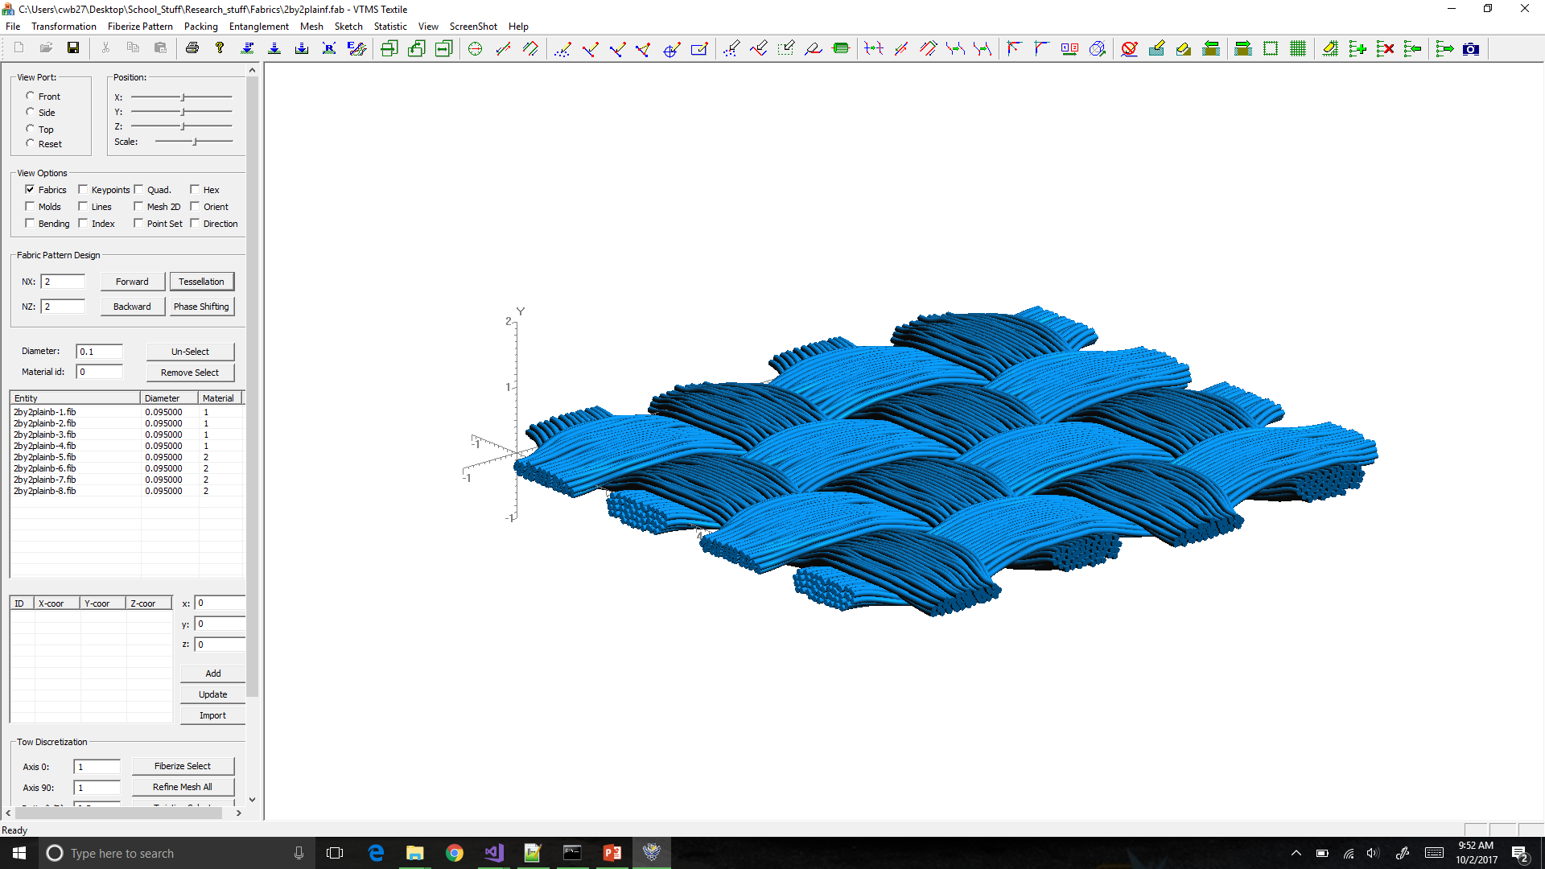
Relaxation
This module is what conducts the simulation to produce the non-idealized geometries
Relaxes the “filaments” or “noodles” systematically using digital chain method

Slide 5
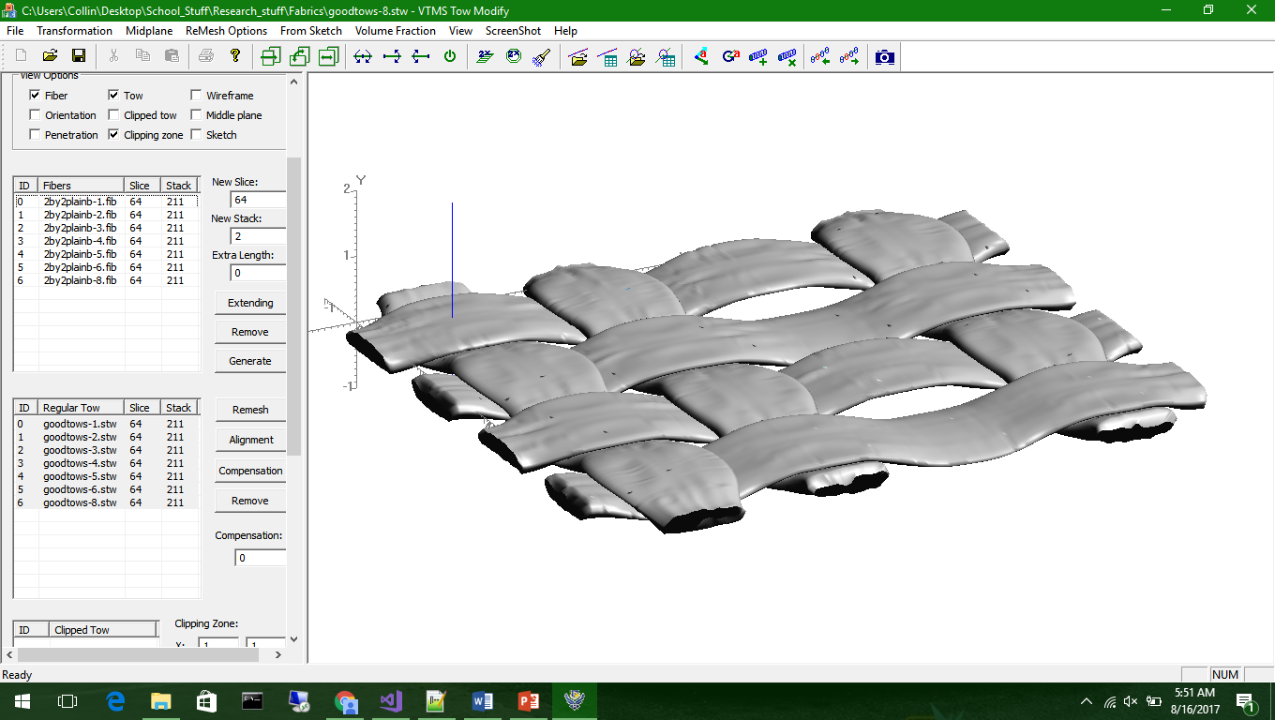
Tow Modify
Creates a surface that defines the “tow geometry” of the filament bundles
Where we are currently working with surface penetrations
Also controls output file type for tow geometry (.stw vs. .ctw)

Slide 6
Mesh Generation
Generates a volume mesh for .ctw files from Tow Modify
Not used for us as we need compatible meshes and could not modify Mesh Generation code

Slide 7
Questions?

