Slide 1
VTMS Method
Collin Blake

Slide 2
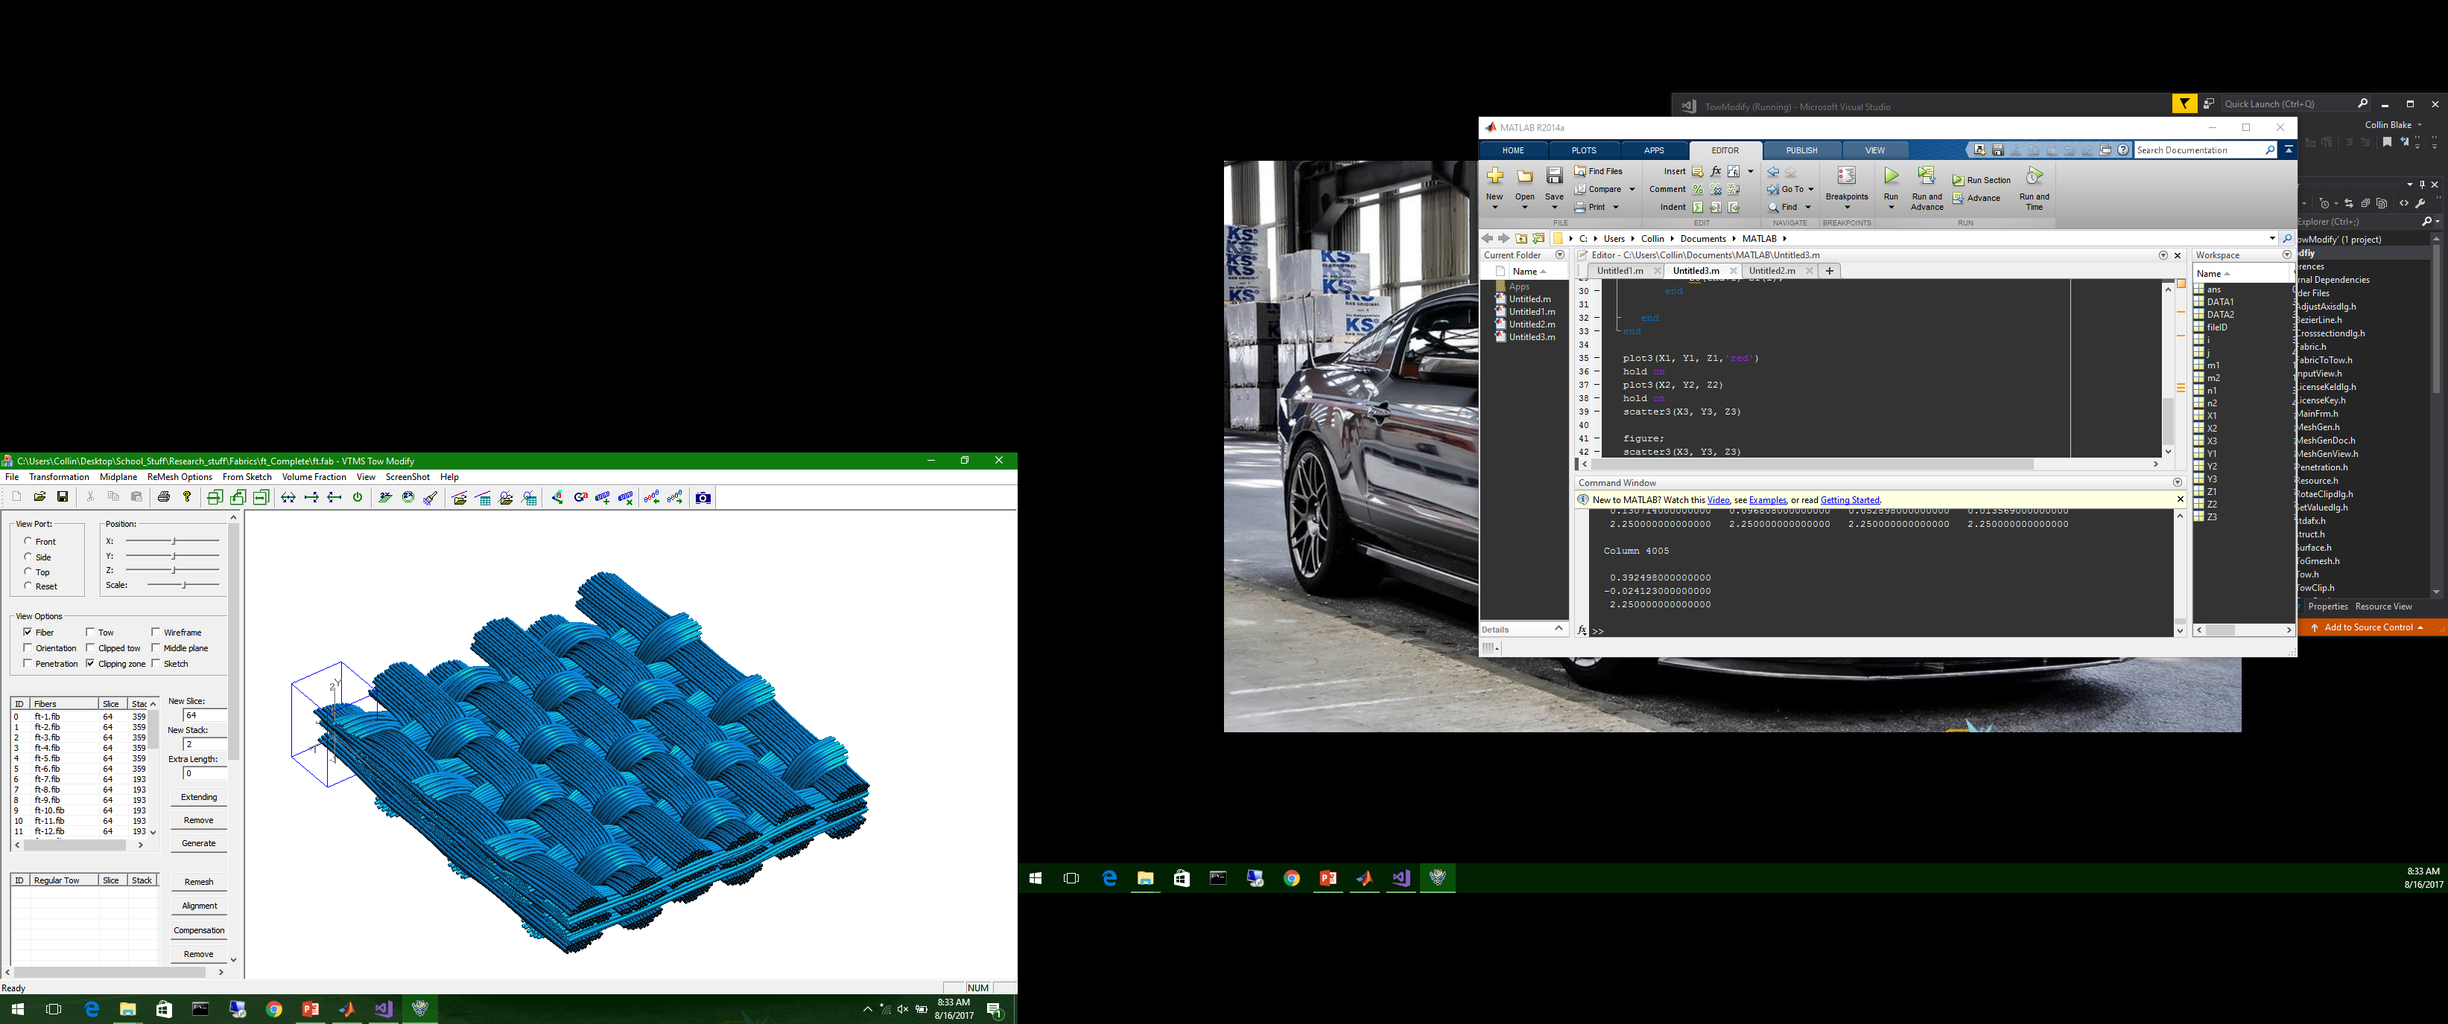
Background
Evolving modelling techniques and computational ability allow us to model increasingly complex geometries for computer analysis
Next evolution in computation Fiber Composite research is woven fabrics
Modelling discrete fibers very computationally expensive
Using Homogenized Tows with matrix surrounding tows

Slide 3
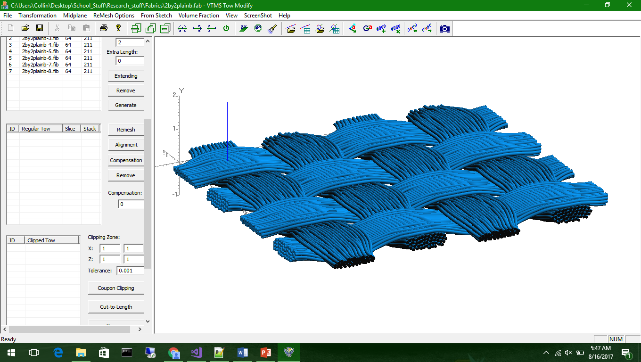
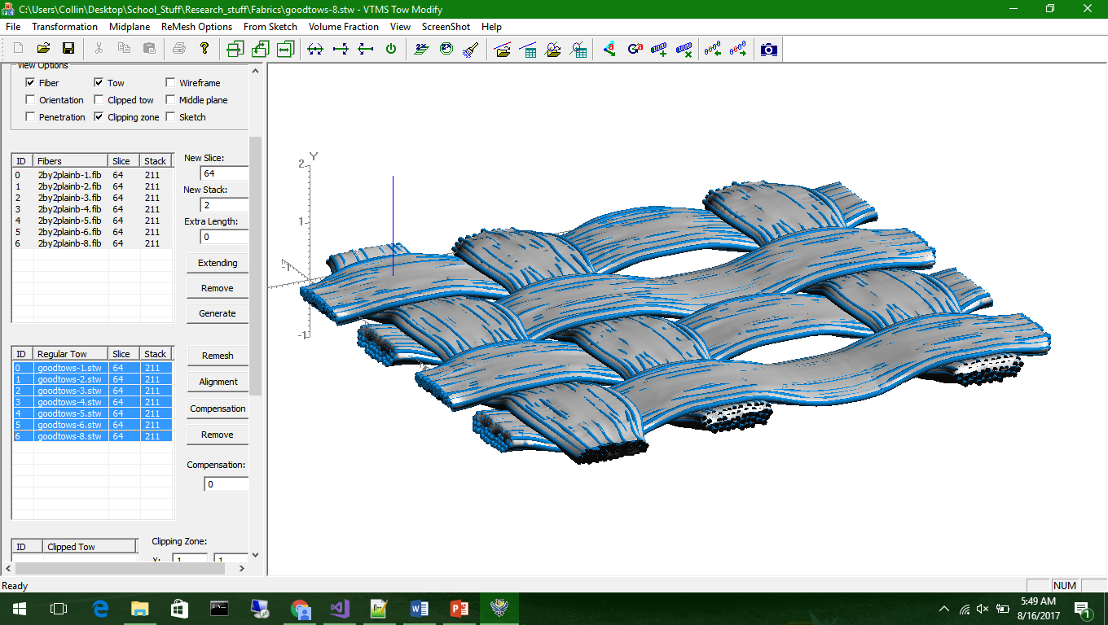
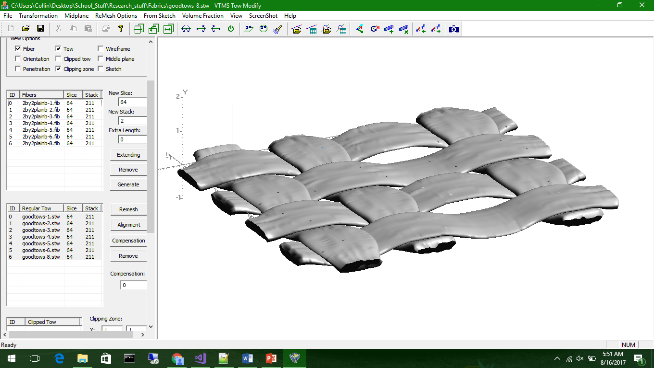
VTMS
Digital chain method to generate realistic woven geometry
Developed by Eric Zhou
Discrete fiber filaments can then be converted into homogenized tows and modelled in a matrix
Creates realistic woven geometries that can be analyzed

Slide 4
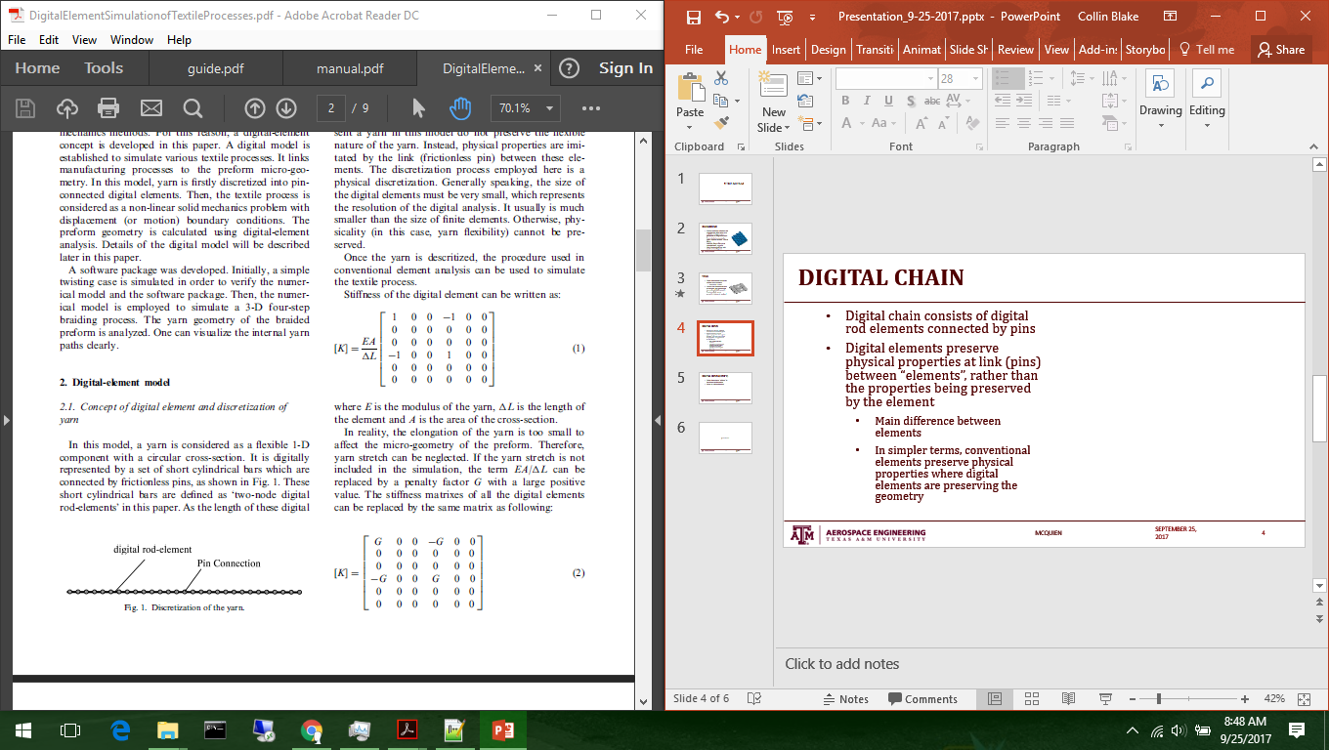
Digital Chain
Digital chain consists of digital rod elements connected by pins
Digital elements preserve physical properties at link (pins) between “elements”, rather than the properties being preserved by the element
Main difference between elements
In simpler terms, conventional elements preserve physical properties where digital elements are preserving the geometry
Wang, 2000

Slide 5
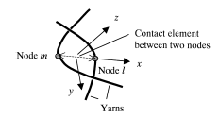
Digital Chain (cont’d)
Digital chains have a “stiffness” in the element axial direction
Replaced with a penalty factor if no yarn elongation is allowed
Allows for a defined tension in axial direction during relaxation step
When yarns contact, a contact element is placed between the two closest nodes
Contact element supports compression and shear
Nodes also account for friction forces (neglected in most cases)
Wang, 2000

Slide 6
Surface Creation
After the digital chain method is used to create the yarn geometry, a surface definition of the geometry can be approximated
This involves “rolling” an imaginary roller around the geometry that defines the surface
User can now define diameter of roller
Larger roller results is smoother topologies
d

Slide 7
Questions?

