Slide 1
CS209: Computer Science I

Slide 2
Introduction
Your task is to write a program for our hospital staff to use that will help us protect the public with information and to identify when there could be a potential caffeine overdose.
The hospital wants to know how much of a typical energy drink is it possible to drink without dying as a result. Write a program to supply the answer.
Research has already been done for this issue using laboratory mice.
Notes:
So here we have a case study. General crates Inc. builds custom design wooden crates. With materials and labor, it costs CGI $.23 per cubic foot to build a crate. In turn, they charge their customers $.50 per cubic foot for the crate. You have been asked to write a program that calculates the volume, in cubic feet, cost, customer price, and profit of any crate CGI builds.

Slide 3
Variables – nouns - data
So far we have:
float for mouse/drinker weight and mouse/drinker dose. All float variables for storing calculated values? Will we need to use static_cast for the calculation?
Variables | Description
weights | Holds the weight of the drinker and mouse.
lethal doses in grams | Holds the lethal dose for the drinker and mouse, grams of caffeine per can, concentration.
cans | Holds the safe amount, and the lethal number of cans.
Notes:
Will we need to use static_cast for the calculation…

Slide 4
More Variables
Two named double constants…
float variables, all storing fixed amounts.
Constant | Description
CONCENTRATION | Initialized with the value .006
ENERGY_DRINK_CAN_WEIGHT | Initialized with the value 350.

Slide 5
Calculations
Grams of caffeine per can
Lethal dose for drinker
Lethal number of cans
Recommended safe amount
Also assume that concentration is .006 (6/10 of 1% of caffeine) and energy drink can weight is 350 grams

Slide 6
The program must perform the following general steps:
Step 1: Ask the user to enter the weight of the mouse, the weight of
the drinker, and the lethal dose for the mouse – VALIDATE inputs
Step 2: Calculate (all grams):
Grams of caffeine per can
Lethal dose for drinker
Lethal number of cans
Recommended safe amount
Step 3: Display the data calculated in Step 2.

Slide 7

 |  |  |  |  |  |  |  | Calculate the caffeine toxicity
 | Get user info and validate |  |  |  |  |  |  |  |  |  | Calculate lethal dose |  |  |  |  |  |  |  |  |  |  |  | Output data

Slide 8

 |  |  |  |  |  |  |  |  |  | Calculate the caffeine toxicity
 | Get user info and validate |  |  |  |  |  |  |  |  |  |  |  | Calculate lethal dose |  |  |  |  |  |  |  |  |  |  |  | Output data
Get mouse weight |  |  |  | Get drinker Weight |  |  |  | Get lethal dose for mouse

Slide 9
 |  |  |  |  |  |  |  |  |  | Calculate the caffeine toxicity
 | Get user info and validate |  |  |  |  |  |  |  |  |  |  |  | Calculate lethal dose |  |  |  |  |  |  |  |  |  |  |  | Output data
Get mouse weight |  |  |  | Get drinker weight |  |  |  | Get lethal dose For mouse |  |  | Calculate the grams of caffeine per can |  |  | Calculate the lethal dose for a drinker |  |  | Calculate the lethal number of cans |  |  | Calculate the safe amount

Slide 10
 |  |  |  |  |  |  |  |  |  | Calculate the caffeine toxicity
 | Get user info and validate |  |  |  |  |  |  |  |  |  |  |  | Calculate lethal dose |  |  |  |  |  |  |  |  |  |  |  | Output data
Get mouse weight |  |  |  | Get drinker weight |  |  |  | Get lethal dose for mouse |  |  | Calculate the grams of caffeine pre can |  |  | Calculate the lethal dose for a drinker |  |  | Calculate the lethal number of cans |  |  | Calculate the safe amount |  |  | Format and Display the weight and lethal dose for a mouse |  |  | Format and Display the weight and lethal dose for a drinker |  |  | Format and Display the lethal number of cans of drink |  |  | Format and Display the safe amount

Slide 11
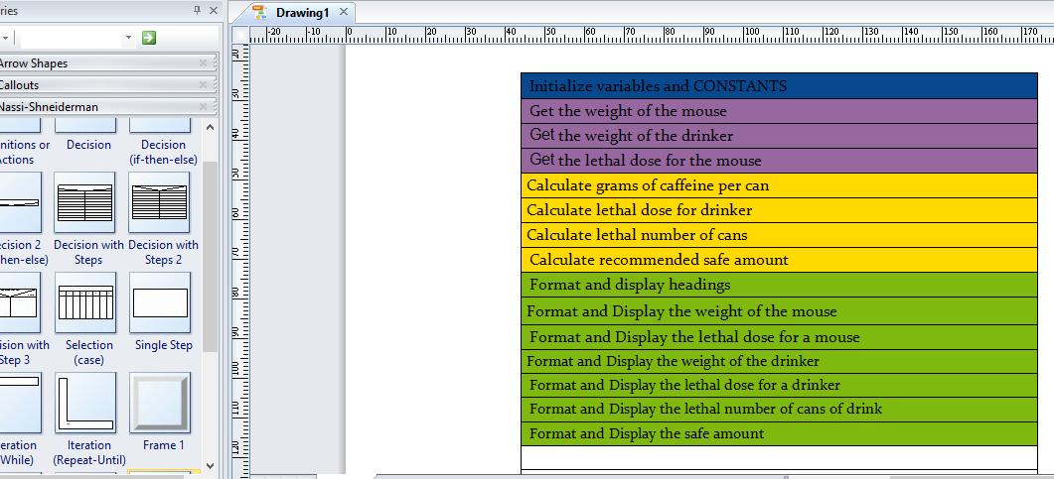

Slide 12
Hand Tracing a Program
Hand trace a program: act as if you are the computer, executing a program: – step through and ‘execute’ each statement, one-by-one – record the contents of variables after statement execution, using a hand trace chart (table)
Useful to locate logic or mathematical errors
Notes:
Tracing through your own code can be a helpful way to debug your program. Unfortunately, it is tedious and often very boring. Basically you are trying to be the computer. You are executing steps one by one and recording the contents of the variables after each statement executes. This can be very useful to locate either logical or mathematical computation errors.

Slide 13

 | Length | Width | Height | Volume | Cost | Charge | Profit
const double COST_PER_CUBIC_FOOT = 0.23; const double CHARGE_PER_CUBIC_FOOT = 0.5; cout << “Enter the dimensions of the crate (in feet):\n”; cout << “Length: ”; cin >> length; cout << “Width: ”; cin >> width; cout << “Height: ”; cin >> height; volume = length * width * height; cost = volume * COST_PER_CUBIC_FOOT; charge = volume * CHARGE_PER_CUBIC_FOOT; profit = charge – cost; ... | ? ? ? ? 10 10 10 10 10 10 10 10 10 | ? ? ? ? ? ? 8 8 8 8 8 8 8 | ? ? ? ? ? ? ? ? 4 4 4 4 4 | ? ? ? ? ? ? ? ? ? 10×8×4 320 320 320 | ? ? ? ? ? ? ? ? ? ? 320×0.23 73.6 73.6 | ? ? ? ? ? ? ? ? ? ? ? 320×0.5 160 | ? ? ? ? ? ? ? ? ? ? ? ? 160-73.6 86.4
Notes:
One of the most common ways hand tracing is to create a column for each variable that you have in your code. With each step you update then value of each variable. After all of your statements are complete, you can see the values of all of the variables in each column. So here we see the tracing out of the variable in time slices, top down.

Slide 14
New Hand-Trace Example
 | Num1 | Num2 | Num3 | Avg
… cout << “Enter the first number: ”; cin >> num1; cout << “Enter the second number: ”; cin >> num2; cout << “Enter the third number: ”; cin >> num3; avg = num1 + num2 + num3 / 3; … | ? 10 10 10 10 10 10 | ? ? ? 20 20 20 20 | ? ? ? ? ? 30 30 | ? ? ? ? ? ? 40
10 + 20 + 30/3 = 40
avg = (10 + 20 + 30) / 3 = 60/3 = 20
avg = (num1 + num2 + num3) / 3;
Notes:
here is another example. This program, which asks the user to enter three numbers and then displays the average of the numbers, has a bug. We step through each statement recording the contents of the variables after each statement executes. If the value is unknown we use a ? mark. The correct value for the average of the 3 numbers is 20, and not 40. What we found here is that in read the statement divides by 3 first and then adds the numbers, instead of adding the numbers and dividing by three. IDEs, or integrated development environments, have built-in debuggers they can step through code, imitating a hand trace. Obviously this is a much faster way and can prevent errors.

Slide 15
References
Slide contributions include:
Walter Savitch, Problem solving with C++ (9th Edition). Addison-Wesley Longman Publishing Co., Inc. Boston, MA, USA ©2015
Gaddis, Starting Out with C++: From Control Structures through Objects, (8th Ed.) , Addison-Wesley Longman Publishing Co., Inc. Boston, MA, USA ©2015
Bjarne Stroustrup, The C++ Programming Language, 3rd Edition, Addison-Wesley Longman Publishing Co., Inc. Boston, MA, USA ©2007
Herb Sutter, Andrei Alexandrescu, C++ coding standards : 101 rules, guidelines, and best practices, Copyright © 2005 Pearson Education, Inc.
Frank M. Carrano. Data Abstraction & Problem Solving with C++ (5th Edition)
Addison-Wesley Longman Publishing Co., Inc. Boston, MA, USA ©2006
TutorialsPoint - http://www.tutorialspoint.com/cplusplus/
Cplusplus.com - http://www.cplusplus.com/doc/tutorial/

