Slide 1
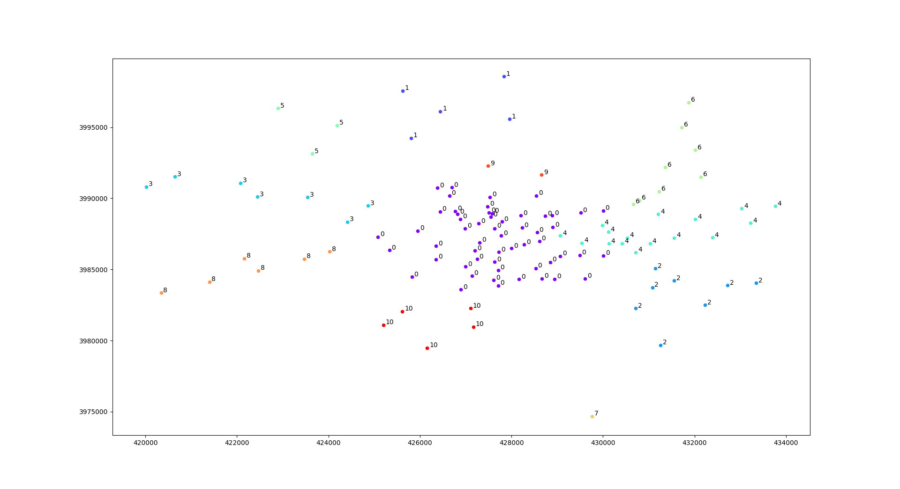

Cluster Number: 11

Slide 2
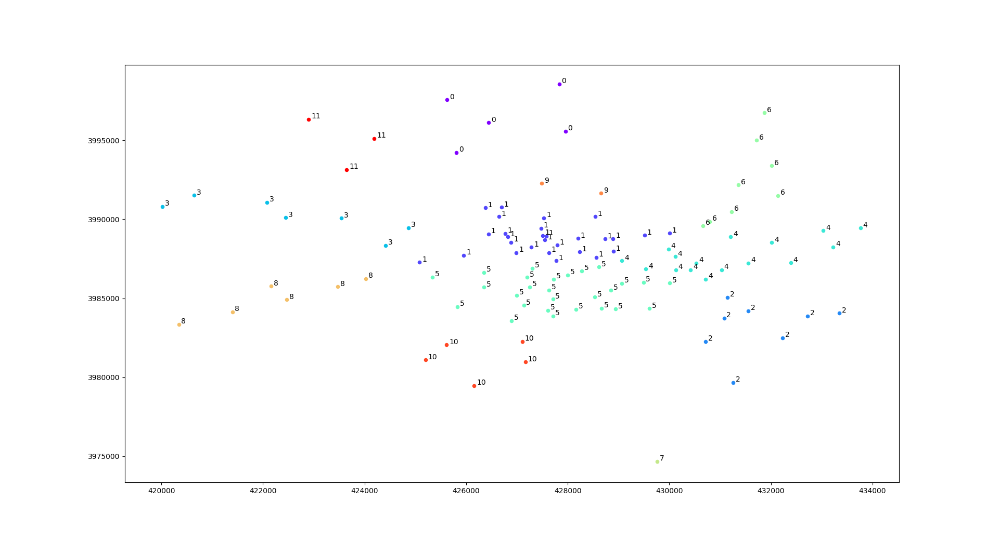

Cluster Number: 12

Slide 3
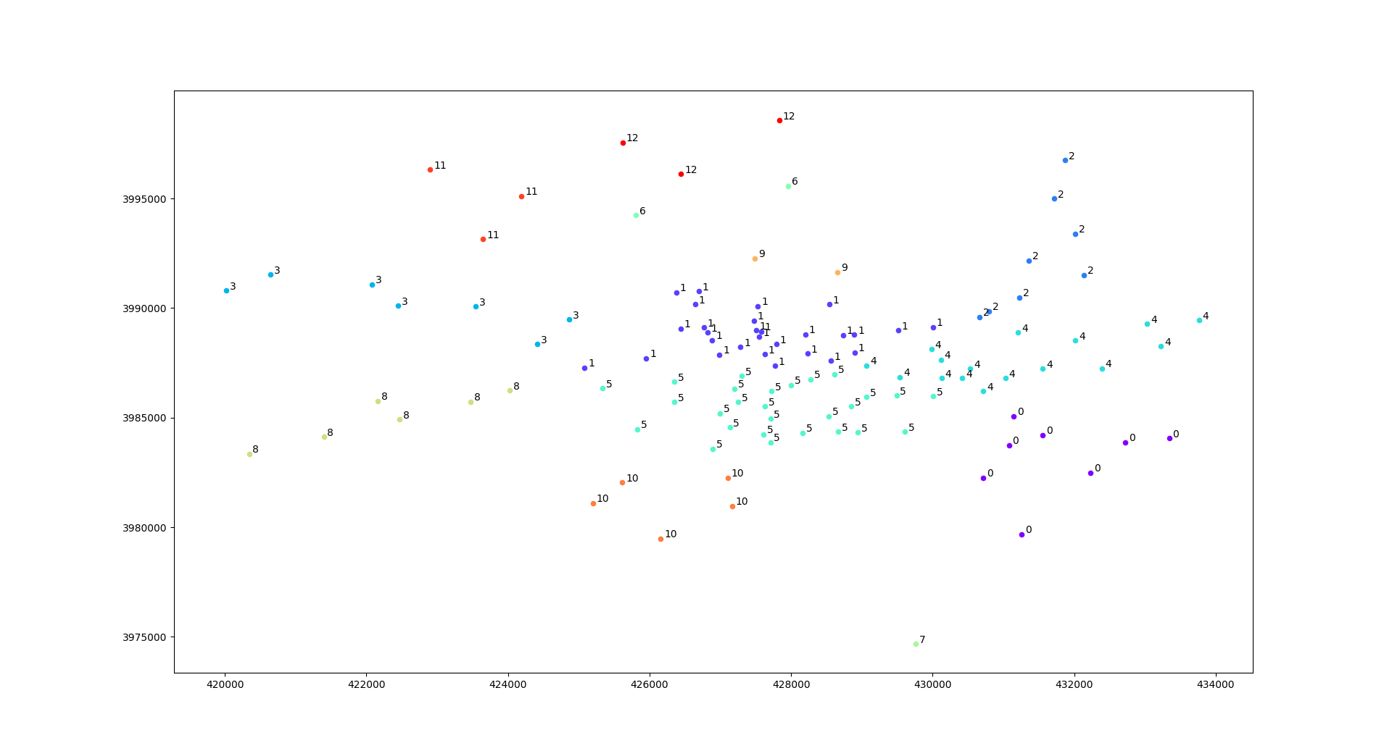

Cluster Number: 13

Slide 4
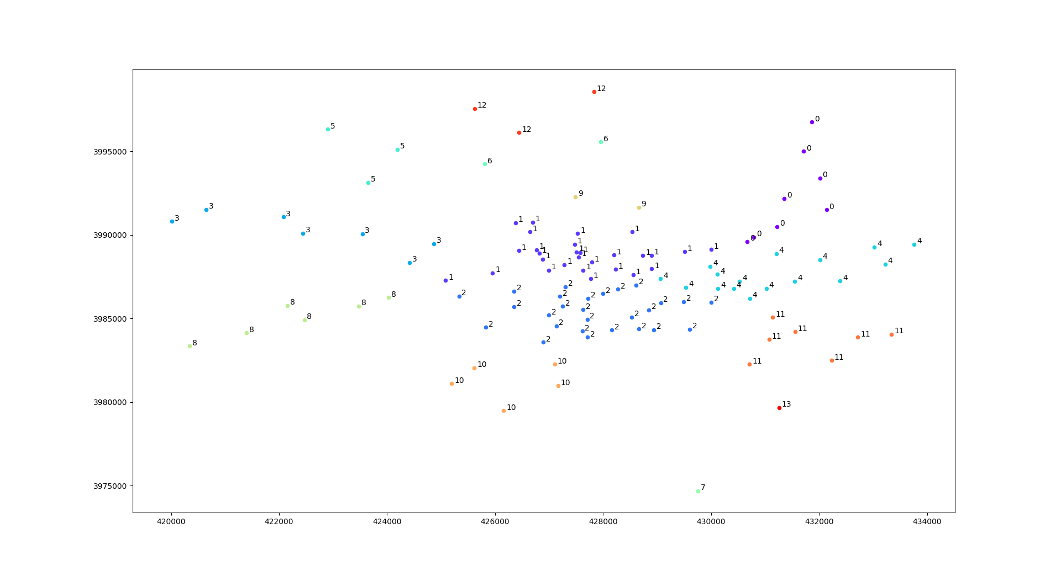

Cluster Number: 14

Slide 5
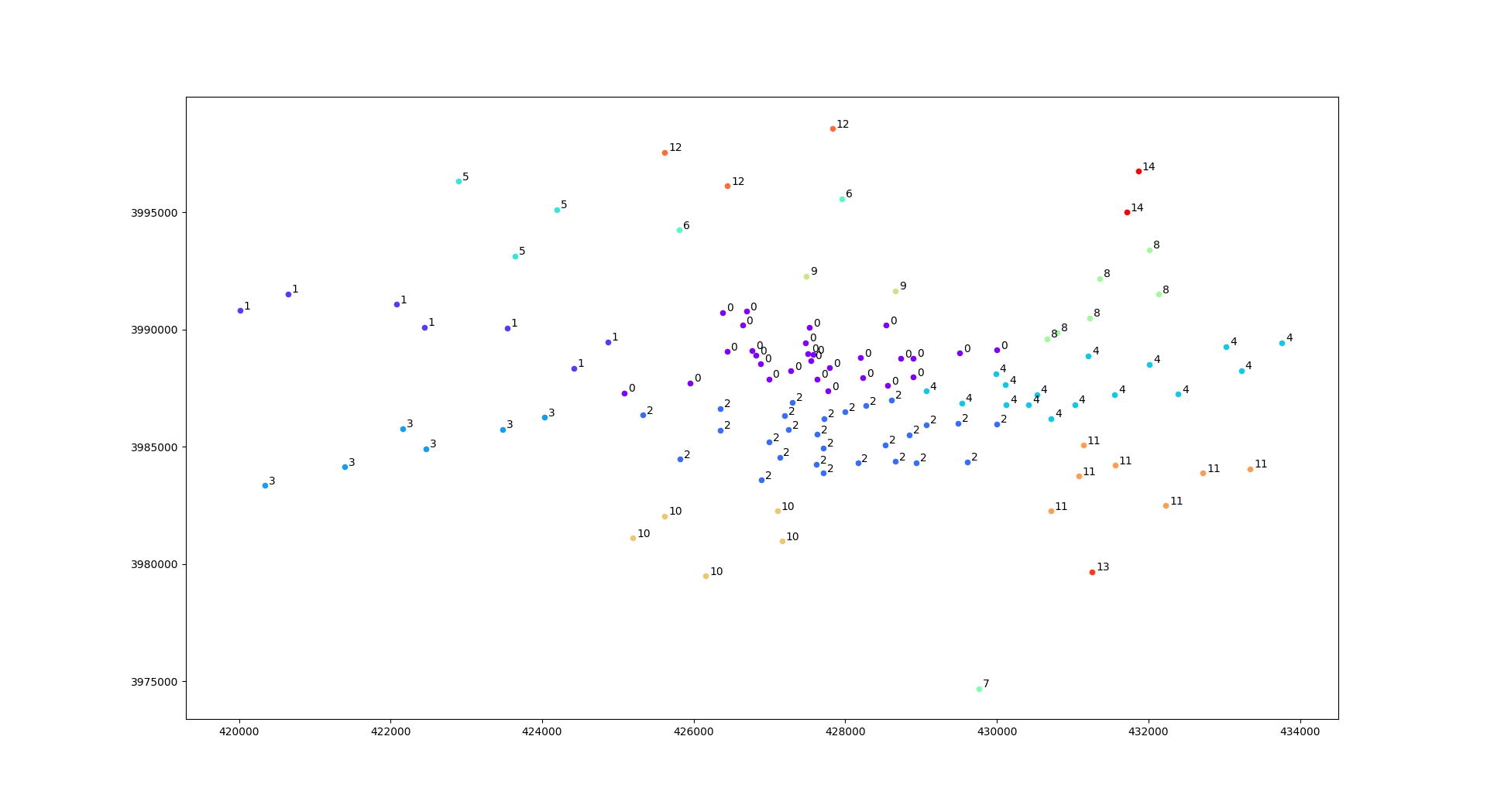

Cluster Number: 15

Slide 6
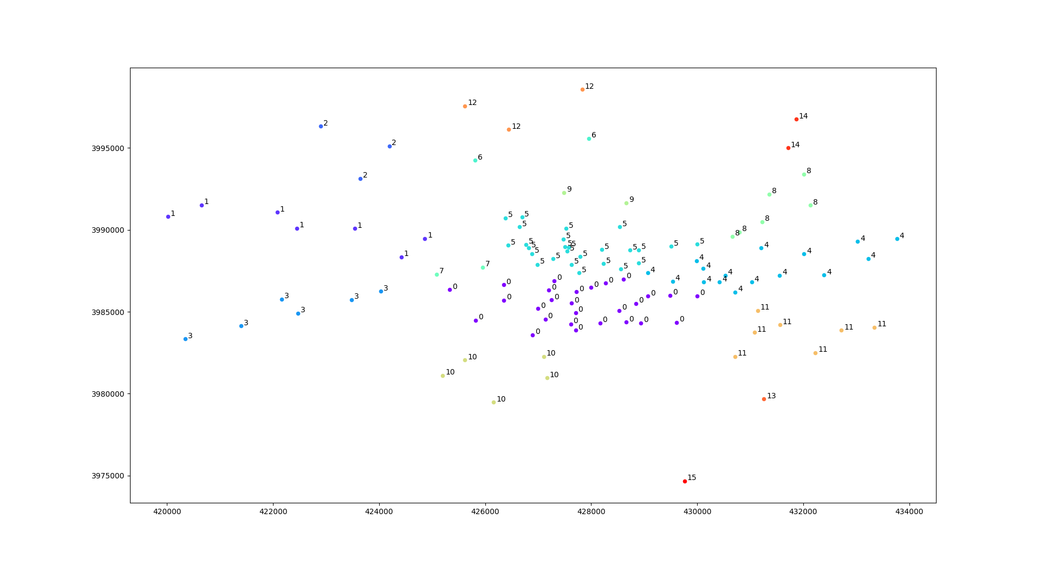

Cluster Number: 16

Slide 7
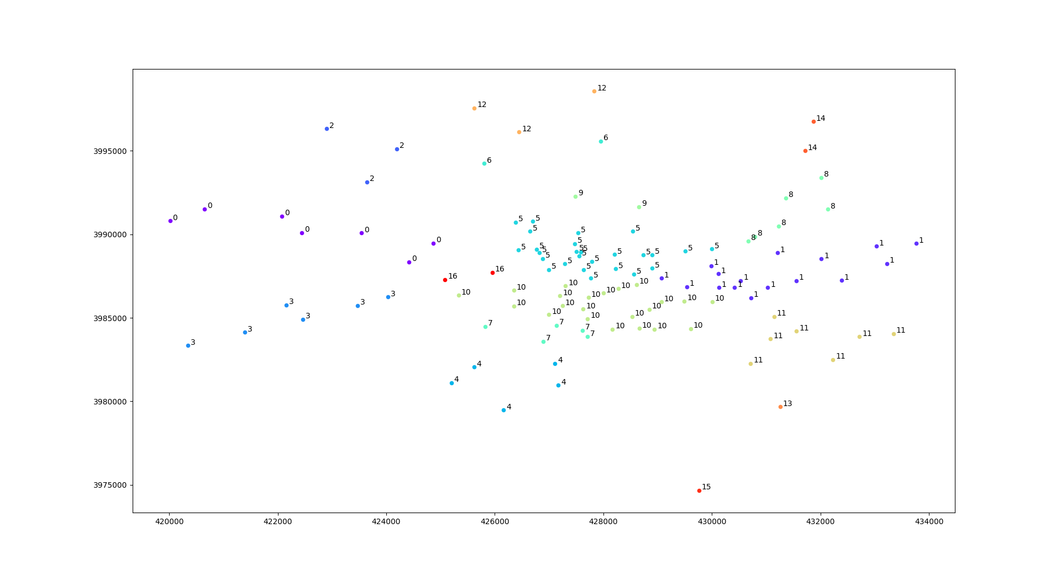

Cluster Number: 17

Slide 8
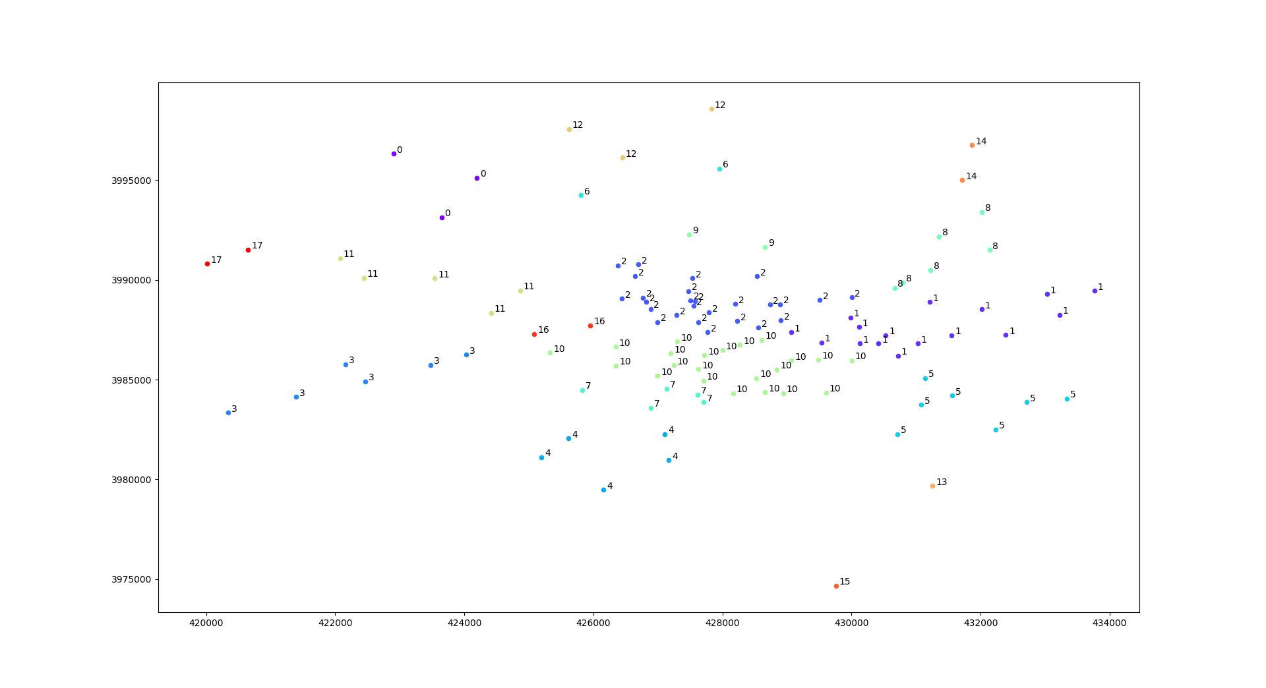

Cluster Number: 18

