Slide 1
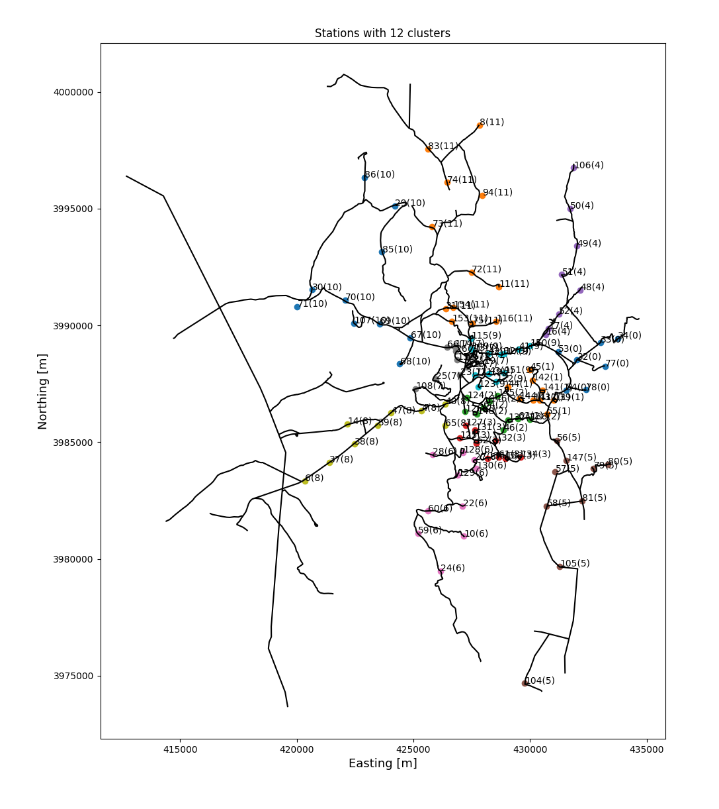
Merged clusters - 12

