Slide 1
Baboon Canyon Crossing: A Synchronization Problem
Course : CS474
Authors : Collin Gros, Preeti Maurya, Bryan Bustillos

Slide 2
Introduction
Being able to have multiple threads in a program is important
Threads may need to share memory
Synchronization requires the use of shared memory
Semaphores protect shared memory
Shared memory and semaphores are therefore needed for reliable synchronization between threads
We chose to solve Problem 1: Synchronization
Baboons from both sides of a canyon use a rope to cross and must adhere to these rules:
Once a baboon has begun to cross, it is guaranteed to get to the other side without running into a baboon going the other way.
There are never more than three baboons on the rope. The order of the baboons crossing the rope should be preserved; i.e., the order in which they enter the rope should be the order in which they exit the rope.
A continuing stream of baboons crossing in one direction should not bar the baboons going the other way indefinitely (no starvation).

Slide 3
Methodology
Input:
1)Text file containing the L,R,R,R,R,R,L,L,R (a sequence of alphabets L (meaning left) and R (meaning right) separated by a comma, that indicate the side of the rope a baboon is trying to cross the rope from)
2)The time (in seconds) required for a baboon to cross the canyon
Strategy:
1)Avoid Deadlock using semaphores
2)Avoid Starvation
sem_init(&rope,0,1); //ensure mutual exclusion on rope ownership
sem_init(&left_mutex,0,1); //left mutex on left side travel to avoid race conditions
sem_init(&right_mutex,0,1); //right mutex on right side travel to avoid race conditions
sem_init(&baboons_counter,0,3); //ensure only 3 baboons are allowed on the rope

Slide 4
Methodology
Baboon crossing from Left to Right
Baboon crossing from Right to Left
int num_baboons;
sem_wait(&left_mutex);
left++;
if (left == 1)
{
sem_wait(&rope);
}
sem_post(&left_mutex);
sem_wait(&baboons_counter);
sem_getvalue(&baboons_counter, &num_baboons);
printf("b%d:\tbaboons on rope: %d\n", *id,3-num_baboons);
sleep(travel_time);
printf("b%d:\t/\n", *id);
sem_post(&baboons_counter);
sem_wait(&left_mutex);
left--;
if (left == 0)
sem_post(&rope);
sem_post(&left_mutex);
int num_baboons;
sem_wait(&right_mutex);
right++;
if (right == 1)
{
sem_wait(&rope);
}
sem_post(&right_mutex);
sem_wait(&baboons_counter);
sem_getvalue(&baboons_counter, &num_baboons);
printf("b%d:\tbaboons on rope: %d\n", *id,3-num_baboons);
sleep(travel_time);
printf("b%d:\t/\n", *id);
sem_post(&baboons_counter);
sem_wait(&right_mutex);
right--;
if (right == 0)
sem_post(&rope);
sem_post(&right_mutex);

Slide 5
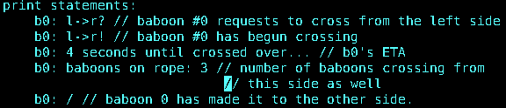
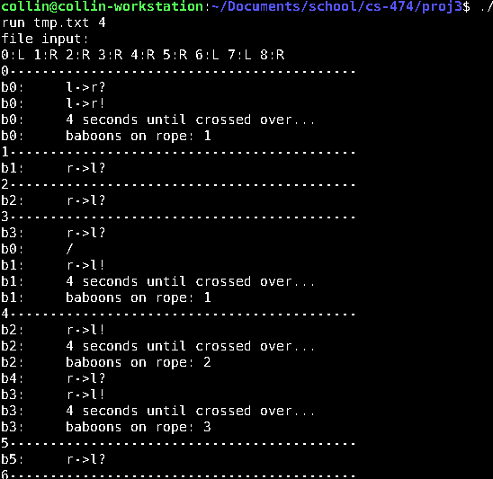
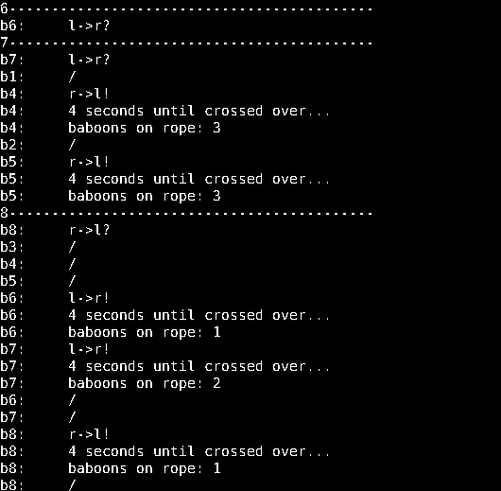
Result
LEGEND:
L,R,R,R,R,R,L,L,R
With travel time = 4(s)
(output pg1 (below))
(output pg2 (below))

Slide 6
Conclusion
Many issues arise without synchronization, such as:
Race conditions
Memory consistency
Deadlocks
Starvation
The solution to these issues is synchronization using semaphores to create critical zones. Thus, preventing the other thread from allowing baboons to cross while baboons are currently crossing.

