Slide 1
ACT Breakout AMIA Annual Symposium
November 19th, 2019

Slide 2

Welcome
General ACT updates
SHRINE 2020 update
Discussion: Machine learning in improving data quality

Slide 3
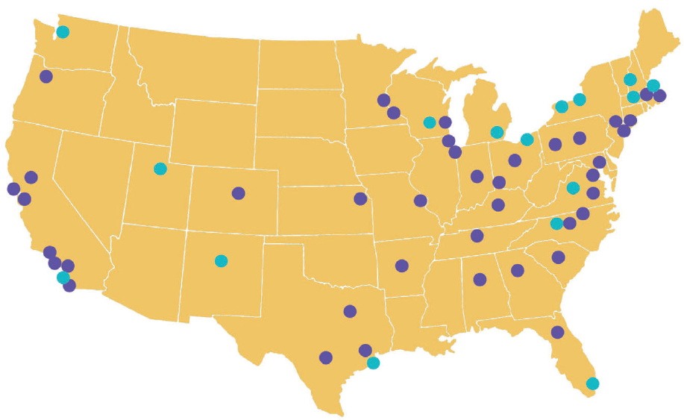

The ACT Network
Over 125 million unique patients currently available to query across the network
Connected to ACT:
Boston University
Children’s National
Columbia University
Duke University
Emory Univ./Morehouse Univ.
Harvard University
Indiana University
Johns Hopkins University
Mayo Clinic
Medical College of Wisc.
Medical Univ. of South Carolina
New York University
Northwestern University
Ohio State University
Oregon Health & Service University
Penn State
Stanford University
U of Alabama at Birmingham
University of Arkansas
University of California, Davis
University of California, Irvine
University of California, Los Angeles
University of California, San Diego
University of California, San Francisco
University of Cincinnati
U of Colo/Children’s Hops. Colorado
University of Florida
University of Illinois-Chicago
University of Kansas
University of Kentucky
University of Minnesota
University of North Carolina at Chapel Hill
University of Pittsburgh
University of Southern California
University of Washington
UT Health Houston
UT Health San Antonio
UT Southwestern
Vanderbilt University Medical Center
Virginia Commonwealth University
Washington University in St. Louis
Weill Cornell Medicine
Staging for ACT:
Case Western University
Dartmouth College
Scripps Research/Scripps Health
Tufts University
University at Buffalo
University of Massachusetts
University of Miami
University of Michigan
University of New Mexico
University of Rochester
University of Texas Medical Branch
University of Utah
University of Virginia
U of Wisconsin-Madison
Wake Forest University
Over 440,000 queriable data elements
Participation by 57 CTSAs

Slide 4
In 2019…
Onboarding 9 additional CTSA hubs to the network
Rolled out ACT ontology v2.0.1
Updated and expanded upon governance documentation
Revamped the Data Harmonization Work Group
Moved to SHRINE 2.0
Hosted kick off meeting to discuss data quality opportunities
Set the initial framework for full ACT launch at an additional 16 hubs
Testing a use case for local participant identification across test network sites

Slide 5
In early 2020…
Move to i2b2 1.7.12 across the network
Expand participant identification use case testing
Continue data quality conversations and translate ideas into action
Confirm additions and modifications for next ontology rollout
Gear up for SHRINE 2020…

Slide 6
SHRINE 2020 Project User Interface Update for ACT

Slide 7
Goals for SHRINE 2020
Create a new, easier to use user interface for ACT
Use case: cohort discovery, study feasibility, and site selection
Focus on “novice” users
Users not familiar with querying EHR data and the traditional i2b2 UI
Assume they understand the purpose of ACT/SHRINE
Assume they know the inclusion/exclusion criteria of their study
Select functionality that is most valuable to these novice users
Limit scope so that the project can finish in one year

Slide 8
What we’ve done so far
Needs analysis
Landscape analysis
Wireframes
Focus groups
Implemented query builder, browse ontology, run basic query

Slide 9
Needs Analysis
Prior User
Feedback
CT.gov
Analysis
User Rep. Interviews
MVP Feature List

Slide 10
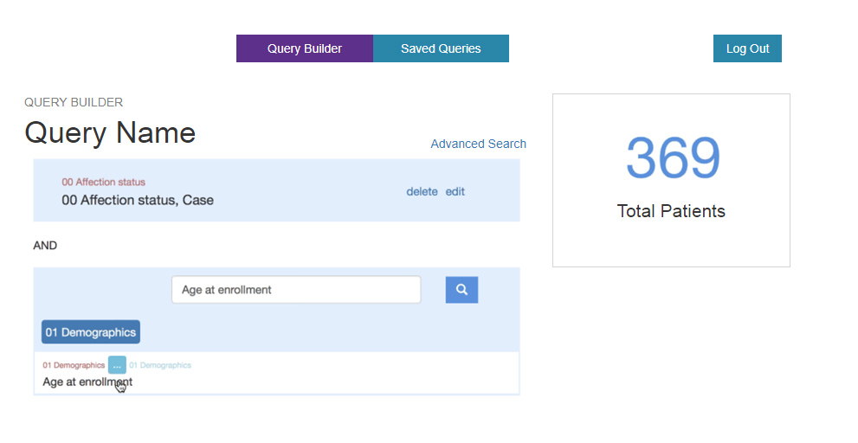
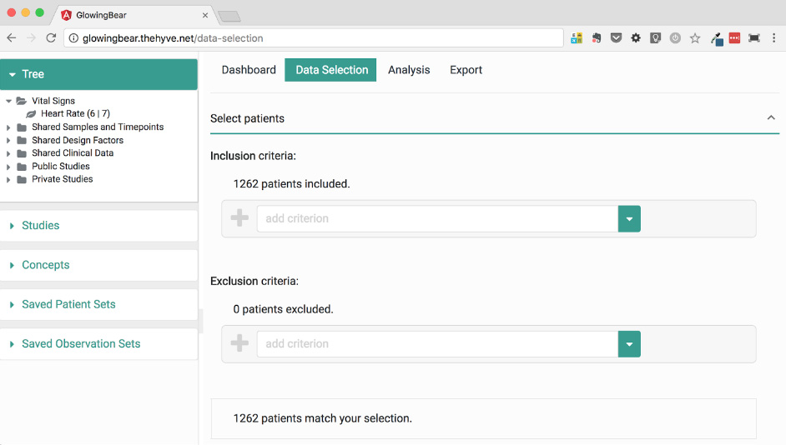
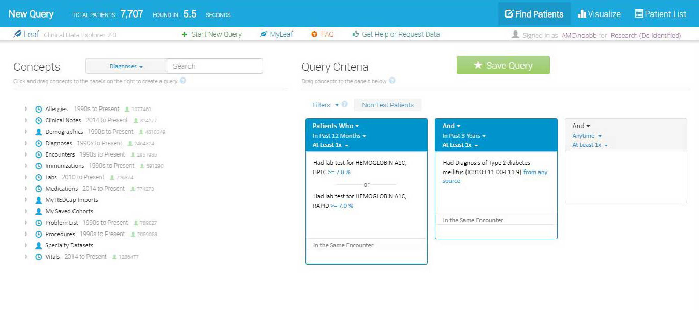
Landscape Analysis
PIC-SURE
HMS
TriNetX
Leaf
U Wash
IHTS
Glowing
Bear
Hyve

Slide 11
Why not use an existing UI?
At the time, Leaf was not open source. TriNetX is not open source and not available at all ACT sites.
Harvard Catalyst has over ten years of work in creating a scalable, asynchronous query tool that supports:
Dozens of sites (query status, results, demographic breakdowns)
Privacy & security (Data Steward, count obfuscation, query auditing)
Works with the i2b2 API and infrastructure at each ACT site
Easier in a one-year period to create a new query builder UI for our existing back-end infrastructure, than to add required functionality to an another UI.

Slide 12
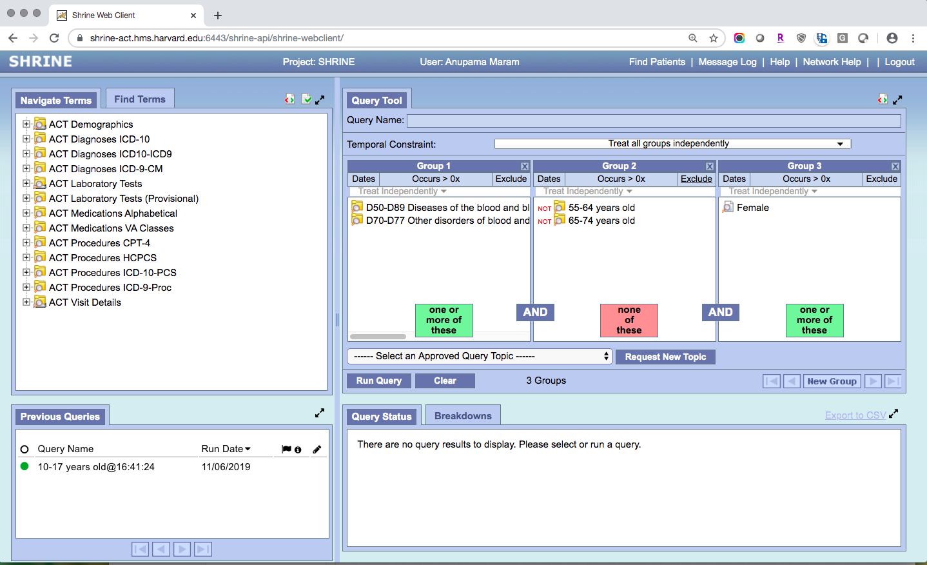
Design Goals
Simpler user interface geared towards novice users
Remove “advanced” features that aren’t needed for novice users
Vertical (top-down) query builder
Walk users through each step with clear sentences
Avoid technical language (“Boolean query”, “Ontology”)

Slide 13
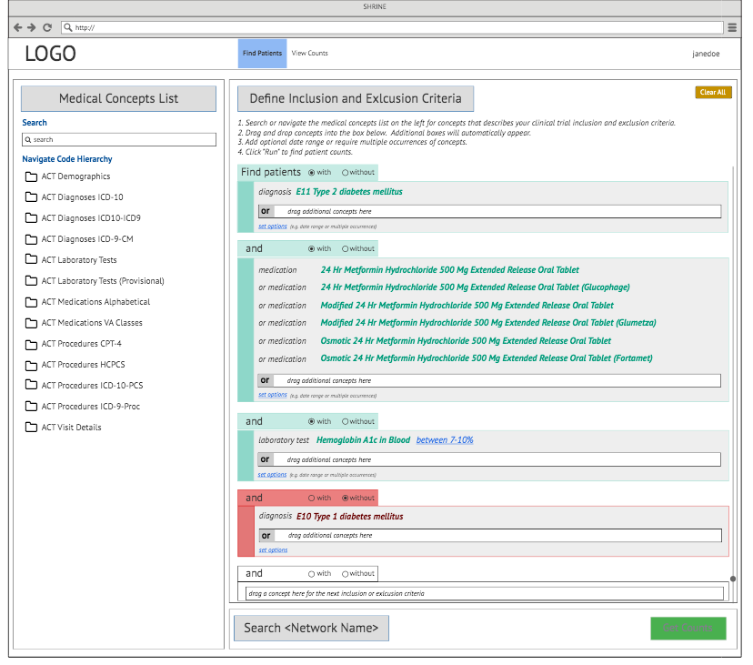
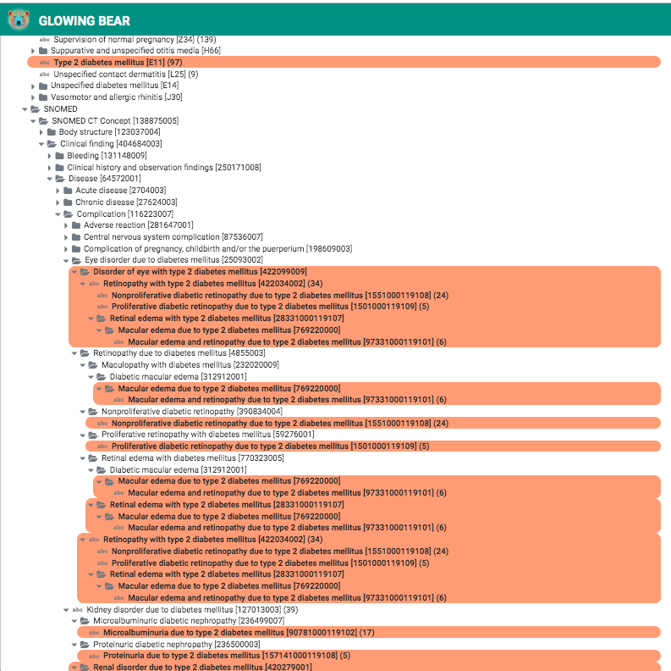
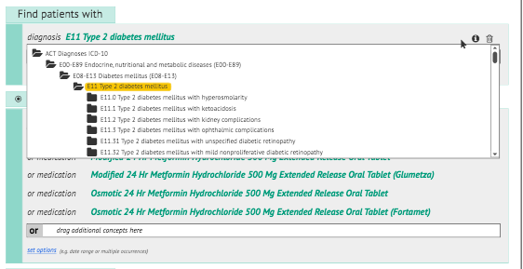
Wireframes and Focus Groups
June i2b2 Conference ACT Meeting
Novice
User Concept Feedback
June i2b2 Conference UI Working
Group
i2b2
tranSMART UI Working
Group

Slide 14
Issues we are not addressing
build a query vs translate their study criteria into the best query.
Not helping users interpret the results of their queries:
Data characterization (data quality, data completeness)
Differences in coding practices between sites
Different patient populations, years of data loaded into each site
Not helping users find collaborators to recruit patients.
Not building a UI for “power users” who need advanced features (e.g., temporal queries). They can still use the old UI.
Not fixing slow queries, offline sites, other technical issues.

Slide 15
DEMO

Slide 16
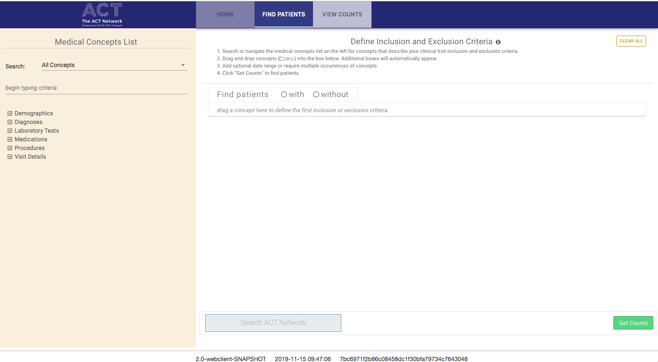

Slide 17
First Concept

Slide 18
Browse Concept List

Slide 19
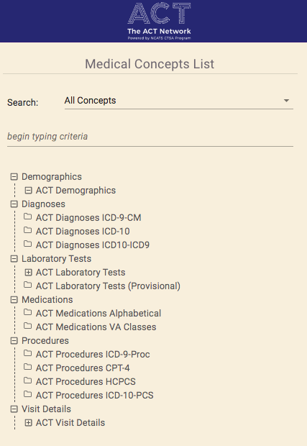

Slide 20
Laboratory Value

Slide 21
Exclusion

Slide 22
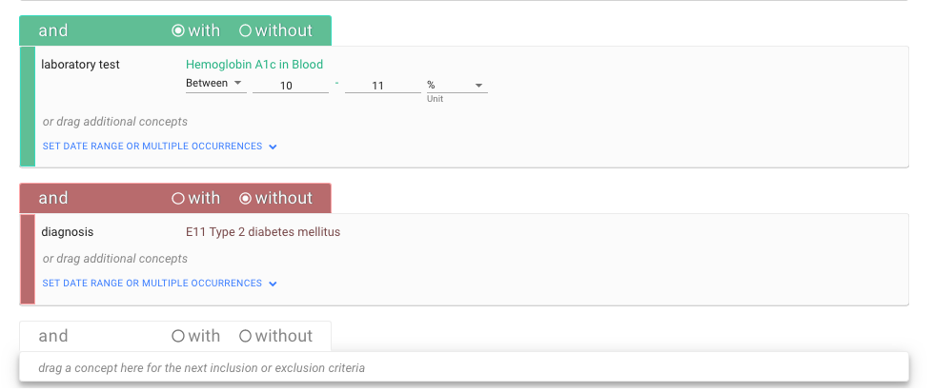

Slide 23
Next Steps - Implementation
Search for concepts
Run the query and view results
View previous queries
Login, logout
Integration with the Data Steward website
Finalize colors, icons, instruction/help text
Home page text and graphics

Slide 24
Next Steps – Beta Testing and Feedback
Users from the CTSA sites
Volunteers from June 2019 i2b2 focus group, UI working group meeting
Work with some sites 1:1 to identify a few novice users
Different testing phases:
Building and running a query
Searching for concepts
View the results of a query

Slide 25
Questions?

Slide 26
Improving Coded Data Quality in ACT
November 19, 2019

Slide 27
Nosology
As long as there have been written records, humans have been describing disease.
From ancient Greek
nosos = ‘disease’
logia = ‘study of’
The branch of medical science that deals with the classification of disease.
Notes:
First, a bit about data classification

Slide 28
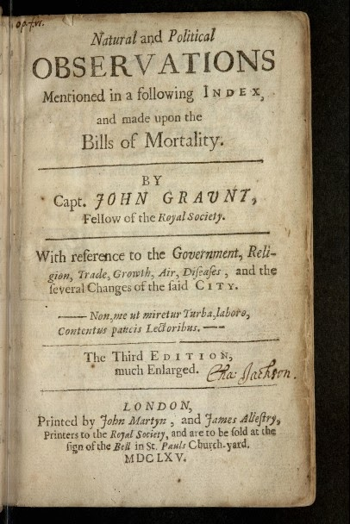
Natural and Political Observations made upon the Bills of Mortality
1663
By John Graunt, a haberdasher
First treatise on epidemiology and public health
Summarized deaths by cause, age, sex, and location

Slide 29
Classifying Disease and Cause of Death in 1663 London
Leading causes of death
Stillborn or infant death – 2,713
Consumption – 1,797
Fever – 1,108
Old age – 628
Small pox - 531
Bad teeth – 470
(none of these are leading causes of death today)
Less common causes of death
Executed and pressed to death – 18
Murthered (the old form of murder) – 17
Made away with themselves - 15
Starved dead in the street – 6
Lunatic – 5
Killed by a Wolf - 1

Slide 30
International Statistical Classification of Diseases and Related Health Problems (ICD-10)
A and B - Infectious and parasitic diseases
C - Neoplasms (tumors, both cancerous and benign)
D - Diseases of the blood and blood-forming organs and certain disorders involving the immune
mechanism
E - Endocrine, nutritional and metabolic diseases
F - Mental and behavioral disorders (psychology and psychiatry)
G - Diseases of the nervous system
H - Diseases of the eye and adnexa
H - Diseases of the ear and mastoid process
I - Diseases of the circulatory system
J - Diseases of the respiratory system
K - Diseases of the digestive system
L - Diseases of the skin and subcutaneous tissue
M - Diseases of the musculoskeletal system and connective tissue
N - Diseases of the genitals and urinary system
O - Pregnancy, childbirth and the puerperium
P - Certain conditions originating in the perinatal period
Q - Congenital malformations, deformations and chromosomal abnormalities
R - Symptoms, signs and abnormal clinical and laboratory findings, not elsewhere classified
S/T - Injury, poisoning and certain other consequences of external causes
V - External causes of morbidity and mortality (accidents, murder, etc)
Z - Factors influencing health status and contact with health services
Codes for special purposes

Slide 31
Can we use administrative data from the EHR for clinical trial recruitment?
Some issues in coded EHR data that can lead to misunderstanding, degradation, and loss of information:
CONTEXT
EHR data is collected retrospectively, while data collected specifically for a trial is collected prospectively and according to the study protocol.
CONSISTENCY
Concepts may be defined and processed differently at different places.
AMBIGUITY
The reasoning behind using certain codes may not be explicit.
FLUIDITY OF MEDICAL KNOWLEDGE
Changes in medical knowledge result in changed coding practices.

Slide 32
Which code to use?
Hodgkin Lymphoma
C81.00 Nodular lymphocyte predominant Hodgkin lymphoma, unspecified site
C81.03 Nodular lymphocyte predominant Hodgkin lymphoma, intra-abdominal lymph nodes
C81.10 Nodular sclerosis classical Hodgkin lymphoma, unspecified site
C81.90 Hodgkin lymphoma, unspecified, unspecified site
Notes:
AMBIGUITY . The coding family for Hodgkin’s lymphoma C81. By itself, C81 is not a valid ICD-10 code, since it does not contain five characters. Any of these codes could be used to indicate Hodgkin’s lymphoma in a patient, even though their specific meanings are notably different.

Slide 33
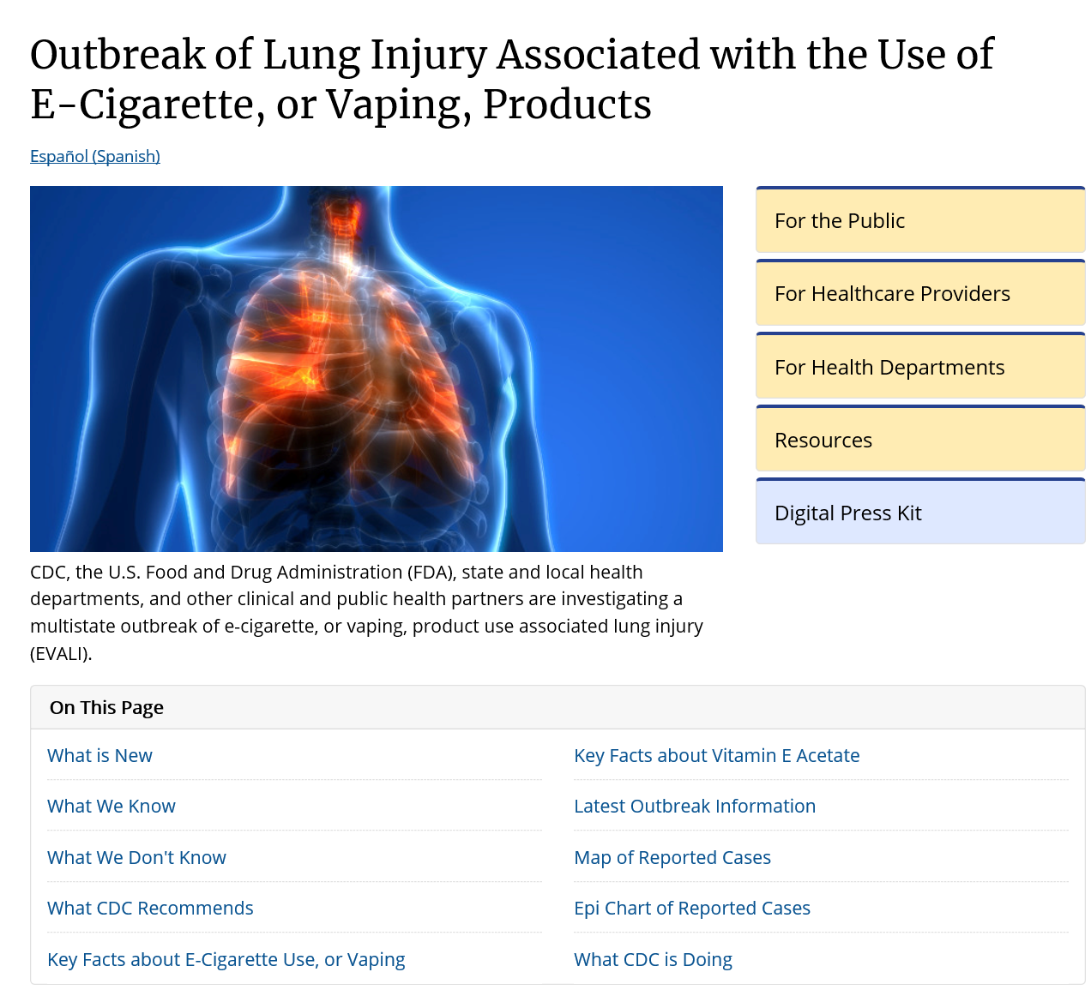
https://www.cdc.gov/tobacco/basic_information/e-cigarettes/severe-lung-disease.html

Slide 34
Coding Conundrum
CDC Guidelines Released October 17, 2019
Vaping-Related Lung Injury
Lung-related complications
For patients documented with electronic cigarette (e-cigarette), or vaping, product use associated lung injury (EVALI), assign the code for the specific condition, such as:
• J68.0, Bronchitis and pneumonitis due to chemicals, gases, fumes and vapors; includes chemical pneumonitis
• J69.1, Pneumonitis due to inhalation of oils and essences; includes lipoid pneumonia
• J80, Acute respiratory distress syndrome
• J82, Pulmonary eosinophilia, not elsewhere classified
• J84.114, Acute interstitial pneumonitis
• J84.89, Other specified interstitial pulmonary disease
For patients with acute lung injury but without further documentation identifying a specific condition (pneumonitis, bronchitis), assign code:
• J68.9, Unspecified respiratory condition due to chemicals, gases, fumes, and vapors
Notes:
As medical knowledge evolves, criteria for diagnosis of disease may be in flux.

Slide 35
Coding Conundrum continued
CDC Guidelines Released October 17, 2019
Vaping-Related Lung Injury
Poisoning and toxicity
Acute nicotine exposure can be toxic. Children and adults have been poisoned by swallowing, breathing, or absorbing e-cigarette liquid through their skin or eyes. For these patients assign code:
• T65.291-, Toxic effect of other nicotine and tobacco, accidental (unintentional); includes Toxic effect of other tobacco and nicotine NOS.
For a patient with acute tetrahydrocannabinol (THC) toxicity, assign code:
• T40.7X1- Poisoning by cannabis (derivatives), accidental (unintentional).
This guidance is consistent with current clinical knowledge about e-cigarette, or vaping, related disorders
Notes:
As medical knowledge evolves, criteria for diagnosis of disease may be in flux.

Slide 36
Accrual to Clinical Trials (ACT)
Despite coding efforts, in clinical medicine, a disease, condition, or other concept is often not directly measurable, and its existence is inferred from other measures.
So, how do we identify subjects for clinical trials using coded EHR data?
Notes:
EXAMPLE = Diabetes defined by one or more elevated lab measures in a certain period of time

Slide 37
Computed Disease Definitions
Rather than using a single billing code to define a disease, EHR-based machine learning (ML) phenotyping methods extract multiple features from patient records and use them to infer whether the given phenotype exists for a given patient.
These data-driven phenotypes typically result in more precise disease cohorts for translational research.

Slide 38
Classifying Epilepsy using ICD only
In a clinical chart review of a random sample of 540 patients enrolled in the Partners Biobank:
The PPV of 1 ICD code for Epilepsy = 0.63
Impact: About a third of patients with an Epilepsy ICD code did not have Epilepsy
The sensitivity of 1 ICD for Epilepsy = 0.98
Impact: Almost all patients with Epilepsy had at least 1 ICD code

Slide 39
Classifying Epilepsy using Computational Phenotyping Methods
A machine learning phenotype algorithm was trained among patients with an ICD code for Epilepsy:
We can achieve a PPV of 0.90*
Impact: Only 10% of this set will not have Epilepsy
The sensitivity of the algorithm is 0.93
Impact: Even with a more stringent cohort criteria we can identify the vast majority of patients with Epilepsy
* The PPV of the machine learning algorithm is customizable. In many cases we can achieve higher PPV but with lower sensitivity

Slide 40
More Phenotypes
 | >1 ICD code |  | Machine Learning Algorithm
Phenotype | PPV | Sensitivity | PPV | Sensitivity
Epilepsy (EPIL) | 0.63 | 0.98 | 0.90 | 0.91
Coronary Artery Disease (CAD) | 0.57 | 0.93 | 0.90 | 0.97
Multiple Sclerosis (MS) | 0.52 | 0.95 | 0.90 | 0.81
Rheumatoid Arthritis (RA) | 0.39 | 0.98 | 0.90 | 0.76
Type-II Diabetes Mellitus (T2DM) | 0.35 | 0.99 | 0.90 | 0.88

Slide 41
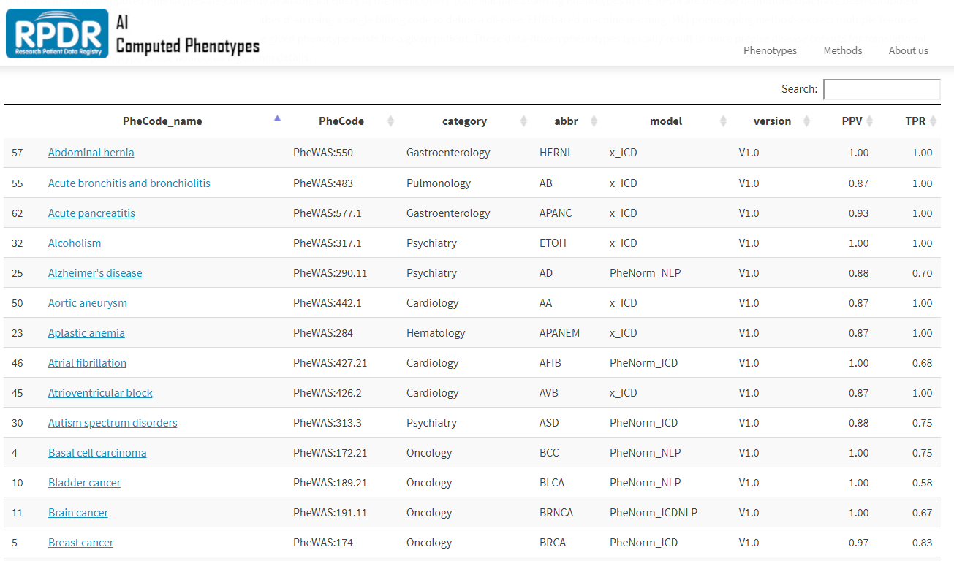
A Library of Computed Phenotypes

Slide 42
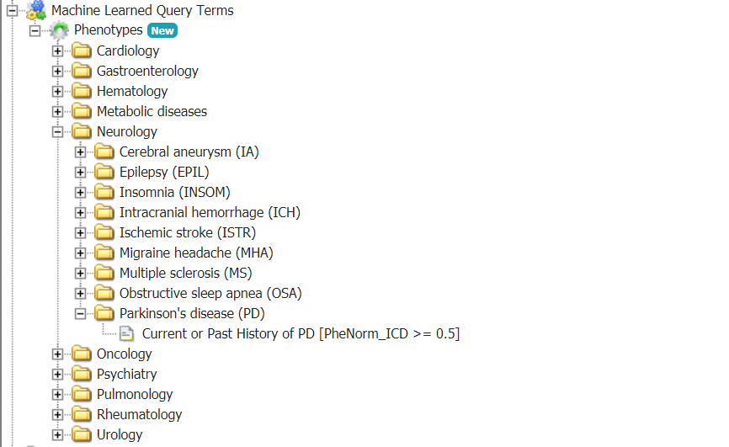
Queryable in ACT

Slide 43
Thanks!

Slide 44
Appendix

Slide 45
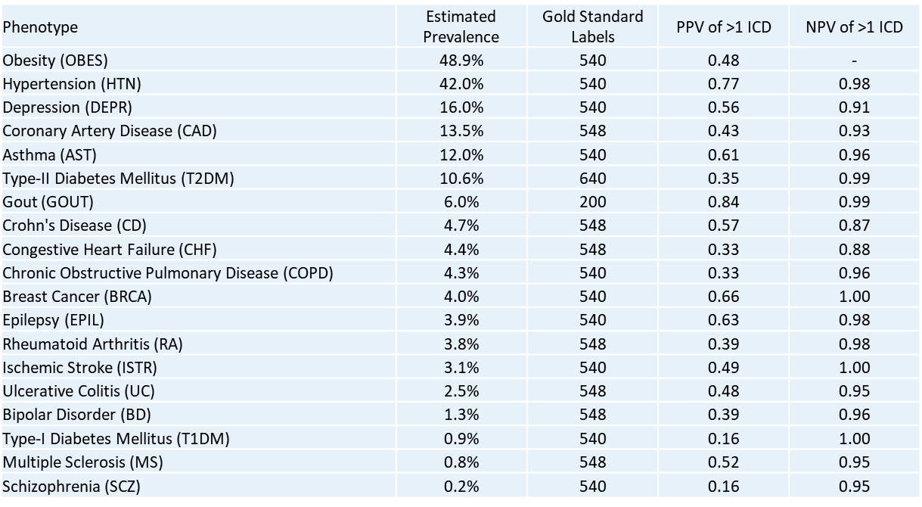
Is one ICD code enough to describe a disease?

Slide 46
Common Data Patterns
Many ICD codes are sensitive but not very precise
Schizophrenia ICD>1 – Precision: 0.16, Recall: 0.95
Rheumatoid arthritis ICD>1 - Precision: 0.39, Recall: 0.98
Multiple sclerosis ICD>1 - Precision: 0.52, Recall: 0.95
Specificity of ICD codes increases with the number of ICD codes
Patients with no data are hard to classify
NLP increases specificity in some disease phenotypes – but not all
Patients with many visits have an increased chance of incorrect/incidental ICD codes

Slide 47

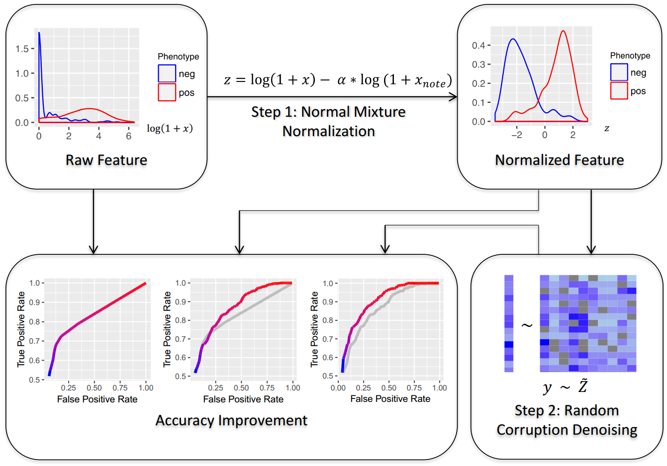
Unsupervised Phenotyping: PheNorm

Slide 48
Specific aims
Quickly develop and deploy machine learning phenotyping algorithms using unsupervised methods and with few gold standard labels
Make them easily accessible and maintainable to a large number of researchers
Use cases
Cohort identification for clinical trial recruitment
Outcome definitions for observational studies
Phenotype definitions for genomic analysis
….

Slide 49
Phenotype Selection
110 Phenotypes Selected
Most common diseases in the EHR problem list
Restricted to discrete diseases or symptoms
Mapped to Phecodes – curated list of ICD codes
https://phewascatalog.org/phecodes
Each phenotype mapped to UMLS CUI(s)

Slide 50
Dataset
RPDR – Partners Healthcare Research Patient Data Registry
4+ million patients from a health system located in eastern Massachusetts
Data from 1990 to Present
Data Floor
Restrict patients to those with 3 visits (on different days) and at least 1 clinical note
2,060,906 patients in the training set
Features for each phenotype
Count of visits (x_{enct})
Count of ICD codes (x_{ICD})
Count of NLP mentions (x_{NLP})
Algorithm training on patients with at least one ICD code

Slide 51

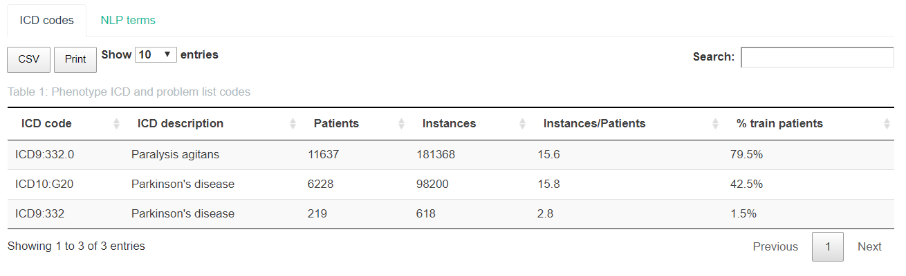
ICD Code Detail

Slide 52
NLP
Query UMLS for synonyms associated with each mapped CUI
String synonyms were reduced to the shortest match.
For example, ‘congestive heart failure’ and ‘heart failure’ were combined into one ‘heart failure’ synonym.
The list of synonyms were then processed through a custom NLP string matching extraction pipeline to generate a count of positive mentions of the disease in the patient’s clinical notes (x_{NLP}).
The count does not include negated mentions (e.g. ‘no history of heart failure’) nor family history mentions (e.g. ‘mother had heart failure’).

Slide 53
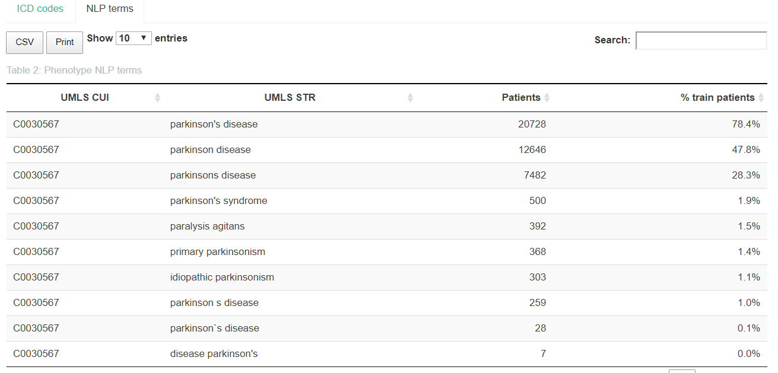
NLP Detail

Slide 54
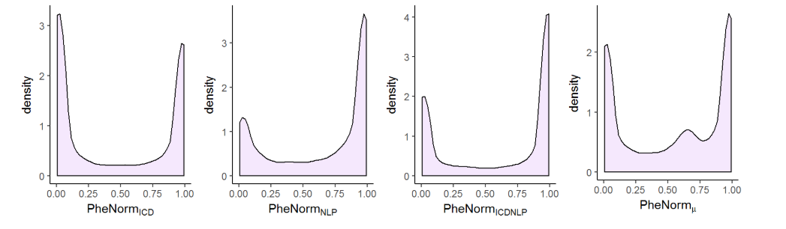
PheNorm Training

Slide 55
Validation of the Algorithm
Patients randomly sampled from the ICD+ population
Gold standard labels generated by clinician chart review of each patient’s entire medical record
Compute area under the curve (AUC) for each PheNorm score as well as precision (PPV), accuracy, and sensitivity at a cut-off of 0.5

Slide 56
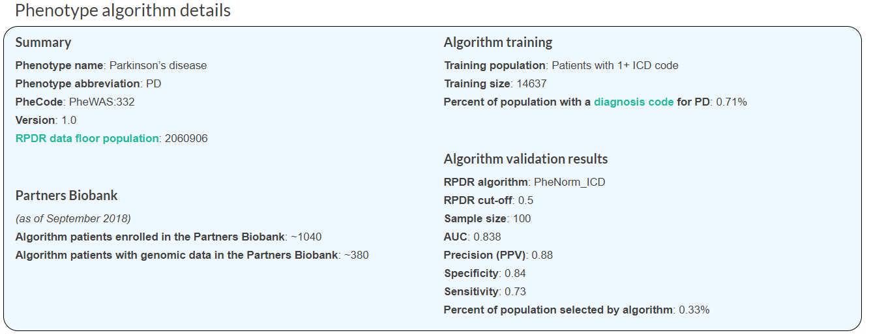
Example Phenotype Report

Slide 57
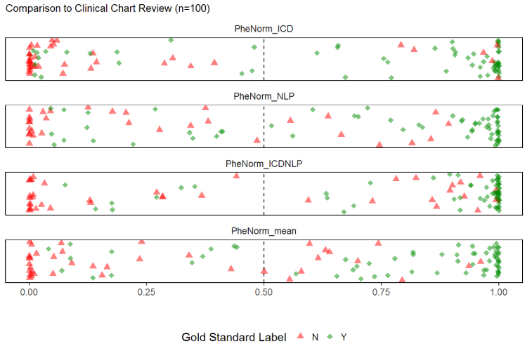
Validation

Slide 58
Results
Validation was done using over 10,000 gold standard labels generated by clinician chart review
Validation Results:
28 Phenotypes have precise ICD codes (PPV of ICD>1 is 0.90+)
PheCode:274.1 Gout, PheCode:185 Prostate Cancer; PheCode:272.1 Hyperlipidemia
31 Phenotypes require only ICD data (PheNorm_{ICD})
PheCode:193 Thyroid cancer, PheCode:250.2 Type-2 diabetes mellitus
16 Phenotypes require NLP data (PheNorm_{NLP,} PheNorm_{ICDNLP,} PheNorm_{mean})
PheCode:411.2 Myocardial infarction, PheCode:433.21 Ischemic stroke
85 Phenotypes deployed to RPDR
25 Phenotypes not yet deployed due to low performance

