Slide 1
chile
country of poet

Slide 2
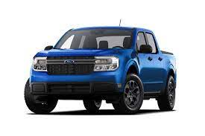
transportation in chile
chevrolet double cabin pick up.

Slide 3
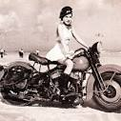
motorbike
motobike

Slide 4
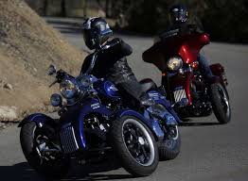
most common sport in chile

Slide 5
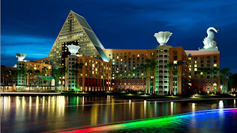
chile city at night

Slide 6

chile mountain

Slide 7
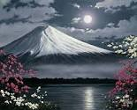
chile volcano

Slide 8
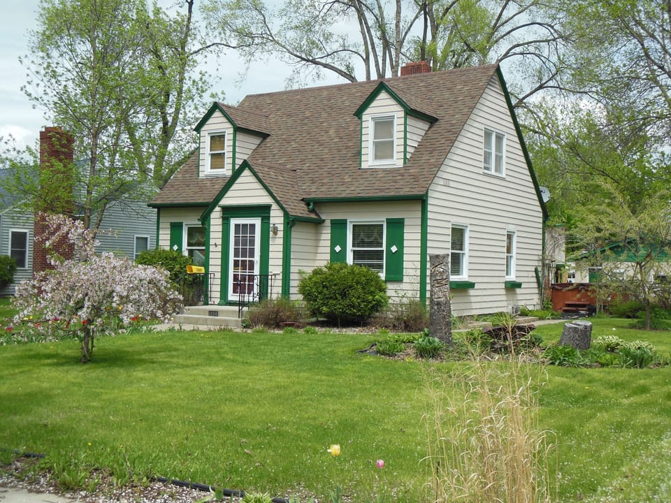
chile real estate house for sale

