Slide 1

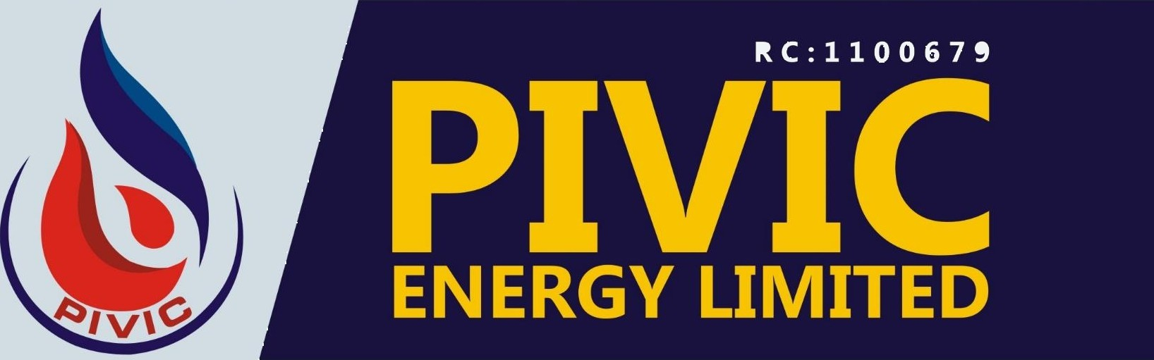
6 ENGINEEŒNG
G PROJECT MANAGEMENT
G PROCUREMENT

Slide 2











P I V I C E N E R G Y L I M I T E D
PIVIC ENERGY LIMITED is an indigenous limited liability company, incorporated under the companies and allied matters Act Cap C20 LFN 2004, with registration number: Rc1100679.
Our Headquarters is strategically located at plot 21A King Perekule Street, G.R.A. Phase II Pot Harcourt, Rivers state Nigeria. We have representative liaison o0ices in Houston Texas, Canada and the United Kingdom.
PIVIC ENERGY LIMITED is an integrated company that o0ers end to end engineering and technical services in areas of Mechanical Design, Machining and Fabricalions, Project Management, Procurement and Supply Chain management, Blasting & Painting, Tank & Vessel Cleaning Services and Human Capital Supply.
PIVIC ENERGY LIMITED is professionally managed by a team of highly skilled and experienced technical and management professionals, with a cumulative work experience in excess of(40) years in the Oil & Gas Industry. We are also in synergy with some reputable foreign companies who provide techniGal suppol services from time to time.

Slide 3






P I V I C E N E R G Y L I M I T E D
To work assiduously to deliver professional and quality service(s) to our
clients on time and budget.
PIVIC ENERGY LIMITED is focused on e0ectively and e0iciently growing our core values and competencies to become the most preferred “GO TO" service company in the oil and gas industry that is sensitive to clients technical and professional needs without compromising safety and standards.
The company is structured into three major depalments namely: Engineering/TeGhniGal Support services, Project Management/human capital supply Services and Procurement. These departments o0er a wide range o1 products and services.
ENGINEERING/TECHNICAL SUPPORT DIVISION
This department provides end to end services in construction, operational and rig maintenance services as well as Fabrication/Construction and installation of facilities, testing, pre-Gommissioning, commission and start-up as well as the supply of human capital. We look beyond the seleGtion of contractors, mobilization of plants and equipment, Personnel resourGes deployment, develop/review of construction issues and Q/HSE functions to ensure that projects are delivered on schedule and on budget without compromising quality in the1oIIowing areas:

Slide 4



P I V I C E N E R G Y L I M I T E D
Welding &Fabrication Services
Rig Maintenance Services/Modifications
Design and Construction of Skips, Load baskets, Platforms,
Containers (10ft, 20ft and 40ft Range).
Electrical/Mechanical Installation Works.
Corrosion control (Sponge-Jet Abrasive Blasting and Coating)
Tank/Vessel Cleaning Service
FEEDS
PROJECT MANAGEMENT/
MAN POWER SUPPLY DIVISION
We have many years experience and expertise in agile and waterfall project management approach; which enables us to ensure that projects
run smoothly to the satisfaction of business and the subject matter expels. Our human capital resource includes but not limited to the following:
+
+
ABS Certified GTAW/SMAW Welders/ Fitters
Sca0olders and Celified Sca0old Inspectors
Rig Electricians
Mechanical & Machine operators
Fire-watchers/mates
Roustabouts
Painters and Blasters
Field service engineers (Project, Mechanical / StruGtural, and
EleGtrical)
m
•

Slide 5











P I V I C E N E R G Y L I M I T E D
PROCUREMENT SERVICES
We provide technical assistance on Materials Procurement and Supplies according to specification of the clients within a specified time frame and on budget too. Our procurement network/team is well equipped and is in synergy with manufacturers and other buyers around the world, which facilitates our ease of procurements and delivery. We are stockiest for some materials which we could deliver within short notice. Some of these materials include:
Fire Protection Equipment and Accessories
Line Steel Pipes (Seamless or Welded) of all sizes
Casings/Tubing and Flanges of all grades
Safety & Environmental Products for Onshore/ O0shore operations Hygienic valves and fittings, swivel joints
PPE Materials
Marine Equipment: Tugs, Flat barges, Fuel barges, Work barges
and Consumables etc.
Equipment leasing & Rental Services: Sca0old Materials, Boat House, Containers, Trucks, Flatbed trailer(s), Crew Buses & Large Vans and other related Equipment.
Pivic has been in existence for a relatively short period, but we are very determined to consistently maintain high standard of e0iciency and quality in all our deliverables, which will earn us the confidence and satisfaction of our clients at all times.

Slide 6




P I V I C E N E R G Y L I M I T E D
PIVIC is gradually acquiring a reputation of high level of e0iciency and work ethics, based on our existing field experiences, therefore we are determined to uphold and improve on our successes and continuously strive to maintain and live up to our aims and objectives.
PIVIC ENERGY LIMITED is solely an indigenous company with 100%
Nigerian content.
PIVIC ENERGY LIMITED encourages the local Gontent value chain by purchasing equipment, materials and other supplies that could be sourced locally from Nigerian suppliers and contractors. Therefore we advocate for the utilization of our local resourGes both professionally and materially in consonance with the local content policy of the Federal Government of Nigeria.

Slide 7




P I V I C E N E R G Y L I M I T E D
Quality control of products and services shall remain a veritable instrument of quality assurance for PIVIC ENERGY LTD and shall form the hub and nucleus of our services to our various clients and the public in general. Consequently, our policy objective is geared towards:
1.
Ensuring that our engineering products and services comply with all relevant industry codes and standards, statutory requisitions and clients' product specification.
2.
Ensuring full implementation of customers/vendors' engineering data that will satisfy the technical requirements laid down by the clients in terms of performance, reliability and safety. To this e0ect, work on client's projects shall not Gommence until there are valid approval of construction drawings.
line customer’s/vendor's design specifications. This will
with entail
Ensuring satisfactory construction results are in
application of appropriate engineering data for fabrication works, construction assembling and inspections at every stage of works, before commissioning/project transfer to the Gustomer.
4.
Ensuring that various revised industry Godes and standards are readily available in-house for ease o1 reference. These shall include but not limited to the engineering codes published by the following

Slide 8



P I V I C E N E R G Y L I M I T E D
bodies on engineering subject: ASME/ANSI, API, AWS, BS, TWI, IEC, ICI, and Clients' in-house standard practices shall be maintained.
5.
Establishing a system of Quality Control Audit vis-à-vis non- conformity data collection and statistic processing with a view to eliminating non-conformities in our deliverables.
6.
Investigating any operational non-conformity promptly in order to unearth any deficiencies arising, correct and prevent future re- occurrenGe.
7.
Preventing all cases of “failure in service" by a consistent approach towards quality assurance and re-assurance at every stage of contract implementation.
8.
Establishing a well-defined quality control procedure, plans and personnel roles and functions and ensuring that these are adequately communicated to all levels in the organization.
9.
Ensuring that for every contract, QA records are readily ava i I ab Ie for easy reference at all times. Also, a complete dossier of As-Built file comprising AFSC, materials and inspection celificates, provisional and final aGceptance certificates etc. shall be maintained and issued to the Glient at the end of contract.
10. Encouraging those employed through periodic inducements that excel in helping to meeting the company's QA objectives.

Slide 9



P I V I C E N E R G Y L I M I T E D
PIVIC operates an Integrated Management System (IMS), whÎGh includes a health, safety and environmental management system.
To the best of our abilities, we eliminate and or minimize health and safety risk by maintaining a prevention of ill-health and injuries program while at work.
We focus on project delivering a charted quality service to our Glients
that subsequently exceeds their impliGit expectations.
M We will conduct our business in a manner that assures the health and safety of our workforGe and our community.
M We will be honest and responsible in our dealings with our client's employees and suppliers.
M We will be accountable, individually and as a team, for our actions and our results.

Slide 10



P I V I C E N E R G Y L I M I T E D
It is the policy of PIVIC ENERGY LIMITED Management to prevent aCGidents as far as it is reasonably practicable by ensuring.
The Promotion and maintenance of the highest degree of physical, mental and social well-being of our workers in all ocGupation.
The protection of workers in their employment and third party who may be involved in risks resulting from factors and adverse to health.
The placing and maintenance of workers in an occupational environment adapted to their physiological and psychological equipment.
B
The adaptation of work to man, and of each man to his job.
M
Safety shall therefore rank with production case and employee morale in order to achieve the desired goal.

Slide 11

















P I V I C E N E R G Y L I M I T E D
FLARE BOOM FABRICATION AND INSTALLATION ONBOARD FRIGG RIG (TOTAL)
ST 160— IRON ROUGHNECK REPAIR OF CRACKED JOINT. SEAWOLF DELTA QUEEN HULL REPAIRS
SEAWOLF DELTA QUEEN PLATE RENEWAL
REPAIR AND SERVICING OF MUD PUMP SUCTION MODULES
JOINING OF LANDING RING AND 30INCH X 1INCH CONDUCTOR PIPE AMKP1-42 MACHINING/PRODUCTION OF BOP CART PIN/BOLTS.
UPGRADING OF JUNIOR AND SENIOR GALLEYS
JOINING OF BELL ADAPTER TO 30INCH X 1INCH CONDUCTOR PIPE. SCAFFOLDING SUPPLY AND INSTALLATION
CONSTRUCTION OF 2 INCH 1502 CONNECTORS (THREADED END) REPAIRS OF BOP TEST STUMP INSERT
MACHINING OF DIVERTER/HYDRAULIC STAB
SAND BLASTING AND PAINTING OF GANGWAYS, TEXAS DECK PLATFORM AND
ANCHORS
CHANGING OF HULL BOTTOM PLATES
CHANGING OF SFT SWASH PLATE CONNECTED TO SIDE SHELL
FABRICATION OF RIG LEG HANDRAIL
WELDING OF 12INCH PIPE INSIDE AVOID TANK

Slide 12
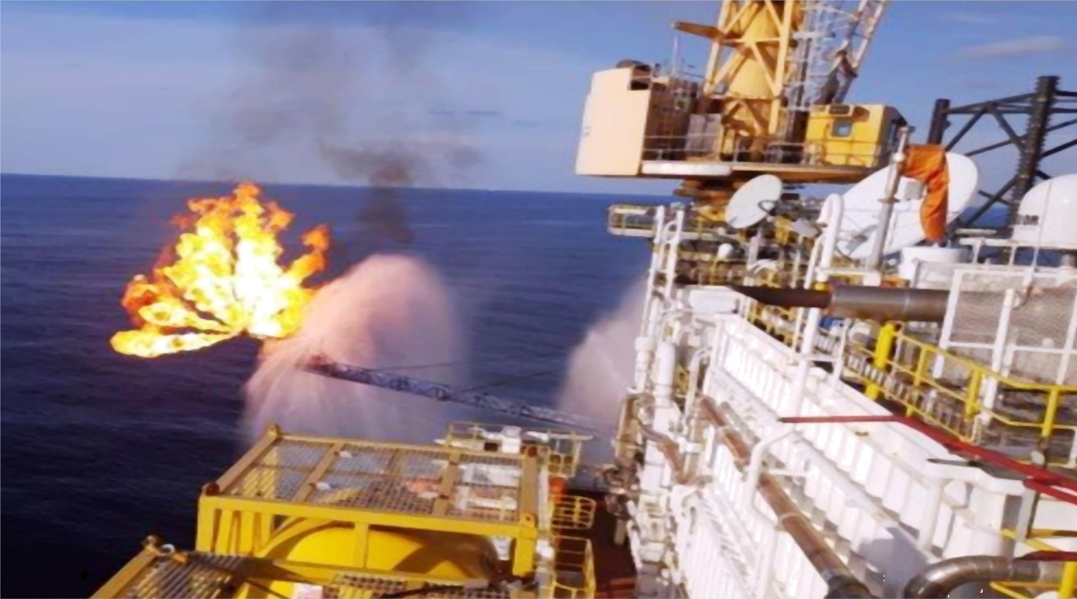
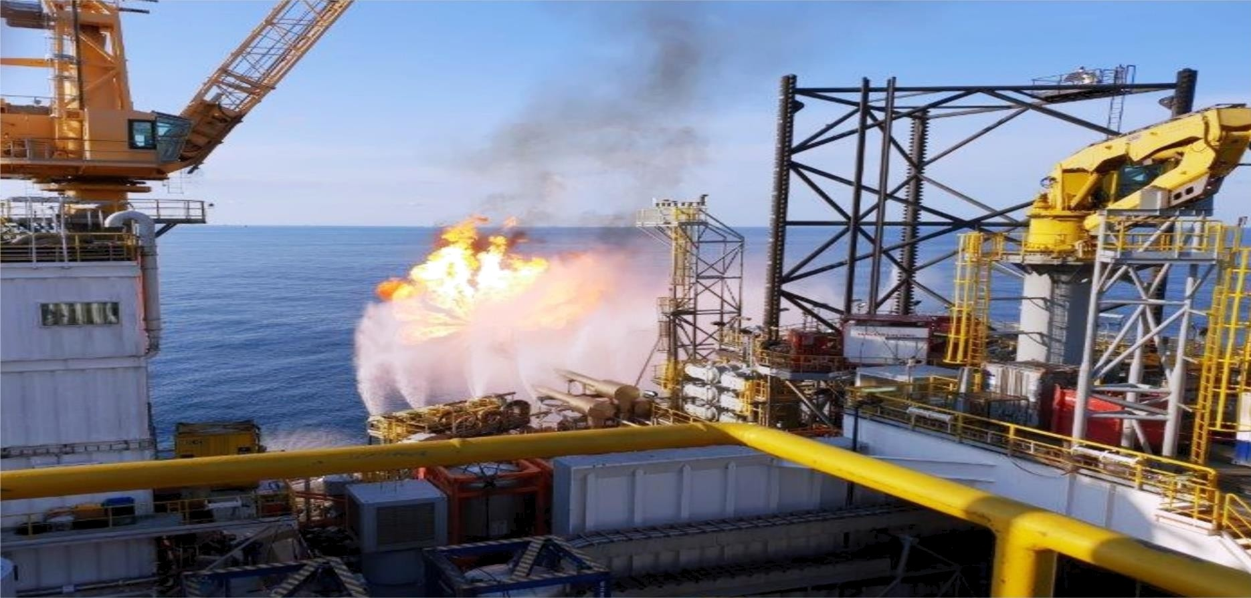
TESTED FLARE BOOM, FABRICATED & INSTALLED BY PIVIC ONBOARD BORR FIGG (TOTAL)

Slide 13
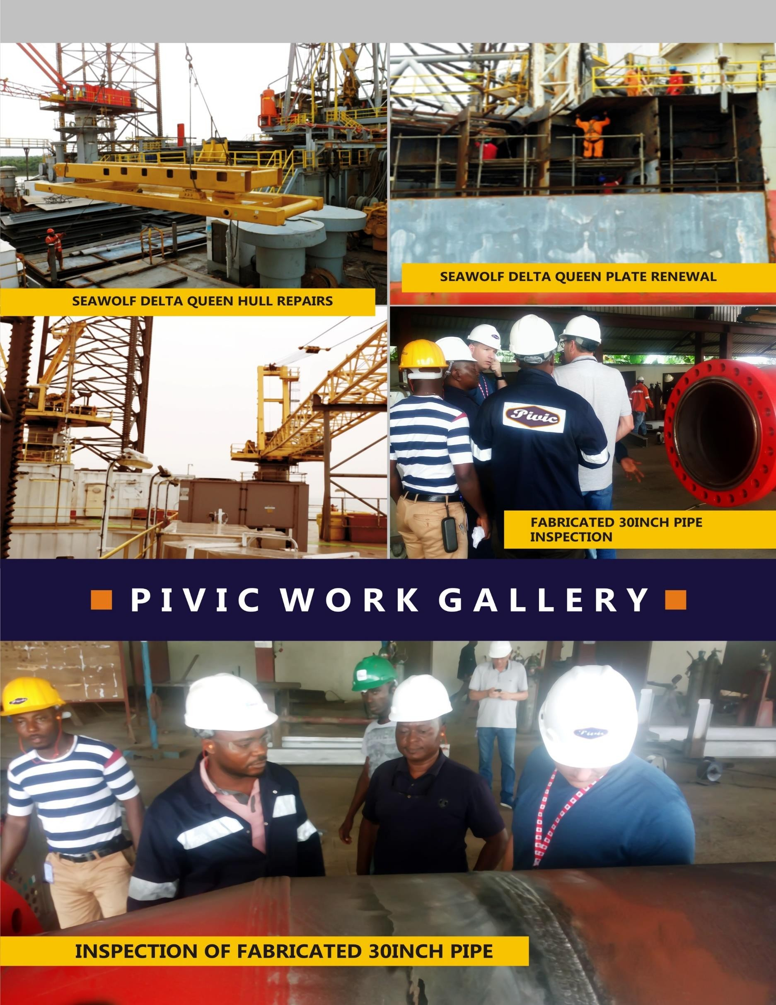

Slide 14
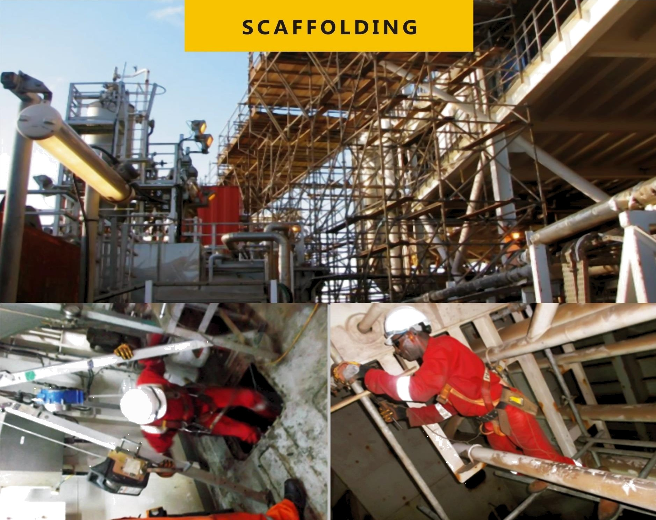
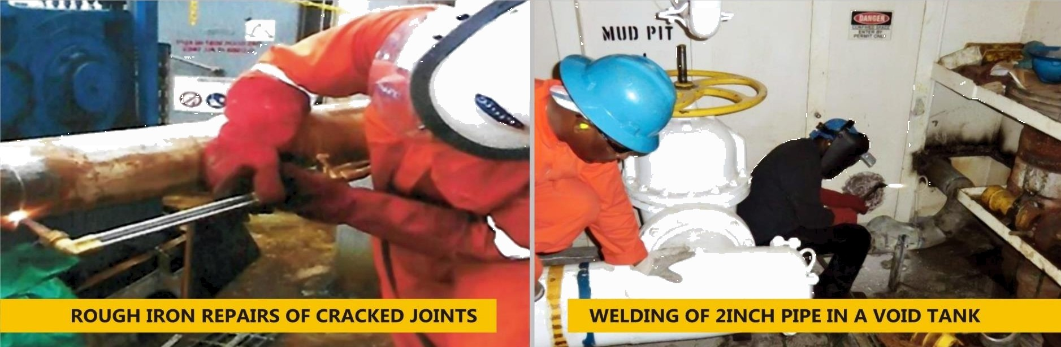
P I V I C W 0
R K G A L L E R Y

Slide 15


