Slide 1
Discussion on an End of Project Strategy
Collin Schwantes

Slide 2
Introduction
Ending projects properly ensures compliance with award obligations, supports proper management of resources, and facilitates reuse of research outputs (code, data, protocols, etc.).
Creating reusable research outputs increases research impact
Primary beneficiary will be you.

Slide 3
Goals of today’s discussion
Provide an overview of the strategy
Understand where it might break down
Determine what training or infrastructure is needed

Slide 4
Overview of strategy
This strategy was developed using the archetypal EHA project
Animal sampling data in Airtable
Human survey data in ODK
Other data sets to inform statistical modeling done in R.
Decouple publication of results from release of data and code
Over arching goal is to end projects with FAIR research outputs
Notes:
- This strategy was developed off the archetypal EHA project that creates animal sampling (in Airtable) and human survey data (in ODK), and uses other data sets to inform statistical modeling done in R.
Decouple publication of results from release of data and code
Over arching goal is to end projects with FAIR research outputs
FAIR – findable accessible Interoperable and reproducible- meaning that your data is discoverable by other people and ideally computers, they can acquire the materials they found, they can open the materials, and the materials have enough context that they can be included in other analyses.

Slide 5
Overview of strategy: Guiding principles
Data management plans change with the project
Digital and physical assets are properly managed
Published outputs can be found and interpreted by users outside the project

Slide 6
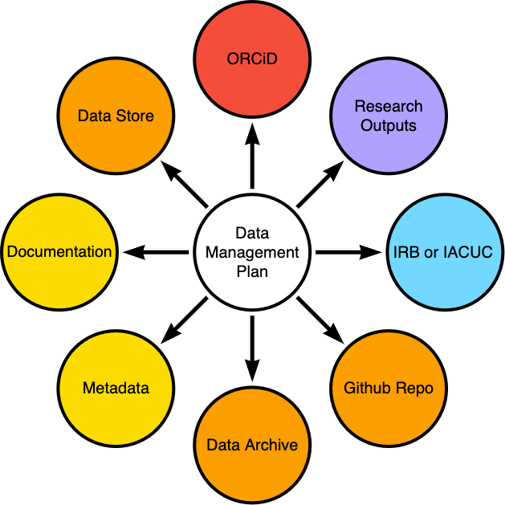
Overview of Strategy: Living data management plans
The data management plan should serve as hub that records connections to different research outputs.
Data management plans should facilitate end of project activities.
Assets are described
Roles and responsibilities are delineated
Standards and repositories are outlined

Slide 7

Overview of Strategy: Asset Management
Where possible, services that are no longer needed should be shut down
Where possible, code running against cloud based data stores (Airtable, ODK, AWS) should be run from version controlled data files.
User access to services should be reviewed
Physical items should be appropriately archived and documented (e.g. reagents, specimens, etc.)

Slide 8

Overview of Strategy: Code
Use best practices for reproducible software
self contained projects (RStudio projects)
version controlled code (git and GitHub)
literate coding practices (in line documentation)
dependency management (renv, docker)
automated code runs (targets, docker)
Provide sufficient meta data about your project to give context and facilitate attribution

Slide 9

Overview of Strategy: Data
Outputs should conform to a standard
Default for data being frictionless data standard.
Outputs should should have project level and item level metadata
Outputs should contain or describe any necessary dependencies
Outputs should be as FAIR as possible

Slide 10

Mechanics of process
Criteria for initiating close out process
Roles and responsibilities
Definition of done

Slide 11
Mechanics of process: Criteria
Project has research outputs that are should be cataloged for future use
At least some project outputs can be shared beyond immediate team members
Project is nearing the end of its funding period
Notes:
Do all projects need to go through this process – no

Slide 12
Mechanics of process: Roles and Responsibilities
Project Team
Review and update DMP
Identify and prepare materials for release
Verify released materials meet expectations and align with DMP
Decommission assets
Data Librarian
Review updated DMP
Provide support for preparing materials to be released
Verify materials are FAIR
Verify released materials are properly linked to DMP and other research outputs

Slide 13

Mechanics of process: Definition of Done
Project materials have been placed into long term storage as defined by the DMP
Assets have been decommissioned and user access has been reviewed
Research outputs are properly linked to each other
Research outputs are in a FAIR state

Slide 14
Concrete Example
We say we are going to do the following in a DMP, what’s needed to make each item a reality? How long do you expect it to take?
Release version controlled reproducible code
Deposit animal viral-survey data in Zenodo
Deposit anonymized human survey data in Zenodo
Publish nucleotide sequence data to Genbank
Update data management plan with research outputs
Notes:
I want everyone to think about a project they are currently working on. Lets say that you’ve included the following in your DMP.
What does NIH policy mean?
Type of data sharing with NIH ---
With partners in non-us countries - we spend a lot of time setting up data sharing agreements. Even materials transfer it depends on types of data and significance of findings. Best we can do is working
Each project with 5-6 institutions - starting this conversation is very helpful.
1) Most important client is yourself - even we
2) there is a time where you have no more funding where going back to the data and documenting it becomes extremely difficult.
3) Important this doesnt come last minute scramble
What didnt we do well on predict - end of predict -- where are the samples, what are the codiitions for that, physical, EDITH - now with USAID is hard to access and many data are not published.
- when we
We did a good job in the beginning honoring partner relationships - went too close to the end on wrap up. Need to build in more time when we are funded and bring partners along. well before the end -- no surprises for partners. Trigger conversation and process early - it didnt have an end state in mind. All cleaning happned at the end. Currently happening on an on goingn basis.

Slide 15
Discussion
Accommodating schedules and approaches to when and how things are released – what is a reasonable timeline?
How might we handle project extensions or second phases of a project?
How should we close out assets? (Airtable, AWS, ODK, etc.)
Where do we need support for this work? Training, infrastructure?
How might we make private data or assets findable?
Notes:
Whats the scope of the data in the project - this is the whole project dataset from this is the publication.
Tensions with care principle -
Whats our expectation given timeline ---
6 m onths to

Slide 16
Thanks!

Slide 17
FAIR Data
Findable – meta data is searchable in a public repository/catalog
Accessible – no arbitrary restrictions on acquiring data
Interoperable – no proprietary/restrictive file formats
Reusable – meta data and other documentation are sufficient to understand the materials and data have a permissive license
Notes:
Making your data FAIR means that its discoverable by other people and ideally computers, they can acquire the materials they found, they can open the materials, and the materials have enough context that they can be included in other analyses.

Slide 18
DMPTool.org
A wizard for creating data management plans
Allows for networking research outputs via stable identifiers
Creates a central location for information about projects with data outputs

