Slide 1
An Overview of the EcoHealth Alliance Data Management Workflow
Collin Schwantes

Slide 2
Introduction
Formally trained as a Community Ecologist
Biosurveillance Scientist at the National Biosurveillance Integration Center (consultant)
Data Science Craft Lead at Accenture Federal Service’s Discovery Lab
Data Librarian at EcoHealth Alliance

Slide 3
What do I do as a data librarian?
Develop the data/research output curation strategy for EHA
Maintain knowledge bases
Help teams with grant submissions
Write code to automate data curation activities
Ask data related questions at seminar

Slide 4
What are we going to talk about today
EcoHealth Alliance’s general data management workflow in the context of Airtable
Our immediate goal is to produce high quality data that is FAIR with as little friction as possible
Near term, we would like that FAIR data to be structured and documented in such a way that harmonization is a relatively painless process.

Slide 5
What is FAIR data?
Findable Accessible Interoperable and Reusable
FAIR Data can be found, interpreted, and linked by computers and the humans who operate them

Slide 6
How do we achieve FAIR status?
Well described data is deposited in searchable repositories in interoperable file formats
To help with this process, we lean heavily on Data Management Plans

Slide 7
What is a Data Management Plan?
- Living documents that help structure the creation and management of data throughout the lifecycle of a project
- Flexible and ask probing questions
- A common framework for EHA think about data management
Notes:
Data management plans (DMP) are living documents that help structure the creation and management of data throughout the lifecycle of a project.
DMPs are flexible and do not force researchers to choose a particular technology set but rather ask probing questions.
Organizing data management in this way provides a common framework for EHA think about data without requiring specific technologies be used in the research workflow.

Slide 8
How do DMPs benefit EHA researchers?
They provide a scaffold for researchers to conceptualize their project
Data life cycle, Resources needed, etc.
They make it easier collaborate
Defining responsibilities, Committing to using data standards, Documenting how the project works
They make it easier for data to be reused
Researchers get more citations, their effort contributes to knowledge creation in unexpected ways, and their results become more reproducible
DMPs are becoming more important in funding decisions
NIH, NSF, NASA, Wellcome Trust, etc.

Slide 9
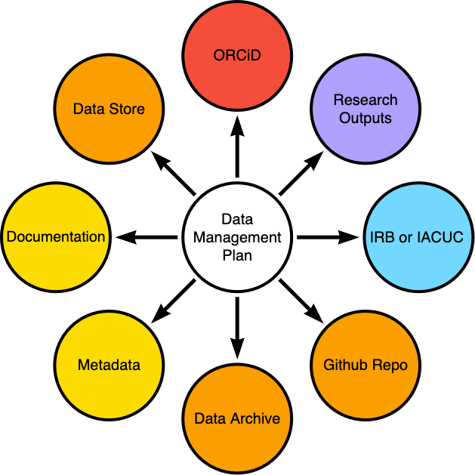
DMP’s connect components of research
The DMP uses persistent identifiers (PIDs) to connect research outputs
Notes:
The DMP uses persistent identifiers (PIDs) to connect authors, publications, data stored in repositories, GitHub repositories, and other components of the research workflow. Some of this occurs automagically, other items must be curated by hand.

Slide 10
From the DMP to the Database
The DMP describes what the general size and purpose of a database will be
Collect more specific use cases
List out the entities in the database and define their properties
Map out how the entities fit together (which properties link them)
Check that the mapping meets the use cases
Build base in Airtable

Slide 11
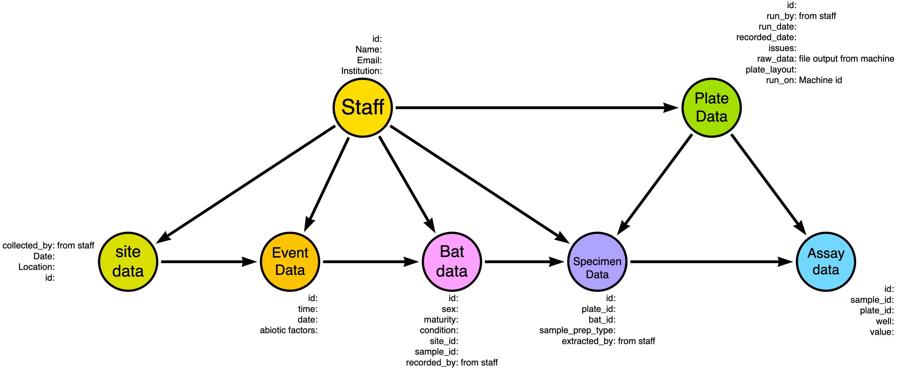
Mapping entities with Arrows.app
Simple
Allows you to add properties and label edges
Collaborative

Slide 12
Benefits of using Airtable
Flexible “no-code” relational databases
Excel-like data entry interfaces
Type controls
Integrated automations
Robust data and metadata APIs
Record history
Ability to set fine grain controls on data entry

Slide 13
Drawbacks
The flexibility is a blessing and a curse.
Not built to be used with data standards
Cannot handle reasonably large data (more than 100,000 rows)
Cannot natively create fixed data sets for analysis

Slide 14
Descriptions and Metadata
We use field descriptions and a custom metadata table to properly document bases
The API and manage fields tool makes this less cumbersome

Slide 15
Automating tasks with the API and scripting
Quality control checks,
Metadata generation
Data backups
Notes:
Because of the robust API, we can automate data management tasks like quality control checks, metadata generation, and backups in R using our publicly available version of the airtabler package and GitHub Actions.

Slide 16
Airtabler
R interface for Airtable data and metadata APIs
Functions for generating metadata
Functions for exporting fixed and versioned data
https://GitHub.com/ecohealthalliance/airtabler
Notes:
T

Slide 17
Why not just use integrated automations?
Integrated automations are not version controlled nor easily exported from a base.
We primarily work in R and scripting in Airtable is done in JavaScript
It is easy to document GitHub based automations in an Airtable base via the Airtable API

Slide 18
How are data validated?
Data are validated as they come in via one of two systems
Validation reports - modifies data in Airtable
Validation logs - does not modify data in Airtable

Slide 19
Data validation reports
Validation reports are generated as markdown documents and issues are recorded in Airtable itself. Corrections are made directly in the base. All corrections are recorded automatically in the base history which is kept for 3 years. Additionally, validation reports are archived outside of Airtable (Google Drive, AWS S3, or Dropbox).

Slide 20
Data validation logs
Validation logs are generated and data are corrected in the log. Data are ingested into R and the original value is replaced by the corrected value from the log. The validation log continuously grows with the data and original data in Airtable remain unmodified. Corrected data releases are published after each pass through the validation code.

Slide 21
Where do we end up?
Airtable works well for 95% of database needs at EHA
It is easy to use version controlled code for checking, displaying, and analyzing data
Combined with careful planning in the DMP, versioned exports deposited into data repositories fit nicely into the FAIR framework

Slide 22
Where are we going?
Automating data deposition process
One Health Data Standard Suite
Automated Research Output Catalog
Notes:
We are currently working on creating data exports from Airtable that can be directly deposited into repositories after human review.
Because of the interdisciplinary nature of our work, it can be difficult for researchers to pick a single data standard or single repository for their data. We are currently compiling a set of data standards that will cover the majority of projects conducted at EHA
So that our work is easier to find and build off of internally, we are building a research output catalog. The DMPTool makes it possible to link research outputs to DMPs in a central place and provides an API for accessing that data programatically. We will leverage that linked data to produce a catalog in Airtable.

Slide 23
Thanks!

Slide 24
Sources of Truth
Tables can be synced across bases - allowing users to create single authoritative sources for a particular data type and use them across many bases.

Slide 25
EHA Reproducibility best practices
EHA’s best practices include
GIT backed code
Using reliable, cloud based data stores
Creating redundancy in data access
Documenting processes/data early and updating documents often
Re-Using templates and resources where appropriate
Storing DMPs in DMPTool.org

