Slide 1
Building Blocks of Reproducibility
Publishing Research Outputs in Scientific Repositories Collin Schwantes

Slide 2
Research outputs are valuable
Research outputs - publications, code, data, protocols, outreach materials, etcetera
They cost: Time, effort, and resources
They provide: Foundation for scientific discoveries
Notes:
They are not only valuable to the researchers who collected the data but also to broader scientific community.

Slide 3
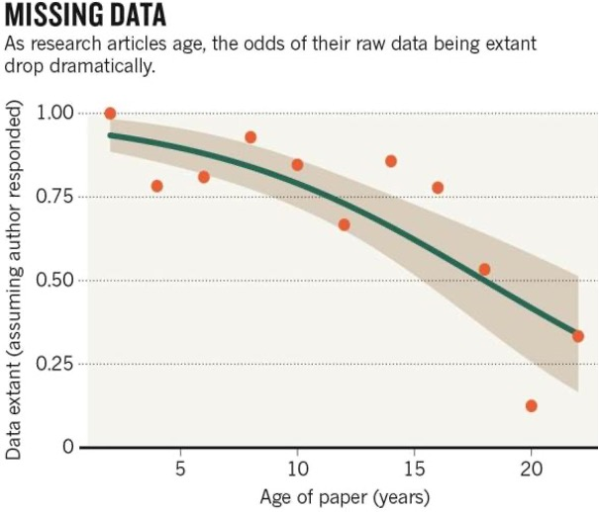
Research outputs can be lost
Odds of having data associated with paper drop by 17% per year
Response rates were not impacted by article age
Individual authors should not be responsible for long term data management
Vines, T. H. et al. Curr. Biol. http://dx.doi.org/10.1016/j.cub.2013.11.014 (2013)
Notes:
Our ability to access data decays over time.
A 2013 study looking at data access for 516 articles published over a 20 year period and found that the odds of an author retrieving the data related to their published paper dropped by 17% per year.
Interestingly, response rate did not decay, authors of older and newer papers were just as likely to respond.
The study authors concluded that individual researchers should not be responsible for managing their data long term
To be good long term data stewards, we use data Management Plan and will put our research outputs into repositories.

Slide 4
Scientific Repositories
Structured long-term file storage services that provide access research outputs
Most can generate persistent identifiers (PIDs)
Most allow you to link research outputs, people, and institutions through metadata.
Notes:
Entire fields of research have been created by the ability to re-use data.

Slide 5
Benefits of depositing outputs
Your outputs will be stored in a safe and accessible location
Your outputs will be cataloged and discoverable in searches
Your outputs will have a persistent identifier (PID) that can be cited
Your research will be more FAIR
Notes:
You will likely be complying with funding requirements
Easier for you to reuse work to get funding

Slide 6

Thought exercise: Climate Change Brainstorm
Several weeks ago, we had a discussion of research questions EHA could answer or has answered relating to climate change.
How might that discussion have gone differently if we had a catalog of deposited research outputs?
Notes:
To make these notions more concrete – lets think back to the discussion on climate change research we had several weeks ago. During that talk we were looking for examples of EHA’s climate related work or studies that could be expanded by looking a them through the lens of climate change.

Slide 7
Generalists vs specialist Repositories
Generalist repositories will accept all kinds of outputs, usually in all kinds of formats. They typically have requirements around descriptive metadata that allow objects to be discoverable. See the GREI Initiative for more on common practices between generalist repositories.
Specialist repositories will accept particular research outputs from a particular area of study. Outputs have to conform to the data standard (controlled vocabularies, file formats, metadata) prescribed by the repository.
Notes:
Transition to talking about characteristics of repositories and requirements for deposited research outputs

Slide 8
Repositories commonly used by EHA
Name | Type | Description
Zenodo | Generalist | Accepts any file less than 50 gb
GenBank | Specialist | Accepts nucleotide data in specific formats
Open Science Framework | Generalist | Accepts any file type, integrated projects and wiki features
GBIF | Specialist | Accepts species occurrence data in a specific format
Figshare | Generalist | Accepts any file less than 20 gb
Notes:
What other repositories are people using for their data?

Slide 9
What qualifies as a good repository?
Long-term funding and planning, including a contingency plan for unforeseen circumstances
Unique persistent identifiers are assigned to research outputs
Metadata is required
Access is free and unencumbered while respecting ethical and privacy concerns
Security, integrity and confidentiality
Provenance for research outputs
Notes:
Long-term funding and planning, including a contingency plan for unforeseen circumstances.
Unique persistent identifiers are assigned to research outputs.
Metadata is required allowing researchers to discover outputs and to link outputs, people, and institutions.
Access is free and unencumbered while respecting ethical and privacy concerns
Security, integrity and confidentiality.
Provenance for research outputs.

Slide 10
Finding an appropriate repository
If your funder requires you to use a specific repository - use it
If people in your field always deposit the type of data your collecting in a particular repository - join the herd
If there is a repository that specializes in the type of data you collected and it meets your funder’s criteria or EHA’s criteria for a good repository? - go for it
Put your data in a generalist repository. They’ll take anything
Repository Catalogs: Re3data FAIRSharing.org

Slide 11
Metadata
Structural – how do items in your Dataset fit together
Descriptive – Who created the output, when, where, why
Notes:
Next will talk about metadata. All of your research outputs will need metadata in order to be deposited
As I said earlier, Metadata is allows researchers to discover outputs and to link outputs, people, and institutions.
In general, there are two types

Slide 12

Metadata – Descriptive metadata
Required for attribution
Vital for creating findable research outputs
Allows you to link items via PIDs
Notes:
- From the perspective of the repository, descriptive metadata usually more important

Slide 13

Structural Metadata and Documentation
Critical for output reuse
Keep in mind that someone may be coming to your item with little to no context

Slide 14

Versioning
Expect outputs to change over time
Updated taxonomies
Modifications to code
Revisions
Improved documentation/metadata
Versions allow you track provenance
Notes:
What happens if something changes? Most repositories allow for versioning.

Slide 15
Access Restriction
Not every dataset can be shared
Ethical concerns
Policies at collaborator’s institutions
Funder restrictions
Access restrictions include:
Open – Fully accessible
Restricted – Metadata are available, files must be requested
- Embargo – Withhold sharing for a certain period
Notes:
Not every dataset can be

Slide 16

Desired General workflow for EHA Research Outputs
Goals:
EHA research outputs are archived in a FAIR enough state.
Outputs can be collated into a searchable catalog to facilitate reuse

Slide 17
Desired general workflow for EHA Research Outputs
Steps:
Projects create and update DMP describing intentions for data deposition (dmptool.org)
Well described research outputs are deposited in repositories with metadata that links them to EHA
Reference deposited objects in workflows/other outputs
Deposited items are collected and added to the EHA Research outputs catalog

Slide 18
Zenodo Walk through
Upload an Item
Add to community
Add appropriate minimal metadata
Link to other research outputs
Update the item to show versioning
https://sandbox.zenodo.org/
Notes:
At EHA we generally recommend using zenodo if you don't have specialist repository.

Slide 19
Deposits package overview
Tabular data
Non-tabular data

