Slide 1
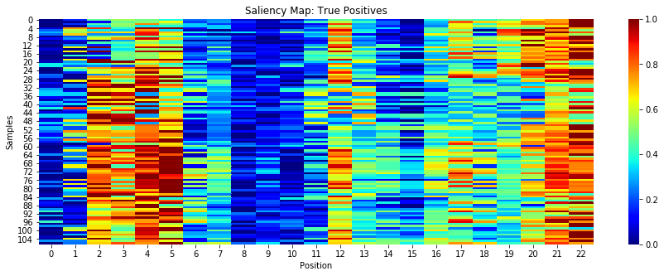
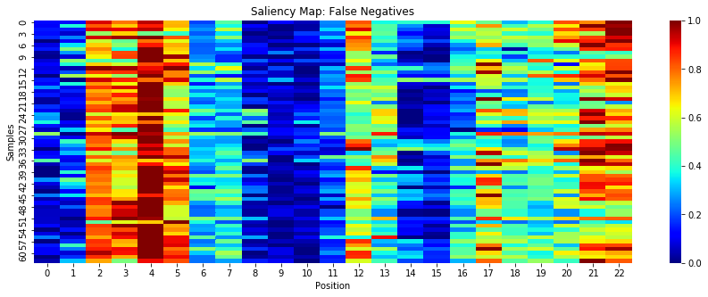
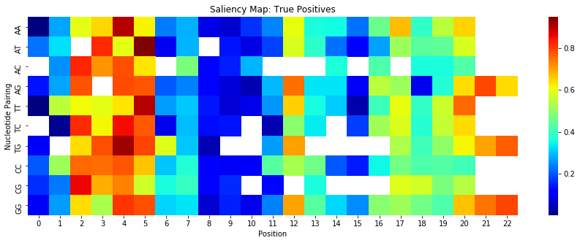
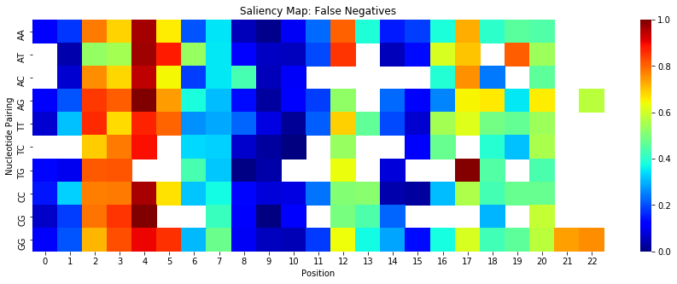
a)
b)
d)
c)
Notes:
Panels a) and b) show saliency over positions, comparing test samples correctly classified as off-targets versus true off-targets that were missed. For these samples, as with the embedding layer model, bases at the end of the sequence matter. However, the CNN model is more perceptive to content at the beginning of the sequence and less at the middle, compared to the embedding layer. This may be due to the model learning different patterns to deduce cleavage. Panels c) and d) show the average saliency for each (guide, off-target) sequence pairing across each position. As seen with the embedding layer model, at positions, single point differences such as AC and TG are weigh heavily on whether a sequence is classified as an off-target. More testing and research should be done as to the biological relevance of less obvious nucleotide pairings across positions.

Slide 2
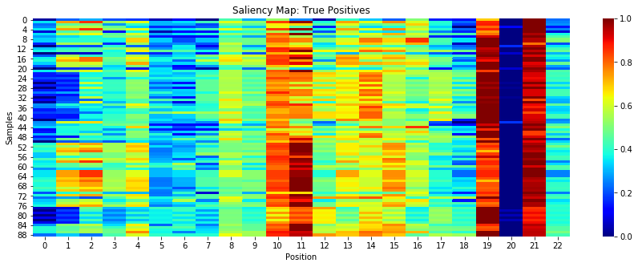
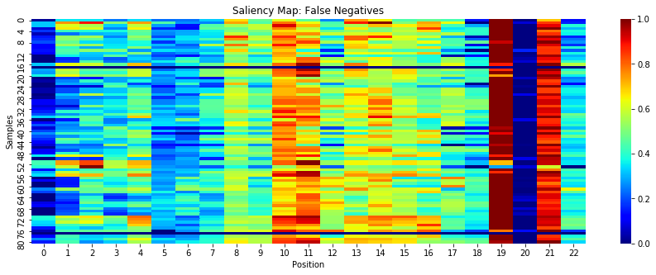
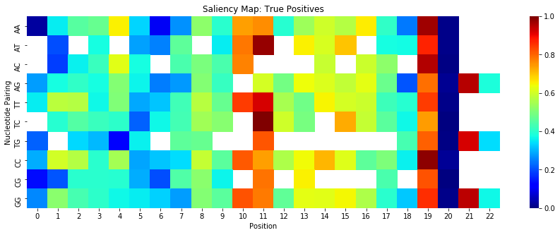
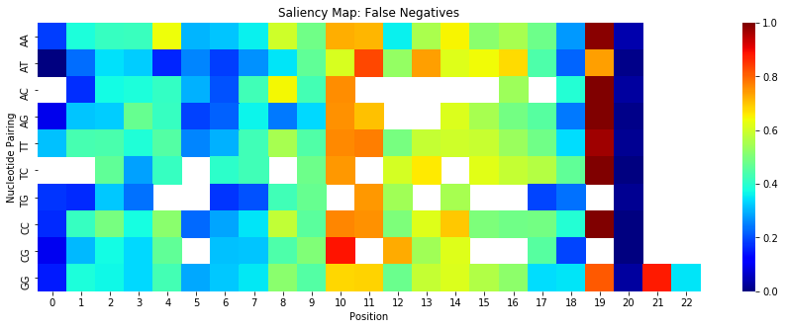
a)
b)
d)
c)
Notes:
As seen at positions 10, 11, 19, 20, and 21, single point differences such as AC and TG are weigh heavily on whether a sequence is classified as an off-target, which makes sense, as the more mismatches in the sequence, the less likely a pair will result in cleavage. This absence of saliency in the false negative map may be why those pairs were misclassified.

Slide 3
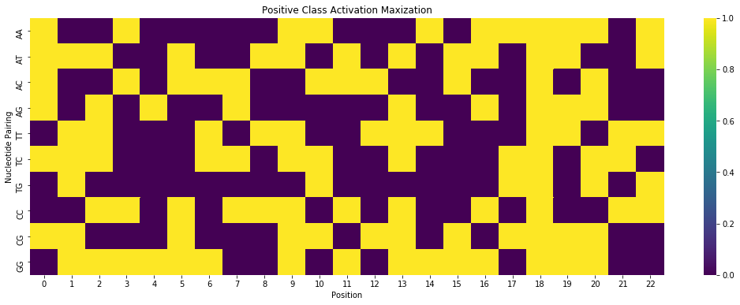
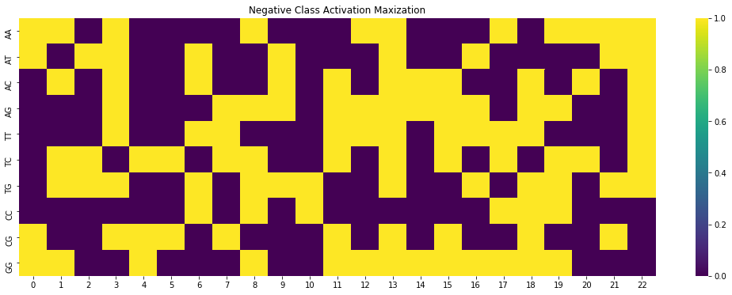
b)
a)
Input
Convolution
Flatten
c)
Dense Layer
Dense
Class membership probabilities
Notes:
Panel a) illustrates the process of activation mapping. We pass a baseline (black or average) input through our fixed, trained model in traditional feed-forward fashion to compute the probability of a pre-specified class. We backpropograte the gradient back to the input layer and update the associated input pixels to increase the probability of that class (gradient ascent). Resulting inputs that maximally activate the positive class and negative class, respectively, are shown in panels b) and c). Yellow indicates presence of a a given nucleotide pairing at that position. As expected, the positive class is activated more by cases where the nucleotides match (i.e. GG), whereas the neuron predicting that a pair will not result in cleavage is activated more by mismatches between the guide and sequence.

Slide 4
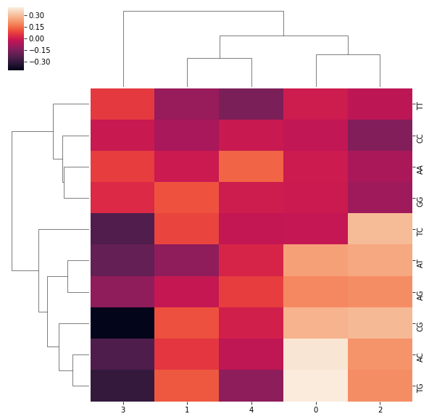
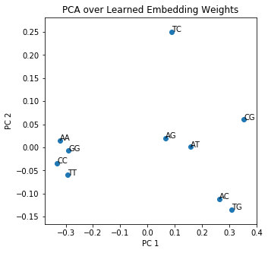
a)
b)
Nucleotide Pairing
Embedding Dimension

Slide 5
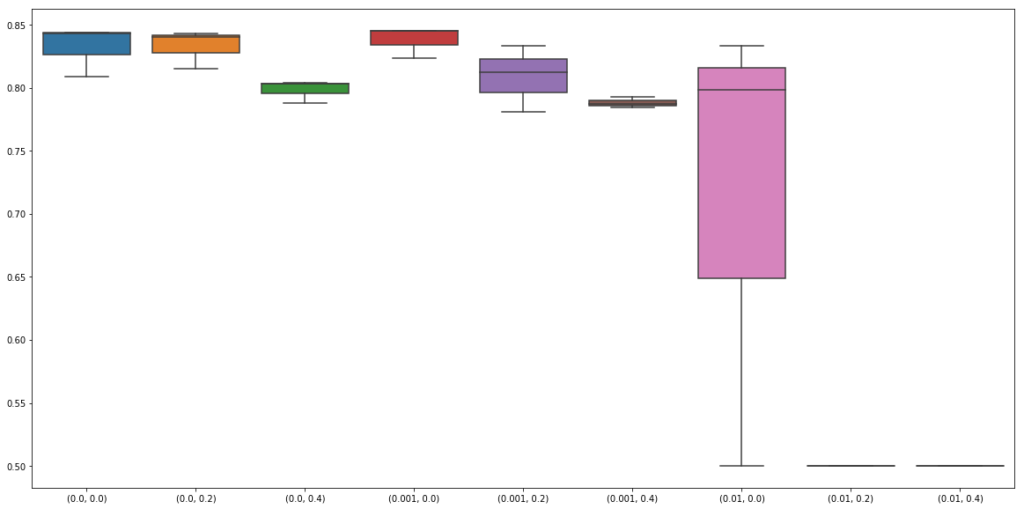
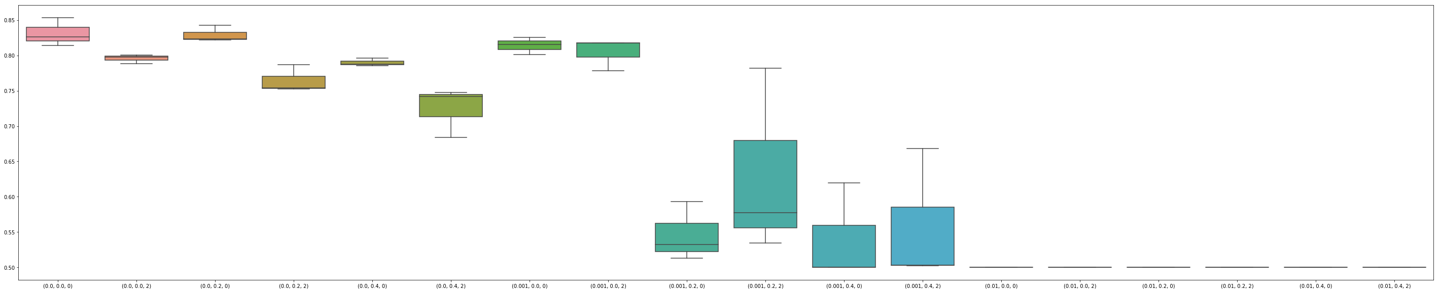
a)
b)
Input
Embedding
Precision-Recall
Flatten
Dense Layer
Dense
c)
Parameter Combination (Dropout Rate, L2 Regularization)
Class membership probabilities
Precision-Recall
Parameter Combination (Dropout Rate, L2 Regularization, Pooling Window Size)
Notes:
Panel a) shows results of the grid search run for the embedding model. L2 regularization coefficient has a large impact on performance. Dropout has a minor impact.
Panel b) illustrates what was removed from the embedding architecture to remove some of the non-linearities learned; rather than pass through a 50 neuron layer, we directly predict class probabilities from embedding layer output. Panel c) depicts the the grid search over the 1D CNN. Pooling window width has a minor impact compared to the larger impact of knocking out neurons (dropout) or damping weights (l2 coefficient).

Slide 6
Performance Metric | Logistic Regression | Logistic Regression (New Alph) | Single Layer, Fully Connected | Embedding Layer | 1D CNN | Lu and Wong Model
Average Precision Recall | 0.0 | 0.0 | 0.83 | 0.84 | 0.82 | 0.48
AUC | 0.5 | 0.5 | 0.75 | 0.76 | 0.81 | 0.97
Accuracy | 0.99 | 0.99 | 0.99 | 0.99 | 0.99 | 0.99
Recall | 0.0 | 0.0 | 0.51 | 0.52 | 0.63 | 0.94
Precision | 0.0 | 0.0 | 0.71 | 0.72 | 0.55 | 0.46
F1 Score | 0.5 | 0.5 | 0.80 | 0.80 | 0.79 | 0.81

Slide 7
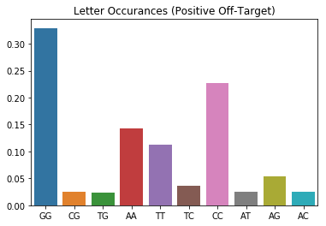
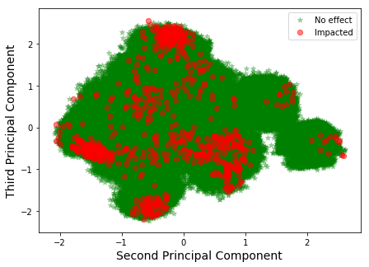
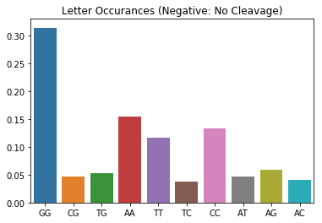
a)
b)
c)
Notes:
Panel a) shows the off-target data, with sequences encoded via the new alphabet mapping, in a lower-dimensional space. PC1 was removed to control for variance explained by the fact that these data are a conglomerate from numerous other expirements. From the PCA, we see little clustering by whether the pair resulted in cleavage or not, suggesting that the new alphabet alone does not intrinsicly separate classes; patterns and dependencies amongst letters must be learned. Panels b) and c) depict frequency counts for each new alphabet letter, mapped back to the (guide, off-target) pair. Interestingly, match frequencies (i.e. CC) are increased in the positive class, indicating importance in evaluating mismatches towards predicting cleavage. Such patterns can be learned by our models.

