Slide 1
Reflex: The Readiness Sprint
(Freeze & Storyboard)

Slide 2
The problem Kenyan retailers lose thousands of shillings monthly due to lost or untracked deliveries.
500M+ Lost Annually in Kenya's Informal Delivery Chaos.
Retailers coordinate deliveries over WhatsApp & phone calls - no paper trail.
No proof of delivery: disputed orders, lost inventory, customer trust eroded.
Dispatchers waste 2+ hours daily manually tracking down rider status.

Slide 3
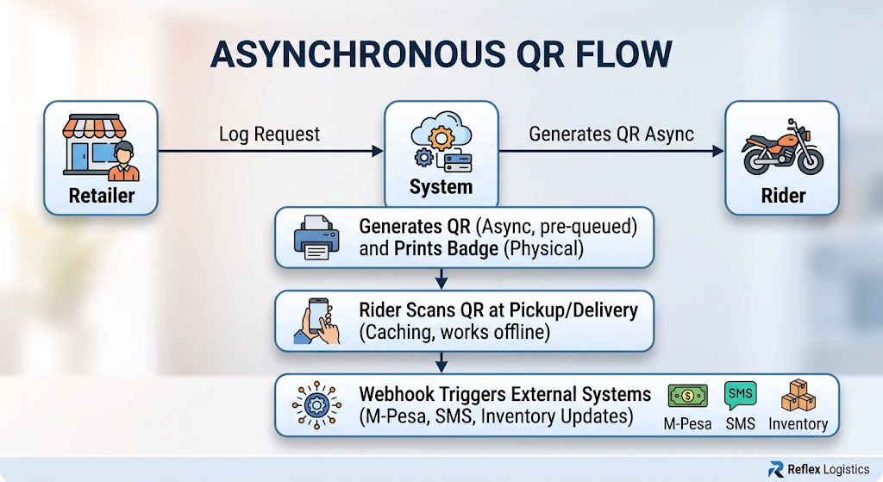
The solution: Reflex: Offline-First Delivery Tracking with QR + Badge Verification
Asynchronous QR: Rider receives QR code even without internet - pre-generated and cached
Badge Printing: Physical badges for riders/retailers - scan to verify identity without phone dependency
Webhook Verification: Automatic notifications to payment systems, SMS gateways, and inventory when delivery status changes

Slide 4
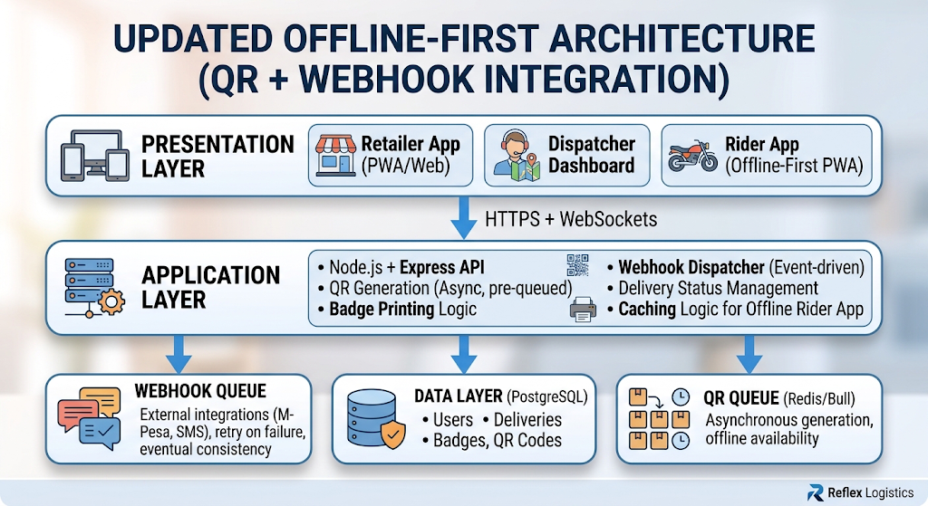
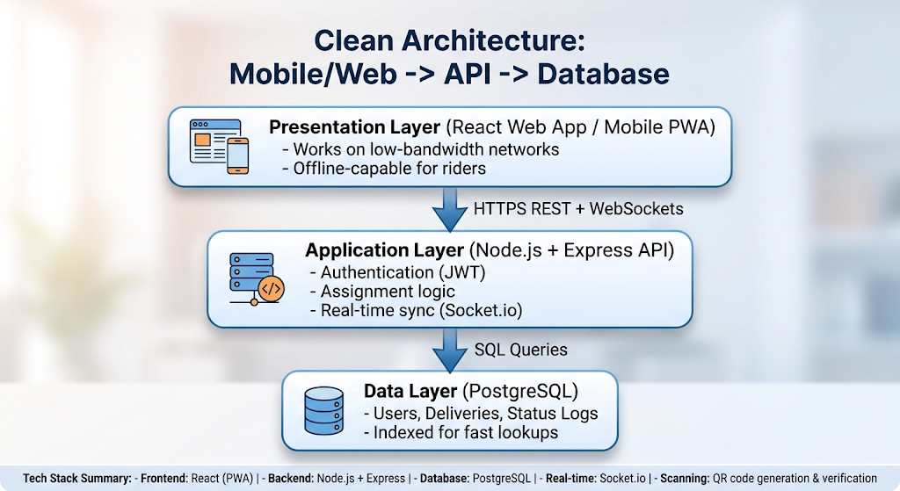
Architecture: Offline-First Architecture with QR + Webhook Integration
Frontend: React PWA (offline-capable with service workers)
Backend: Node.js + Express
Database: PostgreSQL
QR Queue: Redis/Bull for async QR generation
Webhook Queue: RabbitMQ/SQS for reliable external notifications
Badge Printing: Thermal printer integration (Zebra/Bluetooth)
Hosting: AWS/Azure with Kenya region

Slide 5
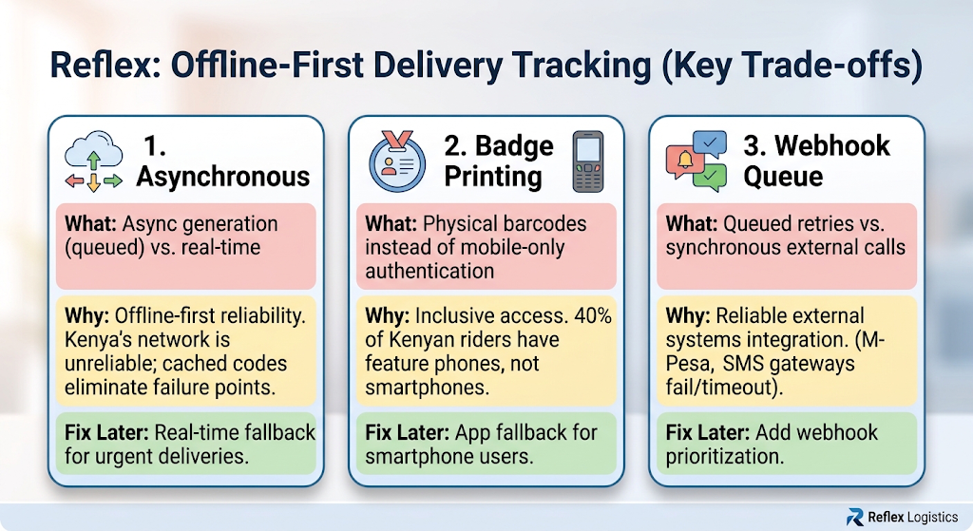
Trade-offs: Three Trade-offs We Accepted (And Why)

Slide 6
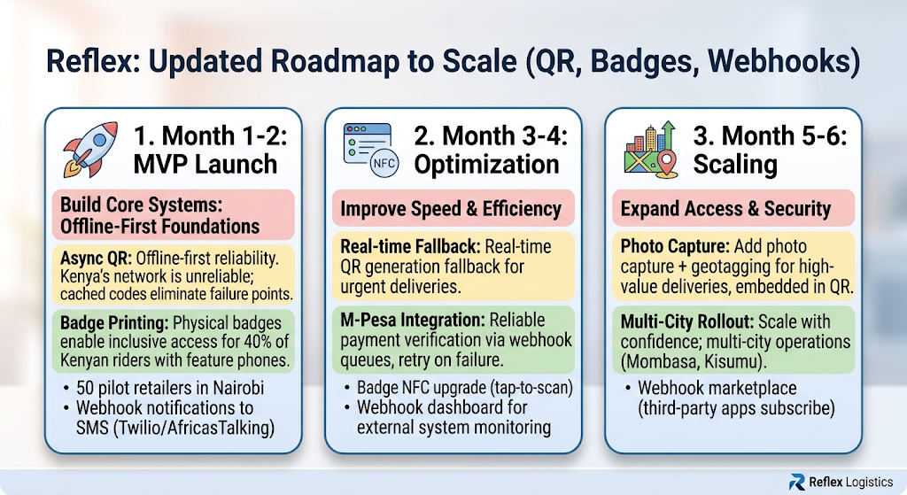
The Roadmap: QR, Badges, and Webhooks to Scale

