Slide 1
Getting Started with Machine Learning (ML)

Slide 2
Introduction
Machine Learning (ML) is a collection of algorithms & techniques used to build systems that learn from data. These systems are then able to perform predictions by finding patterns in data. Machine learning is a disruptive technology which sweeps away traditional programming in certain cases.
What is the difference between machine learning & traditional programming?
In traditional programming, the data & the program produce the output. For example, when performing some accounting tasks, the program takes in the data (sales records, inventory lists, etc) & calculates your profits or losses. It will also give some nice & fanciful charts showing your sales performance.
Traditional programming is a manual process — meaning a person (programmer) creates the program by manually formulating or coding the rules.
In machine learning, the data & the output produce the program. You take both data & output & use them to derive a set of rules to make predictions. It means that you may use this model to predict the most popular items that will sell next year.
In machine learning, the algorithm automatically formulates the rules from the data.

Slide 3
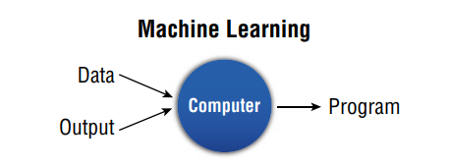
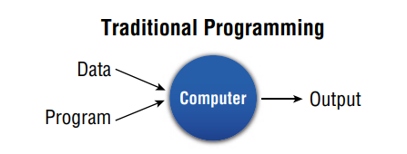
ML consists of the following disciplines:
Scientific computing (e.g. Python or R programming)
Mathematics
Statistics
When using ML, a data scientist needs to know about the followings:
Which method of machine learning will best help in completing the given task
How to apply that method

Slide 4
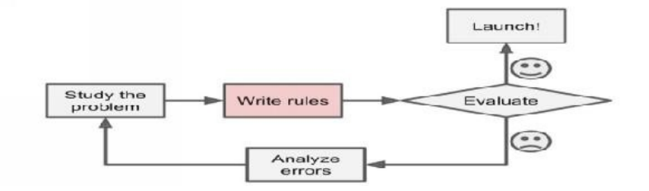
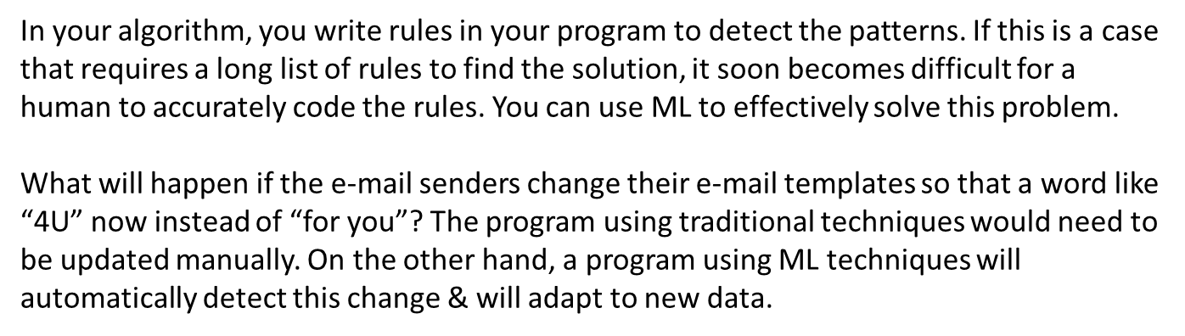
Why machine learning?
Consider an event of creating a spam e-mail filter program without using ML. The programmer writes that program by following the steps in a certain order.
Step 1: Identify how spam e-mails look like. (Words: “debit card”, “free”, “for you”, etc)
Step 2: Write an algorithm to detect the patterns that you’ve seen.
Step 3: Finally, you’d test the program & then make changes to the program until the results are good enough.
After that, the software would flag emails as spam if a certain number of those patterns are detected.

Slide 5
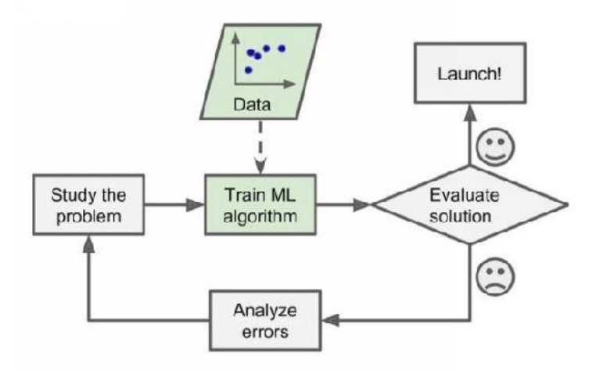

Slide 6
When should you use machine learning?
ML is not a solution for every type of problem. There are certain cases where solutions can be developed without using ML techniques. For example, you don’t need ML if you can determine a target value by using simple rules & computations. If you implement ML techniques for such problems, they will be getting more complex & you will need more computer power to get the solutions.
However, there are some situations where you need to use ML.
Very complex problems for which there is no solution with a traditional approach: You need to use a data-driven approach to get the solution. For example, speech recognition: When you say “one” or “two”, the program should distinguish the difference. You will need to develop an algorithm that measures sound.
Non-stable environments: Machine learning software can adapt to new data.
When you have a problem that requires many long lists of rules to find the solution: When rules depend on too many factors, it soon becomes difficult for a human to accurately code the rules. You can use ML to effectively solve this problem.
You cannot scale: ML solutions are effective at handling large-scale problems. For example, a spam e-mail filter program: There are millions of emails which are needed to check in a single day! It cannot be done manually.

Slide 7
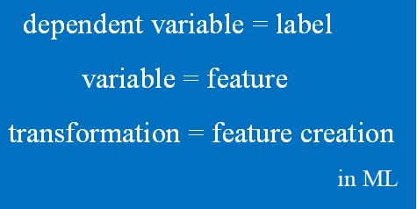
A few of ML terminology
There is a long list of ML terminology. Here I list some terms which are mostly used. Others will be given in relevant parts as we progress.
In ML, a target is called a label. In statistics, a target is called a dependent variable.
A variable in statistics is called a feature in ML.
A transformation in statistics is called a feature creation in ML.

Slide 8
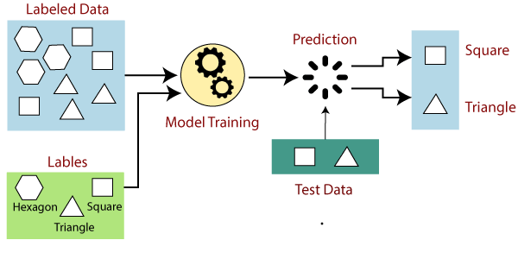
Supervised vs unsupervised learning
In supervised learning, you supervise the learning process. You train the algorithm using labelled data. You can correct your algorithm if it makes a mistake in giving you the answer in the learning process. This can be compared to learning which takes place in the presence of a supervisor or a teacher.
In supervised learning, both input & output variables are given. This can be explained mathematically. You have input variables (called x) & an output variable (called y) & you use an algorithm to learn the mapping function of from the input to the output, y=f(x). In supervised learning, the goal is to determine the mapping function so well that when you have new input data (x), you can predict the output for that data. If the mapping is correct, the algorithm has successfully learned. Else, you make the necessary changes to the algorithm so that it can learn correctly. In simple words, what we do in supervise learning is that we use a labelled dataset to obtain a new label for unlabelled data.

Slide 9
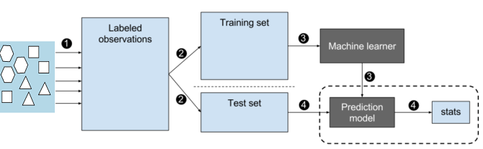
There are two phases: Training Phase & Testing Phase. In the training phase, you take a randomly selected specimen of geometric shapes (training data) & label them accurately. Then you make a table of all the characteristics (features) of each shape. You feed this data to the machine learning algorithm & it learns a model (called prediction model). In the testing phase, you input a shape (test data) which was also labelled. The prediction model which was created earlier will give the correct label for that shape. If the output is correct, the algorithm has successfully learned. Else, you make the necessary changes to the algorithm so that it can learn correctly.
Classification and Regression are two types of supervised learning. Supervised learning is a highly accurate method. The main drawback is that classifying big data can be a real challenge.

Slide 10
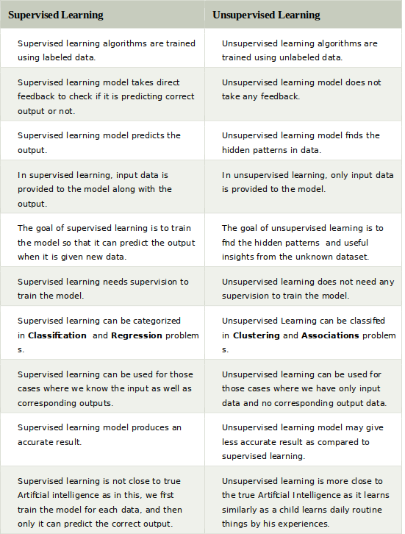
Differences between Supervised and Unsupervised learning

Slide 11
Advantages of Supervised learning:
With the help of supervised learning, the model can predict the output on the basis of prior experiences.
In supervised learning, we can have an exact idea about the classes of objects.
Supervised learning model helps us to solve various real-world problems such as fraud detection, spam filtering, etc.
Disadvantages of supervised learning:
Supervised learning models are not suitable for handling the complex tasks.
Supervised learning cannot predict the correct output if the test data is different from the training dataset.
Training required lots of computation times.
In supervised learning, we need enough knowledge about the classes of object.

Slide 12
Advantages of Supervised learning:
With the help of supervised learning, the model can predict the output on the basis of prior experiences.
In supervised learning, we can have an exact idea about the classes of objects.
Supervised learning model helps us to solve various real-world problems such as fraud detection, spam filtering, etc.
Disadvantages of supervised learning:
Supervised learning models are not suitable for handling the complex tasks.
Supervised learning cannot predict the correct output if the test data is different from the training dataset.
Training required lots of computation times.
In supervised learning, we need enough knowledge about the classes of object.

Slide 13
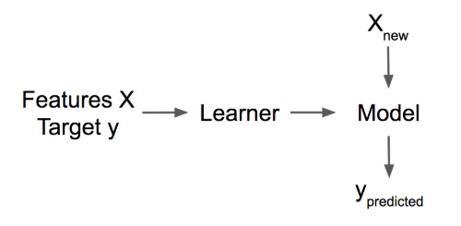
Machine learning algorithms
An algorithm is a set of rules that a machine follows to achieve a particular goal. These rules are in a certain order. A learner or machine learning algorithm is a set of rules used to learn a machine learning model from data. ML algorithms are given general guidelines that define the model, along with data while classical algorithms are given exact & complete rules to finish a task. An ML algorithm can accomplish its task when the model has been adjusted with respect to the data. We have to fit the model on the data or the model has to be trained on the data. ML algorithms are different from classical algorithms in a way that they automatically learn from the data you provide.

Slide 14
Some useful definitions of commonly used terms related to machine learning algorithms are:
Dataset: A table with the data from which the machine learns. The dataset contains the features and the target to predict.
Instance: A row in the dataset. Other names for “instance” are data point, observation. An instance consists of the feature values x(i) & if known, the target outcome y(i).
Feature: An input used for the machine learning algorithm. A feature is a column in the dataset. The matrix with all the features is called X for a single instance. The vector of a single feature for all instances is x(j).
Target: The information that the machine learns to predict. In mathematical formulas, the target is usually called y. In statistics, it is called a dependent variable.
Prediction: The target value that the machine learning model “guesses” based on the given features.

Slide 15
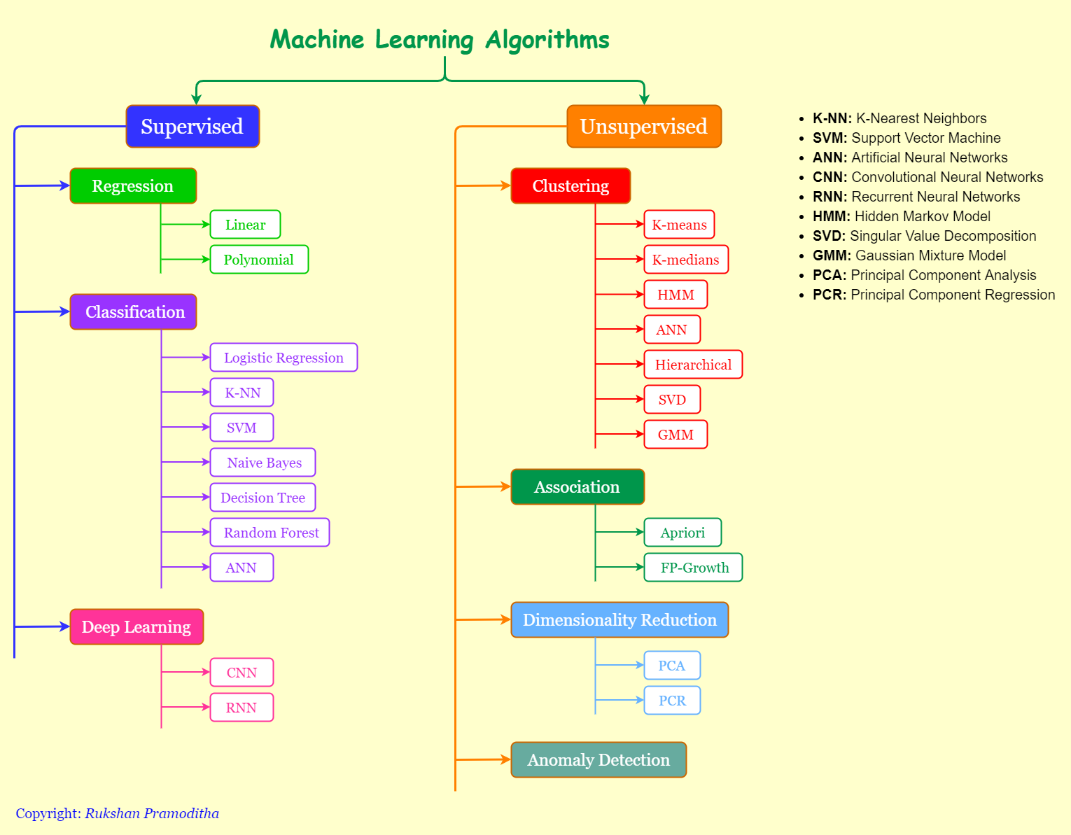

Slide 16
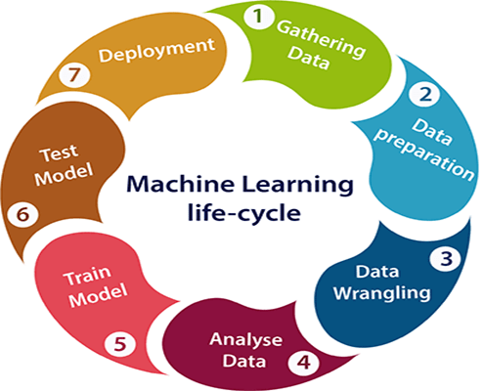
Machine learning Life cycle
Machine learning has given the computer systems the abilities to automatically learn without being explicitly programmed. But how does a machine learning system work? So, it can be described using the life cycle of machine learning.
Machine learning life cycle is a cyclic process to build an efficient machine learning project. The main purpose of the life cycle is to find a solution to the problem or project.
Machine learning life cycle involves seven major steps, which are given below:
  Gathering Data
  Data preparation
  Data Wrangling
  Analyse Data
  Train the model
  Test the model
  Deployment
The most important thing in the complete process is to understand the problem and to know the purpose of the problem. Therefore, before starting the life cycle, we need to understand the problem because the good result depends on the better understanding of the problem.

Slide 17
1. Gathering Data
Data Gathering is the first step of the machine learning life cycle. The goal of this step is to identify and obtain all data-related problems.
In this step, we need to identify the different data sources, as data can be collected from various sources such as files, database, internet, or mobile devices. It is one of the most important steps of the life cycle. The quantity and quality of the collected data will determine the efficiency of the output. The more will be the data, the more accurate will be the prediction.
This step includes the below tasks:
Identify various data sources
Collect data
Integrate the data obtained from different sources
By performing the above task, we get a coherent set of data, also called as a dataset. It will be used in further steps.

Slide 18
2. Data preparation
After collecting the data, we need to prepare it for further steps. Data preparation is a step where we put our data into a suitable place and prepare it to use in our machine learning training.
In this step, first, we put all data together, and then randomize the ordering of data.
This step can be further divided into two processes:
Data exploration:
It is used to understand the nature of data that we have to work with. We need to understand the characteristics, format, and quality of data.
A better understanding of data leads to an effective outcome. In this, we find Correlations, general trends, and outliers.
Data pre-processing:
Now the next step is preprocessing of data for its analysis.

Slide 19
3. Data Wrangling
Data wrangling is the process of cleaning and converting raw data into a useable format. It is the process of cleaning the data, selecting the variable to use, and transforming the data in a proper format to make it more suitable for analysis in the next step. It is one of the most important steps of the complete process. Cleaning of data is required to address the quality issues.
It is not necessary that data we have collected is always of our use as some of the data may not be useful. In real-world applications, collected data may have various issues, including:
Missing Values
Duplicate data
Invalid data
Noise
So, we use various filtering techniques to clean the data.
It is mandatory to detect and remove the above issues because it can negatively affect the quality of the outcome.

Slide 20
4. Data Analysis
Now the cleaned and prepared data is passed on to the analysis step. This step involves:
Selection of analytical techniques
Building models
Review the result
The aim of this step is to build a machine learning model to analyze the data using various analytical techniques and review the outcome.
It starts with the determination of the type of the problems, where we select the machine learning techniques such as Classification, Regression, Cluster analysis, Association, etc. then build the model using prepared data, and evaluate the model.
Hence, in this step, we take the data and use machine learning algorithms to build the model.

Slide 21
5. Train Model
In this step we train our model to improve its performance for better outcome of the problem.
We use datasets to train the model using various machine learning algorithms. Training a model is required so that it can understand the various patterns, rules, and, features.
6. Test Model
Once our machine learning model has been trained on a given dataset, then we test the model. In this step, we check for the accuracy of our model by providing a test dataset to it.
Testing the model determines the percentage accuracy of the model as per the requirement of project or problem.
7. Deployment
The last step of machine learning life cycle is deployment, where we deploy the model in the real-world system.
If the above-prepared model is producing an accurate result as per our requirement with acceptable speed, then we deploy the model in the real system. But before deploying the project, we will check whether it is improving its performance using available data or not. The deployment phase is similar to making the final report for a project.

Slide 22



Machine Learning – Skills for Machine Learning
Machine Learning
Machine Learning has a very large width and requires skills across several domains. The skills that you need to acquire for becoming an expert in Machine Learning are listed below:
Statistics
Probability Theories
Calculus
Optimization techniques
Visualization
Necessity of Various Skills of Machine Learning
To give you a brief idea of what skills you need to acquire, let us discuss some examples:
Mathematical Notation
Most of the machine learning algorithms are heavily based on mathematics. The level of mathematics that you need to know is probably just a beginner level. What is important is that you should be able to read the notation that mathematicians use in their equations. For example - if you are able to read the notation and comprehend what it means, you are ready for learning machine learning. If not, you may need to brush up your mathematics knowledge.

Slide 23



Probability Theory
Here is an example to test your current knowledge of probability theory: Classifying with conditional probabilities.
•
•
With these definitions, we can define the Bayesian classification rule:
If P(c1|x, y) > P(c2|x, y) , the class is c1 . If P(c1|x, y) < P(c2|x, y) , the class is c2 .
Optimization Problem
Here is an optimization function
Subject to the following constraints:
If you can read and understand the above, you are all set.

Slide 24
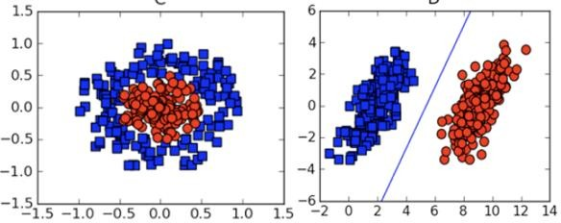
Visualization
In many cases, you will need to understand the various types of visualization plots to understand your data distribution and interpret the results of the algorithm’s output.
Besides the above theoretical aspects of machine learning, you need good programming skills to code those algorithms.
So what does it take to implement ML? Let us look into this in the next slide.

Slide 25
Machine Learning – Implementing Machine Learning
Machine Learning
To develop ML applications, you will have to decide on the platform, the IDE and the language for development. There are several choices available. Most of these would meet your requirements easily as all of them provide the implementation of AI algorithms discussed so far.
If you are developing the ML algorithm on your own, the following aspects need to be understood carefully:
The language of your choice – this essentially is your proficiency in one of the languages supported in ML development.
The IDE that you use – This would depend on your familiarity with the existing IDEs and your comfort level.
Development platform – There are several platforms available for development and deployment. Most of these are free-to-use. In some cases, you may have to incur a license fee beyond a certain amount of usage. Here is a brief list of choice of languages, IDEs and platforms for your ready reference.
Language Choice
Here is a list of languages that support ML development:
Python
R
Matlab
Octave
Julia
C++
C
This list is not essentially comprehensive; however, it covers many popular languages used in machine learning development. Depending upon your comfort level, select a language for the development, develop your models and test.

Slide 26
IDEs
Here is a list of IDEs which support ML development:
R Studio
Pycharm
iPython/Jupyter Notebook
Julia
Spyder
Anaconda
Rodeo
Google –Colab
The above list is not essentially comprehensive. Each one has its own merits and demerits. The reader is encouraged to try out these different IDEs before narrowing down to a single one.
Platforms
Here is a list of platforms on which ML applications can be deployed:
IBM
Microsoft Azure
Google Cloud
Amazon
Mlflow
Once again this list is not exhaustive. The reader is encouraged to sign-up for the above- mentioned services and try them out themselves.

