Slide 1


IoT Live Demo-
When your fridge becomes your personal nutritionist
By: Collins Kiprono Rotich

Slide 2
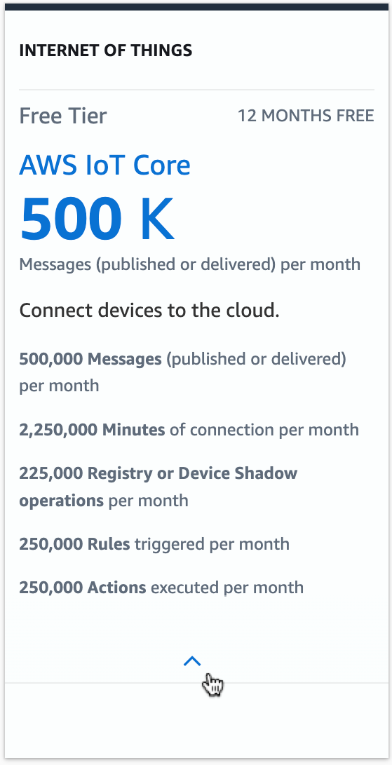
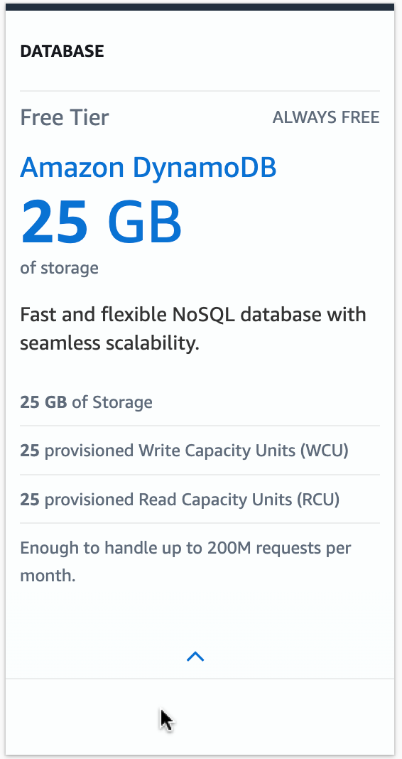
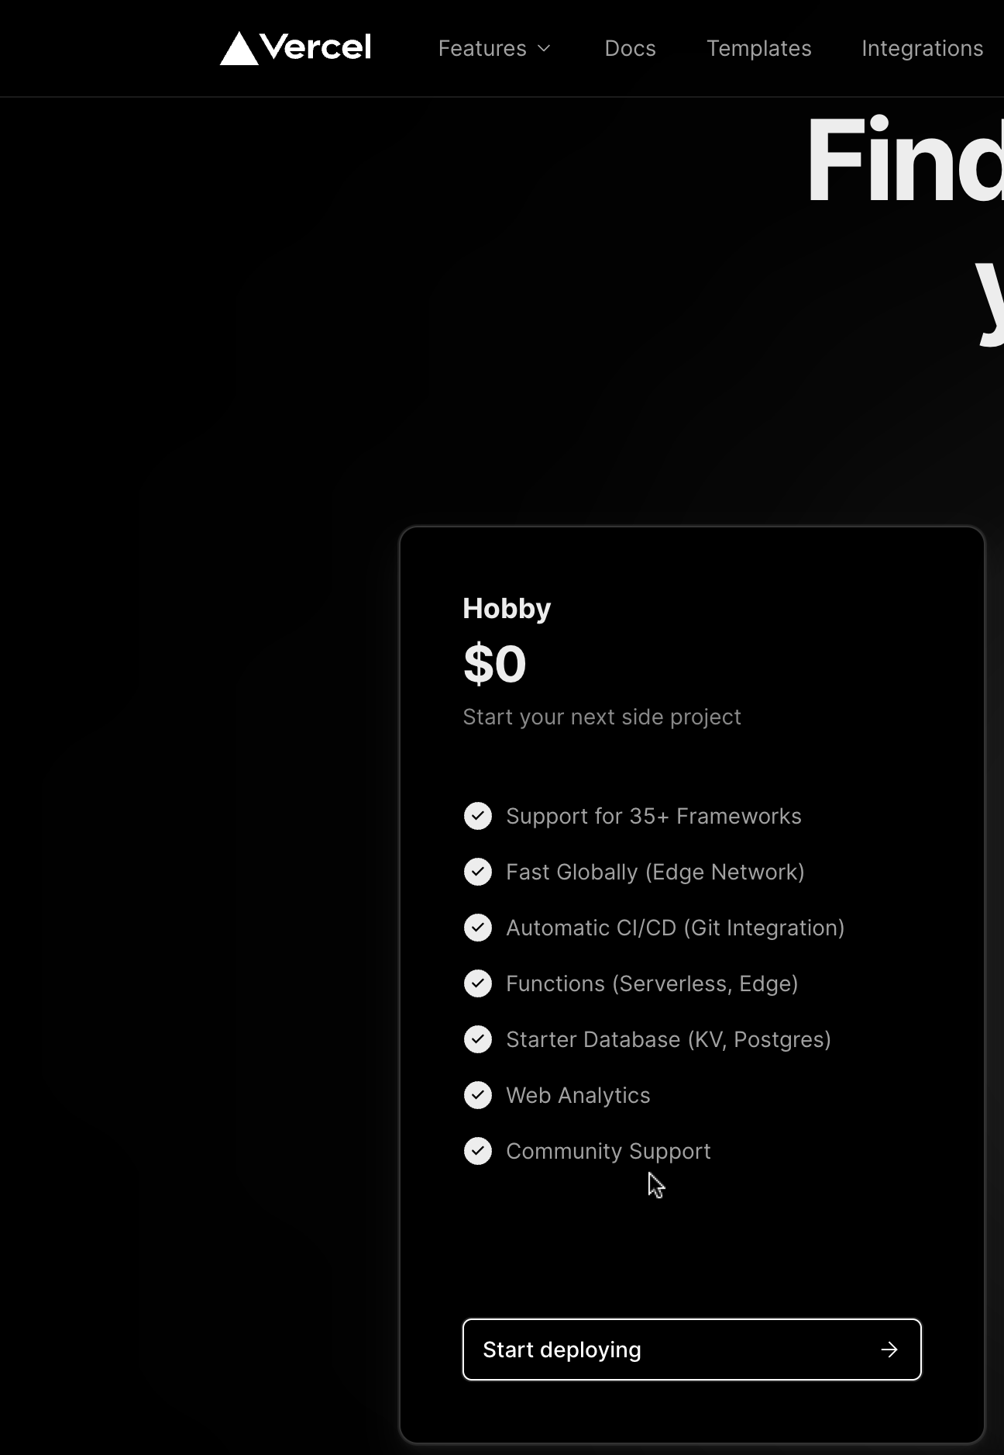

Slide 3
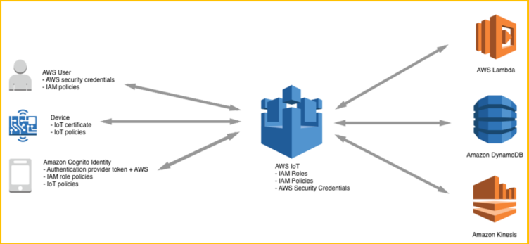

Slide 4
Fridge
Microcontroller board( Arduino, Raspberry Pi)
Temperature sensor
Humidity sensor
Camera

Slide 5
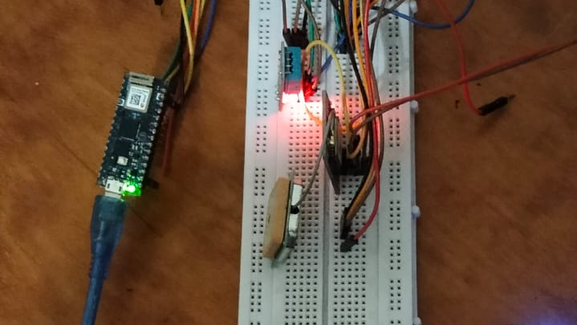

Slide 6
Cold Chain Industry
Beverage Industry
Medical Cold Chain
Meat, Poultry & Dairy Industry
Horticultural Industry
WHO recommends certain temperature ranges from the point of manufacture to the point of administration
Monitoring temperature can prevent thousands of shillings of food waste if an employee forgets to close the fridge or there is a power outage
Kenya’s fresh produce exporters have raised the alarm over increased blockage of their goods in Europe due to quality concerns
Beverage cabinets are critical trade assets as they ensure products are sold at the right conditions
Solutions for temperature-controlled supply chain
Storage
Transport
Distribution
Cold Storage
Data Centers
Refrigerated Trucks
Commercial Coolers/Fridges
Self Service Display Units

Slide 7











Connected Cooler Solution
A solution that enables efficient remote monitoring of performance and status of commercial coolers, fridges and self-service retail display cabinets
Certified Hardware & Sensors
Track cooler location & movement with high precision Multiple Cell ID and Wi-Fi module or GPS
Intuitive Platform
Monitor cooler usage & refills, product quality and store owner behavior by monitoring Door openings, temperature and Cooler Power Offs
Simple, efficient, error free auditing & inventory.
Business
logic
Data
storage
Device management
Geospatial analytics & location
Usage & Performance
Sales analytics
Operational analytics
Commercial Beverage Distribution Coolers
Pharmaceutical Freezer/cooler monitoring
Dairy Products i.e., Yoghurt, Ice-cream Display Cabinets

Slide 8
Cold Storage Solution- Temperature Tag
A solution that enables efficient remote monitoring of long-term storage environment
Long Term Cold Storage Monitoring
SME/SOHO Cooler/Fridge Monitoring
Industrial, Real Estate Facility Monitoring
Portable Temperature Tag Solution
Temperature & Humidity Monitoring
Movement Detection
Multiple Location Technologies

Slide 9
Cold Logistics Monitoring Solution
Solution that enables efficient remote monitoring of temperature-controlled logistics i.e., refrigerated trucks.
Realtime Location Tracking
Asset status & location with PoI activity monitoring
Temperature & Humidity Monitoring
Temperature fluctuation monitoring and alerting via certified sensors
Cabin Door Status Monitoring
Cargo offload detection, correlation with temperature fluctuations.
Perishable Commodity Transportation
Chemical Products Transportation
Horticulture
Seafood, Meat & Poultry
Pharmaceutical Products
Cosmetic Products

Slide 10


dekut-saf-demo.vercel.app

