Slide 1
Time Machine
Rule based
Add users
Build now
Train
Outdoor
Garden
Garage
Home
Barn
Street
Indoor

Slide 2
Time Machine
Rule based
Add users
Build now
Train
Indoor
Living room
Kitchen
1st floor
Bathroom
Bedroom
Outdoor
2st floor
Home

Slide 3
Time Machine
Rule based
Add users
Train
Build now
Indoor
Living room
Kitchen
Start
1st floor
Bathroom
*
Bedroom
*
Stop
2st floor
Outdoor

Slide 4
Time Machine
Rule based
Add users
Train
Build now
Indoor
Living room
Kitchen
Start
1st floor
Bathroom
*
Bedroom
*
Stop
2st floor
Outdoor

Slide 5
Time Machine
Rule based
Add users
Train
Build now
Indoor
Living room
Kitchen
Start
1st floor
Bathroom
*
Bedroom
*
Stop
2st floor
Outdoor
Calibrated

Slide 6
Time Machine
Rule based
Add users
Train
Build now
Indoor
now
- 1 yr
Living room
Kitchen
1st floor
Bathroom
Home
Bedroom
*
2st floor
Outdoor

Slide 7
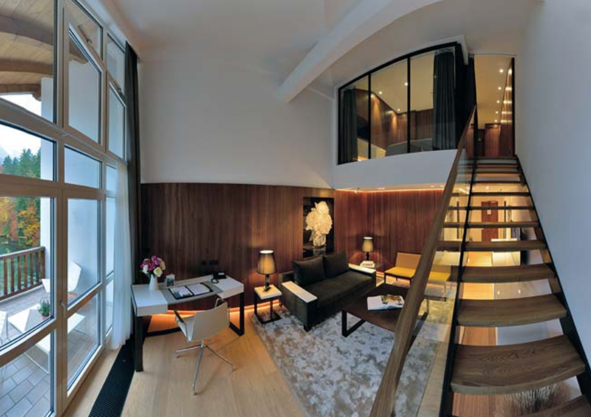
Time Machine
Rule based
Add users
Train
Build now
Indoor
now
- 1 yr
Living room
Kitchen
Bathroom
Bedroom
Outdoor

Slide 8
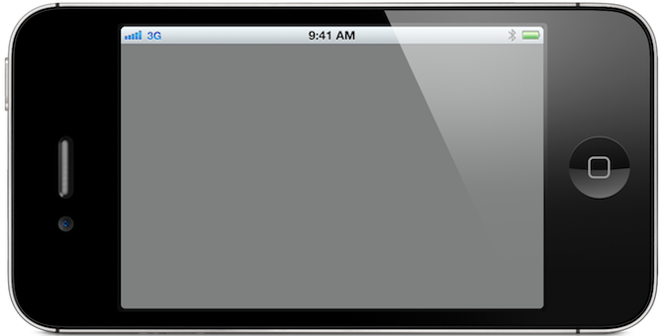
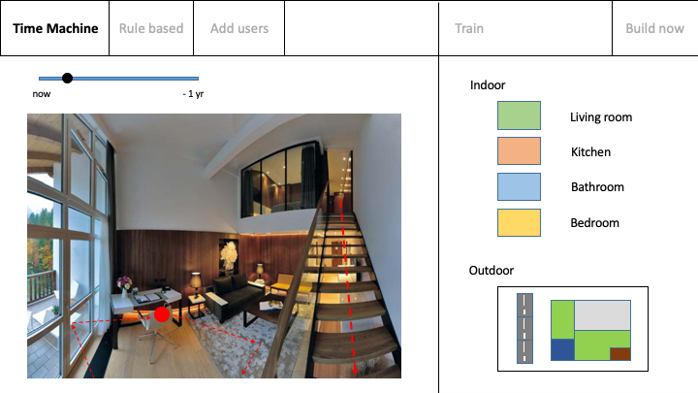

Slide 9
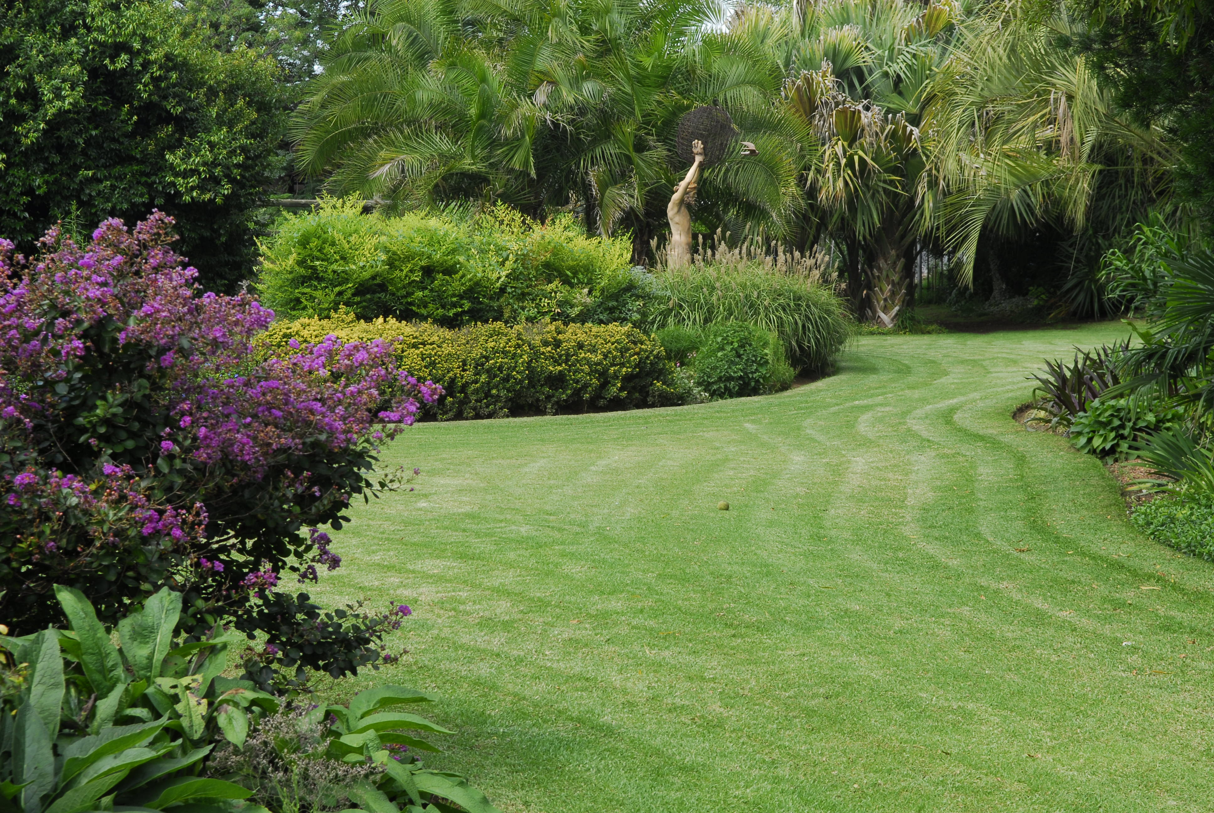

Slide 10
Time Machine
Rule based
Add users
Train
Build now
Indoor
Text Bob: Dinner ready!
Living room
Dim lighting
1st floor
Kitchen
Bathroom
Bedroom
Outdoor

Slide 11
Time Machine
Rule based
Add users
Build now
Train
Outdoor
Dad
Garden
Children
Garage
Barn
Street
Indoor
1st floor
2st floor

