Slide 1
Time Machine
Rule based
Add users
Build now
Train
Outdoor
Garden
Garage
Home
Barn
Street
Indoor

Slide 2
Time Machine
Rule based
Add users
Build now
Train
Indoor
Living room
Kitchen
1st floor
Bathroom
Bedroom
Outdoor
2st floor
Home

Slide 3
Time Machine
Rule based
Add users
Train
Build now
Indoor
Living room
Kitchen
Start
1st floor
Bathroom
*
Bedroom
*
Stop
2st floor
Outdoor

Slide 4
Time Machine
Rule based
Add users
Train
Build now
Indoor
now
- 1 yr
Living room
Kitchen
1st floor
Bathroom
Home
Bedroom
*
2st floor
Outdoor

Slide 5
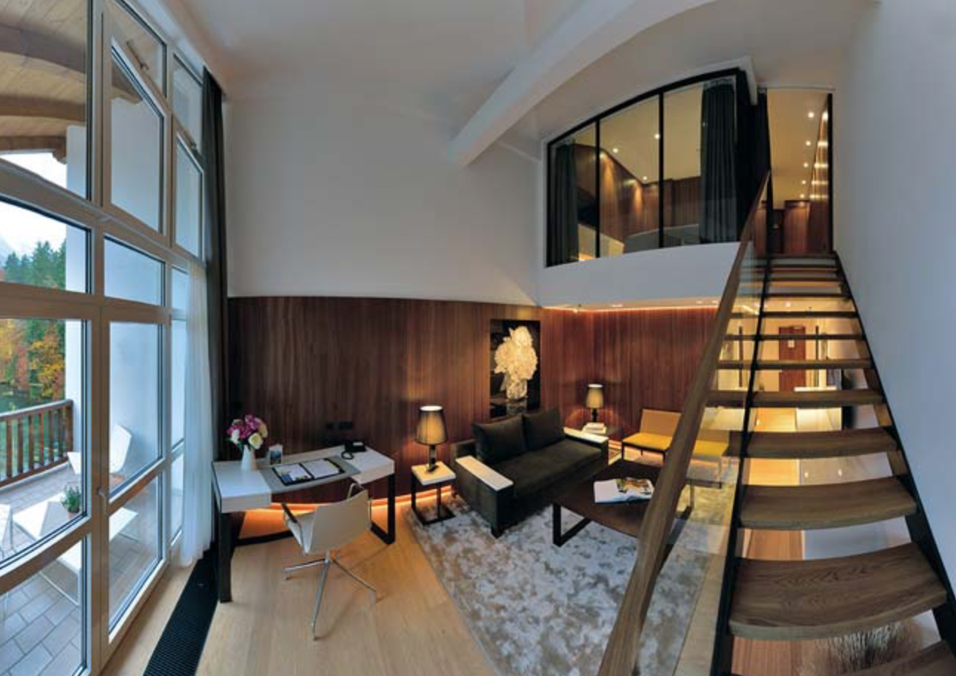
Time Machine
Rule based
Add users
Train
Build now
Indoor
now
- 1 yr
Living room
Kitchen
Bathroom
Bedroom
Outdoor

Slide 6
Time Machine
Rule based
Add users
Train
Build now
Indoor
Text Bob: Dinner ready!
Living room
Dim lighting
1st floor
Kitchen
Bathroom
Bedroom
Outdoor

Slide 7
Time Machine
Rule based
Add users
Build now
Train
Outdoor
Alice
Garden
Bob
Garage
Home
Barn
Street
Indoor
1st floor
2st floor

