Slide 1


Nonlinear Control of Quadrotor for Point Tracking
Collin Thornton | ECEN5463 Final Project

Slide 2
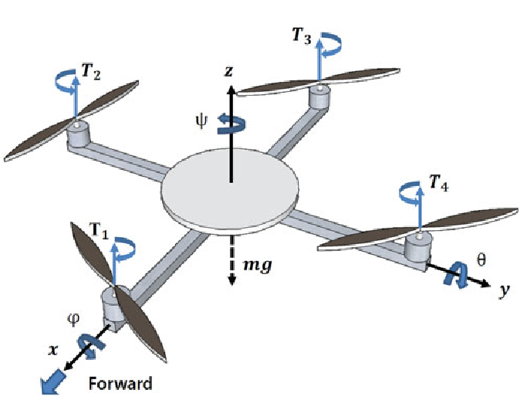
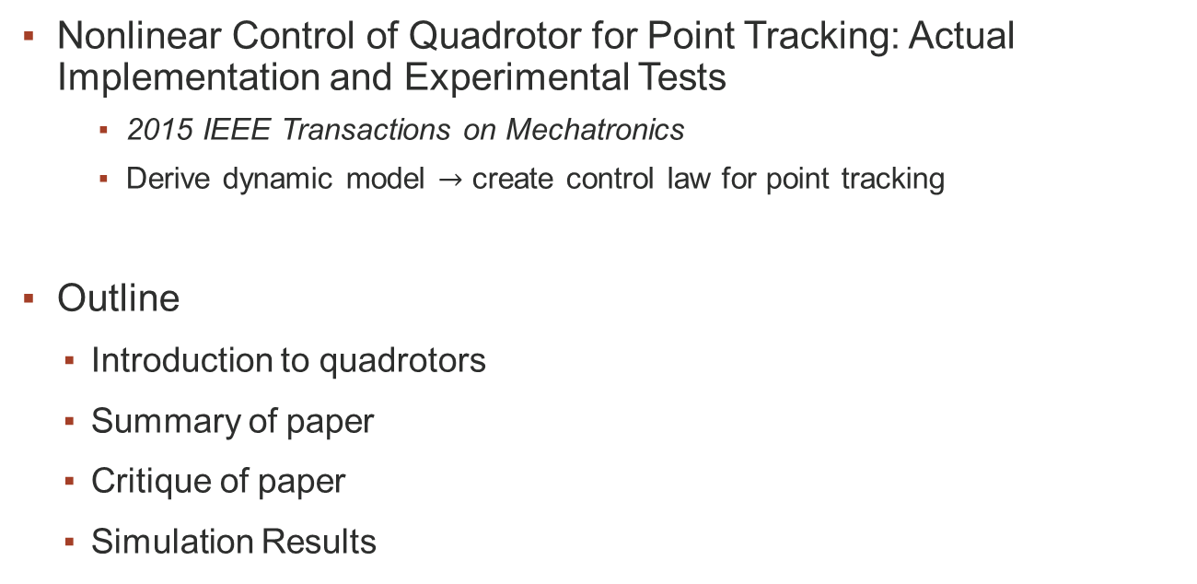
Introduction & Outline
Nonlinear Control of Quadrotor for Point Tracking: Actual Implementation and Experimental Tests
2015 IEEE Transactions on Mechatronics
Derive dynamic model $→$ create control law for point tracking
Outline
Introduction to quadrotors
Summary of paper
Critique of paper
Simulation Results

Slide 3
Introduction to Quadrotors
Quadrotor UAVs are underactuated
4 inputs & 6 outputs
Attitude & Altitude control are well defined
Position control becomes complicated
Motor effects, Drag effects, strong coupling
Simple case
Strong coupling between Euler angles and acceleration
Disregard electrical & aerodynamic effects

Slide 4
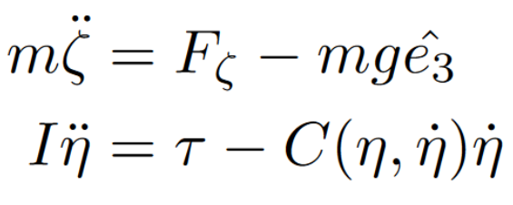


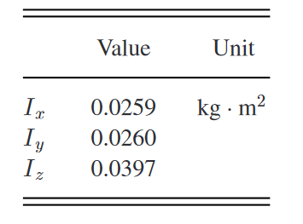
Summary of Paper - Approach
Create simple dynamic model
Solve attitude & altitude controller
Lyapunov analysis
Shows asymptotic stability
Solve position controller to generate desired attitude
Standard approach, but this section has numerous errors
Simulation & physical implementation
Good results, but doesn’t include enough detail

Slide 5
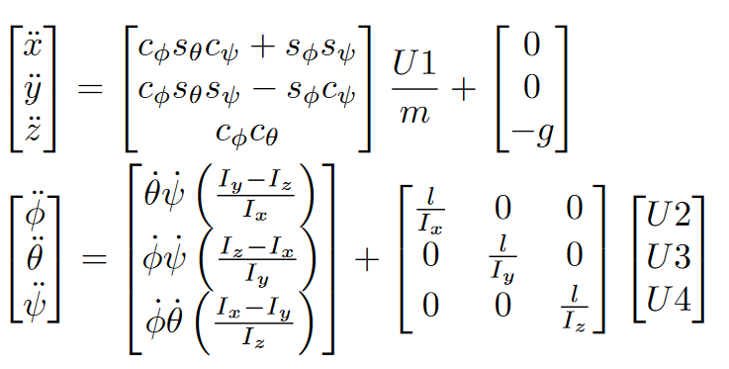
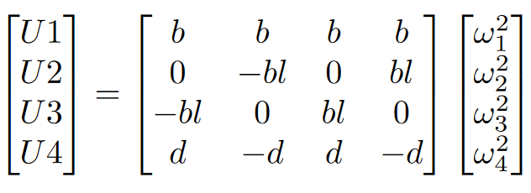
Summary of Paper - Modeling
Compact model
Expanded model
Control distribution

Slide 6
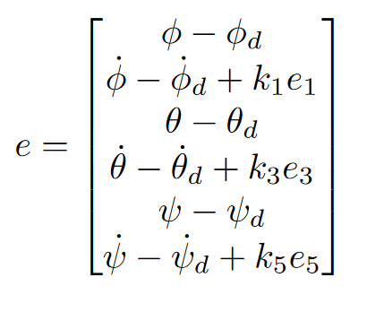

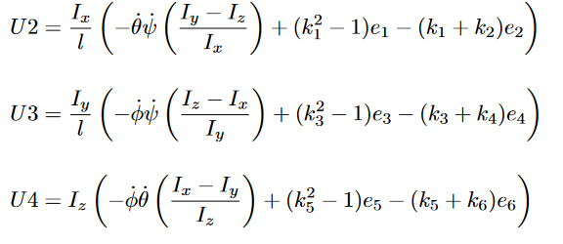


Summary of Paper – Attitude
Closed loop state

Slide 7
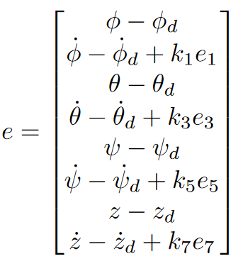
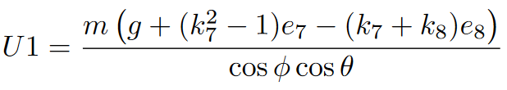


Summary of Paper – Altitude
Closed loop state

Slide 8
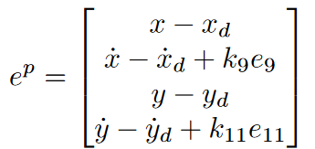

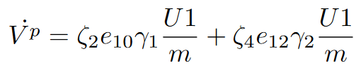




Summary of Paper – Position
New virtual controller
Neg. def. iff $γ$ is of opposite sign of $e$
$$\dot{x_{d}}=\ddot{x_{d}}=\dot{y_{d}}=\ddot{y_{d}}=0$$

Slide 9
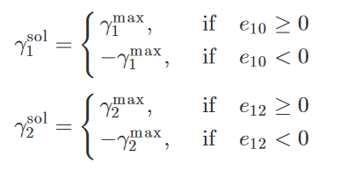


Critique of Paper – Position
New virtual controller
Mistake!
Neg. def. iff $γ$ is of opposite sign of $e$
$$\dot{x_{d}}=\ddot{x_{d}}=\dot{y_{d}}=\ddot{y_{d}}=0$$
Unclear $→$ desired?

Slide 10
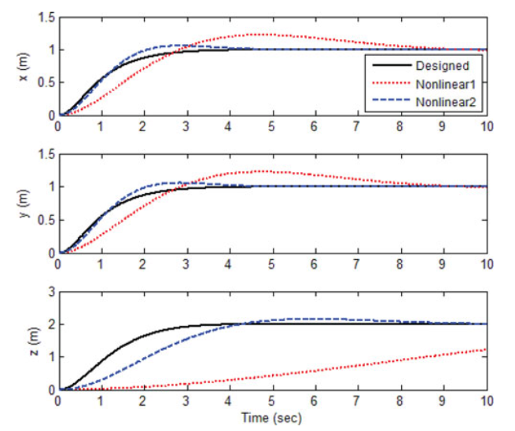
Critique of Paper – Results
Alternate controllers are merely cited
No mention of gains
No mention of optimization
Baseless comparison

Slide 11
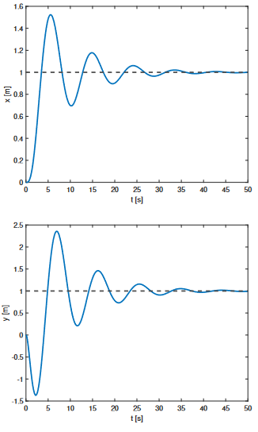
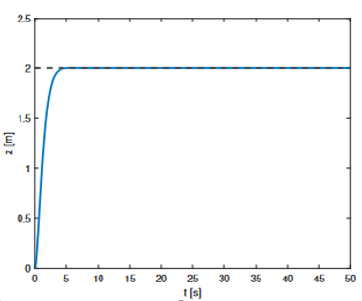
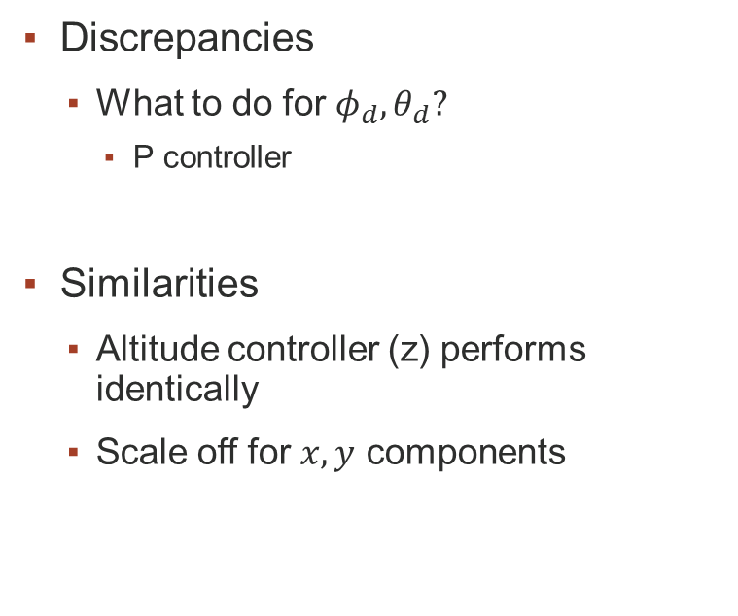
Simulation Results
Discrepancies
What to do for $φ_{d},θ_{d}?$
P controller
Similarities
Altitude controller (z) performs identically
Scale off for $x,y$ components

Slide 12
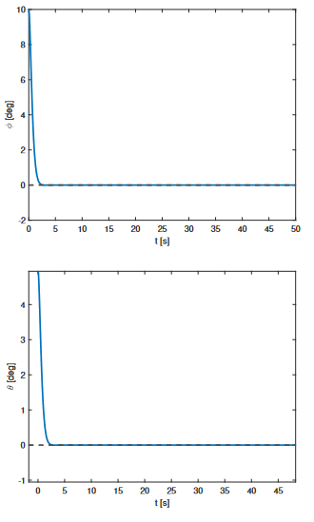
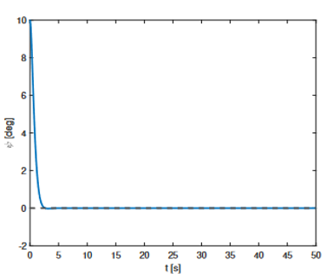
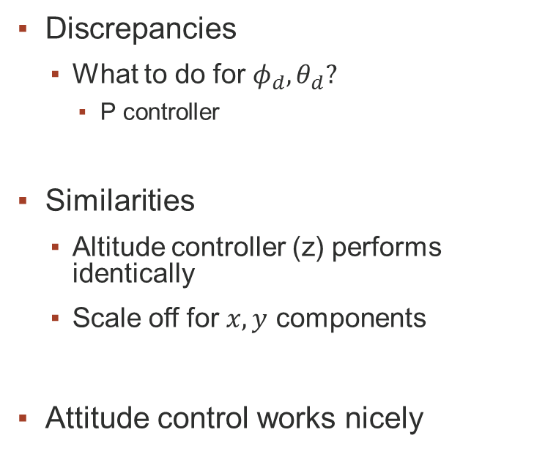
Simulation Results
Discrepancies
What to do for $φ_{d},θ_{d}?$
P controller
Similarities
Altitude controller (z) performs identically
Scale off for $x,y$ components
Attitude control works nicely

Slide 13
Conclusions
Good attitude & altitude control implementation
Poor analysis on position control
Paper focuses too much on the implementation
Grammatical & mathematical errors
Numerous typos in notation
Baseless comparisons

Slide 14
Q/A
Thanks!

Slide 15

References

