Slide 1
mmWave Doppler Emulator for UAVs
TWISTER
Amit, Collin, Scott, Paul and Arifur
TWISTER
(Transformative Wireless Innovative Sciences, Technologies and Engineering Research)
Electrical and Computer Engineering
Oklahoma State University
Sep. 2019
twister.okstate.edu

Slide 2
Outline
Sawyer Control Interfaces
Jacobian Matrix
TWISTER

Slide 3
Sawyer control interfaces
Are many. We’ve tested four:
Motion Controller Interface
  CARTESIAN and JOINT modes
Joint Control Modes
  POSITION and VELOCITY modes
We’re using Joint Control on VELOCITY mode
TWISTER

Slide 4
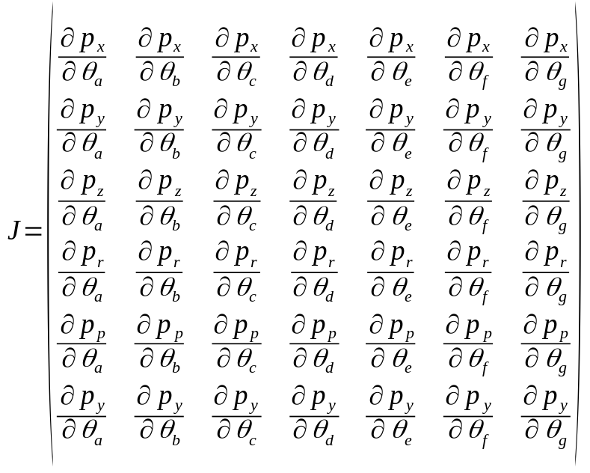
jacobian matrix
Matrix of first-order partial derivatives
Calculates transformations between end-effector and joint velocities
TWISTER

Slide 5

jacobian matrix
We use psuedo inverse
Where P = joint velocities, V = ee velocities
TWISTER

Slide 6
jacobian matrix
We use psuedo inverse
Where P = joint velocities, V = ee velocities
TWISTER

Slide 7
THANKS!
TWISTER

