Slide 1
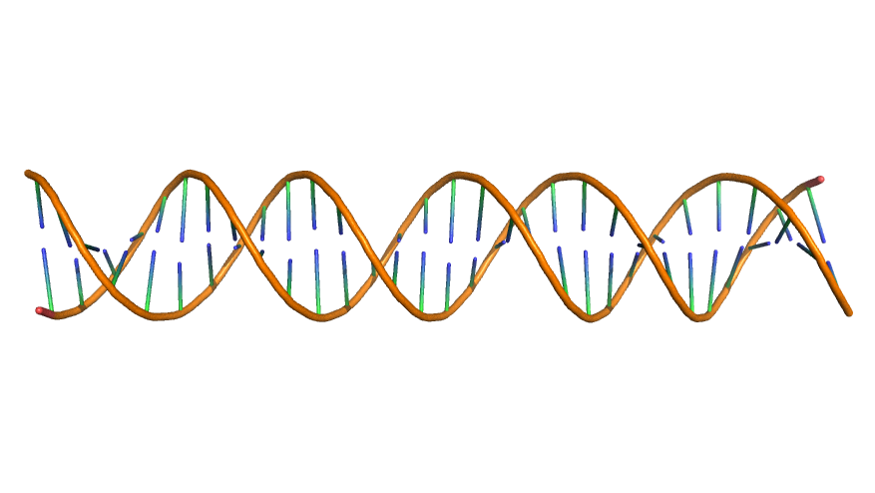
MTA1/2
p66α/β
RbAp46\48
HDAC1\2
CHD3/4
MBD2/3

