Slide 1
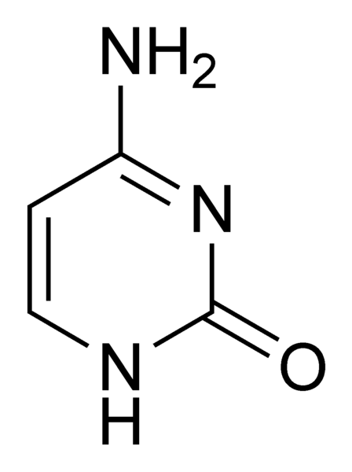
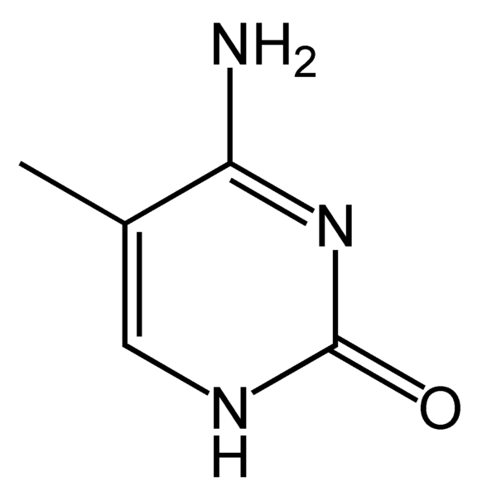
DNMT
SAM
cytosine
5-methyl-cytosine

