Slide 1

aChatty
AI based Customer Help & Support App

Slide 2
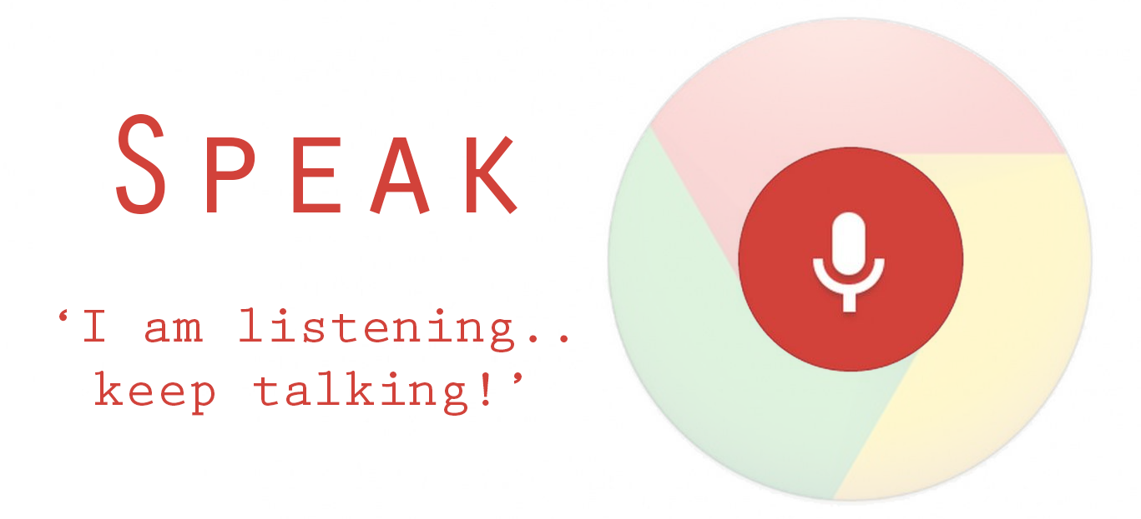
Features
Voice Recognition and sending the intents
Work with voice as well as text chats
Talk with Customer and maintain small talks with greetings.

Slide 3
Features
Get Balance For a Mobile Number
Create Service Request Against a Mobile Number
Get Service Request Status of a Ticket Number
Request To Talk with Real Agent
Ask Of Offers
Get Detail About Airtel

Slide 4
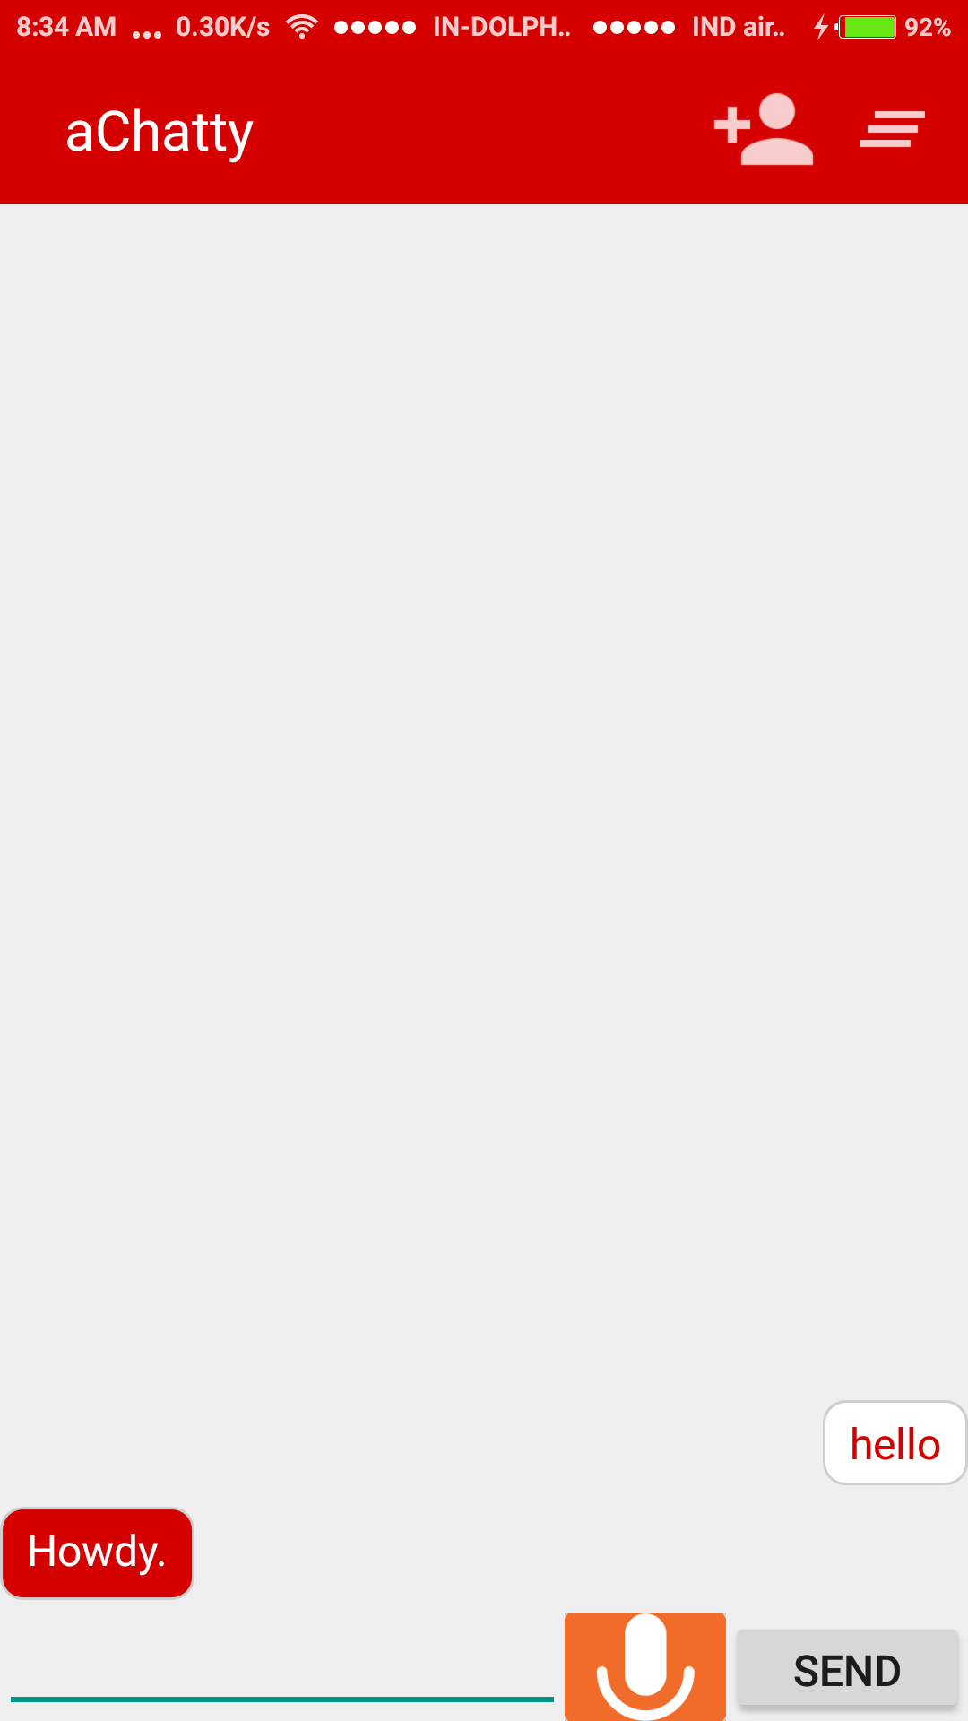
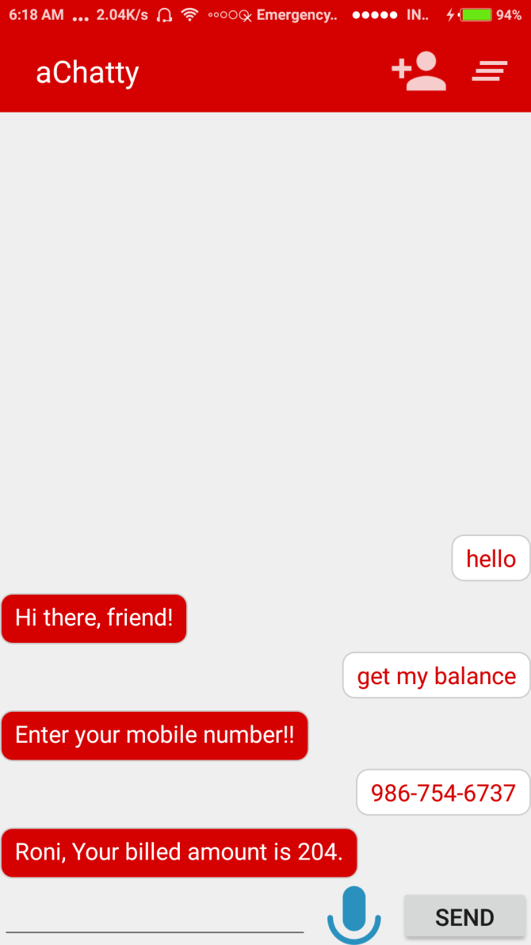
ScreenShots

Slide 5
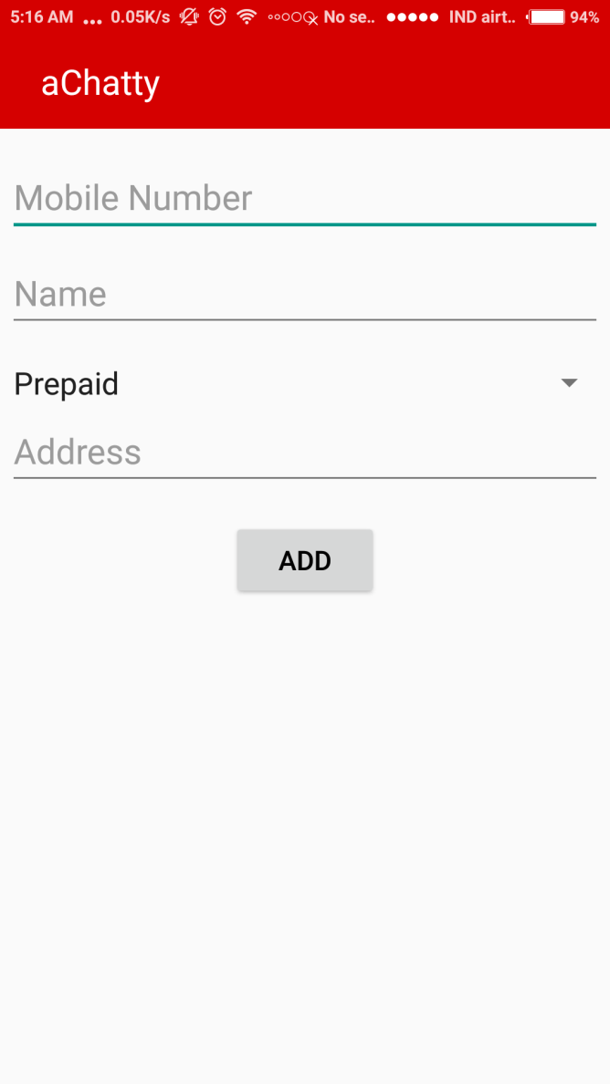
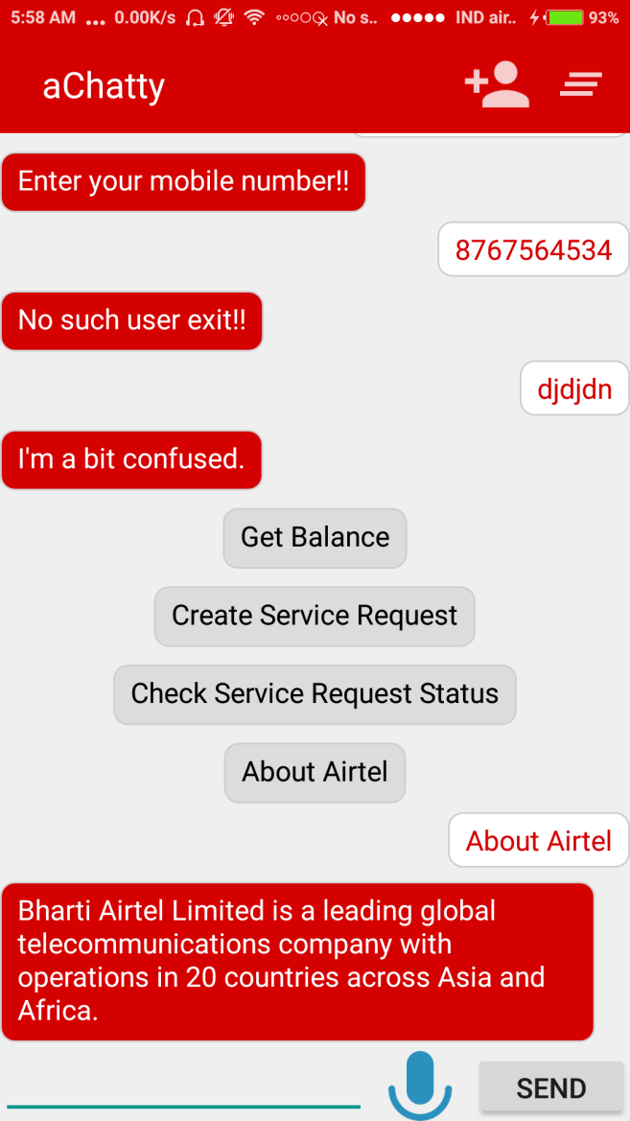
ScreenShots

Slide 6
Thank You

