Slide 1

CASE INTAKE
Automated e-mail intake, case creation and evidence handling
Collision Engineers · July 2026
Notes:
This is the case intake system. The aim: remove as much of the manual work as possible between an e-mail arriving and a case being ready for EVA. Built on top of the document mapper concept, now running automatically on a cloud server rather than an app you drag files into.

Slide 2

BACKGROUND
The current process
All work arrives by e-mail across three shared inboxes. Each e-mail is read, sorted and typed up by hand, and a case doesn't exist anywhere on our systems until the images arrive.
01
02
Three shared inboxes
No early identifier
info@, engineers@ and desk@ — all triaged by hand.
No Case/PO exists until the images arrive, so there is no internal identifier to organise early e-mails around.
The new system automates as much of this as possible. E-mails are categorised automatically and the data is extracted from the attachments — built on the document mapper concept, reworked to run automatically on a cloud server rather than as an app you drag files into.
03
04
Manual data entry
Limited visibility
Details are typed out of the instruction documents by hand.
“How many did we send over today?” has no quick answer at the moment.
Notes:
Common question in the office is 'how many did we send over today?' — currently nobody can answer it without counting by hand. Prior to getting the images we have no internal identifier for cases, which makes organising things a lot harder.

Slide 3
THE PIPELINE
What happens when an e-mail arrives
1
2
3
4
5
6
E-mail received
Provider match
Classified by type
Data extracted
Case created
Tracked after
A webhook notifies the orchestrator — a Function on Azure — which obtains a copy of the e-mail.
Attempted from the e-mail address and any attachments.
Receiving work (existing provider or new enquiry), case update, case query, cancellation, payment, other.
The document mapper reads the instruction document automatically.
For existing providers' instructions, a case is created and the e-mail and attachments stored on Box under it.
Followed through EVA submission and on to the report being sent.
Deterministic first
Nothing stored on the app
Classification, extraction and address suggestions all run deterministically first — zero AI usage. Below a set confidence level, an AI assists and provides suggestions.
Everything is deep links to Box — documents are stored there under the Case/PO.
Notes:
When an e-mail comes in, a webhook notifies an Azure Function called the orchestrator. It obtains the e-mail, attempts a provider match on the address and attachments, classifies the e-mail by type, and for existing providers' instructions it creates the case automatically. All classification and extraction is deterministic first — zero AI usage — falling back to AI suggestions only when confidence is low.

Slide 4
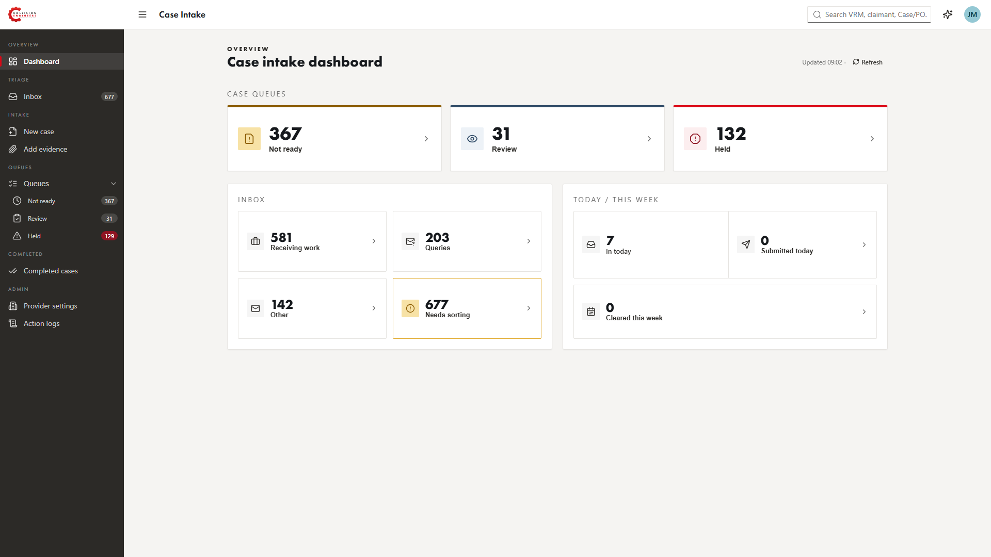
OVERVIEW
Dashboard
Basic stats and an overview of the work that's waiting and what's been sent — including how many went over today.
Notes:
The dashboard shows basic stats and an overview of the work that's waiting, and what's been sent. Answers the daily admin question of 'how many did we send over today?' without anyone counting.

Slide 5
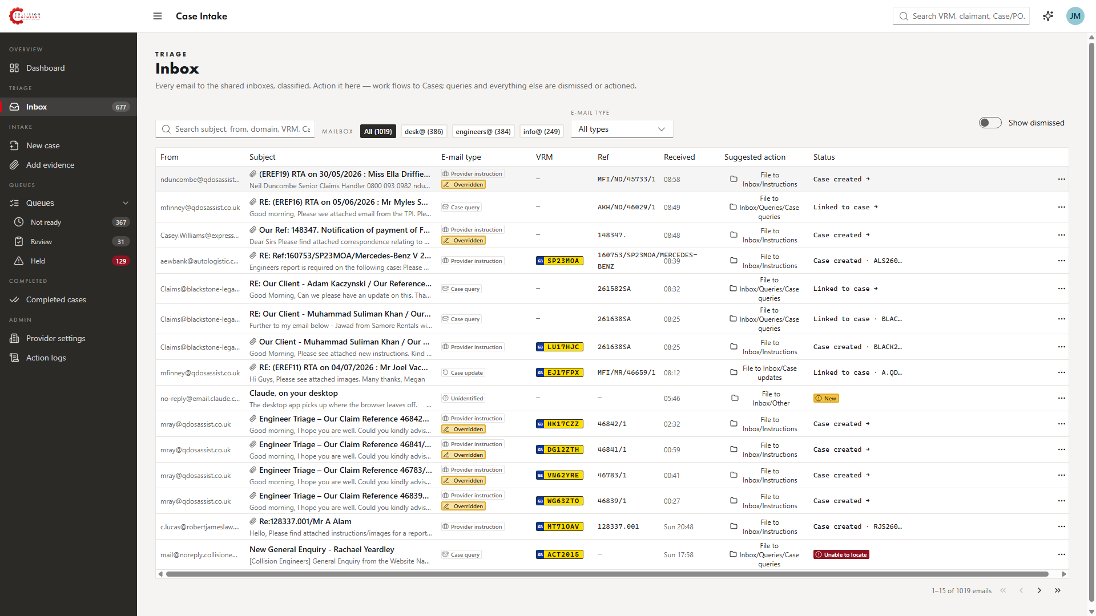
TRIAGE
Inbox view
1
All three inboxes
A unified view of the three shared inboxes, with options to filter by inbox and e-mail type, plus a search feature.
2
Classified by type
Each e-mail is classified — receiving work, case update, case query, cancellation, payment — with a suggested action.
3
Sent e-mails logged too
A notification hook logs our sent e-mails on cases, so they are viewable here as well.
The inbox view — classification, suggested action and status for each e-mail.
Notes:
Unified view of all three inboxes with filters and search. Work flows to cases; queries and everything else are dismissed or actioned. Sent e-mails on cases are also logged and viewable here via a notification hook.

Slide 6
INTAKE
Automatic case creation
1
Case/PO minted at initial intake
Unlike the current process, the Case/PO number is created when the instructions arrive — we no longer wait for images to have an internal identifier.
Instructions case
Created from the provider’s e-mail
2
Stored on Box at the same time
The e-mail and any attachments are stored on Box under the Case/PO.
Images-only case
Identified by registration alone
3
Images-only cases
Where an e-mail just contains images, the registration is read from the e-mail content or attachment — or from the image itself with OCR/VLM — and an “images only” case is created, identified by registration.
One Case/PO
Merged on a registration match
4
The two processes encircle each other
Instructions are checked against active images-only cases, and vice versa. On a registration match the two are merged, so no case ends up orphaned.
Notes:
Unlike the current process, the Case/PO number is minted at initial intake. It also checks for any active 'image only' cases with a matching registration and merges them into the instructions case when found — and vice versa. If no reg can be read from content, OCR/vision reads it off the photo.

Slide 7
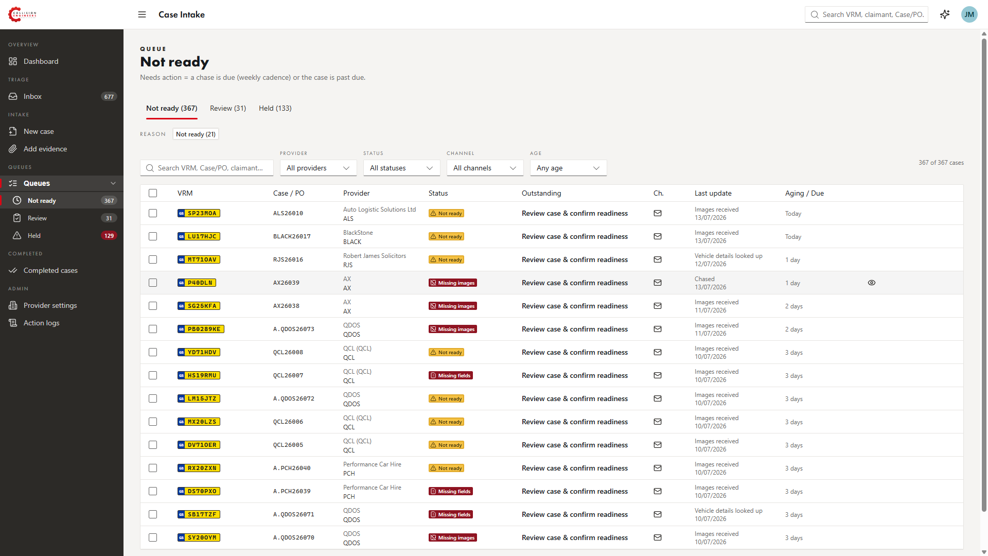
WORKFLOW
Queues
Not ready, Review and Held — each case shows its status, what’s outstanding, its age and when it was last updated.
Notes:
Cases move through Not ready, Review and Held queues. Statuses like 'Missing images' or 'Missing fields' are set automatically, and the Outstanding column tells staff exactly what to do next. Anyone can add notes to a case.

Slide 8
EVIDENCE
Getting images onto cases
1
Extracted from the e-mail
2
AI assistant in the app
3
Chase with a Box link
Attachments are extracted and linked on arrival. Tractable’s e-mail style is already mapped, so images from their e-mails are extracted immediately.
Attach images and say “store these” — it reads the reg and either finds the case or creates a new images-only case.
One button creates a fileshare link for the case’s Box folder and copies a chase template. A Box webhook updates the case when images are uploaded.
4
Network drive via Claude
5
Manual upload
A Claude/Cowork automation checks the network drive where images are currently stored — usually foldered by registration, but the reg can be read either way.
Images can also just be uploaded manually and attached to a case.
There are a few more ideas to make this easier — including integrating Tractable or Raven.
Notes:
More routes are planned — including full Tractable or Raven integration. When a client uses Tractable it e-mails us the PDF as well as updating the portal, and that e-mail style is already mapped, so the images extract immediately today.

Slide 9
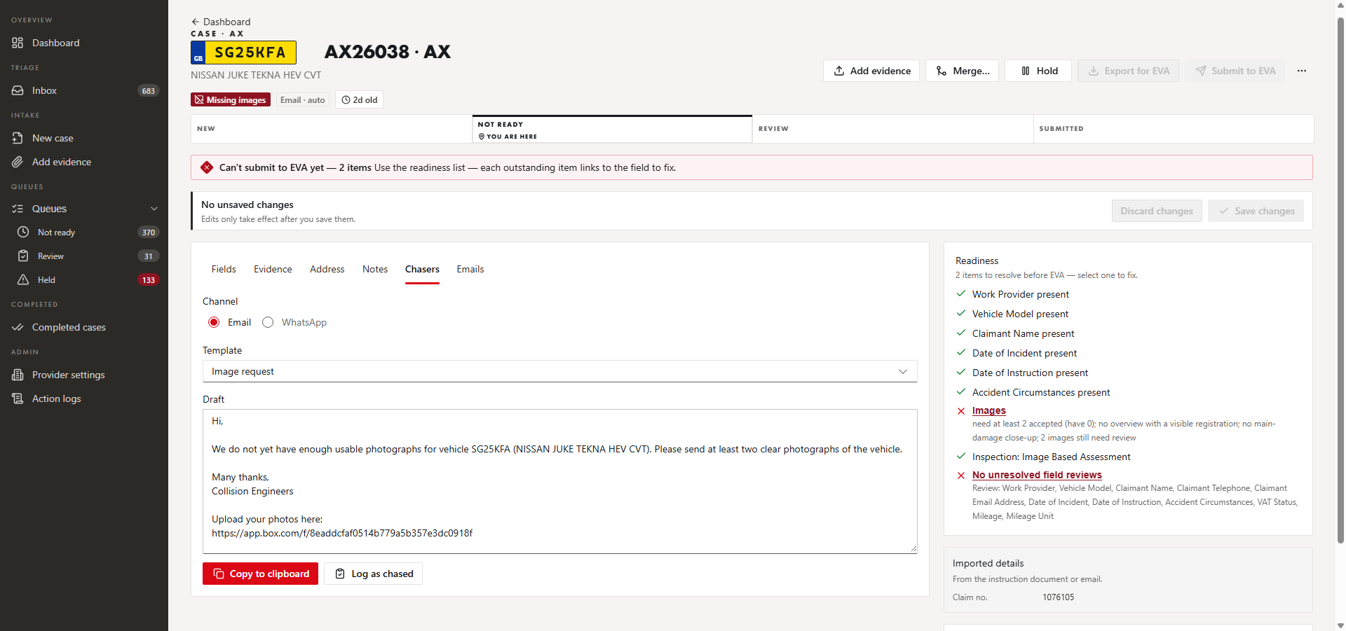
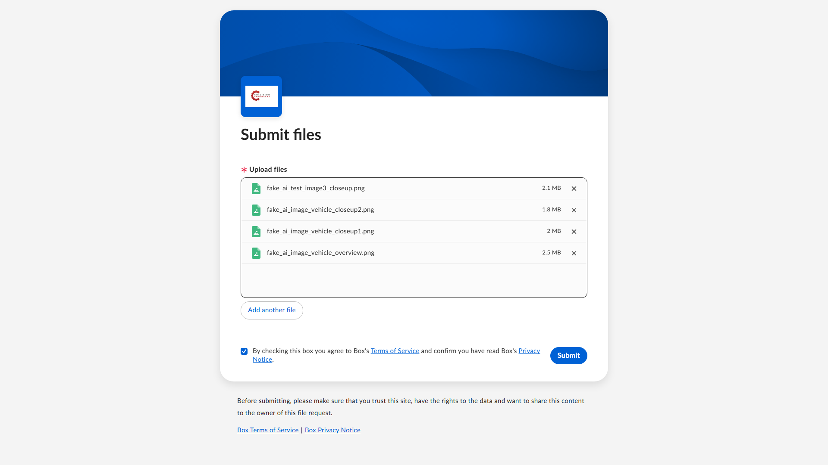
CHASERS
Chasing images
The client uploads to the case’s Box folder directly — no account needed.
The button creates a fileshare link for the case’s Box folder and copies a chase template — e-mail or WhatsApp — and the chase is logged.
A Box webhook updates the case on the app as soon as images are uploaded — no one has to check the folder or file anything.
Notes:
A more advanced version of the copy-and-paste chaser on the jobsheet: pressing the button creates a fileshare link for the case's Box folder and copies a chase template. A Box webhook updates the case in the app the moment images are uploaded.

Slide 10
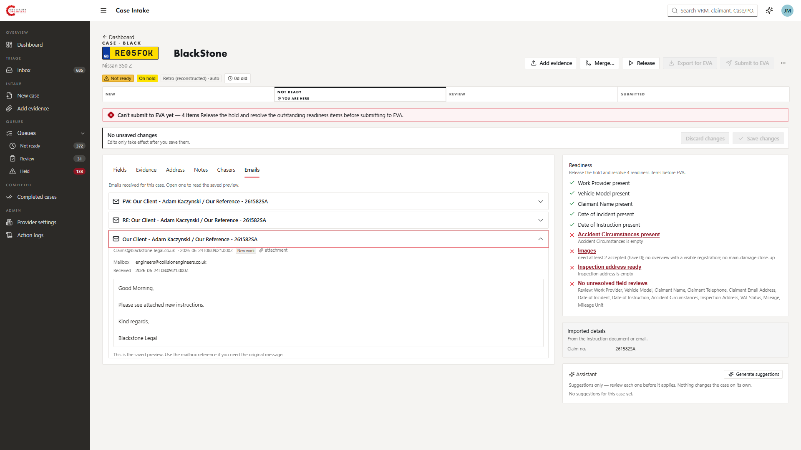
CASE VIEW
Every e-mail on the case
All e-mails about a case are attached — including pre-instruction e-mails such as triage — matched on registration, client name and provider reference. Each case also has a notes section anyone can add to.
Notes:
Any e-mail related to the case is attached — including 'pre-instruction' e-mails like triage or 'when the instructions come in on this one, do xyz'. Linking matches registration, client name and the provider's reference; chains are followed even when a message carries no identifiable details. Sent e-mails are logged too — the user can see everything that's ever been said about the case.

Slide 11
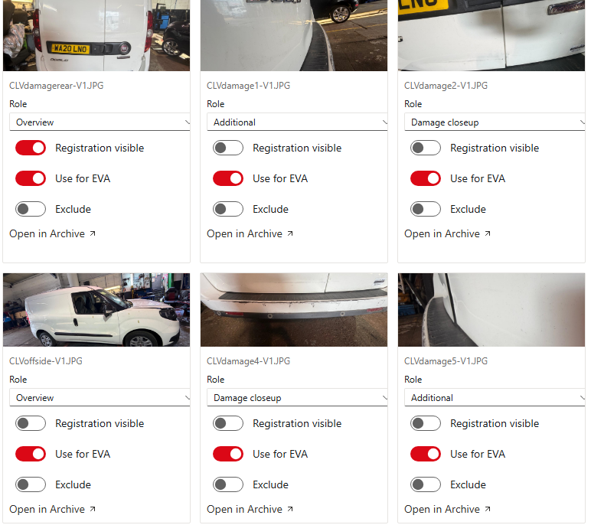
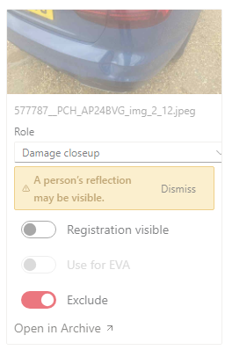
ADDITIONAL HELPERS
Vision model helpers
1
Reflections flagged
Any vehicle image that shows a reflection is flagged.
2
Image roles identified
It identifies images that are a good overview with a registration, and highlights the images that show the damage.
3
Odometer reading
If the instructions don’t provide a mileage but an image shows the odometer, it attempts to read it. A DVSA lookup estimates the mileage as a cross-check for misreads, and a person still reviews it. With no odometer and nothing in the instructions, the DVSA lookup is the third fallback.
Image roles, registration visibility and EVA use pre-set; on the right, a reflection flagged for exclusion.
Notes:
The vision model flags images showing a reflection, identifies good overviews with a registration, and highlights damage images. If instructions don't provide mileage but a photo shows the odometer, it reads it — cross-checked against a DVSA estimated mileage so a misread first digit can't slip through, and still reviewed by a person. With no odometer and nothing in the instructions, the DVSA lookup is used as the third fallback.

Slide 12
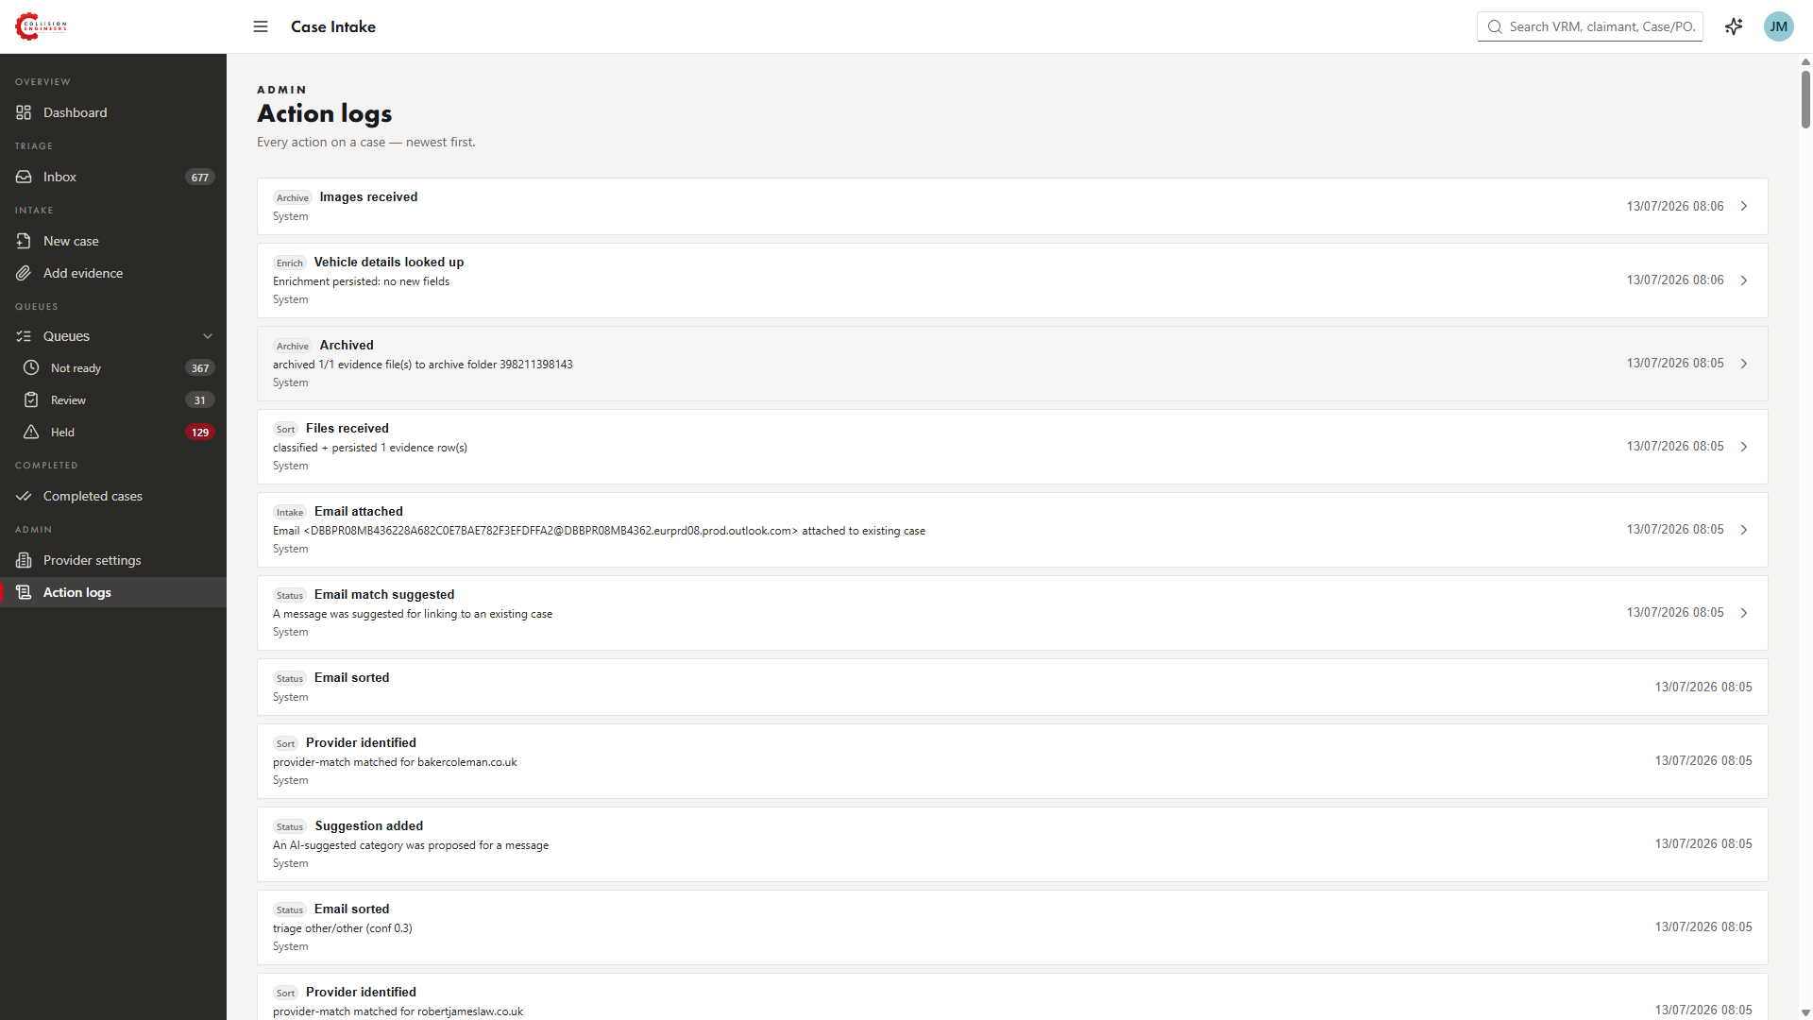
TRACKING
Beyond EVA submission
1
Report tracking
The system tracks if and when the report is sent afterwards and links it to the case — so a later query can be identified as belonging to an already completed case.
2
Retroactive cases
A separate function reconstructs cases by examining Outlook and Box. If a provider asks about a job from four months ago, it will appear on the app with whatever information is available.
3
Provider database
All work providers with their e-mail domains, intermediaries/CMCs and repairers, plus provider-specific processes — e.g. image-based assessment prefilled where that’s always the case.
The action log — every automated action is recorded, newest first.
4
Inspection addresses
Addresses used more than a handful of times in the last two years are stored, and a function suggests the likely inspection address. Still being sharpened.
Notes:
Tracking doesn't stop at EVA submission — the system watches for the report being sent and links it to the case. A separate function retroactively creates cases by examining Outlook and Box, so queries about old jobs still resolve to a real case. Behind it all sits a database of work providers (domains, intermediaries, repairers, provider-specific processes) and every inspection address used more than a handful of times in the last two years.

Slide 13
Where it stands
STATUS
APPROACH
NEXT
Running on all three inboxes — classifying e-mails, extracting data, creating cases and filing to Box, with every action logged.
Everything runs deterministically first, with zero AI usage. AI assists only below a confidence level, and its suggestions are reviewed by a person.
Direct EVA submission, integrating Tractable or Raven, and more ways of getting images onto cases automatically.
Happy to walk through the app live.
Notes:
Close on status: the intake pipeline is live on info@, engineers@ and desk@. Offer a live walkthrough of the app as the natural next step.

