Slide 1
Investment Strategy Analysis
Financial Bootcamp – Project 1
By: Andrew Unruh, Ahudiya Osiri, Diego
& Andrew Lim
July 8, 2021
Notes:
The other 2 members of the group were no where to be found after the first class when we were split into the groups.

Slide 2
Summary
We wanted to look at how different investment strategies have performed over time, relative to each other
We decided the best way to look at that was by using an ETF that was designed to track these strategies
In order to get a better picture of the overall strategy we decided to look at the historical data from 4 different ETF providers for each strategy, giving each member of the group 12 to analyze. The analysis included:
Look at the correlation of the returns for each strategy
Calculate and compare the historical returns, the daily returns, the standard deviation, the sharpe ratios & the volume traded

Slide 3
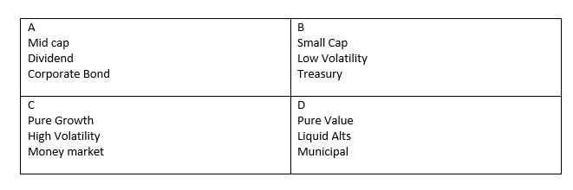
Questions Asked
How have the returns for each of the ETFs compared to each other?
Which has the best return over the past 5 years? And the worst?
How risky is each strategy?
How does the risk compare to the returns?
What portfolios are outperforming the index?

Slide 4
The Data
For the analysis, we downloaded the 5-year historical data for each of our ETFs from the NASDAQ site as .csv files and imported them.
After importing data frames were created for each ETF
Growth | RPG | IUSG | SPYG | QLD
Emerging Markets | EEMO | EEM | EET | SPEM
20 Year Treasury | PLW | TLH | TBF - (Inverse) | SPTL
Value | RPV | VTV | IVE | SPYV
Alts | QVOPX | RLY | VASFX | FUT
Municipal Bond | PZA | VTEB | MUB | TFI
Small Cap | IJR | JPSE | VIOO
Low Volatility | IJS | SPLV | VTV
Treasury | FBND | GOVT | VGLT

Slide 5
The Analysis
Show & explain Jupyter Notebook for one of the Analysis

Slide 6
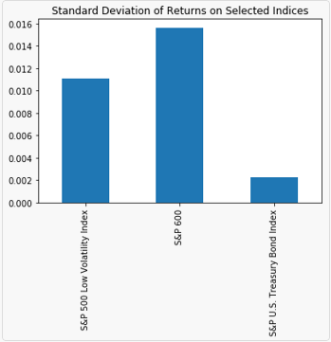
Our Conclusions
each strategy reflected the age old saying "the higher the risk, the higher the return“
Best return cumulatively can be seen from the small cap, and high volatility and high growth. Lowest return was seen in treasury ETFs
How risky? ---standard deviation numbers
Risk vs return – Sharpe ratio numbers

Slide 7
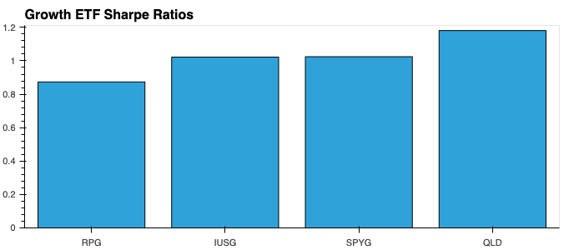
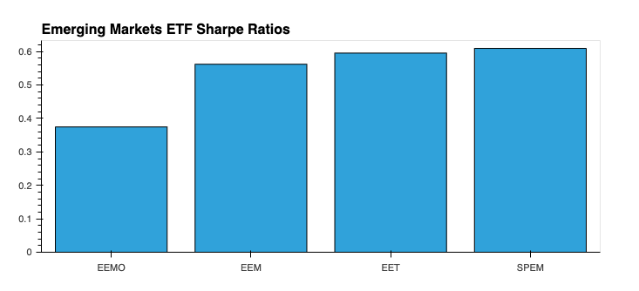
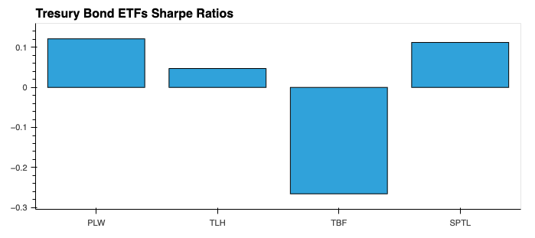

Slide 8
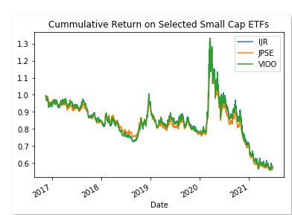
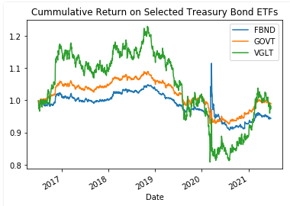
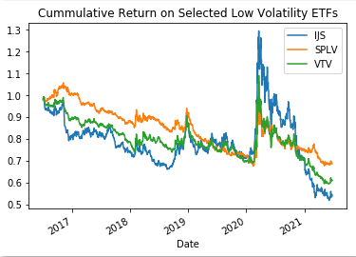
How have the returns for each of the ETFs compared to each other?

Slide 9
How have the returns for each of the ETFs compared to benchmarks?

Slide 10
CONCLUSIONS

