Slide 1
AppFog
Platform as a Service
(PaaS)
Kalanamith

Slide 2
Introduction
Appfog is a PaaS for Public and Private Clouds.
With over 100,000 applications and counting, AppFog delivers a reliable, scalable and fast platform for deploying apps in the cloud.
Managed , maintained and incorporates cloud foundry technology.
Cloudfoundry.org widened the perimeter of Platform as a Service.
Mainly runs on Amazon cloud.

Slide 3
Infrastructure
Use cloudfoundry.org code and runs it on multiple infrastructures and public cloud systems.
Mainly runs on Amazon EC2.
Compatible with OpenStack platforms like Rackspace, HP Cloud.
Designed in a way that can be integrate with third-party cloud services and incorporate those into its platform.

Slide 4
Getting Started
Request for an account.
Register
Log in

Slide 5
Package details
Unlimited apps within 2GB RAM
Up to 8 service instances
100MB storage per MySQL or PostgreSQL instance
10MB RAM & 6 concurrent connections for Redis, MongoDB, and RabbitMQ instances
5GB data transfer per month
100 requests per second
Community-based support
Apps limited to *.af.cm domains

Slide 6
Prerequisites
Ruby 1.8.7 or higher required
A Text Editor or an IDE

Slide 7
Installation
Install command line tool
$ sudo gem install af
If the installation encounters any errors use rvm to install an updated version of ruby
Notes:
After successfully installing ruby install appfog client tool
$ sudo gem install af
If any error occurs use rvm to update ruby version
Check ruby version by $ sudo ruby –v
$ rvm install ruby-1.9.3

Slide 8
Log in to AppFog – Client tool
Create a work folder for the appfog project
Simply type $ af login
Notes:
After typing $ af login simply enter the registered email address for the appfog and the password.
Now you have logged in to the system.

Slide 9
Log in to AppFog web
You crate a new app by simply clicking New App .
Select the technology you prefer to create an application
Select an infrastructure.
AWS
HP Openstack AZ 2
Choose a subdomain .
Hit on create app button
Once done click on my apps .
Notes:
Technology either can be a programing language , client side scripting tool or a database.
Appfog offers you to select an infrastructure
Amazon AWS
HP Openstack AZ 2
Select a unique subdomain . A free subdomain
A free domain name looks as follows
Icter2013.ap01.aws.af.cm
Console.appfog.com , can view the newly created application features.
Click on the application name

Slide 10
Application Console
Offers you variety of services and other facilities to manage your application .
Mission control offers you to
Start , stop and restart your application
configure application instances
change memory quota
RAM capacity
Mission control shows statistics about your application

Slide 11
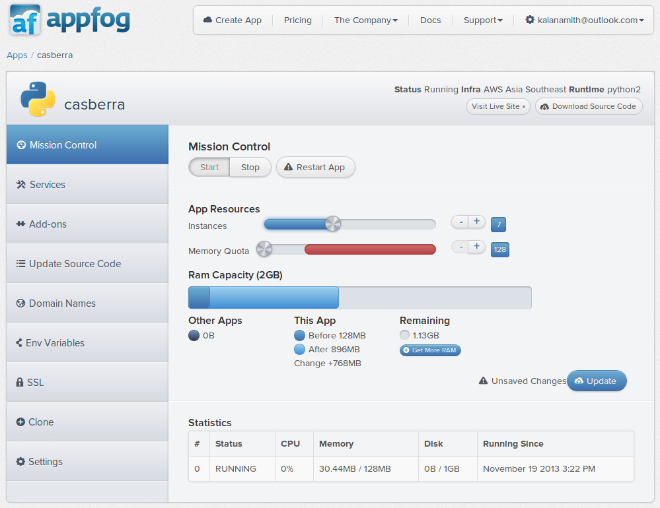
Application Console – Mission Control
Notes:
Overview of application console

Slide 12
Application Console
Services
This section offers you the services offered by AppFog
8 Services are eligible for the free package
Mainly offers Database services and Task Queue Services
MySQL
PostgreSQL
MongoDB
Redis
RabbitMQ
Notes:
Once service assigned to one instance

Slide 13
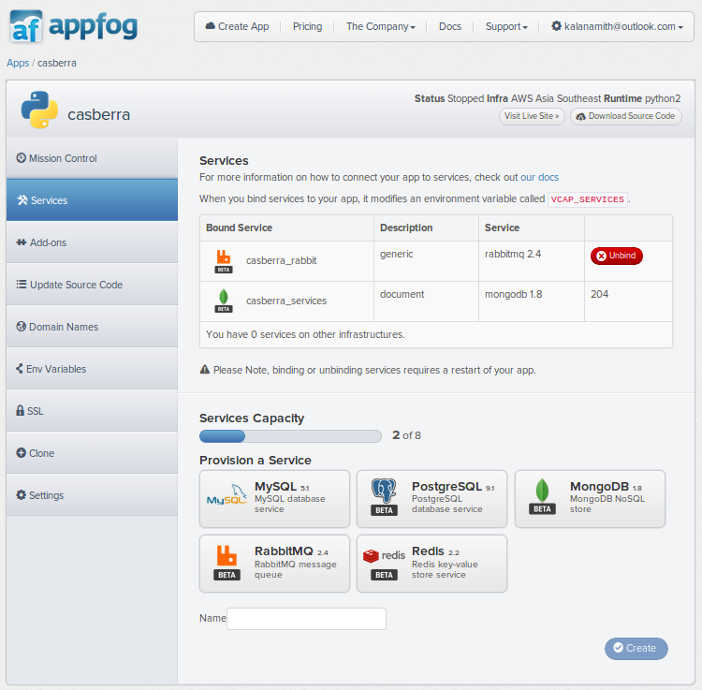
Application Console - Services
Notes:
This currently this application bound with two services offered by AppGod
A Task Queue
A NOSQL Database

Slide 14
Application Console - Services
When you bind services to your app, it modifies an environment variable called VCAP_SERVICES.
This variable contains a JSON document with a list of all credentials and connection information for the bound services.
We can call this this variable via AppFog’s language specific facility

Slide 15
Application Console - Services
How to call VCAP_SERVICES variable ?
In Java :- java.lang.System.getenv("VCAP_SERVICES")
In Ruby :- ENV['VCAP_SERVICES']
In Javascript :- process.env.VCAP_SERVICES
In Python :- os.getenv("VCAP_SERVICES")
In PHP :- getenv("VCAP_SERVICES")

Slide 16
Application Console - Add-ons
Add-ons are third party services we can couple with AppFog Environment.
Available Add-ons
Load Balancing
Infrastructure
Logging
Databases
Redis
PostgreSQL
RabbitMQ
Search
Email
Analytics
Testing
Image Management
Background Processing

Slide 17
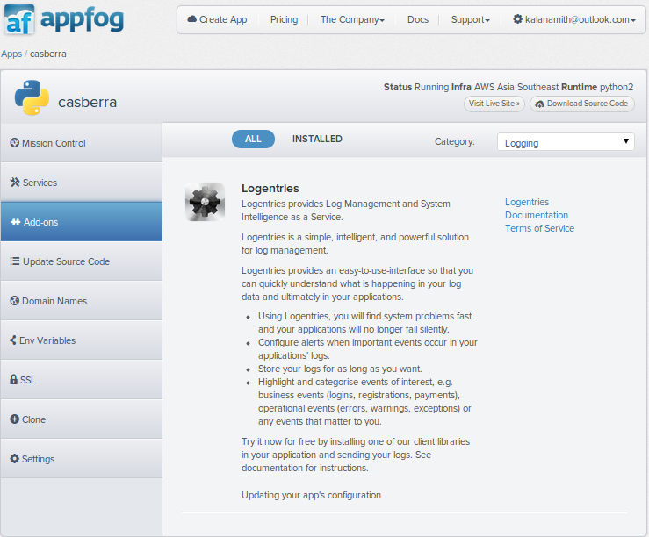
Application Console - Add-ons

Slide 18
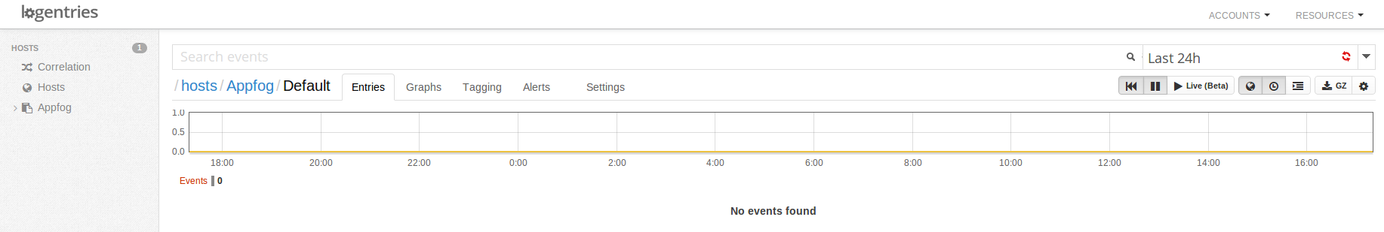
Application Console - Add-ons
For an example we have installed the log entries add-on
We can use this add-on to manage our logins which look after by a separate service
Notes:
We can configure our log entry settings on add-ons service’s settings.

Slide 19
Application Console – Add-ons
You might get errors after installing an add-on
Example :- Error 422 - memcachedcloud - Region amazon-web-services::ap-southeast-1 is not supported. appFogId: casberra-kalanamith@outlook.com
For that you can simple change the infrastructure to a supporting platform.
Another common error is the regional support
Example :- Error 422 - memcachier - We can't provision MemCachier in the region you requested

Slide 20
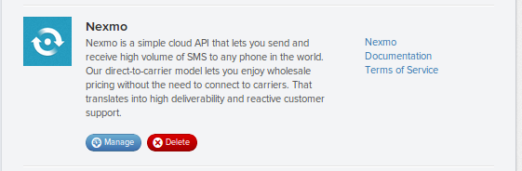
Application Console – Add-ons
Once an add-on successfully configured you can access configurations via manage button .

Slide 21
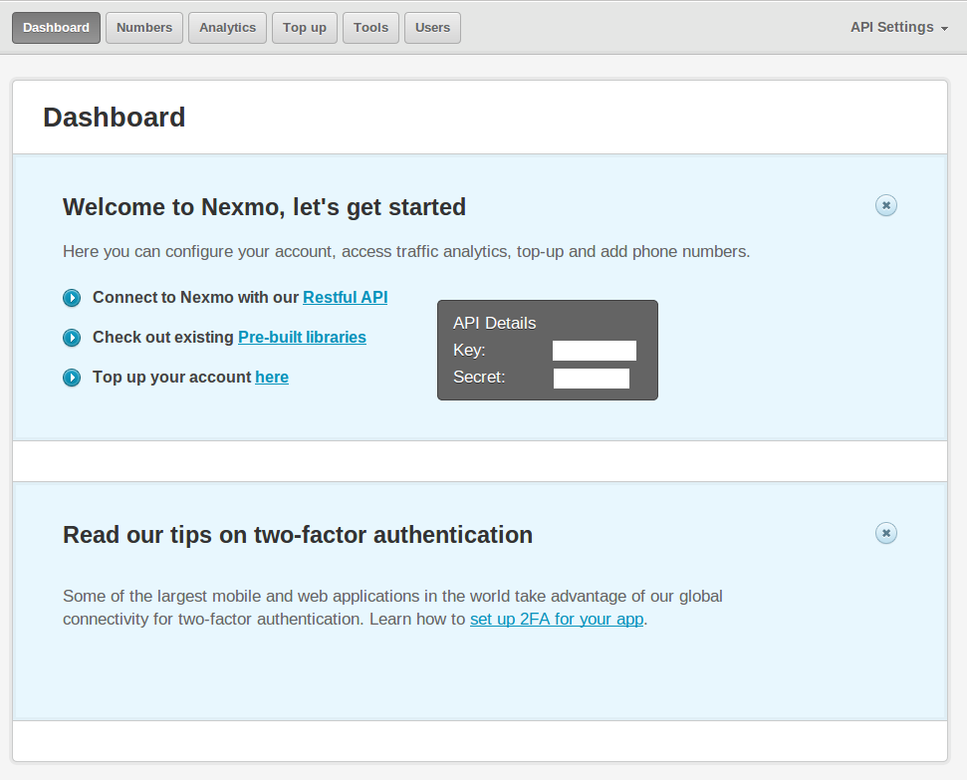
Application Console – Add-ons
Dashboard of an Add-on
Notes:
SMS gateway . Dashboard with settings

Slide 22
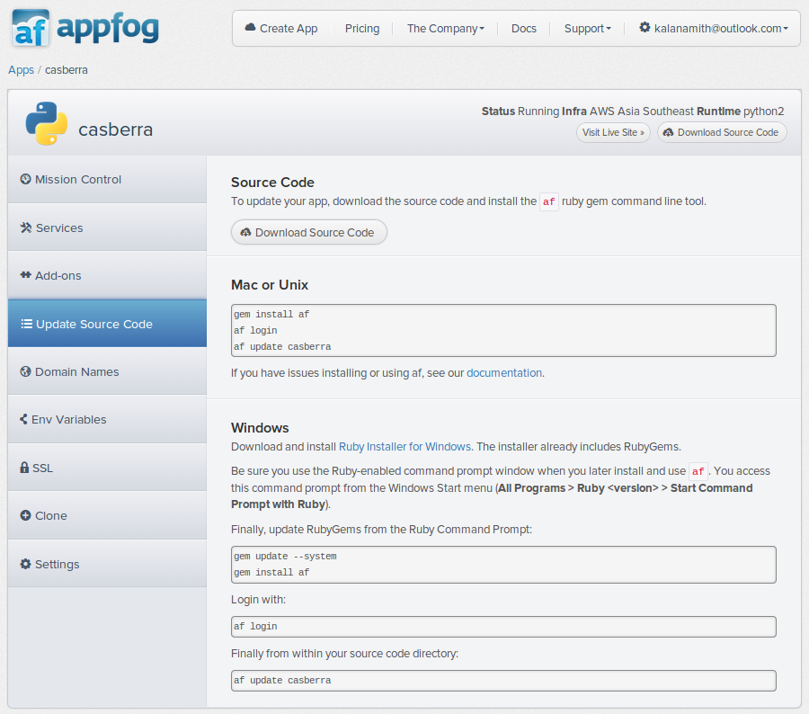
Application Console – Update Source code
This section shows how to install AppFog client tools, login command, update your source code to AppFog , download your source code

Slide 23
Application Console – Domain Names
This section allows you to configure your domain names .
Also facilities to add sub domains.
AppFog offers two ways to add custom domain names to your app
Application Console
Command Line Tool

Slide 24
Application Console – Domain Names
App Console
Head over to the app console and click on your app.
Click on the "Domain Names" tab on the left.
Add your custom domain name in the field and hit the "Update" button.
That's it!
AF CLI
If you haven't already, install the af command line tool and log in.
Map the domain.
$ af map

Slide 25
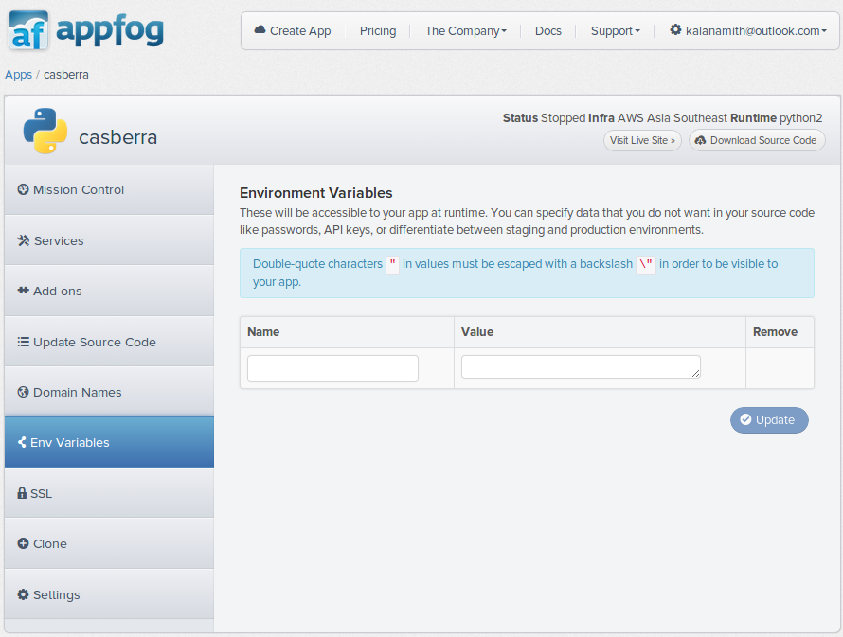
Application Console – Environment variables
Enables to define variables can be accessed by the run time

Slide 26
Application Console - Clone
This will enables you to clone an existing infrastructure to another domain .
You should select a subdomain to clone.
Resources will be consumed for this action

Slide 27
Application Console - Settings
This will simply delete your application

Slide 28
Appfog
Start Developing .

Slide 29
Question Time

Slide 30
Thank you
Reach us via Twitter :-
https://twitter.com/99XTechnology
https://twitter.com/CMBCamps
Reach us via LinkedIn :-http://www.linkedin.com/company/99xtechnology

