Slide 1
OpenShift Introduction
A Platform as s Service
Kalanamith

Slide 2
Building Blocks of Cloud Computing
Software as a Service (SaaS)
Infrastructure as a Service (IaaS)
Platform as a Service (PaaS)

Slide 3
What is a PaaS?
provides you computing platforms which typically includes operating system, programming language execution environment, database, web server etc. AWS Elastic Beanstalk
Heroku
Force.com
Google App Engine
OpenShift
etc….

Slide 4
Why OpenShift
The foundation of OpenShift is RHEL
OpenShift Supports
Public PaaS
Private PaaS
Community PaaS
Supports many runtimes and Languages
You can build your own cloud .
Notes:
What is aPublic PaaS
What is a Private PaaS ?
Privacy and Control Over Data
A private PaaS enables you to control where your data is stored. Organizations that collect personally identifiable information about their customers are obligated, and in some cases legally required, to keep that information private (e.g. healthcare or financial records). A private PaaS keeps this sensitive information within your organization to those who require access to it, while also enabling you to control where that data is physically stored to achieve better compliance and avoid any jurisdictional concerns in the US, Europe or elsewhere.
What is a Community PaaS

Slide 5
OpenShift Architecture
OpenShift consists of
Broker
Nodes
Cartridges
Gears

Slide 6
What is a Broker?
Broker serves as the PaaS Management Service.
Multiple nodes are managed by the Broker.

Slide 7
What is a Node?
Node is a place where an end user application resides
Also equivalent to an instance
Different packages offers different number of nodes.

Slide 8
What is a Gear?
A Gear is a container with a set of resources that allows users to run their applications.
OpenShift runs many Gears on each virtual machine and dynamically distributes Gears across them.

Slide 9
What is a Cartridge?
Cartridges house the framework or components that can be used to create an application.
One or more cartridges run on each Gear or the same cartridge can run on many gears for clustering or scaling.
Equivalent to add-ons in other cloud solutions.
Consists of Databases, Runtimes , etc

Slide 10
Multitenancy Architecture in brief
OpenShift designed to serve Multitenancy .
Single instance of a software application serves multiple customers.
Designed to virtually partition its data and configuration.
Client works with a customized virtual application instance.
This concept regard as the key concept in cloud computing.

Slide 11
Advantages in Multitenancy
Economical
Ease of maintenance
Notes:
Economical because software development and maintenance costs are shared.
Ease of maintenance :- It can be contrasted with single-tenancy, an architecture in which each customer has their own software instance and may be given access to code. With a multi-tenancy architecture, the provider only has to make updates once. With a single-tenancy architecture, the provider has to touch multiple instances of the software in order to make updates.

Slide 12
Requirements
Ruby version 1.8.7 or above
Linux (recommended) , Windows or any other platform
GIT(recommended) ,mercurial has few workarounds
Android application is available to manage your app
(https://github.com/sabre1041/openshift-android)

Slide 13
OpenShift
You can directly upload your application via git.
Configure public keys
Do not share your private keys.

Slide 14
Let’s get started
Install rhc
Log in to your account by the console
View cartridge status.

Slide 15
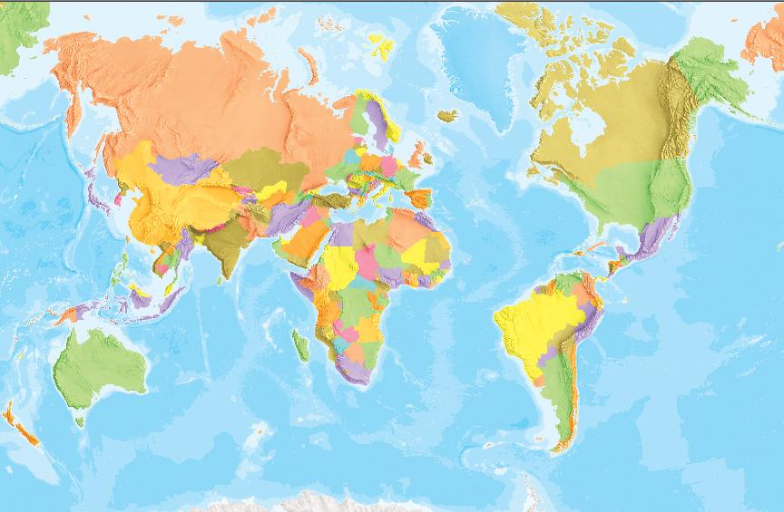
Questions ?
Reference :- http://photos1.blogger.com/blogger/5522/3070/1600/World_Reverse.jpg
Reference:-http://photos1.blogger.com/blogger/5522/3070/1600/World_Reverse.jpg

Slide 16
Reach us
Find us more http://www.linkedin.com/company/99xtechnology
Twitter
@CMBCamps
Colombo Camps Community
https://www.facebook.com/ColomboCampsCommunity?fref=ts

Slide 17
This is not the end
“That is how it must be.”
By Master Shifu
Thank you

